Slide 1
Battle of neighbourhood

Slide 2
Introduction
When deciding on opening new restaurants, there are many things should be considered. Especially regarding the current locations of other restaurants. Analysing on how the restaurants are located and if there are other venues which are present near the restaurant can help the owners of the new restaurant to draw a conclusion.
In this project, data from Foursquare will be leveraged to analyse and recommend the factors the new restaurant owners can consider before opening a new restaurant. Number of restaurant in the neighbourhood and other venues types near the restaurants had to be analysed before concluding

Slide 3
Data
Main table
Data scraped from https://en.wikipedia.org/wiki/List_of_postal_codes_of_Canada:_M
This contains the data of boroughs in Canada. After scraping the data, it was placed in a data frame so that it can be used for analysis.
Geopy
Geopy was used to extract the latitude and longitude of every neighbourhood and restaurants in the data set. This was then passed to Foursquare to extract details on venues.
Foursquare
Foursquare is a location provider which can be leveraged to extract more details

Slide 4
Exploratory analysis

Slide 5
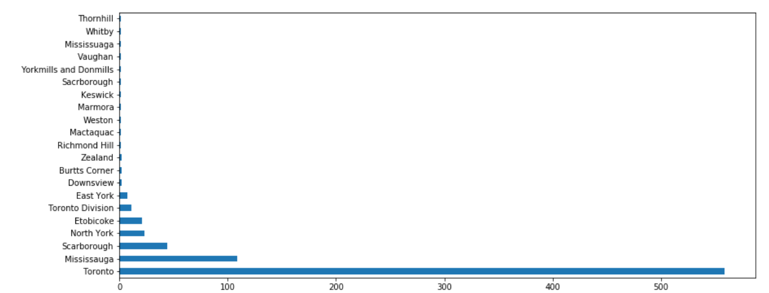
Distribution of Venues
When analysing the number of venues in the boroughs of Canada, it was found that Toronto has the highest number of venues, followed by Mississauga, Scarborough.
This helps to understand the distribution of venue in Canada

Slide 6
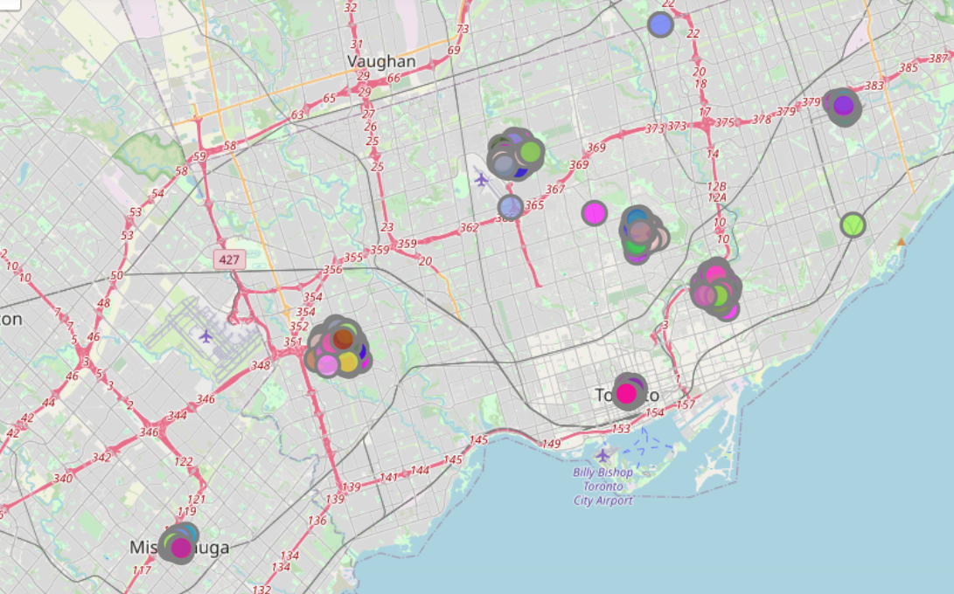
Analysis on City center
The clusters seem to be near the City center rather than the suburbs
This can be due to the presence of other shops and venue which attracts more customers

Slide 7
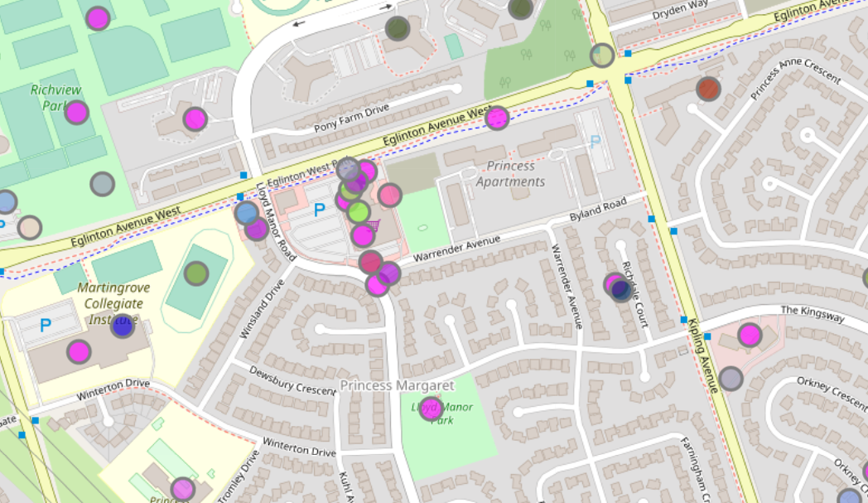
Nearest locations
High clusters seem to be near shopping malls/metros
This can indicate the huge amount of people which may visit the location and hence visit restaurants

Slide 8
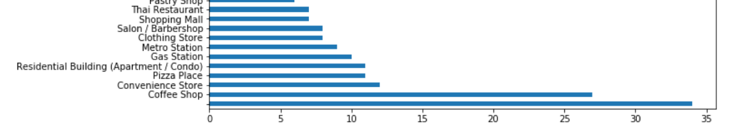
Other venues
Coffee shops, convenience store and Pizza place seem to be the most popular locations near a restaurant

Slide 9
Results section and Discussion
As can be seen from the maps, restaurants tend to cluster together with other restaurants
Most of the restaurants seem to be located near Gas station,coffee shops and other restaurants
The clusters seem to be more near the city central rather than the outliers
The number of restaurants seem to be higher near shopping malls

Slide 10
Conclusion
When opening a new restaurant , it is recommended to open near locations such as shopping malls, Gas stations
As discussed in the discussion section, restaurants seem to be higher in population near city centre. So new restaurant owners can check the city centre first before considering other options

