Slide 1
Battle of neighbourhood

Slide 2
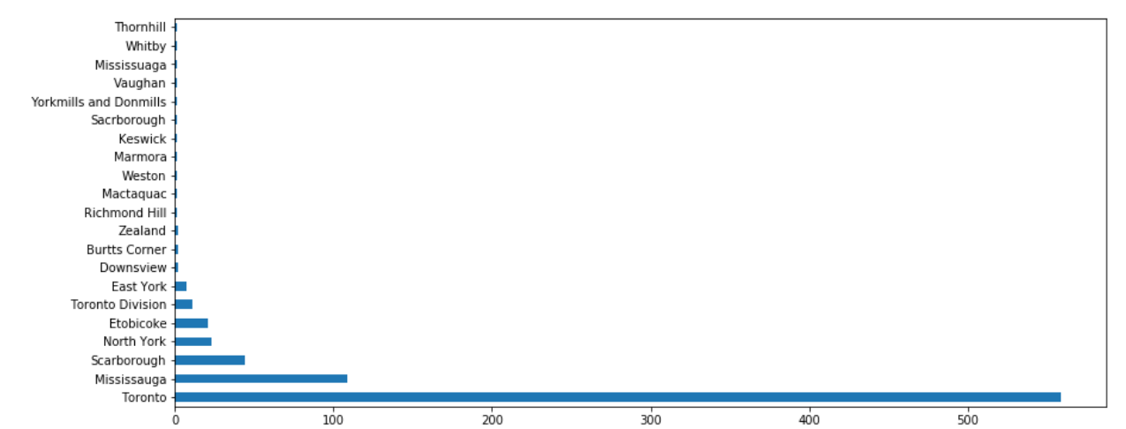
Distribution of Venues
Toronto has the highest number of venues, followed by Mississauga, Scarborough

Slide 3
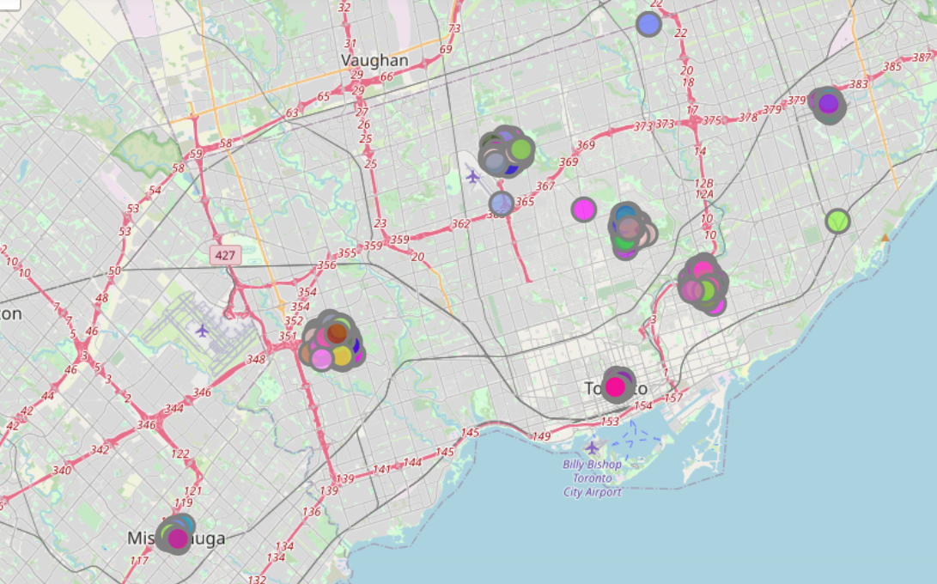
City center
The clusters seem to be near the City center rather than the suburbs
This can be due to the presence of other shops and venue which attracts more customers

Slide 4
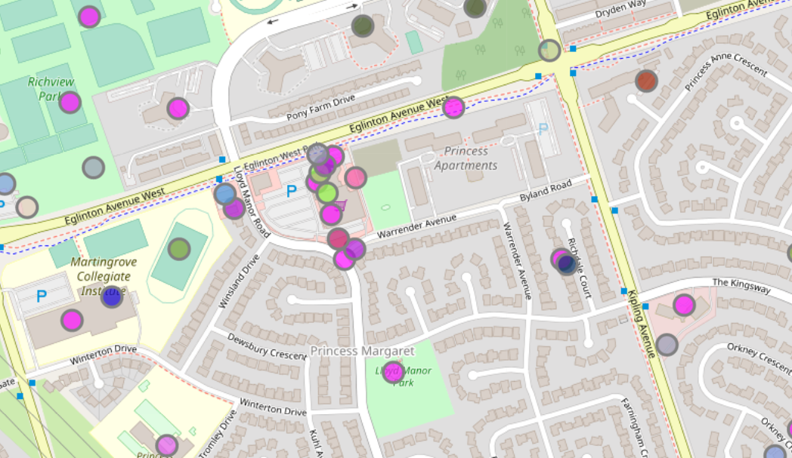
Nearest locations
High clusters seem to be near shopping malls/metros
This can indicate the huge amount of people which may visit the location and hence visit restaurants

Slide 5
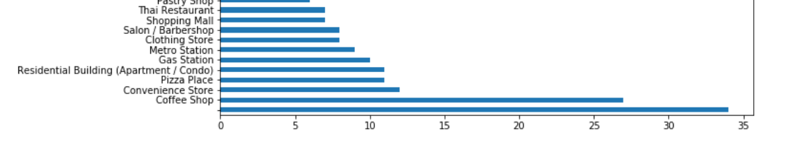
Other venues
Coffee shops, convenience store and Pizza place seem to be the most popular locations near a restaurant

Slide 6
Results section and Discussion
As can be seen from the maps, restaurants tend to cluster together with other restaurants
Most of the restaurants seem to be located near Gas station,coffee shops and other restaurants
The clusters seem to be more near the city central rather than the outliers
The number of restaurants seem to be higher near shopping malls

Slide 7
Conclusion
When opening a new restaurant , it is recommended to open near locations such as shopping malls, Gas stations
As discussed in the discussion section, restaurants seem to be higher in population near city centre. So new restaurant owners can check the city centre first before considering other options

