Slide 1

CAPSTONE PROJECT PRESENTATION FOOTBALL GAME ANALYSIS
MENTOR NAME: Mr.Munna Pandey PRESENTED BY
M.MUTHUVEL
BATCH NO:DA283S28
ENROLLMENT NO:EN12024080316

Slide 2

OBJECTIVE:
The main objective of the project is to analyze football dataset and identify key factors for success in areas of players performance, team comparison etc..Multiple tools like Excel, MySql,Python,& Tableau are used to analyze the game data set analytically which includes the following steps,
1.Data preprocessing(Excel and Python)
2.Generating business objectives
3.Solving business questions and providing interpretation
4.Presentation of all analysis in ppt
After all analyses, Pro active measures are suggested to improve the players and team performance with the help of obtained results.

Slide 3

BUSINESS QUESTIONS :
Performance analysis:
1. Find top 10 players on basis of number of goals scored and assists, and find the relation between the two?
2. Find top 10 players who got less number of yellow and red cards?
3. Find top 10 players who has scored at least 100 goals in both away clubs and home clubs?
4. Show the players contribution in total number of goals scored in home and away games by their position of play?
Player profile and market value:
1. What is average market value of players in attack position?
2. Is there a correlation between players position and market value? If so, then what it is?
Which nationality of players has highest market value on average?
Team Comparison:
Mention the top home and away club teams which scored more goals
Visualize the average attendance in home/away club teams.

Slide 4
BUSINESS QUESTIONS :
Substitution Patterns:
1. How many minutes did substitutes played?
Attendance and stadium analysis:
Mention the top stadium names which has more attendance in home club
Mention the top stadium names which has more attendance in away club
What is the percentage of attendance over competition type? Visualize it with the help of pie chart
Referee Analysis:
1. Which referee had issued more average number of red cards issued to players?
2. Which referee had issued more average number of yellow cards issued to players?
Competition analysis:
1. Show the variation in average number of goals with respect to competition type
2. Which competition type has been played more number of minutes?
3. Visualize the variation of average attendance in different type of competitions.

Slide 5

Excel:
It is a spreadsheet program developed by microsoft.
Excel organizes data in columns and rows and allows you to do mathematical functions. It runs on windows, mac-os, android and ios.
It is easy to learn and get started and we can develop our skill in
Excel as continue to learn advanced techniques in it

Slide 6
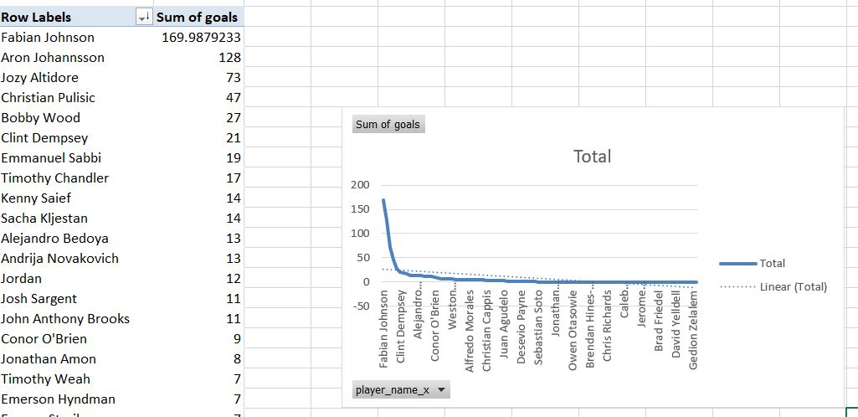
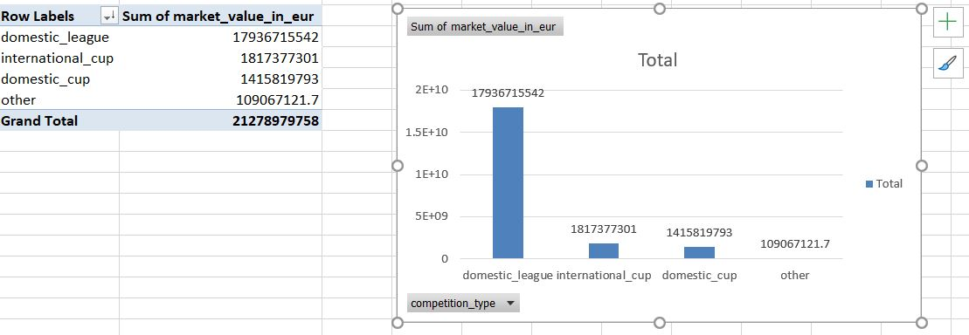

Analysis in excel:
Identify the player who had scored more number of goals?
Find the average market value of players with respect
to various leagues?
Interpretation:
Fabian Johnson and Aron had scored more number
of goals than all other players and its visualized by a line chart
Interpretation:
The average market value of players is higher for
players in domestic leagues.

Slide 7
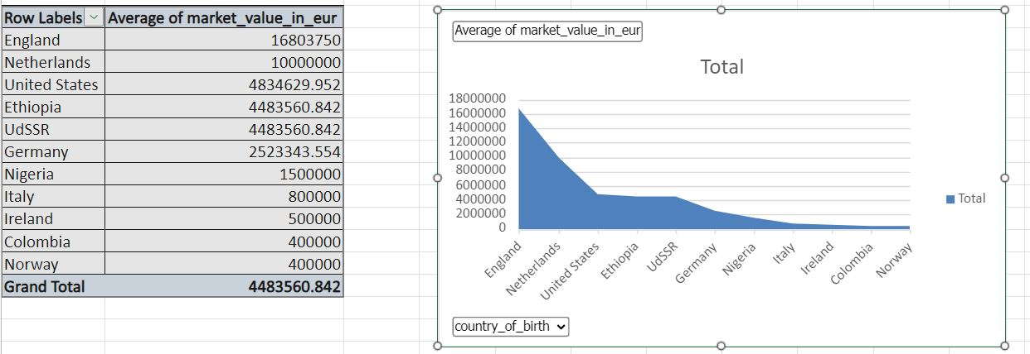

ANALYSIS IN EXCEL:
Find the average market value of players with respect to nationality?
Interpretation:
Average market value of players
is more for players from england,
compared to all other countries
.

Slide 8

My sql:
Mysql is a open-source relational database management system
It is ideal for both small and large applications
Operation is very fast, reliable, scalable, and easy to use
Mysql is a very powerful program in its own right. It handles a large subset of the functionality of the most expensive and powerful database packages.

Slide 9
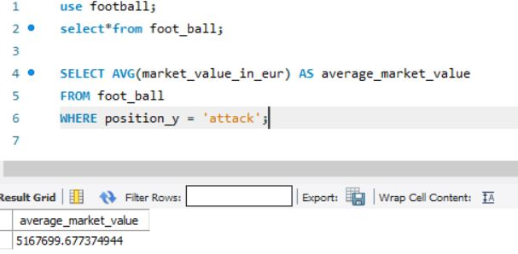
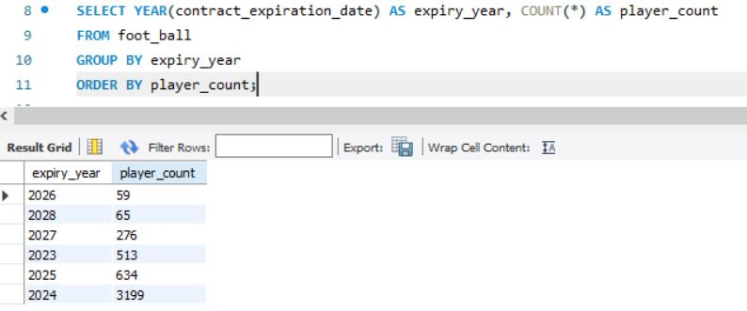
Analysis in Sql:
Identify the average market value of players with respect
to playing position?
Find the count of players, year-wise in which players contract
are about to expire?
Interpretation:
Average market value of players in attacking position
is found to be five hundred and sixteen million dollars.
Interpretation:
In the year 2024,3199 players contract are to be expired where
as in 2026 only 59 players contract are going to expire.

Slide 10
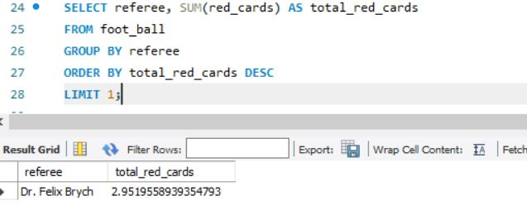
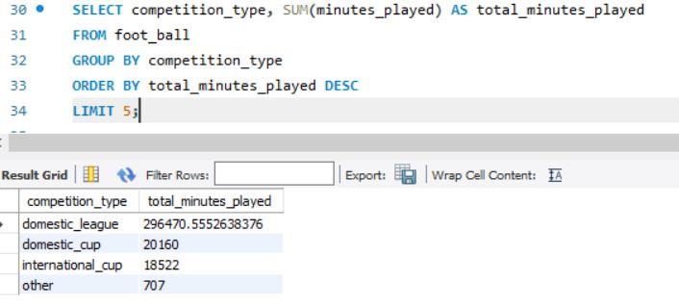
Analysis in sql:
Which referee had issued more number
of red cards?
Find out the type of football competition,which has
engaged more minutes?
Interpretation:
It is found Dr.Felix had issued more
number of red cards(almost 3 cards)
Interpretation:
Domestic league competition has been played
more(296471 minutes ) ,when compared with other
types of competitions

Slide 11

Python:
Python is a popular programming language. It was created by guido van rossum, and released in 1991.
It is used for:
Web development (server-side),Software development,Mathematics,System scripting.
What can python do?
Python can be used on a server to create web applications.
Python can connect to database systems. It can also read and modify files.
Python can be used to handle big data and perform complex mathematics.
Python can be used for rapid prototyping, or for production-ready software development.

Slide 12
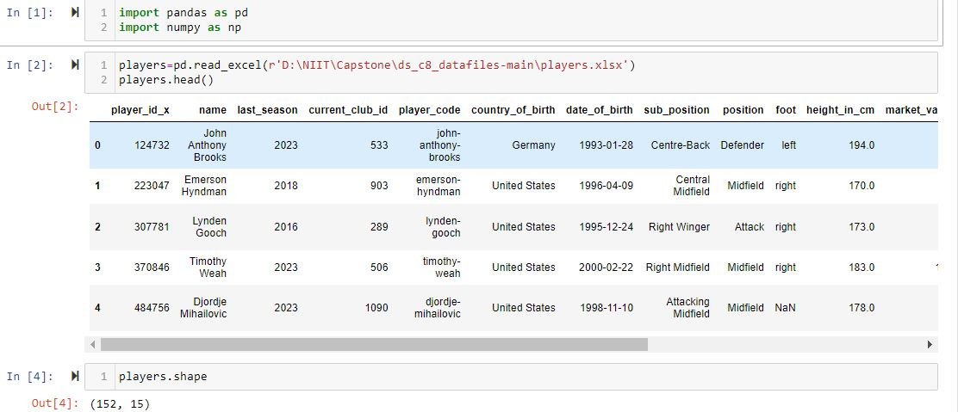
Data preprocessing: (Python)
Interpretation:
The data set is imported in python and then it is merged into a single data frame

Slide 13


Data preprocessing:
Interpretation:
The given 5 data sheets are merged in python using outer join method
,and its shape is displayed containing 4746 rows and 59 columns.

Slide 14
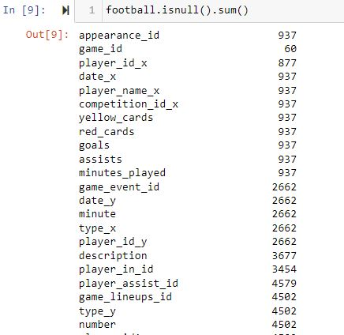
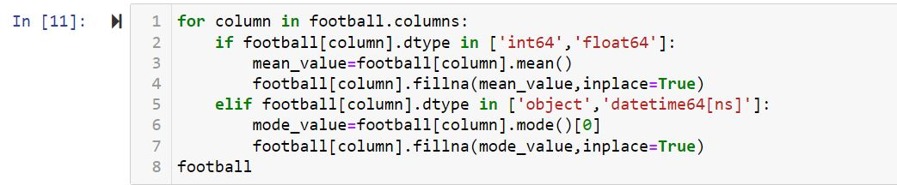
Null value treatment:
Interpretation:
The number of null values are initially displayed and then it is treated by using mean and mode replacement method

Slide 15
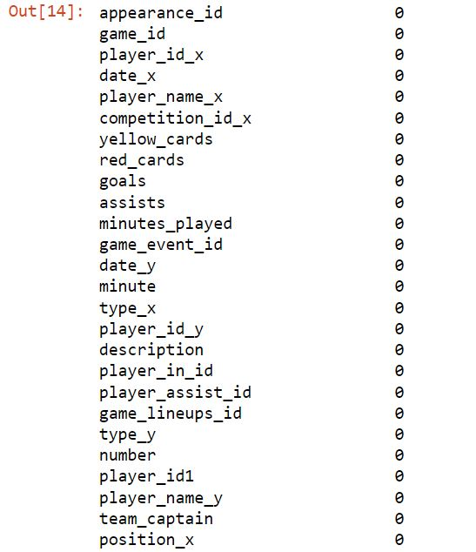
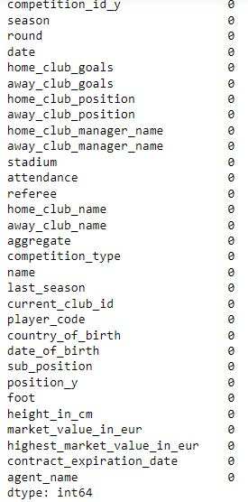
Null value treatment:
Interpretation:
The null values are treated and finally almost all null values are cleared

Slide 16
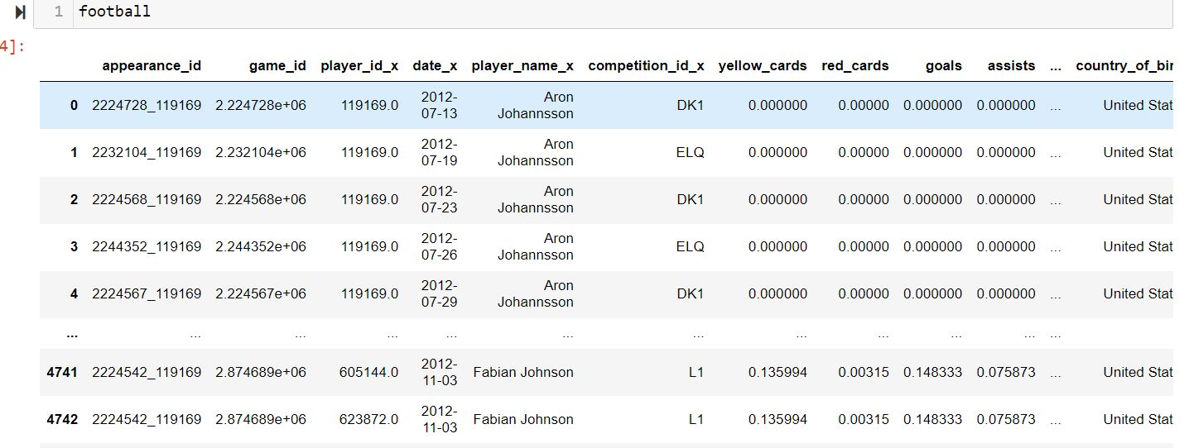
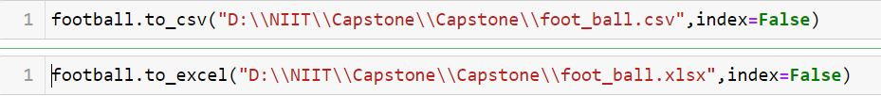

Final data set after cleaning:
Interpretation:
The final cleaned data set with 4746 rows
and 57 columns is to be use for further analysis
Cleaned data set is saved as .csv file and .xlsx file

Slide 17
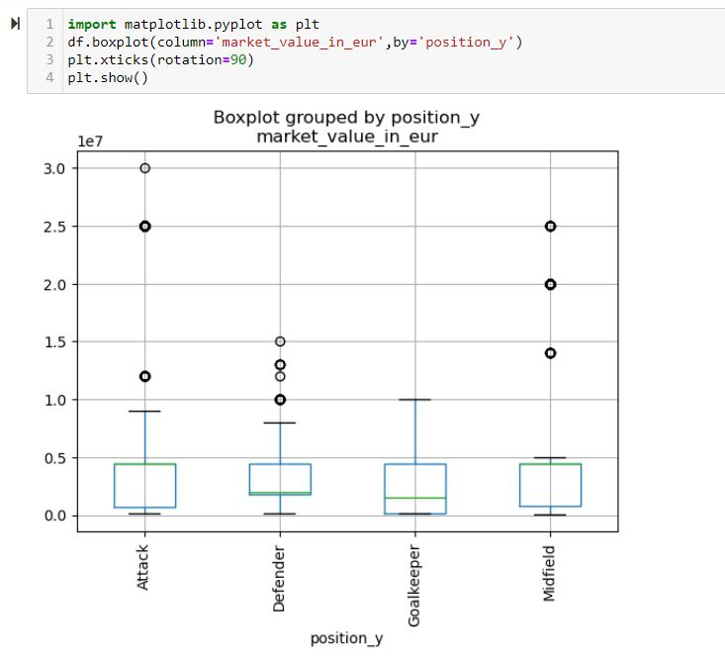
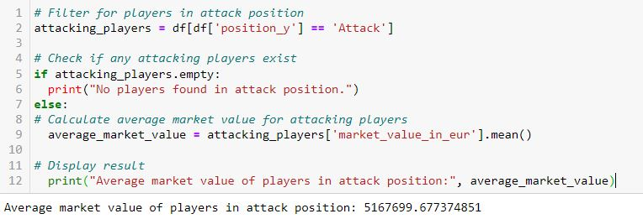
Analysis in python:
Identify the average market value of players with respect
to playing position?
Carry out outlier analysis for players according to their
playing position?
Interpretation:
The average market value of players with respect to
various playing position is calculated using python.
Interpretation:
Box plot shows that players in attack position has high range
of outlier values

Slide 18
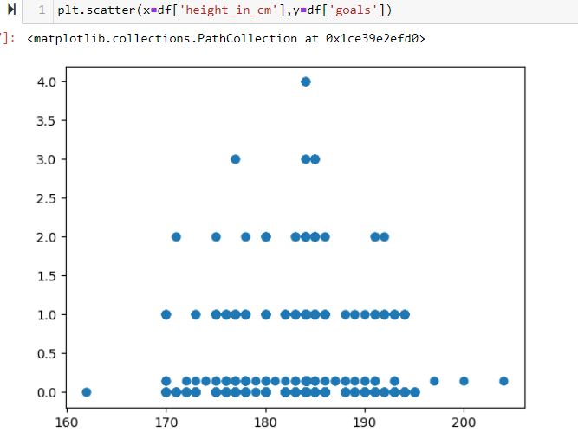
Analysis in python:
Find in which range of height did the players scored maximum number of goals using scatter plot?
Interpretation:
Scatter plot shows that most number of goals were scored by players with height in between 170 and 190.

Slide 19
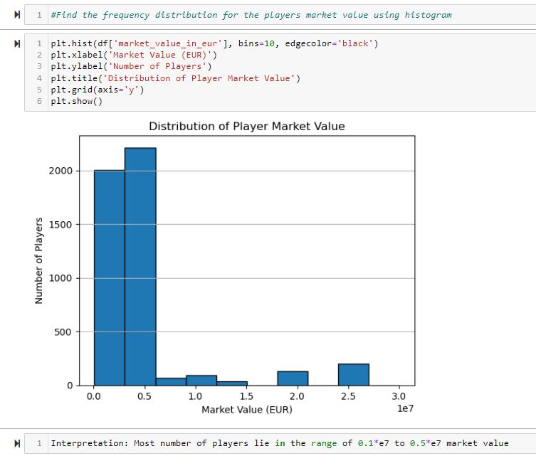
Analysis in python:
Interpretation:
Frequency distribution for the market value
using box plot shows that most players lie in the range of 10 million to 50 million dollars

Slide 20

Tableau:
Tableau is a powerful tool used for data analysis and visualization.
It allows the creation of amazing and interactive visualization and that too without coding.
Tableau is very famous as it can take in data and produce the required data visualization output in a very short time.
Basically, it can elevate your data into insights that can be used to drive your action in the future.

Slide 21
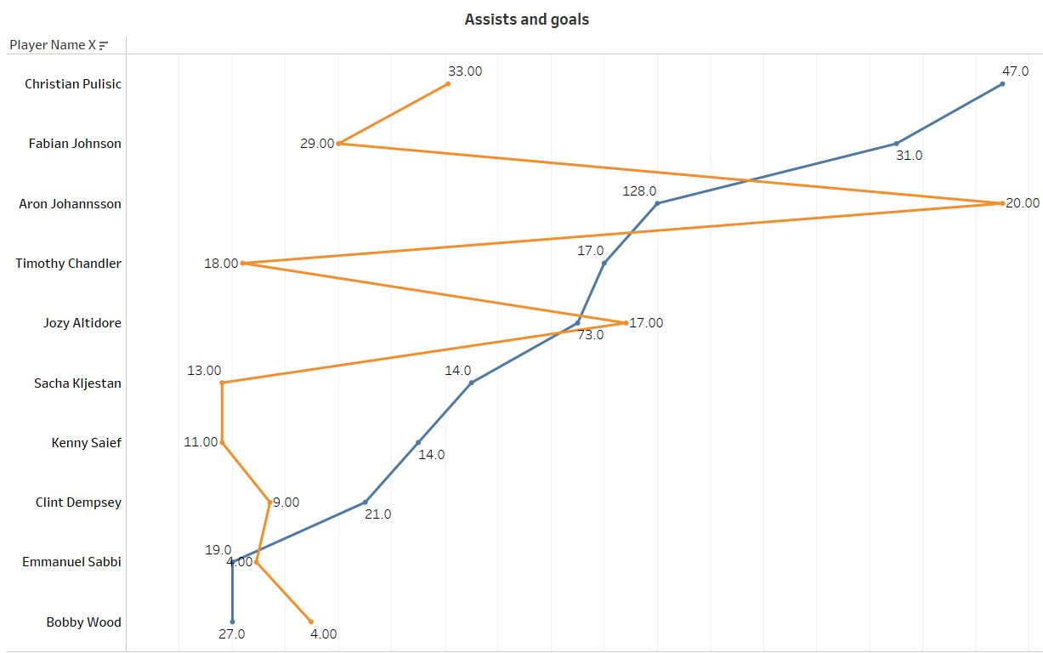
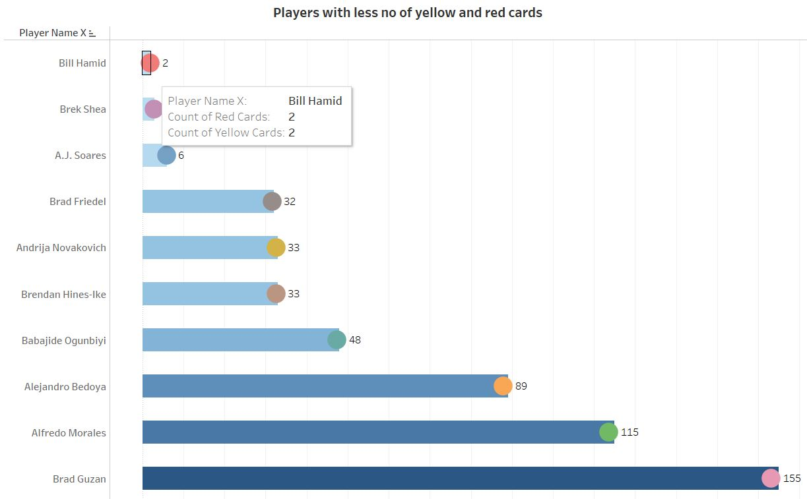
Analysis in Tableau based on players performance, profile and market value:
Find out the relation between number of assists and goals?
Find out players with very less number of red and yellow cards?
Interpretation:
From the line chart ,we can infer that players with maximum
Number of assists will obviously score more number of goals
Interpretation:
Bill hamid and Brek shea has got very less number of
yellow and red cards

Slide 22
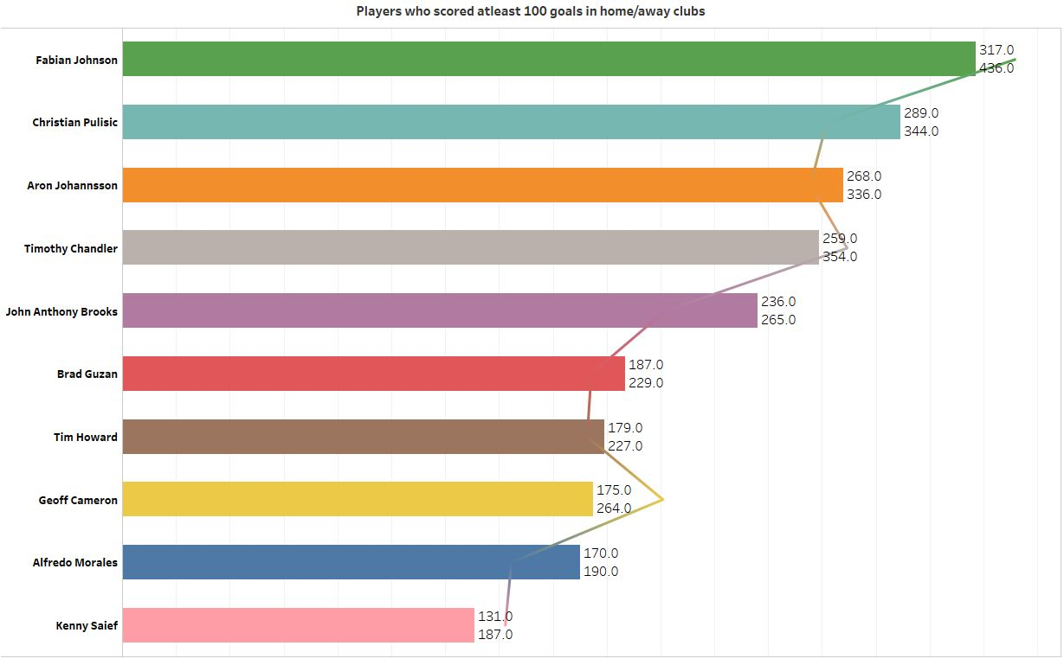
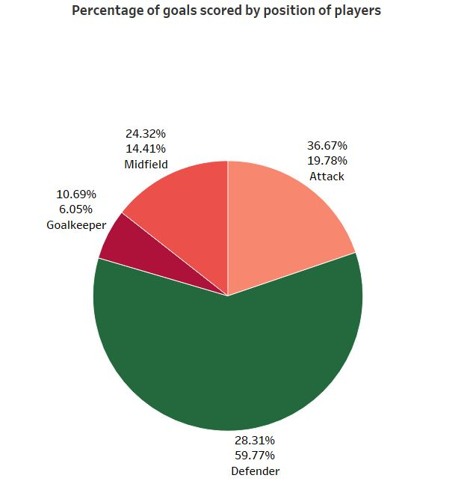
Name the players who had scored at least 100 goals
in home/away games?
Show the composition of goals according
to their playing position.
Interpretation:
Fabien Johnson and Christian Pulisic had scored at least 100
Goals in both home and away games
Interpretation:
Composition of goals (home/away) scored by
players based on their playing position

Slide 23
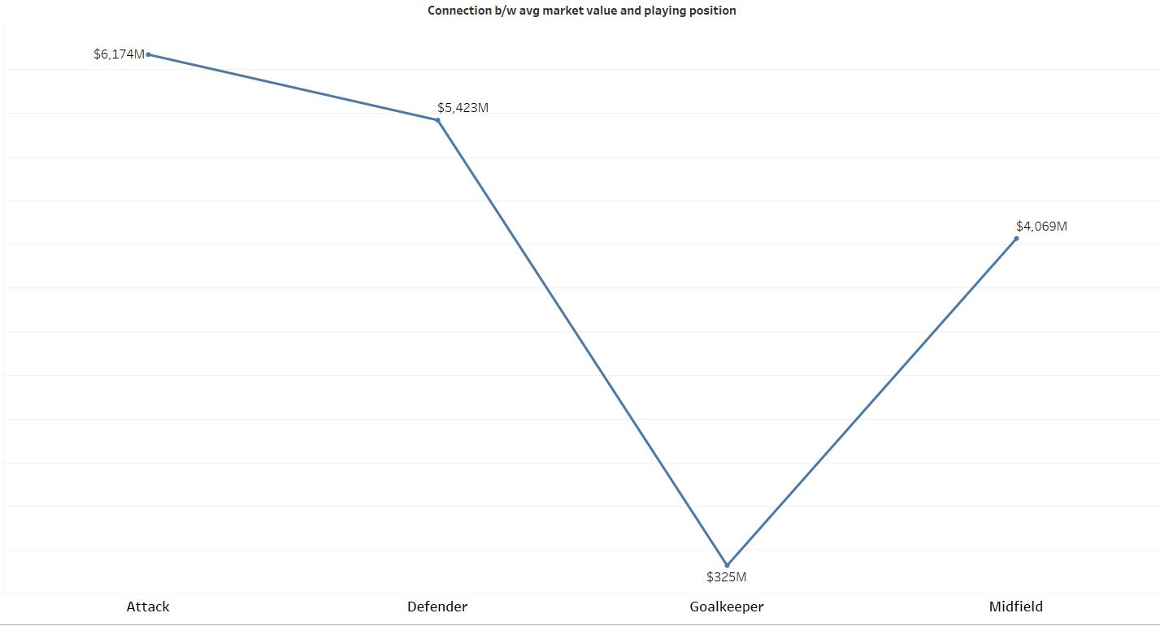
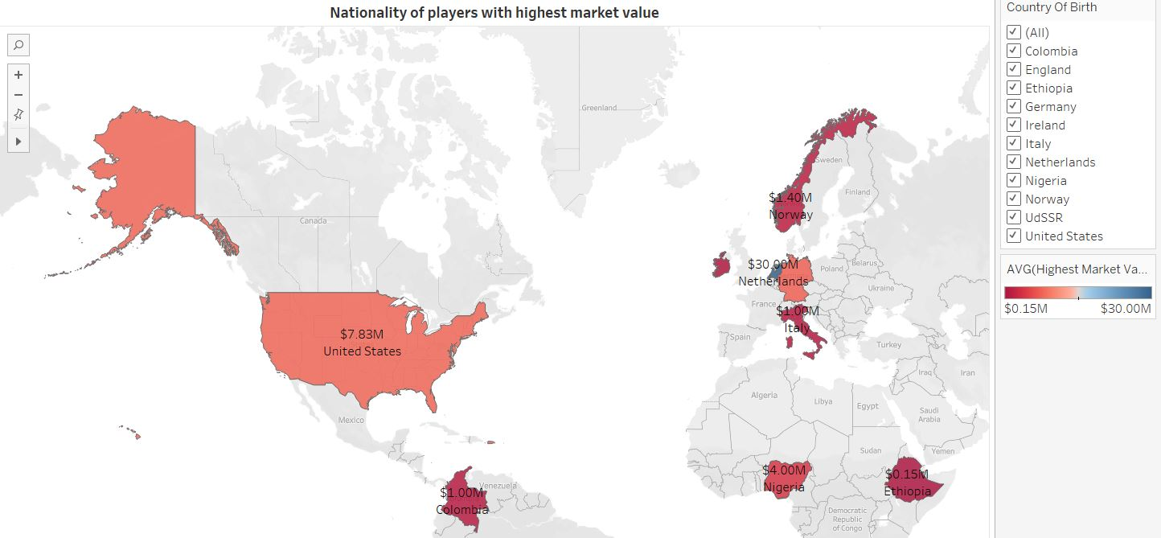
How’s the player’s playing position and market value
are related?
Which country has players with market value and lowest
market value?
Interpretation:
Players in attack position has got more market value where as goal keeper has low market value
Interpretation:
Players in netherlands has highest average
market value(30million)where as Ethiopia has lowest
market value (0.15 million)

Slide 24
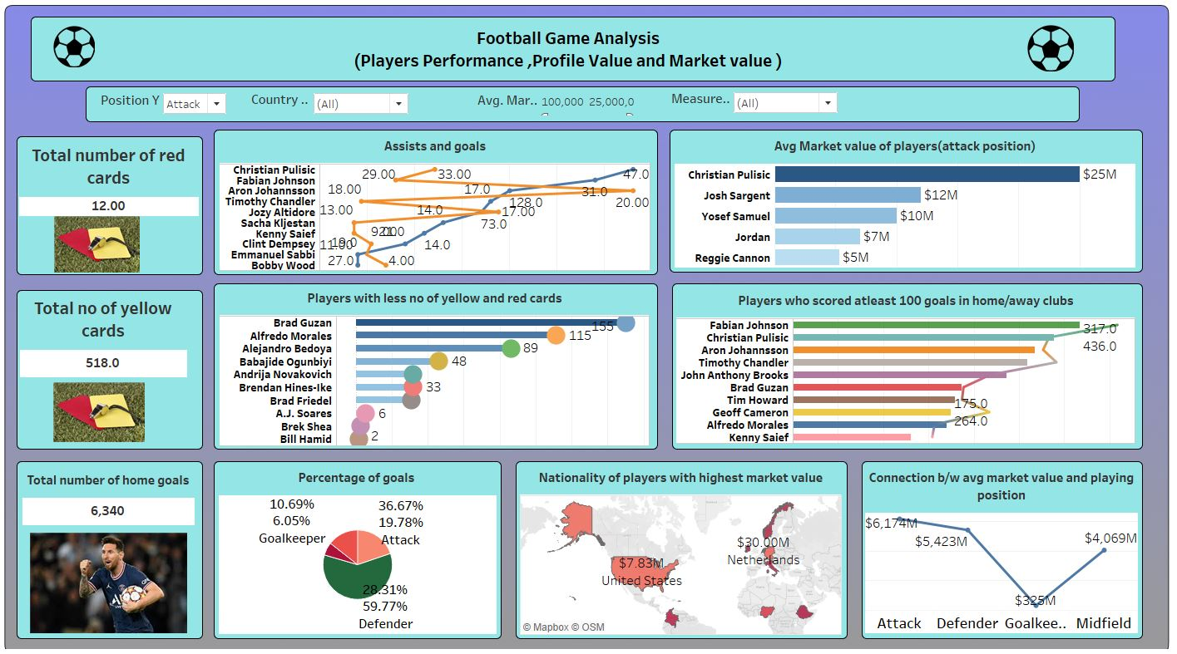
Dashboard view in tableau:

Slide 25
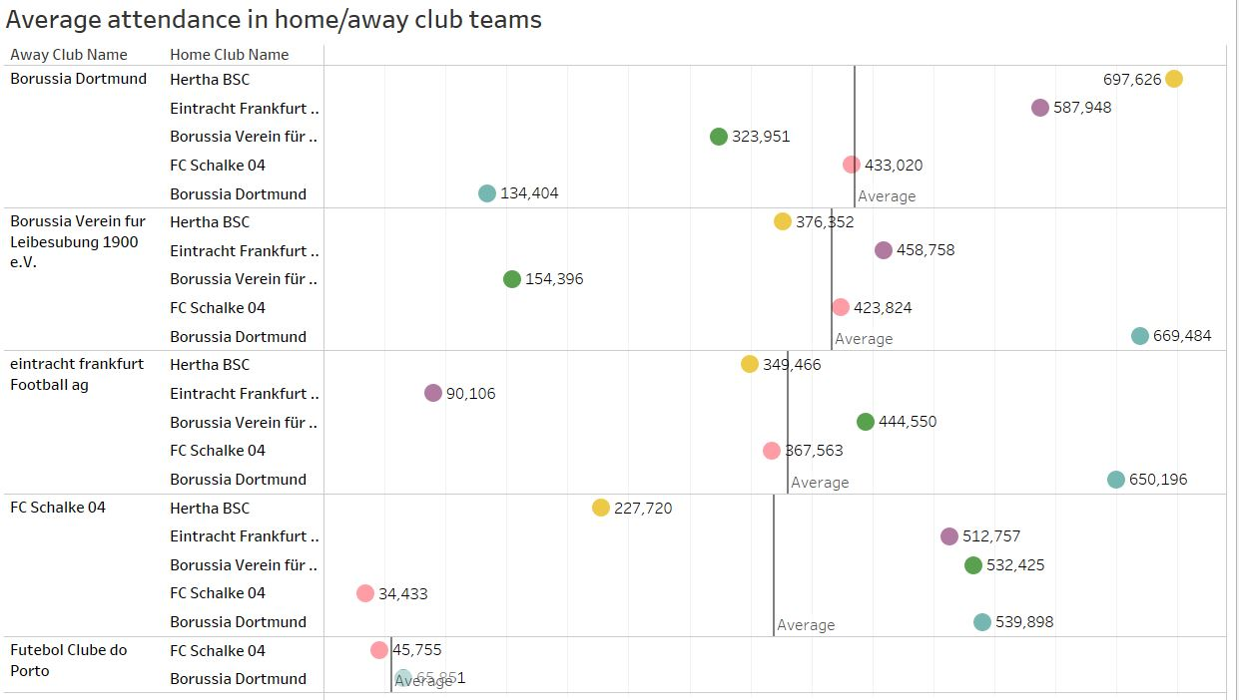
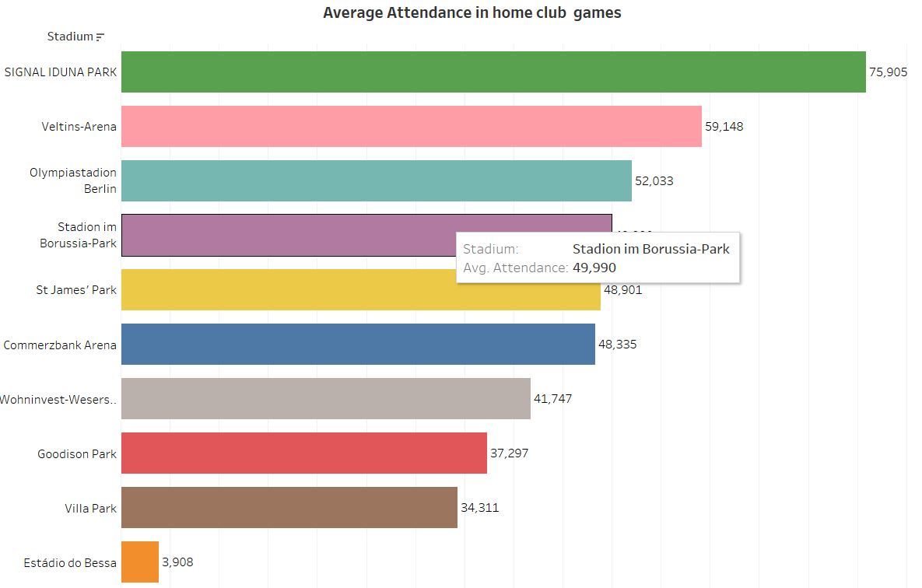
Analysis in Tableau based on ATTENDANCE, REFEREE and COMPETITION TYPE:
Find the average attendance of viewers in home/away
games?
Which stadium has high average attendance in home games?
Interpretation:
The average attendance of home/away club
games are displayed.
Interpretation:
Signal iduna park has more number of average attendance
(75,905 members) compared to all other stadiums.

Slide 26
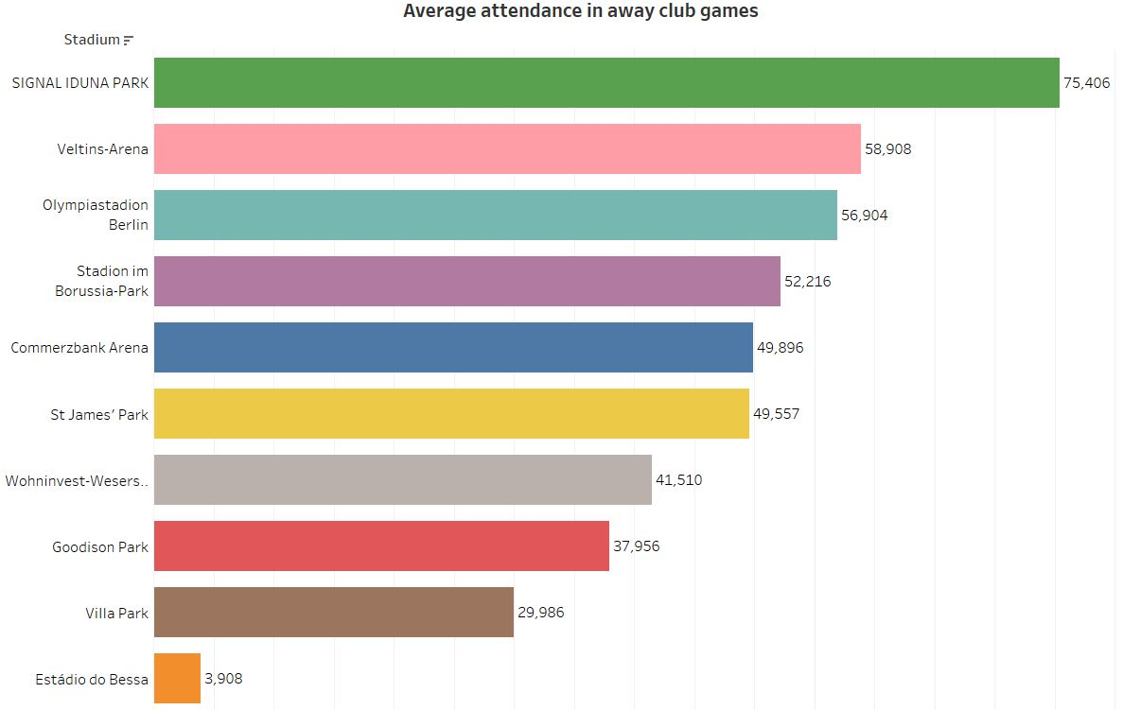
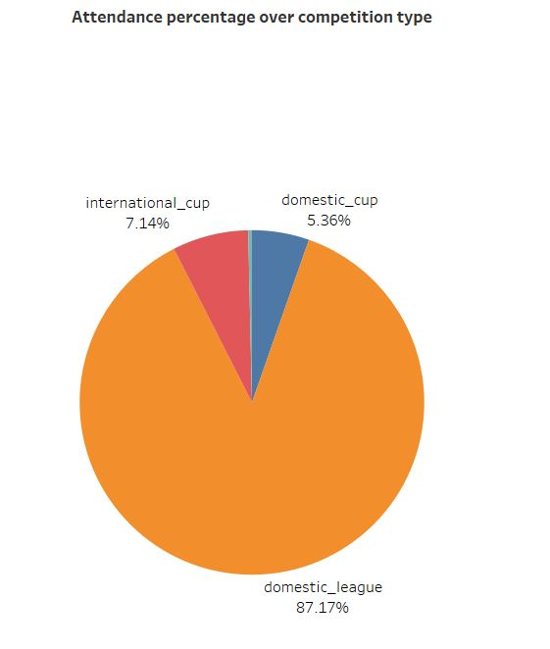
Which stadium has high average attendance in
away games?
Show the composition of attendance over competition
Type.
Interpretation:
Signal iduna park has high average attendance
in away club games.
Interpretation:
Domestic league has more composition (87.16%)of
attendance percentage over other type of competion.

Slide 27
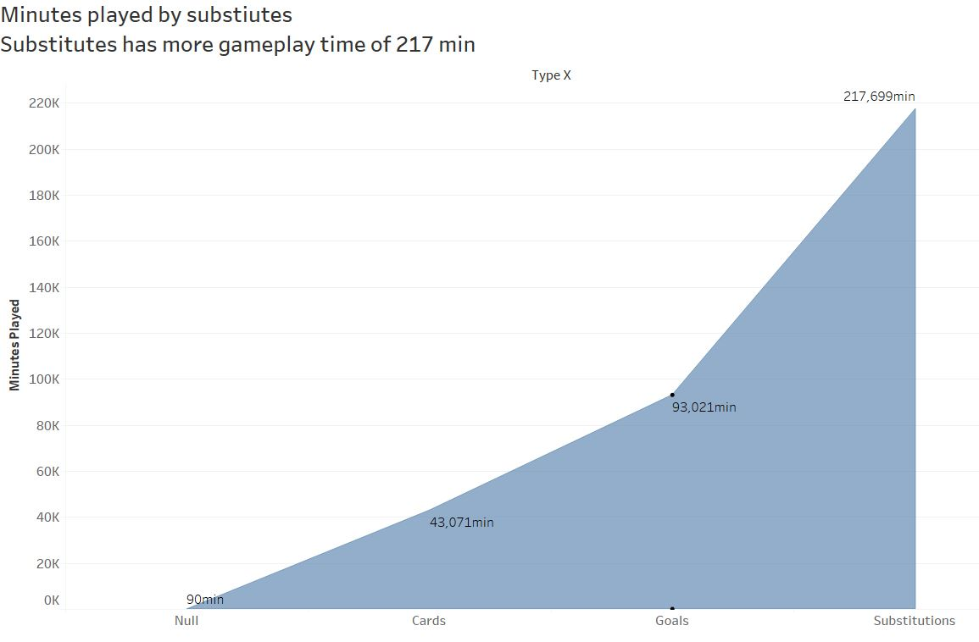
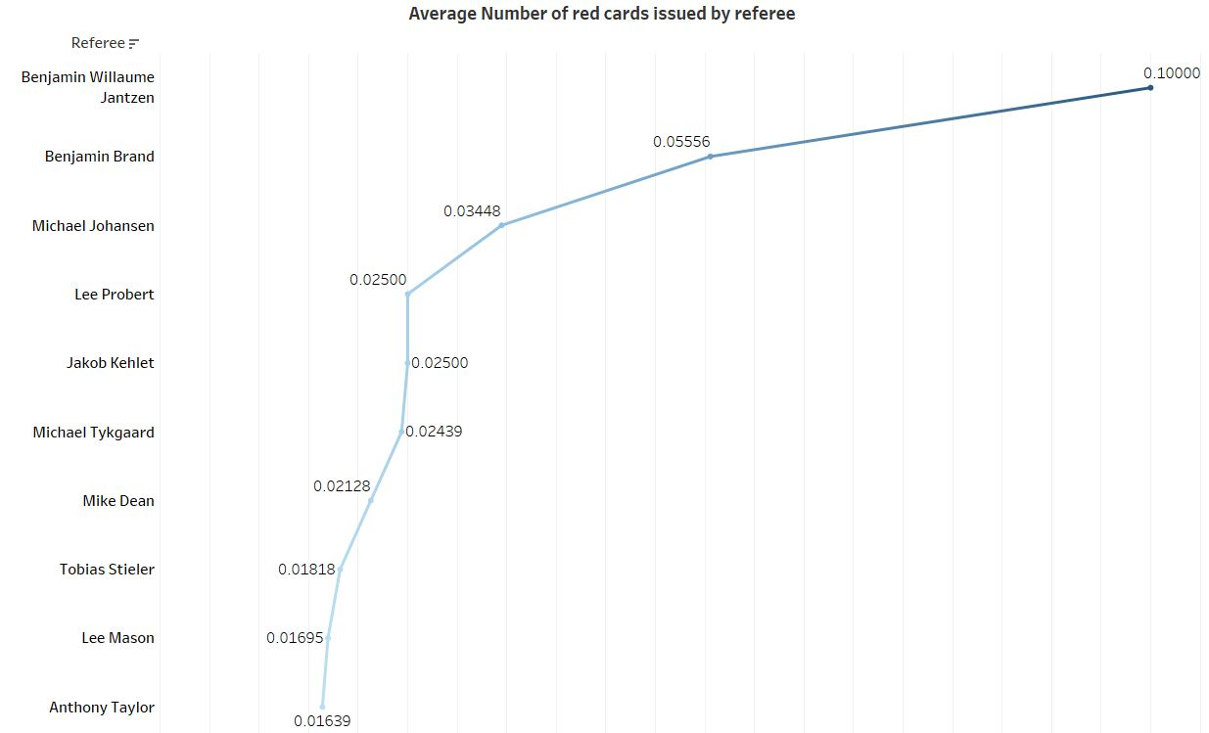
Which type of competition has more game play time?
Which referee had issued high average number
of red cards?
Interpretation:
Substitutes players has more gameplay time of
217 minutes
Interpretation:
Benjamin Williaume and Benjamin Brand had issued more
Number of red cards on average(0.10,0.055)

Slide 28
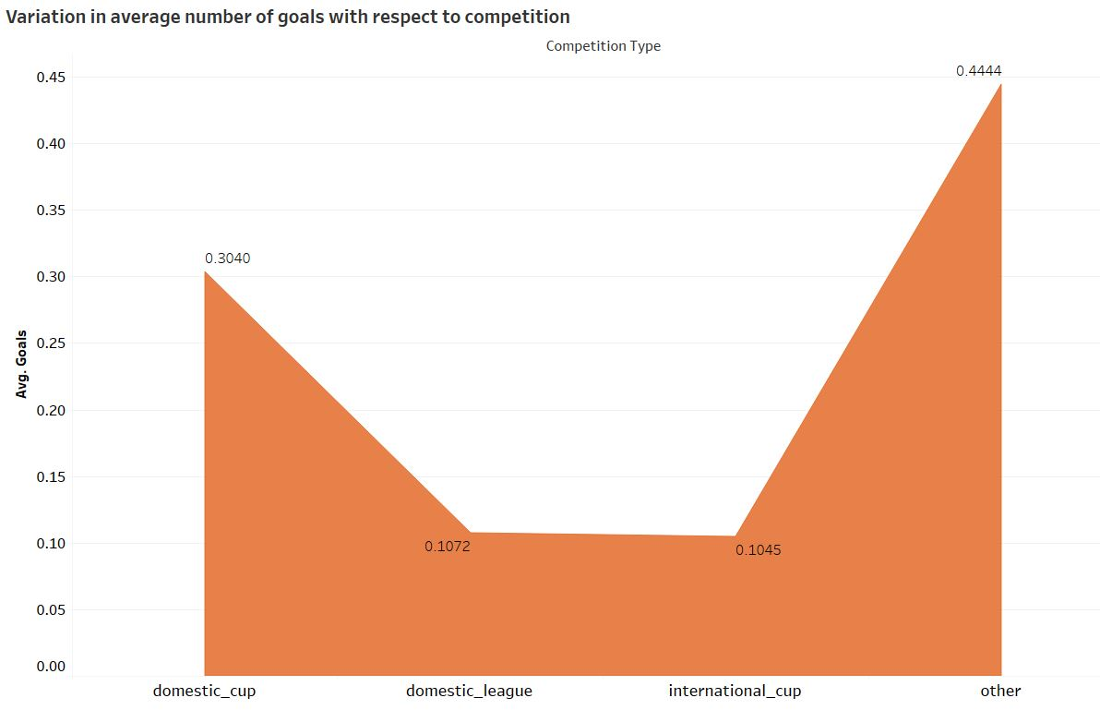
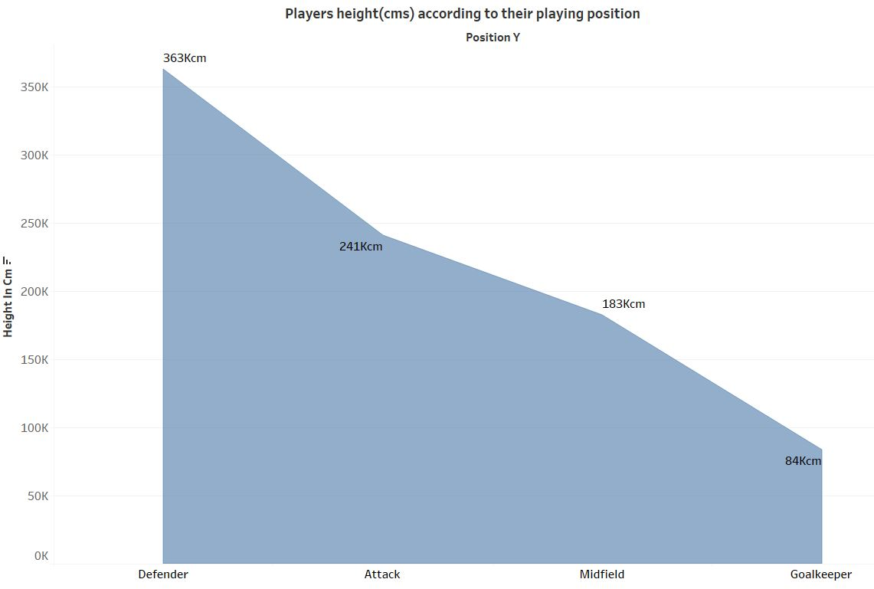
Which type of competition has very less average number of goals?
Which type of playing position has players with more heights?
Interpretation :
Domestic league and international cup has
less number of avg goals compared to domestic cup and
other competition
Interpretation :
Defending position players has more heights(sum=363 k cms) than all other players .

Slide 29
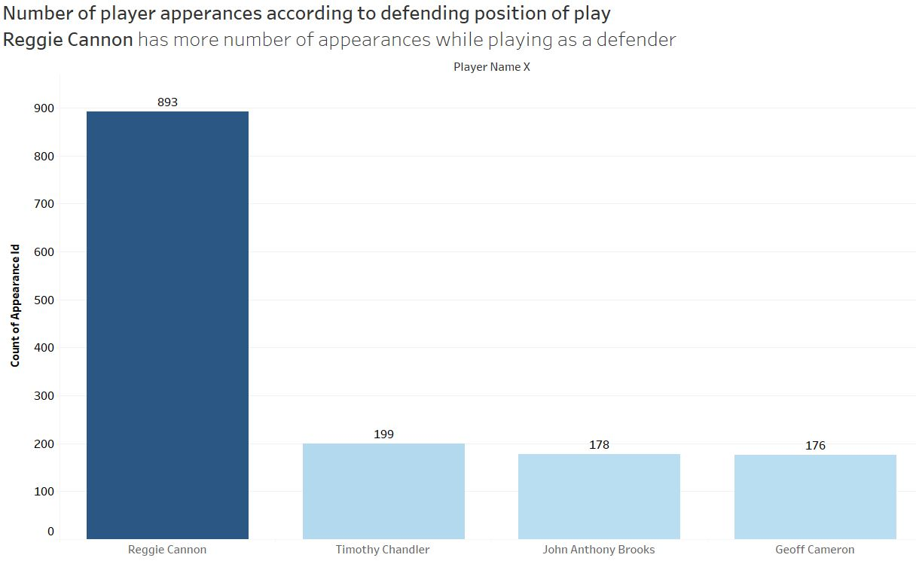
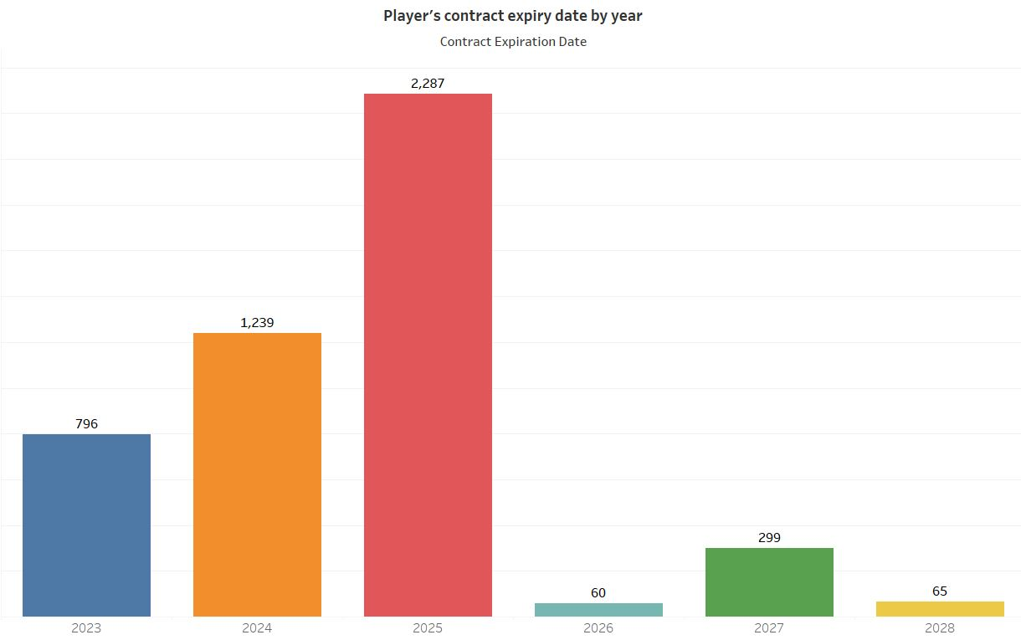
Which player had appeared most number of times in
defending position?
In which year most of players contract are to be expired?
Interpretation:
Reggie canon had appeared 893 times while playing as a defender .
Interpretation:
By the year 2025, almost 2287 players contract are to be renewed.

Slide 30
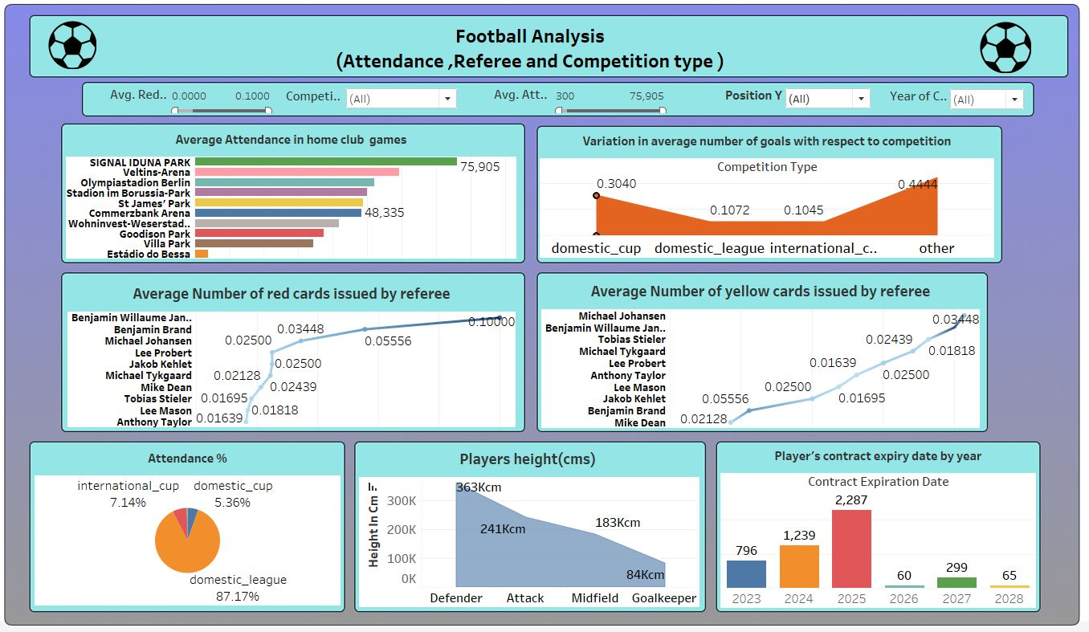
Dashboard view in tableau:

Slide 31

Conclusion:
As a data analyst,I had analyzed the game with number of goals, assists, and other metrics, along with insights into player contributions and effectiveness.
Fabian Johnson and Christian Pulisic are the players who had scored more number of goals and they have more market value than all other players
A team can choose players with more height so that they can defend and attack effectively that obviously improves the team performance
Domestic league are played more than other type of competitions, instead away club matches can be played more to improve players exposure on various levels
New players can be bought during auctions by conducting talent scouts in various countries rather than buying more players from a single country that would cause monopoly
Buying new players from various countries would reduce the money spent on hyped players that would benefit the team management.

