Slide 1
Directed Research Outlier Detection IQR and One Class SVM
02/22/2019
Summarizing the work of Week6
Muthulakshmi Chandrasekaran
USC ID : 4486180242
Masters in Electrical Engineering

Slide 2
Overview of the work done
Outlier Detection – IQR
Output - format
Implementation of One Class SVM
Output – with ROI Names
One class SVM and Nilearn

Slide 3
Outlier Detection - IQR
Read input from files
Do processing in panels
Processing is done for each ROI, across all the 170 subjects
Each item in the panel – data for one ROI across all subjects
Since all measures are being displayed, create separate panels for storing quartile values
Replace the actual value in the dataframe with the outlier value
Output the outlier ROI_ID, Measure, ROI Name, Actual value, Quartile range in the text file

Slide 4
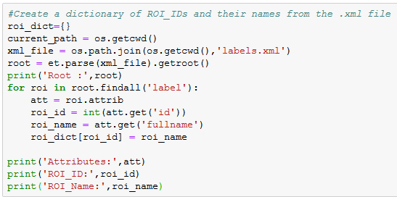
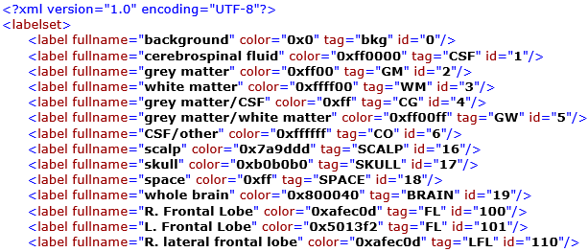

ROI Names from brainsuite_labeldescription.xml
Read in Python using ElementTree
Extract the attributes
Extract ROI_ID, ROI_Name

Slide 5
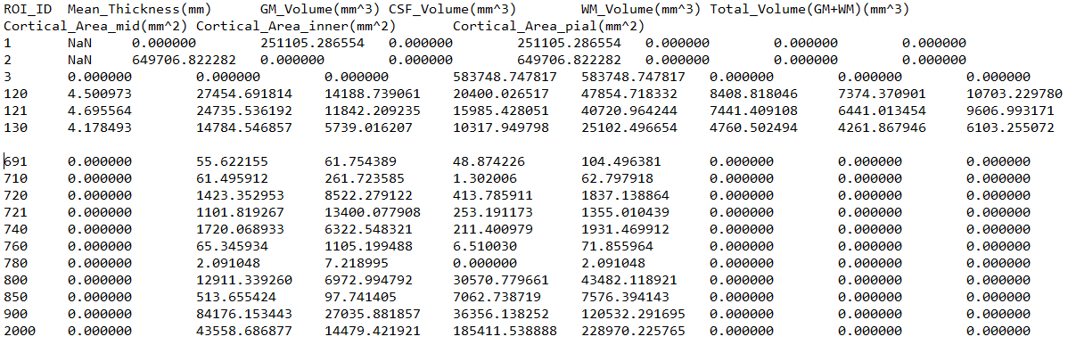
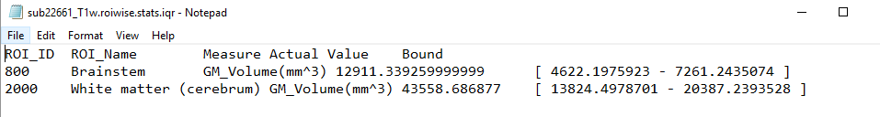
Outlier Detection(IQR) – Input and Output Samples
Input File
Output File

Slide 6
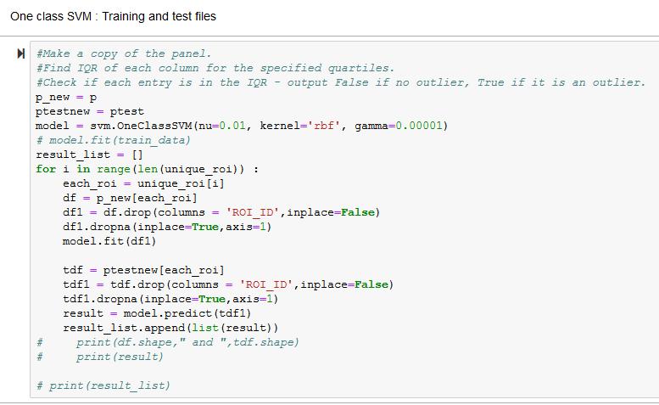
Implementation of one – class SVM
Test : Train split = 0.1 : 0.9
Do the same pre – processing for training and test files
Train the model on only the training files

Slide 7
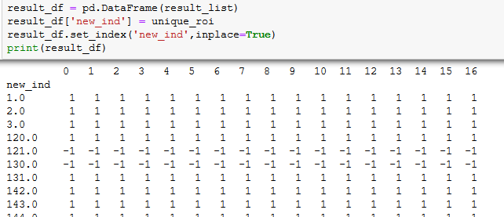
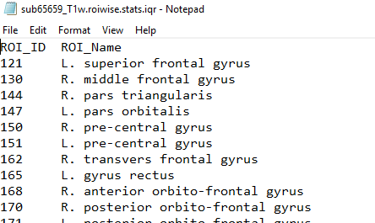
One Class SVM
Result = -1 → Outlier
For each ROI, the outlier for each file is obtained as an array
All measures are taken as features, hence the output is a single digit – telling if an outlier is present in the file or not.
Hence the output is just the ROI_ID, plus the name of the ROI, from the xml file.

Slide 8
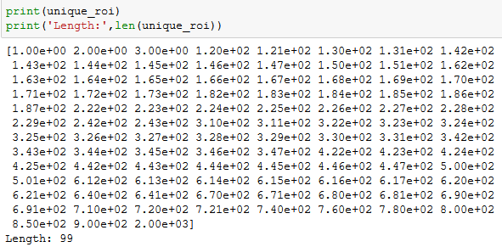
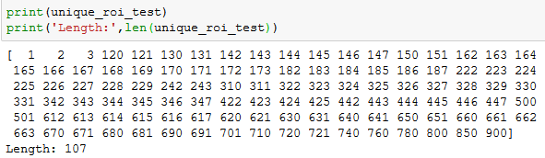
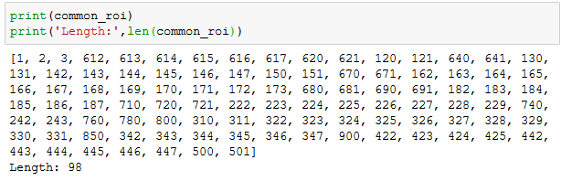
Outlier Detection - SVM
To find if a particular region is an outlier or not
Training data : all 170 subjects given in fcon1000_Beijing_zang_stats
Training data : contains 99 unique ROIs for all subjects
Test data : 2523412.roiwise.stats – sample file from BrainSuite
Test data : 107 unique ROIs
Take only the common ROI – helps in training

Slide 9
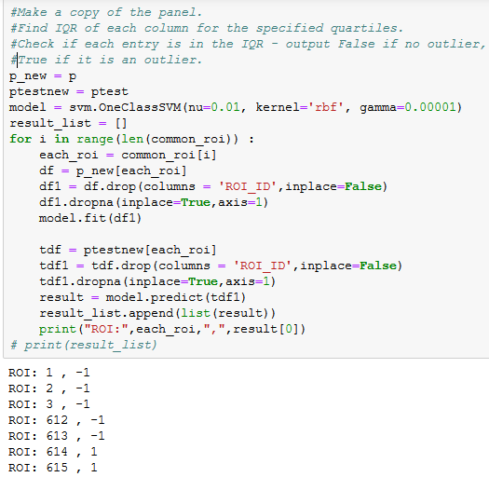
Outlier Detection - SVM
Train the model for each ROI across all subjects.
Test data : Check if that’s an outlier, for each ROI
Result = -1 → Outlier
Here for each measure, we can detect if that’s an outlier.
[Since there is only one test file]

Slide 10
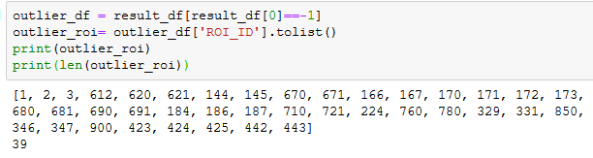
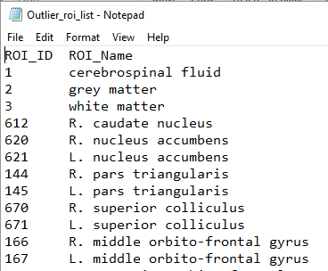
Outlier Detection - SVM
Store the outlier ROIs in a list or array
Write these values to a file

Slide 11
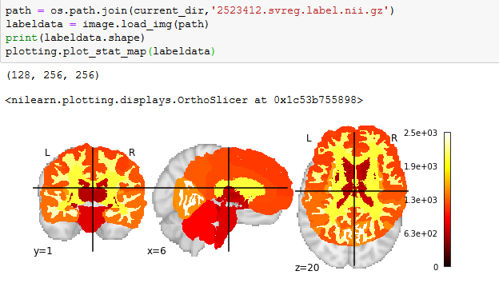
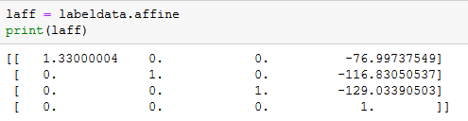
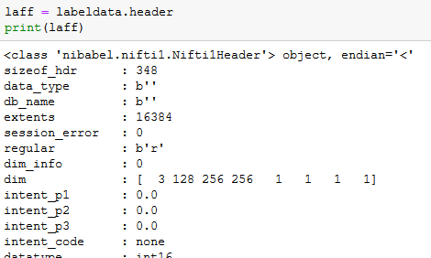

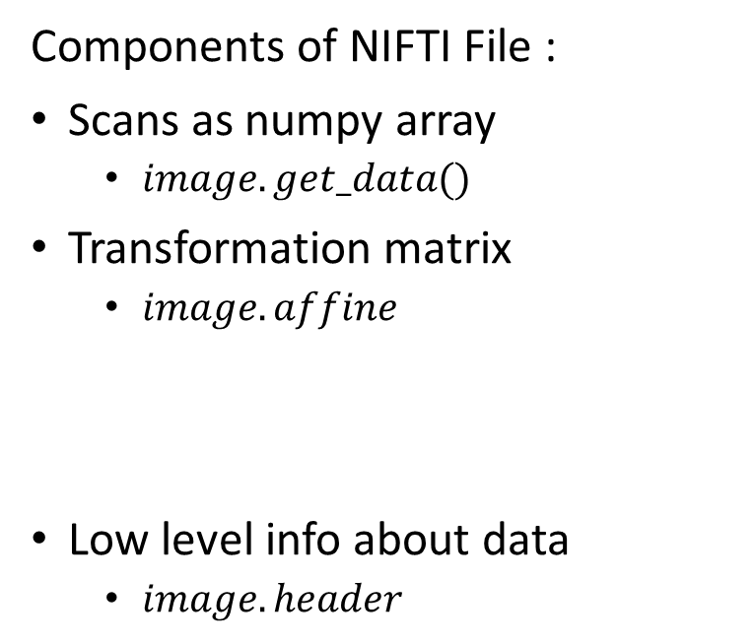
Outlier Visualization using Nilearn
Input file :
2523412.svreg.label.nii.gz
3D volume, so use $plot_stat_map$
Components of NIFTI File :
Scans as numpy array
$image.get_data()$
Transformation matrix
$image.affine$
Low level info about data
$image.header$

Slide 12
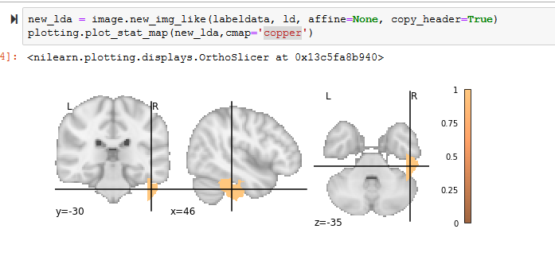

Outlier Visualization using Nilearn
Output brain image :
Normal regions – have value False
Outlier regions – have value True

Slide 13
Thank You!

