Slide 1
Directed Research Outlier Detection IQR and One Class SVM
03/22/2019
Muthulakshmi Chandrasekaran
USC ID : 4486180242
Masters in Electrical Engineering

Slide 2
Overview of the work done
IQR – Detailed Explanation
Improving Outlier Detection using IQR
Improving Outlier Detection using One Class SVM

Slide 3
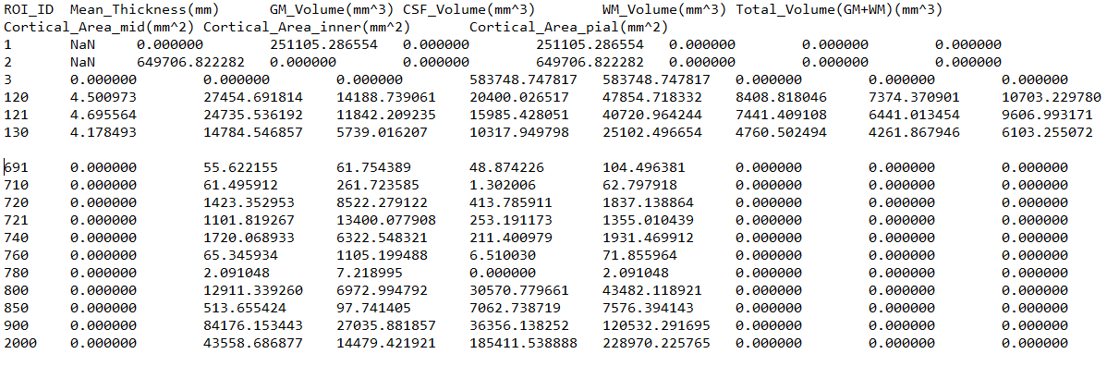
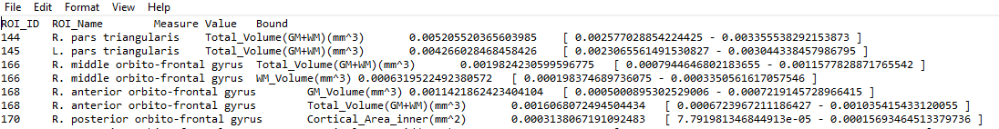
Outlier Detection(IQR) – Input and Output Samples
Input File
Output File

Slide 4
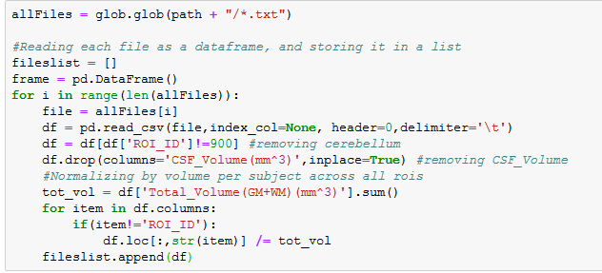
Outlier Detection(IQR) – Changes made
New set of training data
Calculation of Outliers was excluded for
Region Cerebellum : ROI_ID 900
Measure CSF_Volume(mm^3)
These calculations were made when reading the files, so the later calculations are done without including them.
The values for each subject are normalized by the total volume across all regions of interest.

Slide 5
Outlier Detection(IQR) – Process
Read training files(170 subjects), one subject at a time
Exclude ROI_ID 900 and CSF_Volume(mm^3)
Normalize the entire data(except for the ROI_ID) by the total volume
Store each subject data
Data is now arranged subject wise, modify it to represent ROI wise data
Calculate the IQR Range for each measure for each ROI, and store it
Read the test file
Exclude ROI_ID 900, if present
Exclude CSF_Volume(mm^3), if present.
Normalize by total volume
Compare with the already obtained IQR Range to test for an outlier.

Slide 6

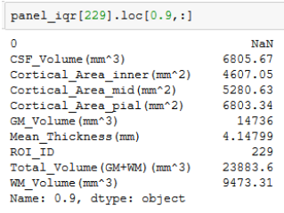
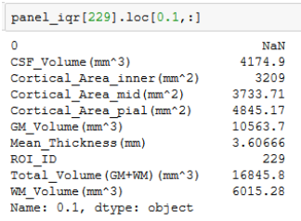
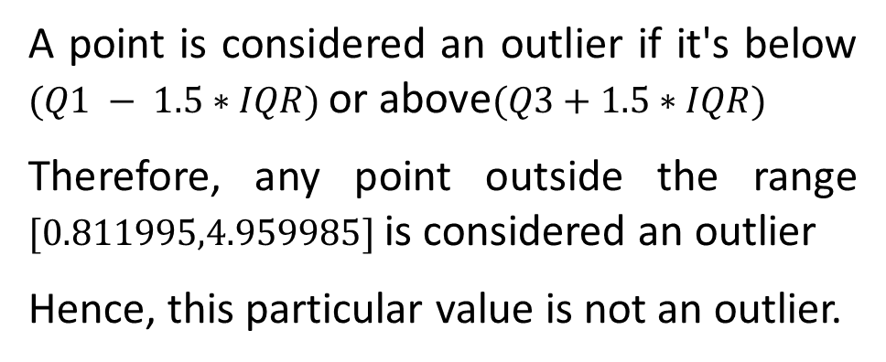
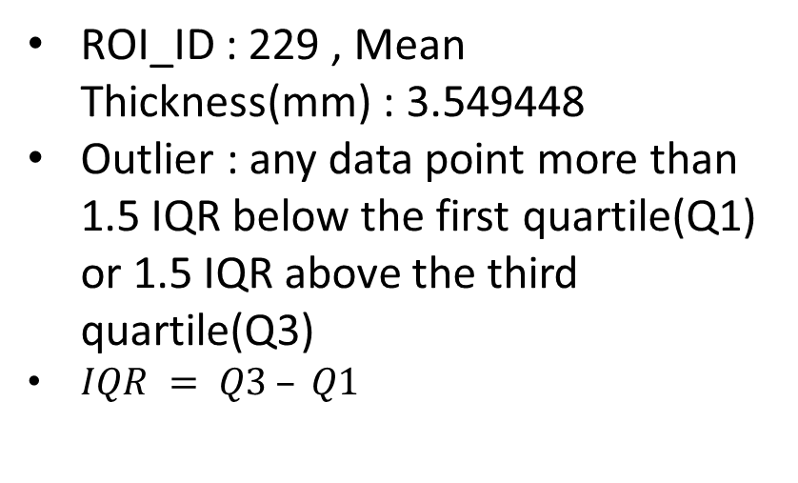
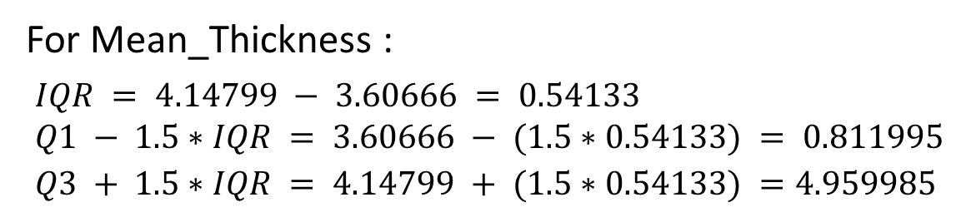
Outlier Detection(IQR) – An example from prev. disc.
ROI_ID : 229 , Mean Thickness(mm) : 3.549448
Outlier : any data point more than 1.5 IQR below the first quartile(Q1) or 1.5 IQR above the third quartile(Q3)
$IQR = Q3 – Q1$
For Mean_Thickness :
$$IQR = 4.14799 − 3.60666 = 0.54133 \\ Q1 − 1.5∗IQR = 3.60666 − (1.5∗0.54133) = 0.811995 \\ Q3 + 1.5∗IQR = 4.14799 + (1.5∗0.54133) =4.959985$$
(Q3)
(Q1)
A point is considered an outlier if it's below $(Q1 − 1.5∗IQR)$or above$(Q3+1.5∗IQR)$
Therefore, any point outside the range $[0.811995,4.959985]$is considered an outlier
Hence, this particular value is not an outlier.

Slide 7
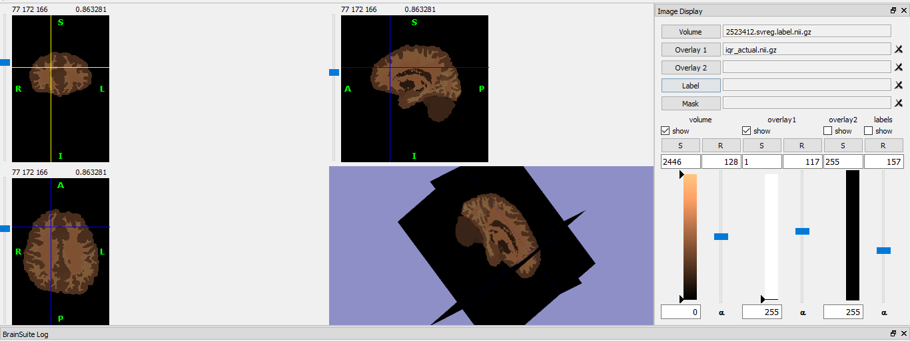
Outlier Detection(IQR) – 2523412.roiwise.stats - Output
iqr_actual_excelfile.xlsx

Slide 8
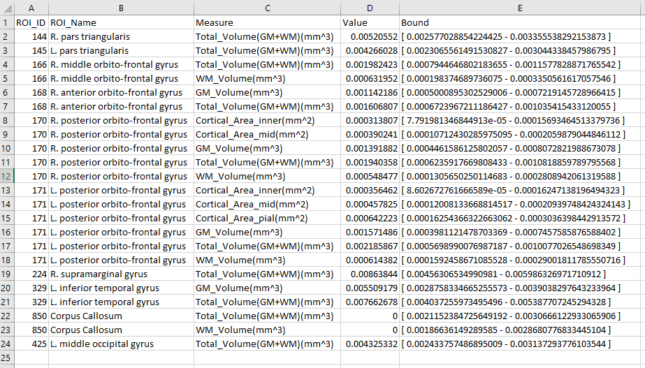
Outlier Detection(IQR) – 2523412.roiwise.stats - Output

Slide 9
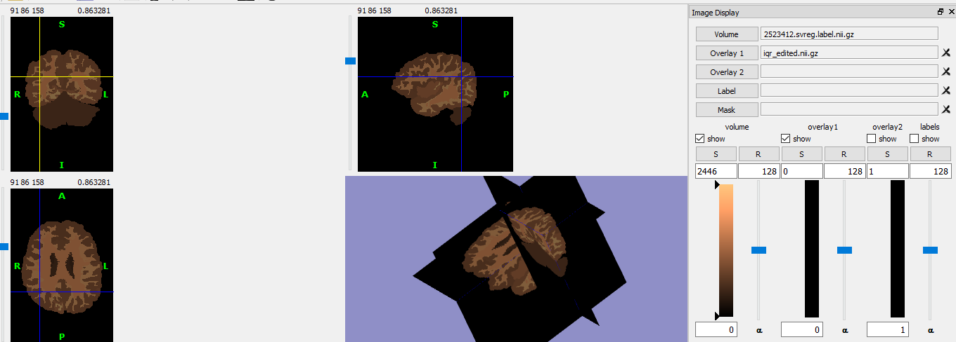
Outlier Detection(IQR) – 2523412_edited.roiwise.stats- Output
iqr_edited_excelfile.xlsx

Slide 10
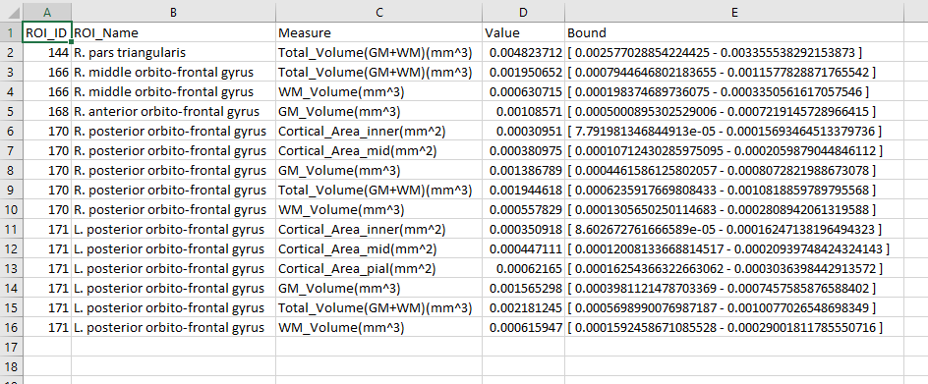
Outlier Detection(IQR) – 2523412_edited.roiwise.stats - Output

Slide 11
Outlier Detection - SVM
Read training files(170 subjects), one subject at a time
Exclude ROI_ID 900 and CSF_Volume(mm^3)
Normalize the entire data(except for the ROI_ID) by the total volume
Store each subject data
Data is now arranged subject wise, modify it to represent ROI wise data
Train the model.
Read the test file
Exclude ROI_ID 900, if present
Exclude CSF_Volume(mm^3), if present.
Normalize by total volume
Output if a region is an outlier.

Slide 12
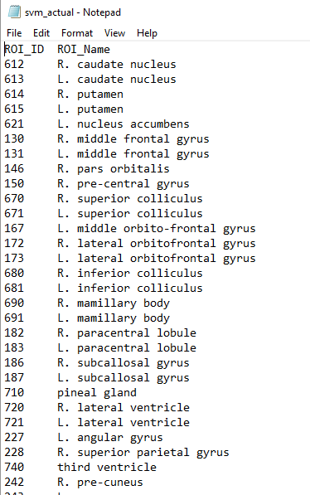
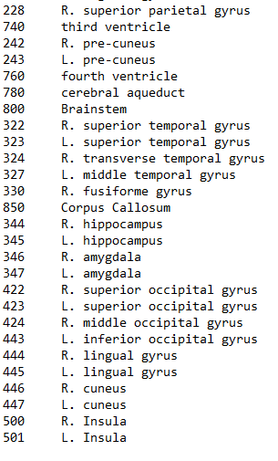
Outlier Detection(SVM) – 2523412_actual - Output
svm_actual_excelfile.xlsx

Slide 13
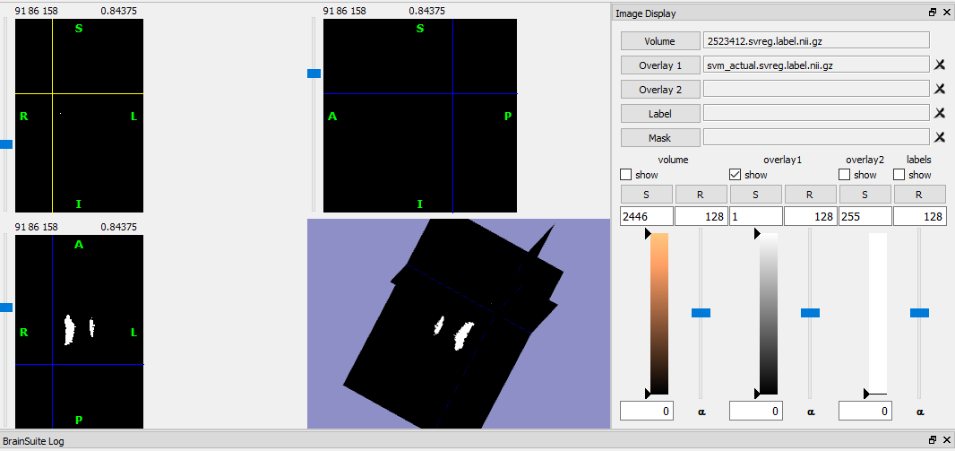
Outlier Detection(SVM)– 2523412_actual.nii.gz - Output

Slide 14
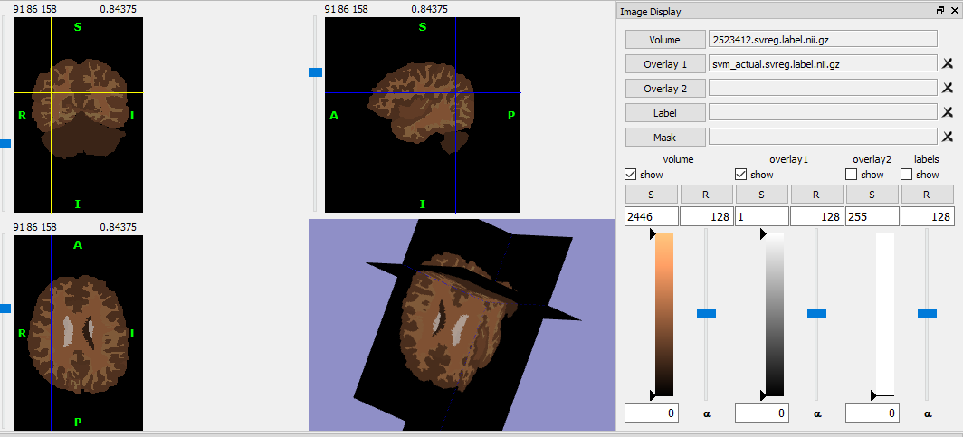
Outlier Detection(SVM)– 2523412_actual.nii.gz - Output

Slide 15
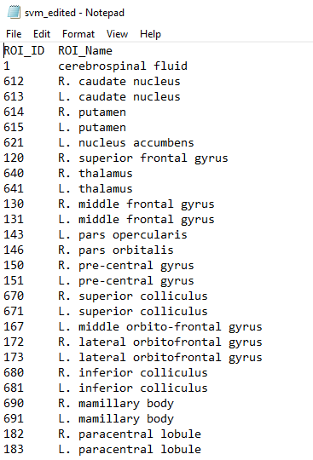
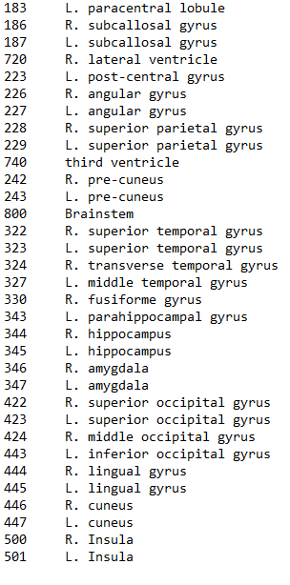
Outlier Detection(SVM) – 2523412_edited.roiwise.stats - Output
svm_edited_excelfile.xlsx

Slide 16
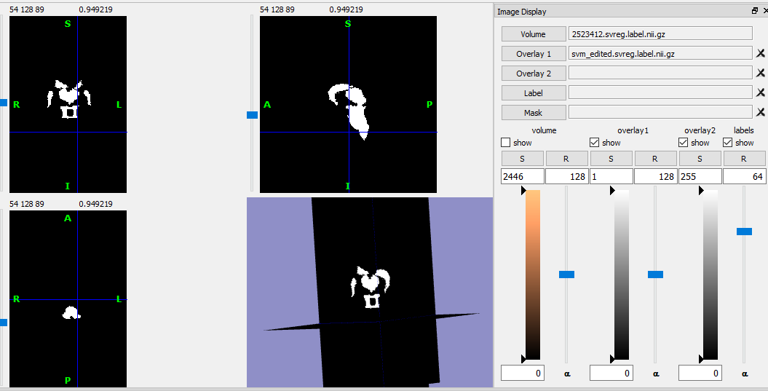
Outlier Detection(SVM)– 2523412_edited.nii.gz - Output

Slide 17
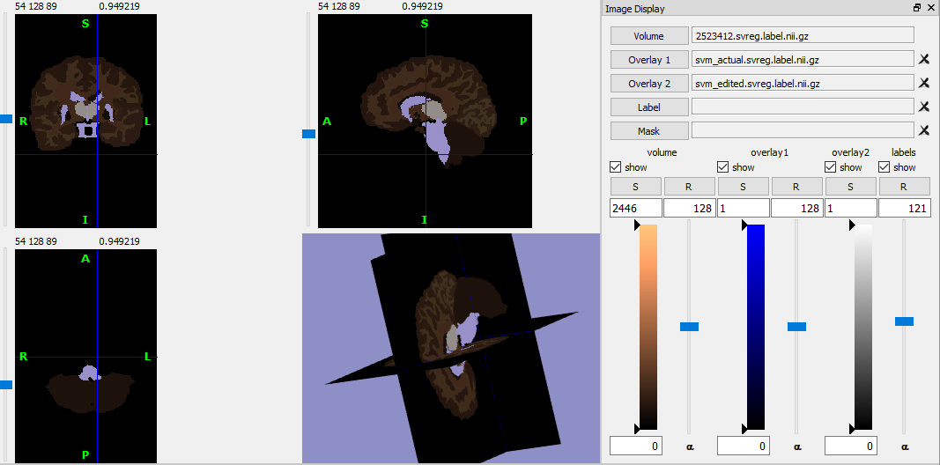
Outlier Detection(SVM) – Comparison of actual and edited

Slide 18
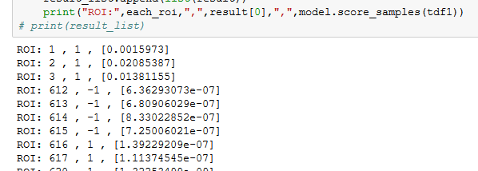
Outlier Detection(SVM)
More test files?
Nu and Gamma can be optimized if training data has some labels(that could be defined manually).
Visualization metric : need labels.
Function score_sample gives
decision boundary
Need to optimize to find the range.

Slide 19
Thank you!

