Slide 1
Directed Research Outlier Detection IQR and One Class SVM
03/29/2019
Muthulakshmi Chandrasekaran
USC ID : 4486180242
Masters in Electrical Engineering

Slide 2
Overview of the work done
IQR – with the new test file
Standardizing the data

Slide 3
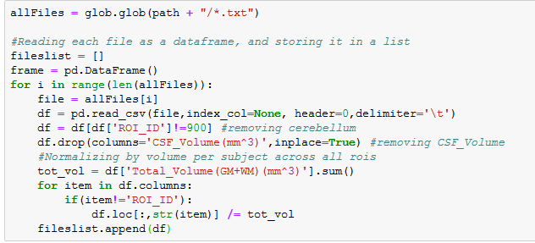
Outlier Detection(IQR) – Changes made
New set of training data
Calculation of Outliers was excluded for
Region Cerebellum : ROI_ID 900
Measure CSF_Volume(mm^3)
The values for each subject are normalized by the total volume across all regions of interest.
These calculations were made when reading the files, so the later calculations are done without including them.

Slide 4

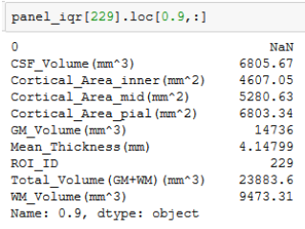
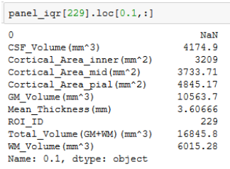
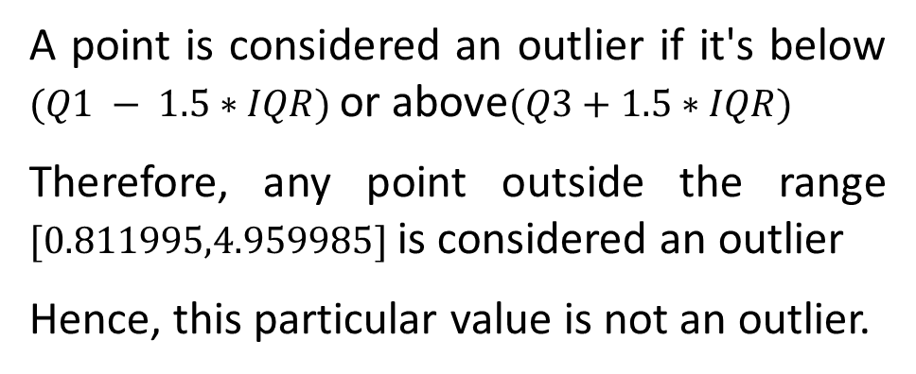
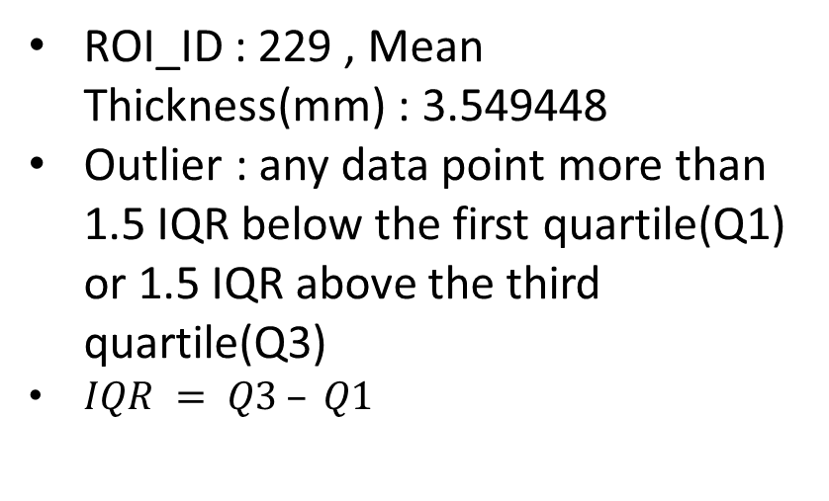
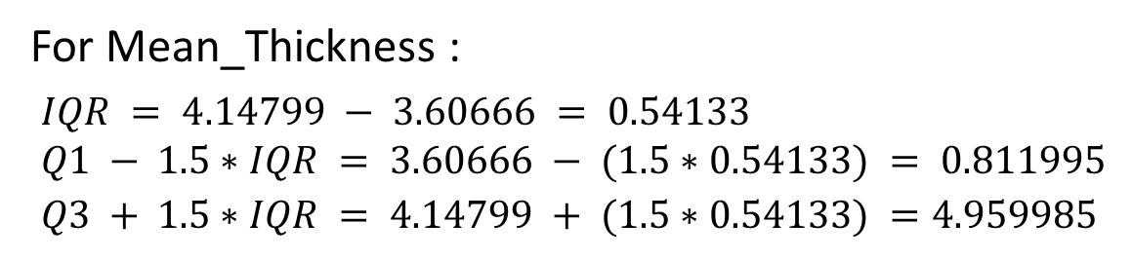
Outlier Detection(IQR) – An example from prev. disc.
ROI_ID : 229 , Mean Thickness(mm) : 3.549448
Outlier : any data point more than 1.5 IQR below the first quartile(Q1) or 1.5 IQR above the third quartile(Q3)
$IQR = Q3 – Q1$
For Mean_Thickness :
$$IQR = 4.14799 − 3.60666 = 0.54133 \\ Q1 − 1.5∗IQR = 3.60666 − (1.5∗0.54133) = 0.811995 \\ Q3 + 1.5∗IQR = 4.14799 + (1.5∗0.54133) =4.959985$$
(Q3)
(Q1)
A point is considered an outlier if it's below $(Q1 − 1.5∗IQR)$or above$(Q3+1.5∗IQR)$
Therefore, any point outside the range $[0.811995,4.959985]$is considered an outlier
Hence, this particular value is not an outlier.

Slide 5
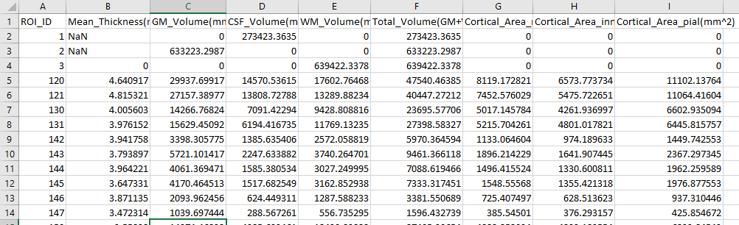
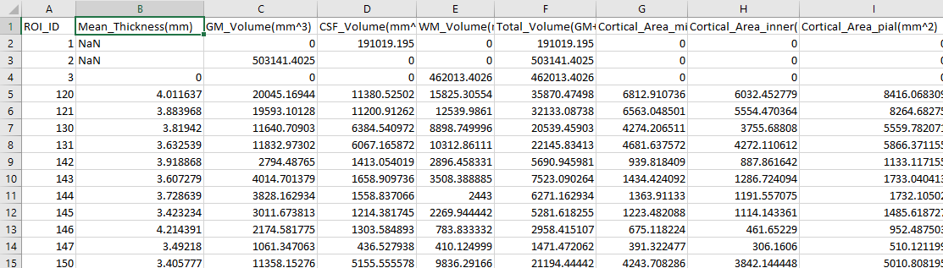
Outlier Detection(IQR) – New set of training and test data
New set of training files : cnstats
149 files
Each file : 99 ROIs
New Test file :
116_S_6517_T1w_edited.roiwise.stats.txt
99 ROIs

Slide 6
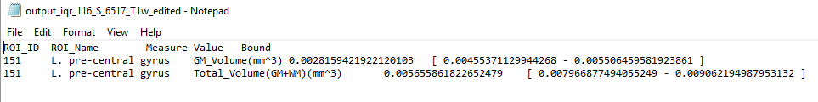
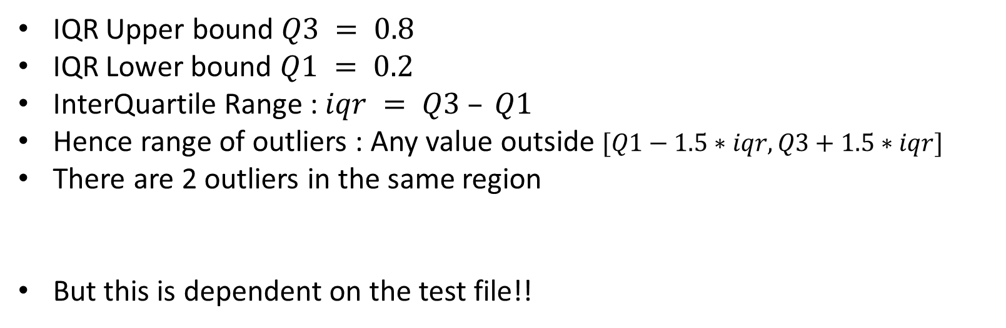
Outlier Detection(IQR) – 116_S_6517_T1w_edited.roiwise.stats - Output
IQR Upper bound $Q3 = 0.8$
IQR Lower bound $Q1 = 0.2$
InterQuartile Range : $iqr = Q3 – Q1$
Hence range of outliers : Any value outside $[Q1−1.5∗iqr, Q3+1.5∗iqr]$
There are 2 outliers in the same region
But this is dependent on the test file!!

Slide 7
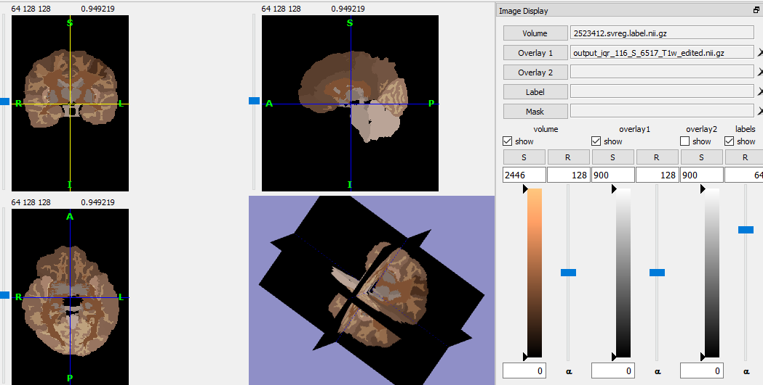
Outlier Detection(IQR) –Test file - Output
116_S_6517_T1w_edited.roiwise.stats

Slide 8
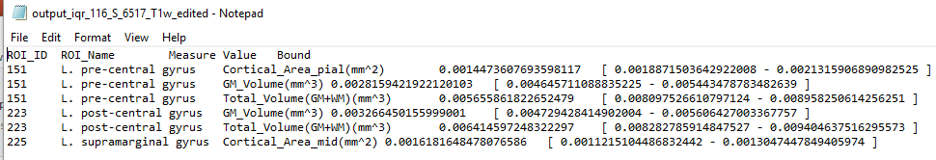
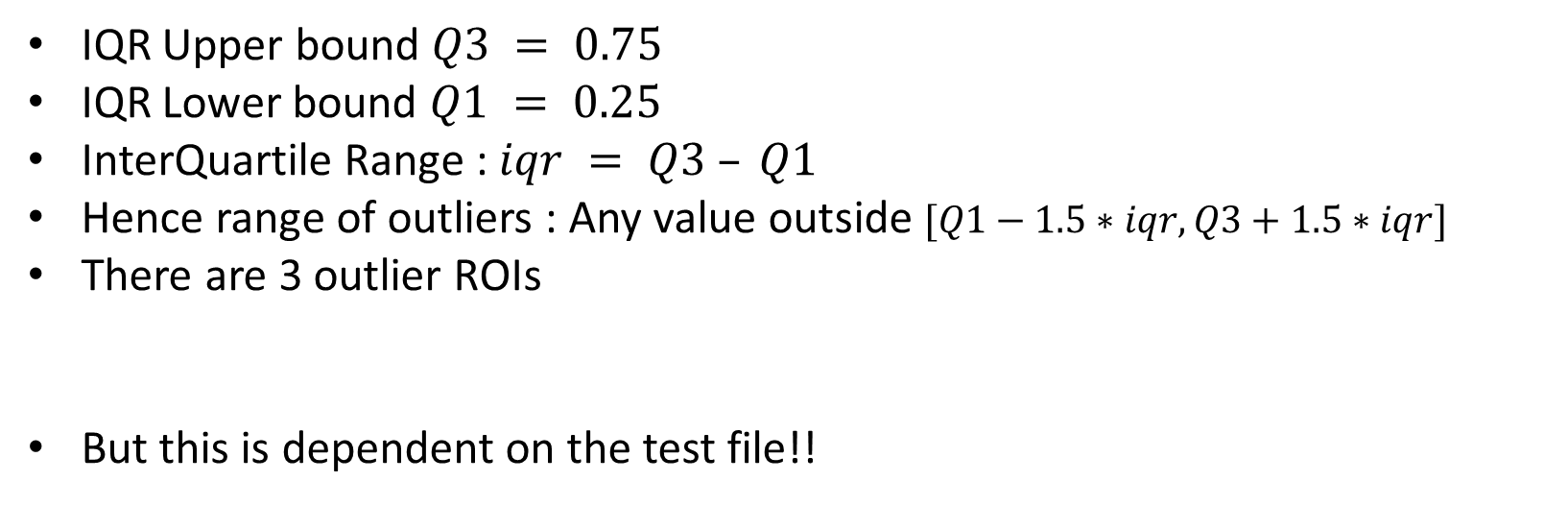
Outlier Detection(IQR) – 116_S_6517_T1w_edited.roiwise.stats - Output
IQR Upper bound $Q3 = 0.75$
IQR Lower bound $Q1 = 0.25$
InterQuartile Range : $iqr = Q3 – Q1$
Hence range of outliers : Any value outside $[Q1−1.5∗iqr, Q3+1.5∗iqr]$
There are 3 outlier ROIs
But this is dependent on the test file!!

Slide 9
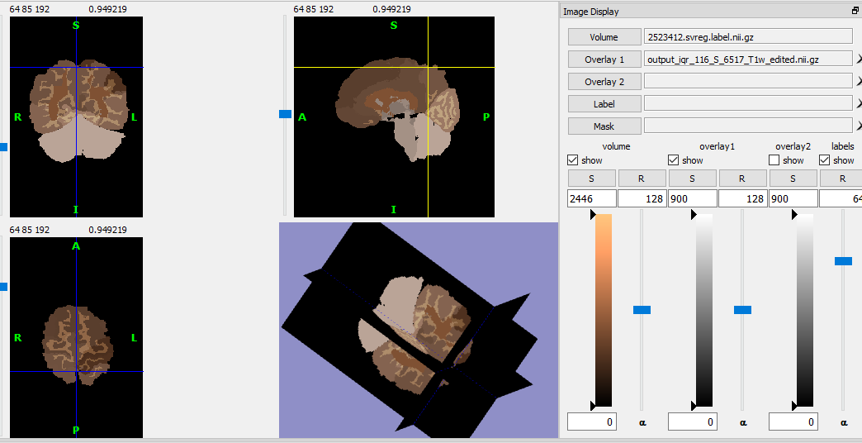
Outlier Detection(IQR) –Test file - Output
116_S_6517_T1w_edited.roiwise.stats

Slide 10
Outlier Detection - SVM
Read training files(170 subjects), one subject at a time
Exclude ROI_ID 900 and CSF_Volume(mm^3)
Normalize the entire data(except for the ROI_ID) by the total volume
Store each subject data
Data is now arranged subject wise, modify it to represent ROI wise data
Train the model.
Read the test file
Exclude ROI_ID 900, if present
Exclude CSF_Volume(mm^3), if present.
Normalize by total volume
Output if a region is an outlier.

Slide 11
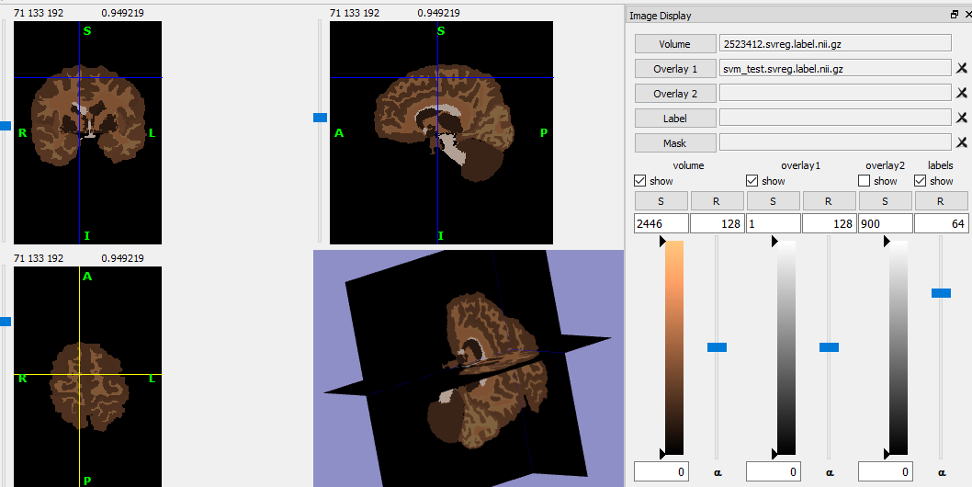
Outlier Detection(SVM) –Test file - Output
116_S_6517_T1w_edited.roiwise.stats

Slide 12
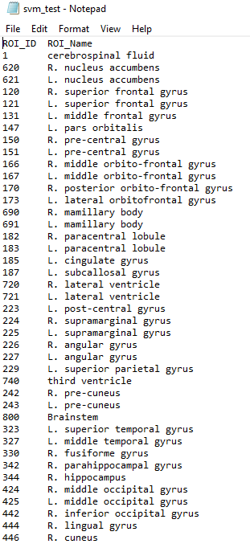

Outlier Detection(SVM) –Test file - Output
116_S_6517_T1w_edited.roiwise.stats

Slide 13
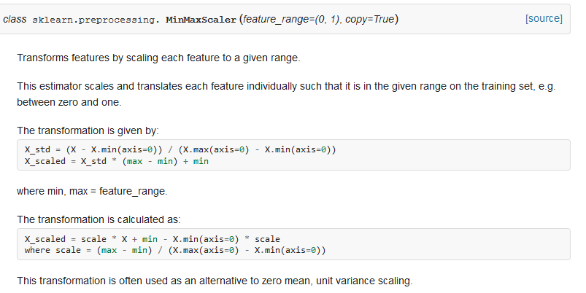
Standardizing all ROI_s
116_S_6517_T1w_edited.roiwise.stats
For each ROI across all subjects, find the mean and standard deviation.
For each value, subtract the mean, and divide by the standard deviation
Use Min Max Scaler

Slide 14
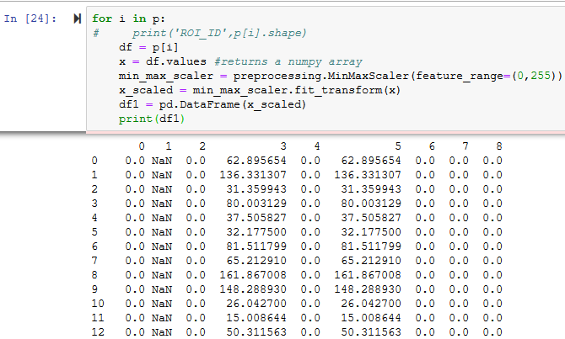
Standardizing all ROI_s
116_S_6517_T1w_edited.roiwise.stats
For each ROI across all subjects, find the mean and standard deviation.
For each value, subtract the mean, and divide by the standard deviation
Use Min Max Scaler

Slide 15
Thank you!

