Slide 1
Directed Research Outlier Detection IQR and One Class SVM
03/01/2019
Summarizing the work of Week7
Muthulakshmi Chandrasekaran
USC ID : 4486180242
Masters in Electrical Engineering

Slide 2
Overview of the work done
Outlier Detection in IQR
Trying with modified file
Visualization in BrainSuite
Implementation of One Class SVM
Trying with the modified file
Visualization in BrainSuite
SVM – in Detail

Slide 3
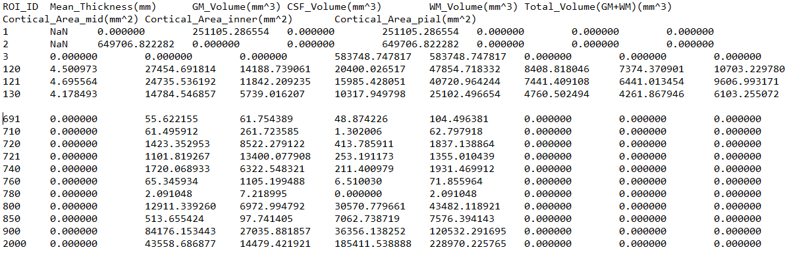
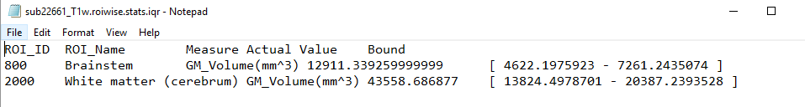
Outlier Detection(IQR) – Input and Output Samples
Input File
Output File

Slide 4
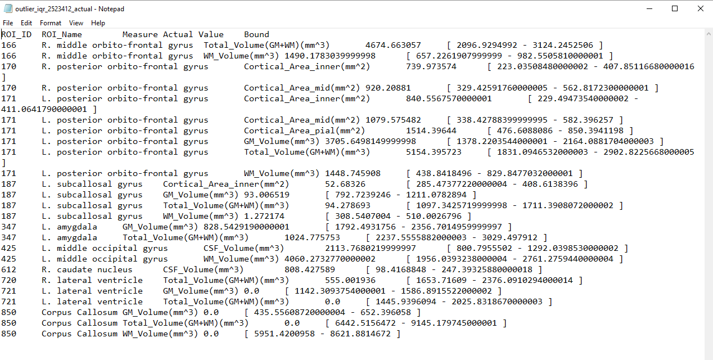
Outlier Detection(IQR) – 2523412_actual.nii.gz - Output

Slide 5
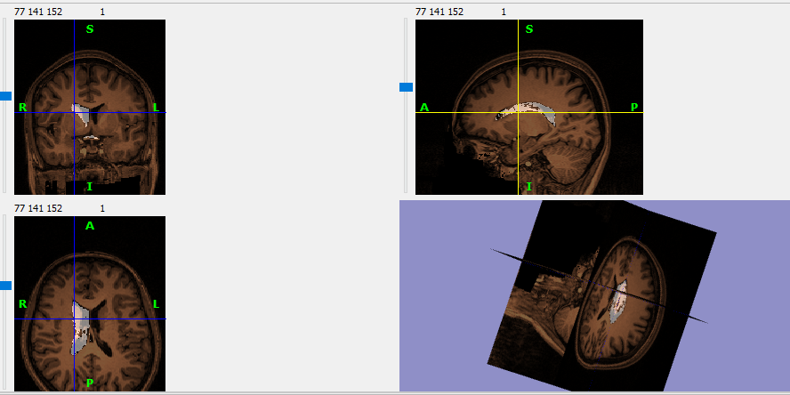
Outlier Detection(IQR) – 2523412_actual.nii.gz - Output

Slide 6
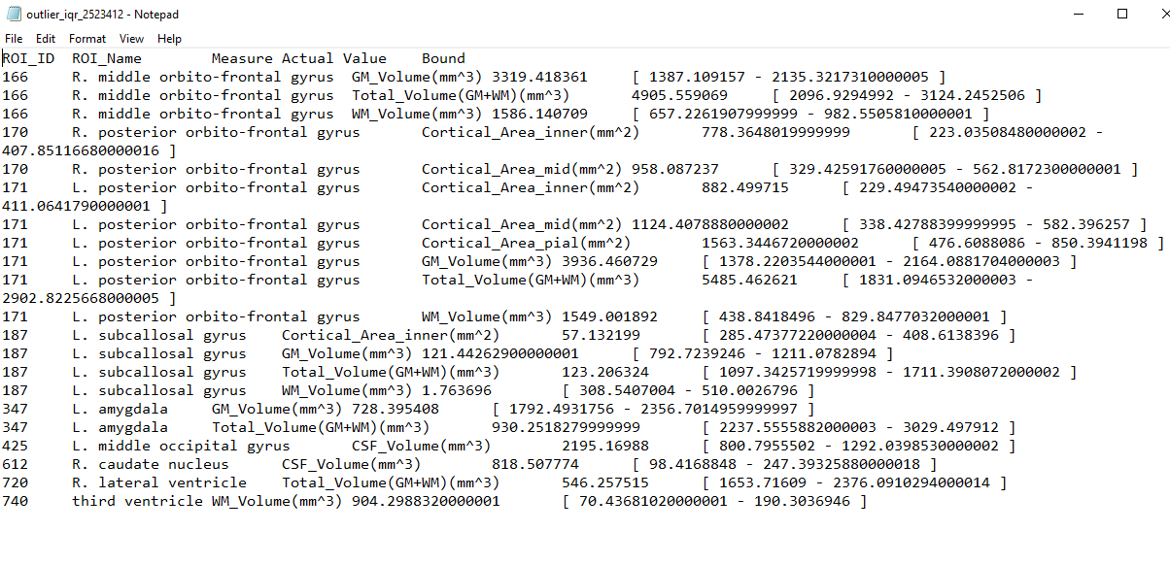
Outlier Detection(IQR) – 2523412_edited.nii.gz - Output

Slide 7
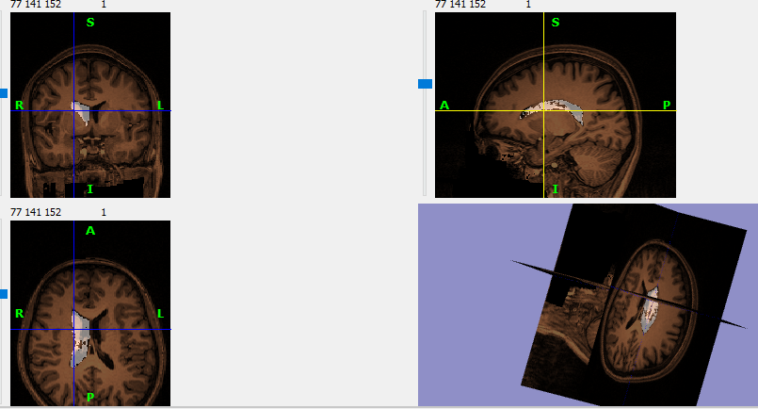
Outlier Detection(IQR) – 2523412_edited.nii.gz - Output

Slide 8
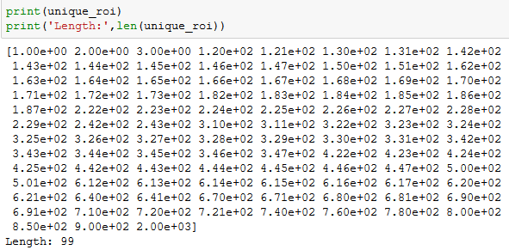
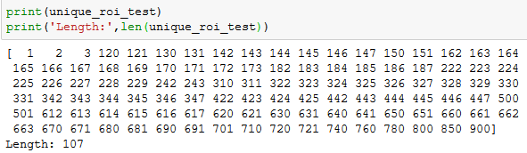
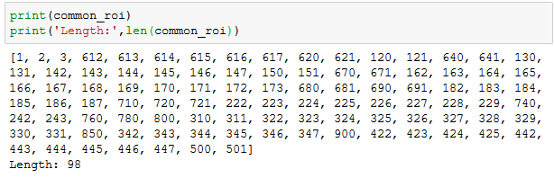
Outlier Detection - SVM
To find if a particular region is an outlier or not
Training data : all 170 subjects given in fcon1000_Beijing_zang_stats
Training data : contains 99 unique ROIs for all subjects
Test data : 2523412.roiwise.stats – sample file from BrainSuite , and its edited version
Test data : 107 unique ROIs
Take only the common ROI – helps in training

Slide 9
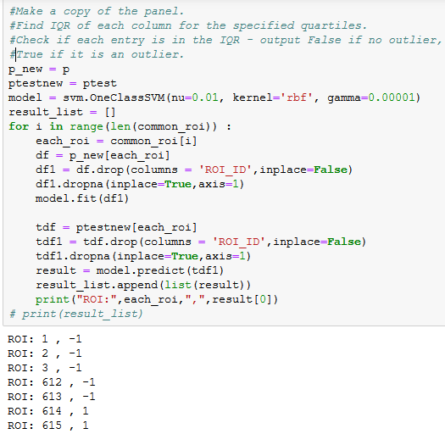
Outlier Detection - SVM
Train the model for each ROI across all subjects.
Test data : Check if that’s an outlier, for each ROI
Result = -1 → Outlier
Here for each measure, we can detect if that’s an outlier.
[Since there is only one test file]

Slide 10
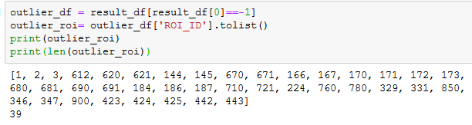
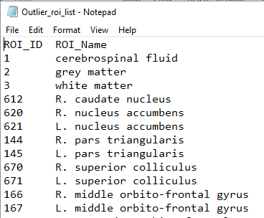
Outlier Detection - SVM
Store the outlier ROIs in a list or array
Write these values to a file
The values are checked, and converted back to the nii files using new_img_like function from nilearn

Slide 11
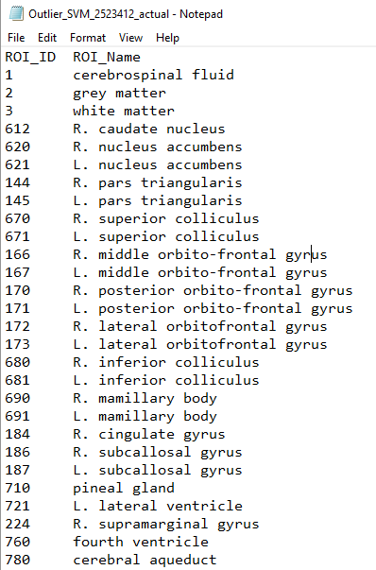
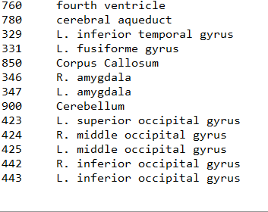
Outlier Detection(SVM) – 2523412_actual - Output

Slide 12
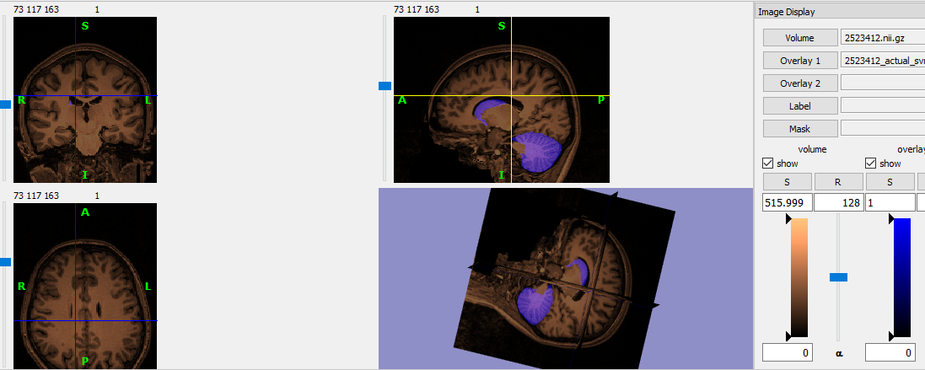
Outlier Detection(SVM)– 2523412.nii.gz - Output

Slide 13
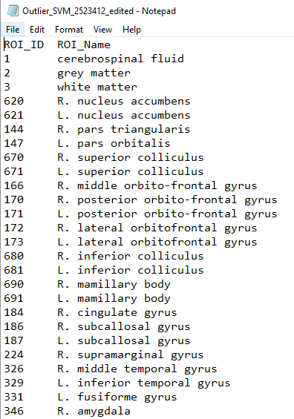
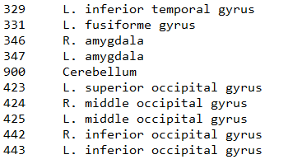
Outlier Detection(SVM) – 2523412_edited - Output

Slide 14
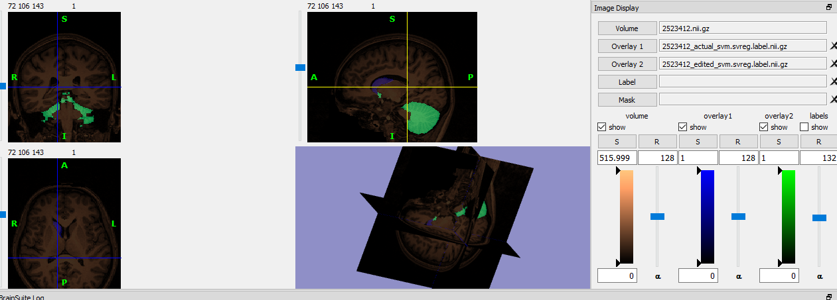
Outlier Detection(SVM)– 2523412_edited.nii.gz - Output

Slide 15

One class SVM - Understanding
Kernel
Degree
Gamma
Coef0
Tolerance
Nu
Shrinking
Cache size
Verbose
Maximum iterations
Random_state

Slide 16
One class SVM
Kernel (default = ‘rbf’)
Transformation method to another dimension
Could be linear, polynomial, rbf, sigmoid, precomputed or callable(to precompute kernel matrix)
Degree(default = 3, int, optional)
Applicable only if kernel is polynomial
Gamma (default = auto)
Kernel co – efficient for rbf, poly and sigmoid
Auto = 1/n_features
Coef0: float, optional (default=0.0)
Independent term in kernel function. It is only significant in ‘poly’ and ‘sigmoid’.
tol : optional, float
Tolerance for stopping criterion

Slide 17
One class SVM
nu (default = 0.5)
An upper bound on the fraction of training errors and a lower bound of the fraction of support vectors. Should be in the interval (0, 1].
shrinking :
Whether to use the shrinking heuristic.
cache_size : float, optional
Specify the size of the kernel cache (in MB).
verbose : bool, default: False
Enable verbose output; Takes advantage of a per-process runtime setting in libsvm that, if enabled, may not work properly in a multithreaded context.
max_iter : int, optional (default=-1)
Hard limit on iterations within solver, or -1 for no limit.
random_state : int, RandomState instance or None, optional (default=None)
Ignored.

Slide 18
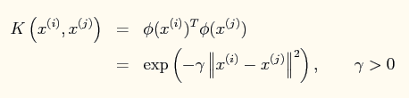
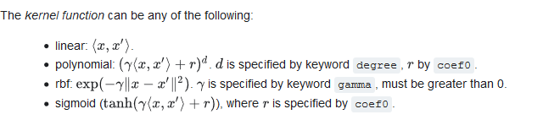
One class SVM
Kernels : linear, poly, rbf
Linear : to classify linearly separable data
RBF : Radial basis function, non – linearly separable data
Usually, C: parameter for soft margin cost function, wherein some examples could be placed on the other side of the margin ; emphasizes the effect of each support vector
Gamma : Parameter of the Gaussian RBF = inverse of Std Dev of Gaussian; small Gamma = large variance = more influence of SV
Increasing Gamma : leads to overfitting
Polynomial : A polynomial kernel.

Slide 19
Thank you!

