Slide 1


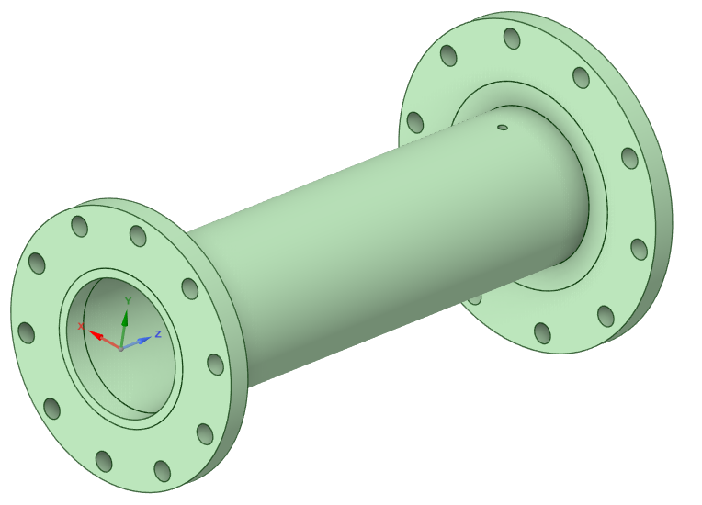
Forschung kompakt: Windenergie und Wasserstoff zusammen denken
17.06.2025
—
Calculation of Adapter to cardan shaft Adapter_Kupplung_20250304.wbpz
Deepak Petchimuthu
© Infografik: Fraunhofer IWES, Pictogramme: istock kadirkaba

Slide 2
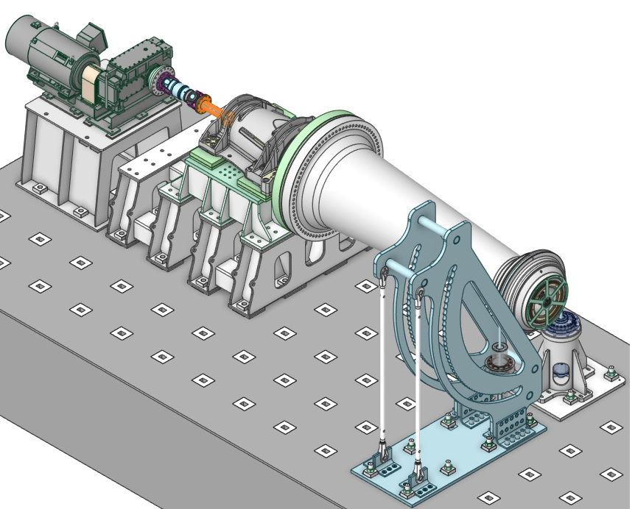
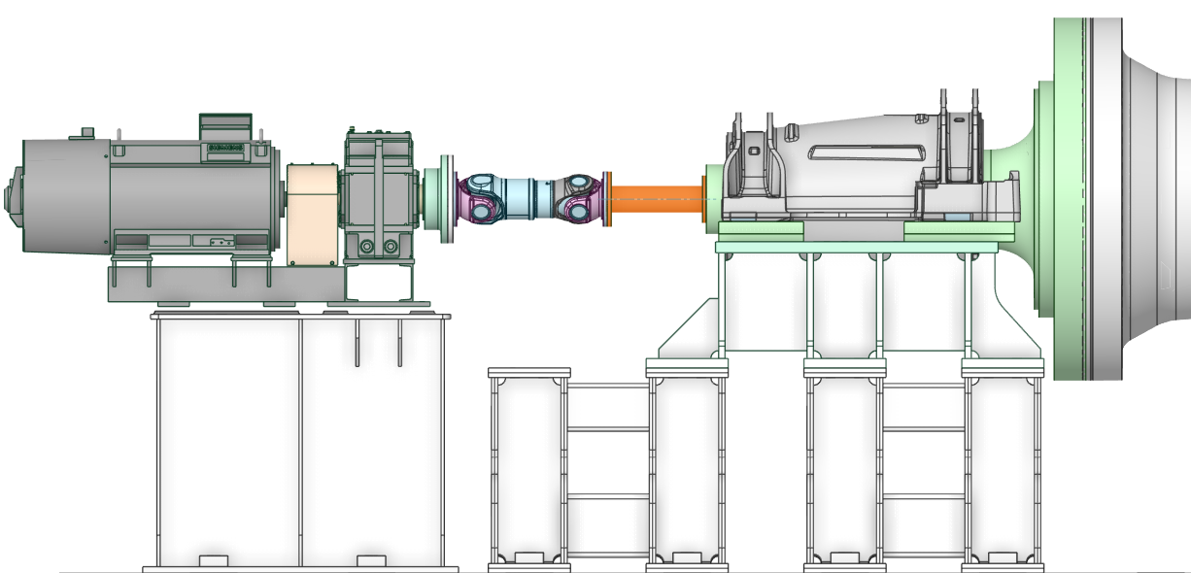
Adapter to cardan shaft
WEA-RiWa testbench setup
Connection of cardan shaft to main shaft
Transfer torque of the drive to the DUT
Supports the cardan shaft
Up to 1e6 cycles: 3x DUT’s with up to 300000 rotations

Slide 3
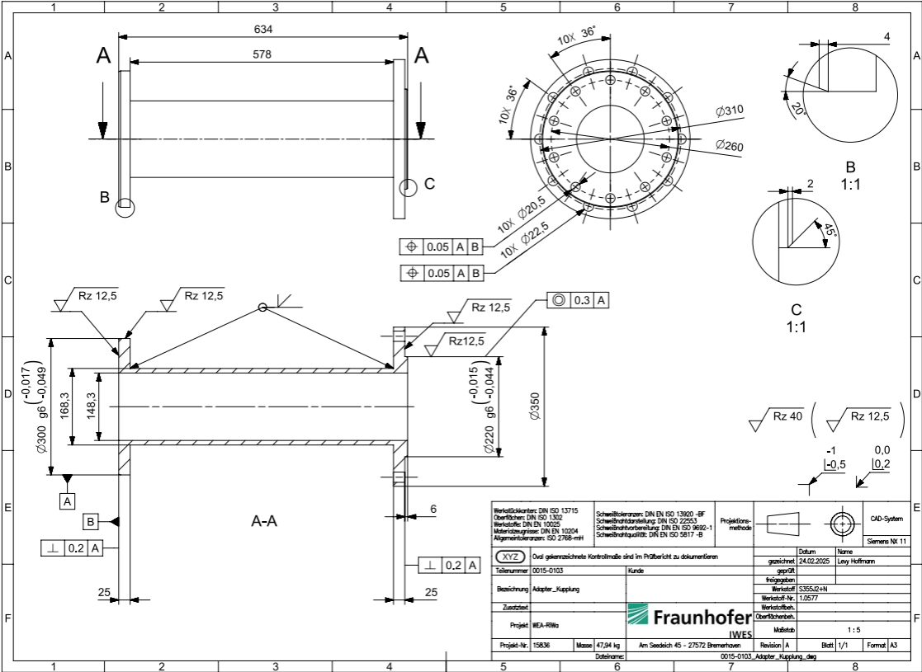
Adapter to cardan shaft
Geometry
Outer tube diameter 168,3 mm
Tube thickness 10 mm
Additional hole dia 10 mm in the tube

Slide 4
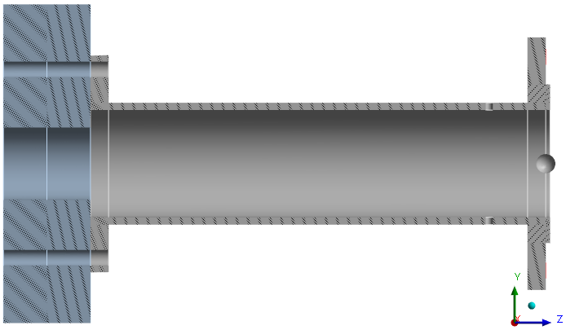
Adapter to cardan shaft
Bolt flange to main shaft
10x M20 10.9
Stress area: As = 244.8 mm² Stress diameter: ds = 17.65 mm P = 2.5
Pretension (90%,µ_{K/G}=0,12) F_{Mmax} = 185.8kN F_{Mmin} = 185.8kN / 1.4 = 132.7kN
Tightening torque = 592 Nm
Friction µ = 0.2 (steel to steel)

Slide 5
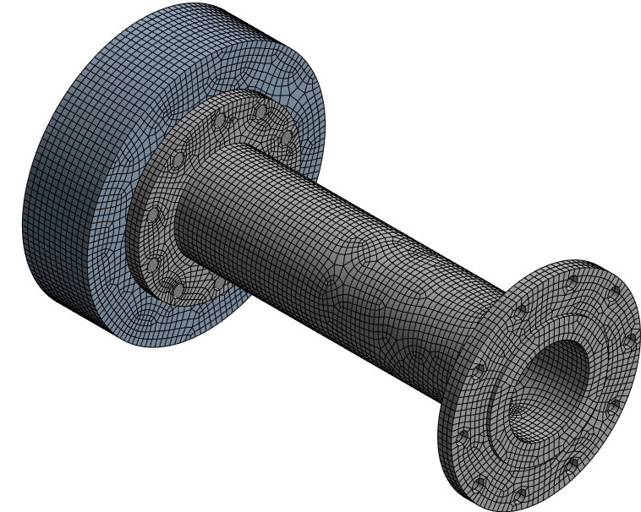
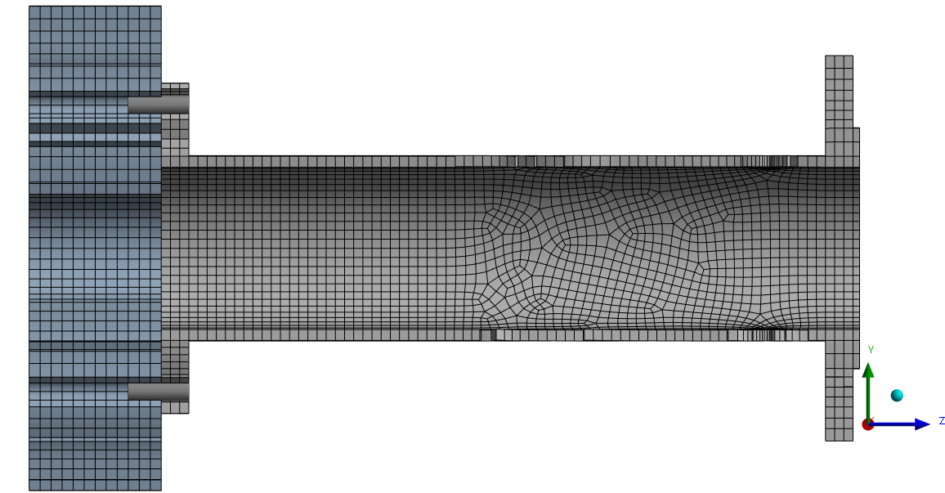
Adapter to cardan shaft
Mesh
Hex mesh (quadratic)
Average element quality: 0.93
128485 Nodes / 25127 Elements

Slide 6
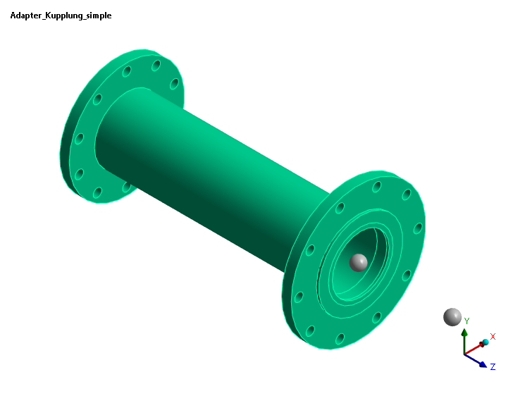
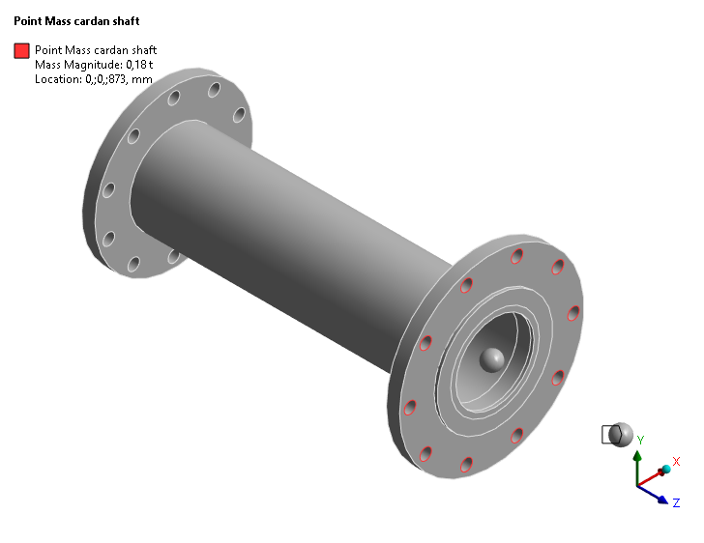

Adapter to cardan shaft
Masses added to the Adapter
Mass Adapter Mass cardan shaft Mass bolts
Half mass of cardan shaft 10x bolts M20x80 & nuts + 20x washer
→ 47.9 kg → 180 kg → 3.4 kg

Slide 7
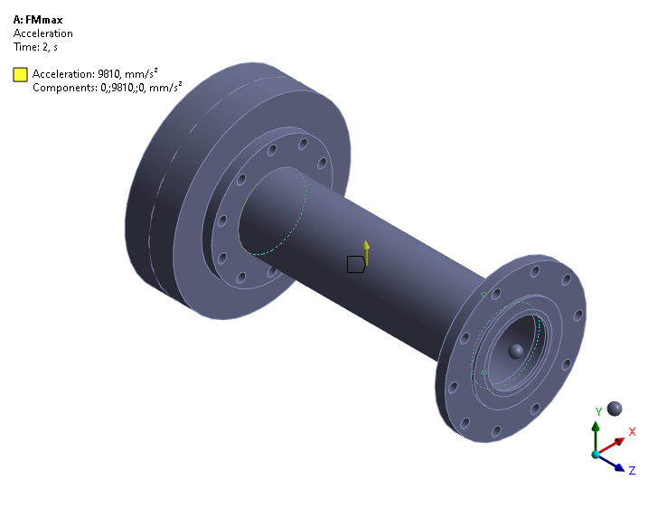

Adapter to cardan shaft
Boundary conditions
Fatigue case: LC 2 positive and LC 3 negative self weight
Backside fixed
in all cases

Slide 8
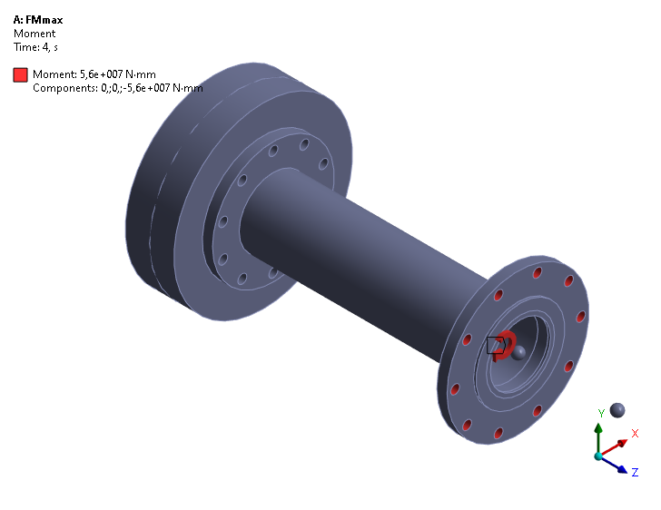
Adapter to cardan shaft
Boundary conditions
Extreme case: LC 4 Max. Torque load 56 kNm
Backside fixed
in all cases

Slide 9
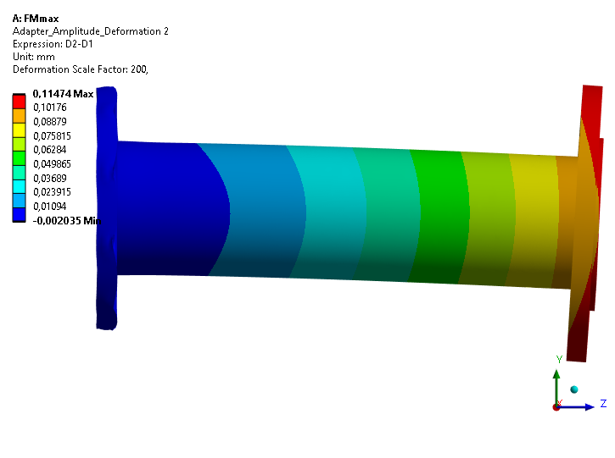
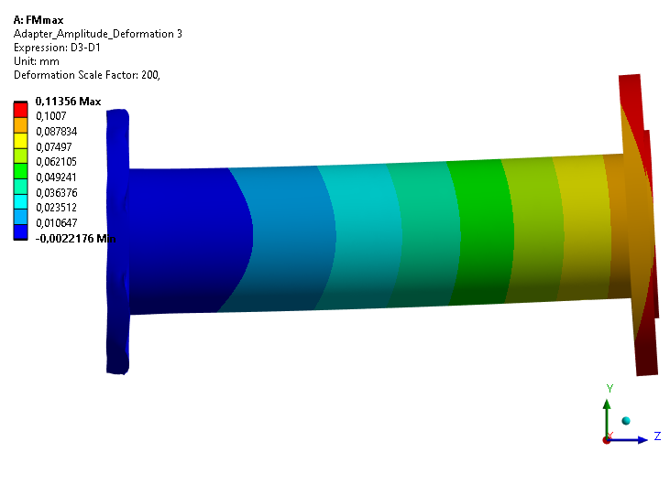

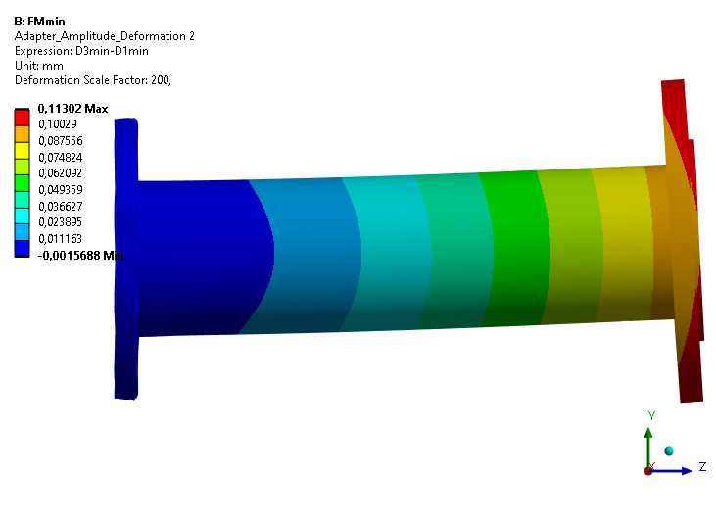
Adapter to cardan shaft
Fatigue Results LC 2 & 3
Deformation (pretension subtracted)

Slide 10
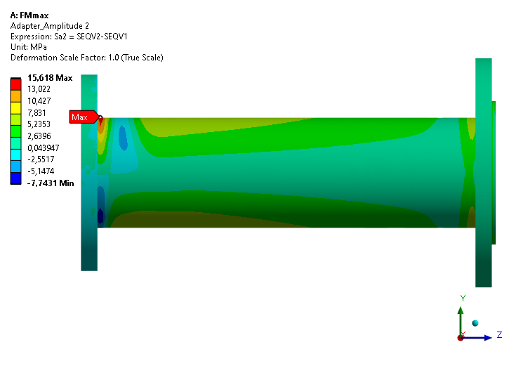
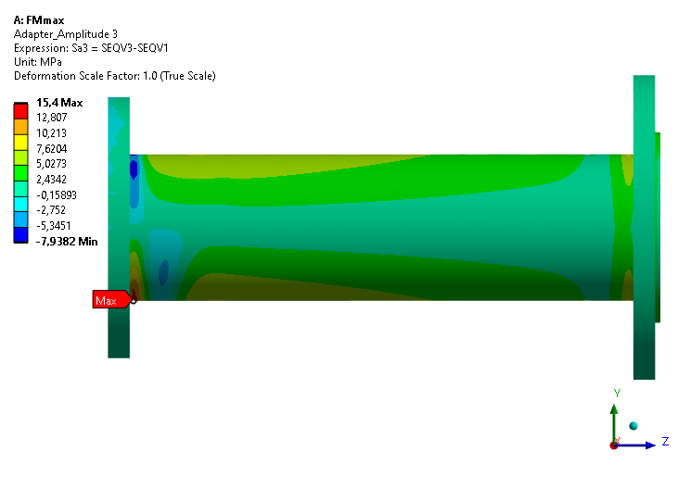
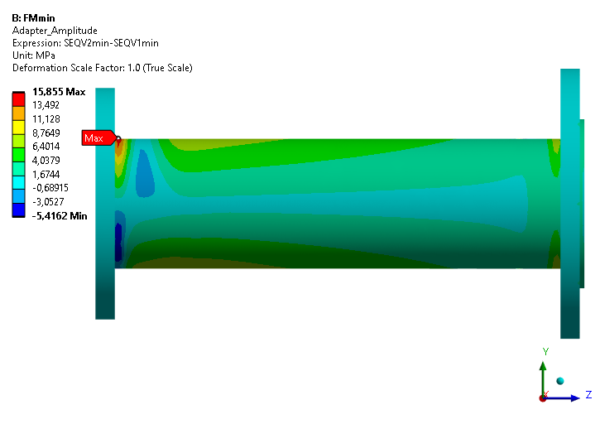
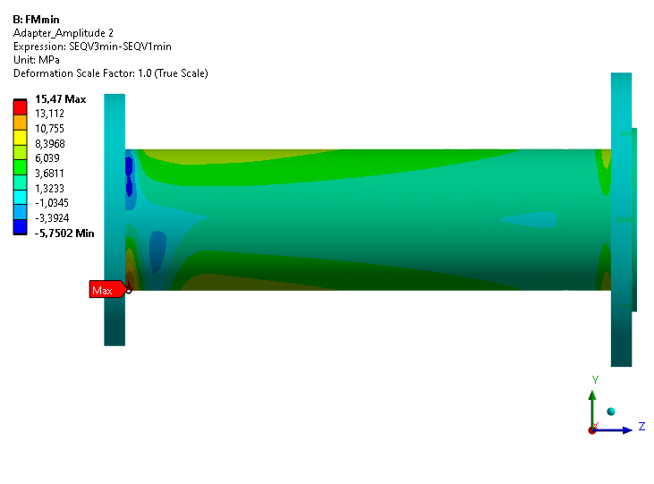
Adapter to cardan shaft
Fatigue Results LC 2 & 3
vonMises stress (pretension subtracted)

Slide 11
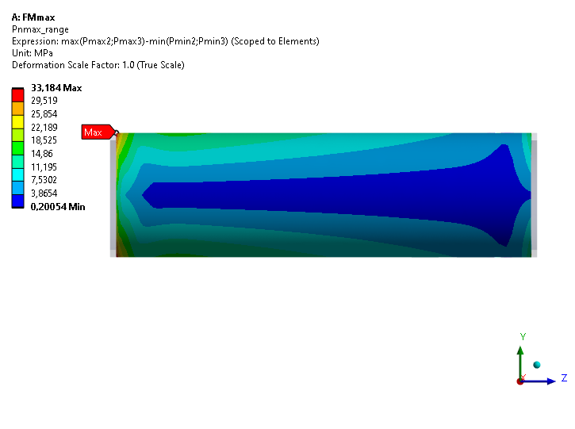
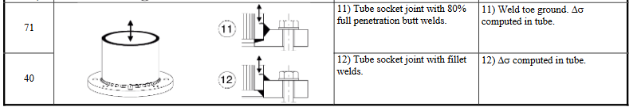

Adapter to cardan shaft
Fatigue Results
Principal stress range at tube (LCmax - LCmin)
→ 33.2MPa < 40 MPa (@2E6 cycles) acc. to DIN EN 1993-1-9:2010-12 table 8.5

Slide 12
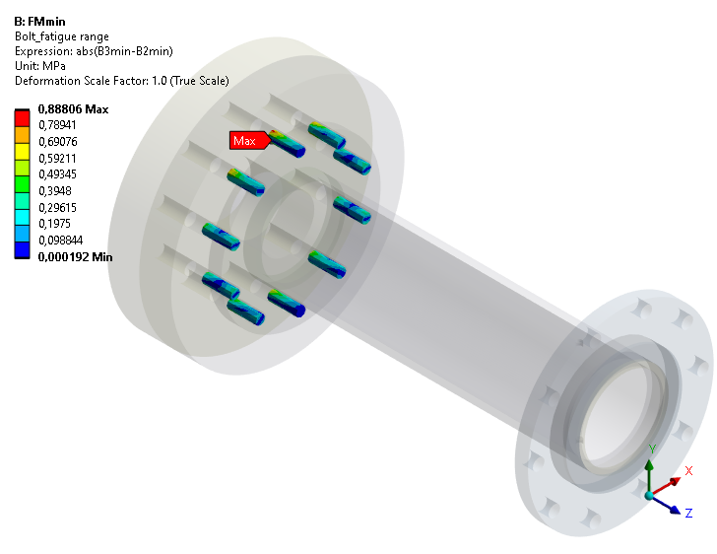
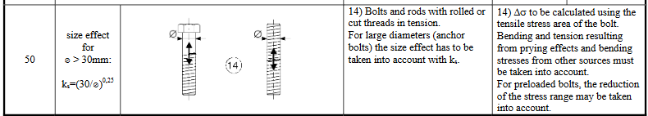
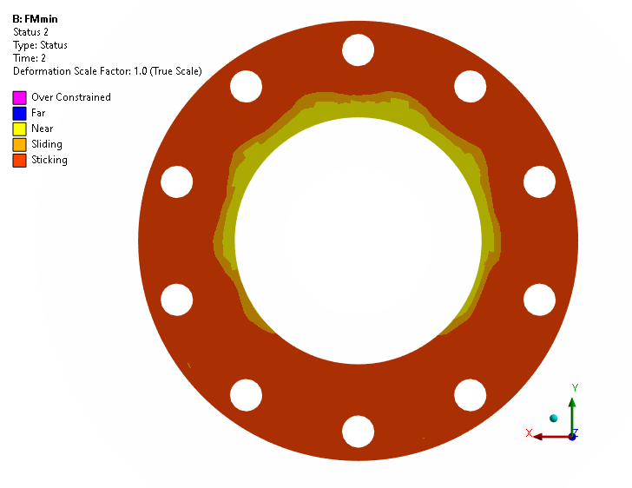
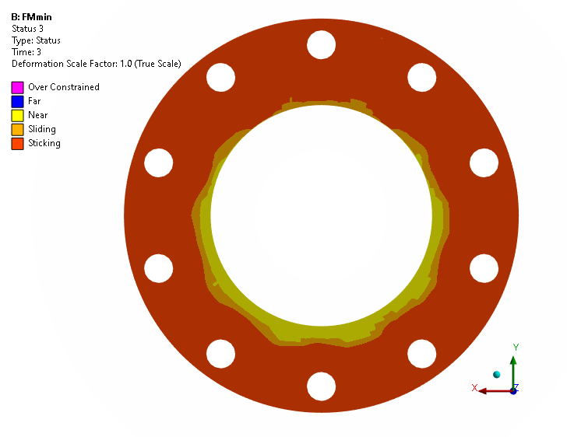
Adapter to cardan shaft
Fatigue Results
Bolt stress range (LC3 - LC2)
→ 1MPa < 50 MPa (@2E6 cycles) acc. to DIN EN 1993-1-9:2010-12 table 8.1
LC 2
LC 3

Slide 13
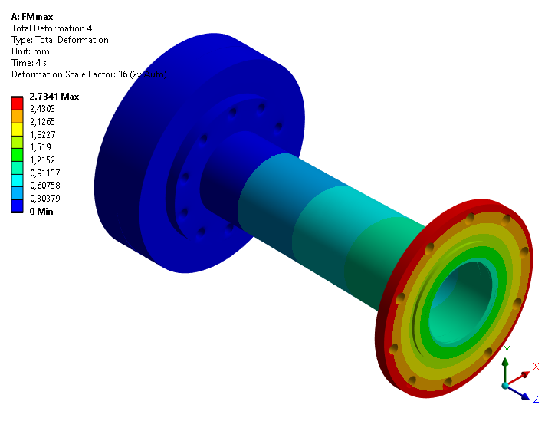
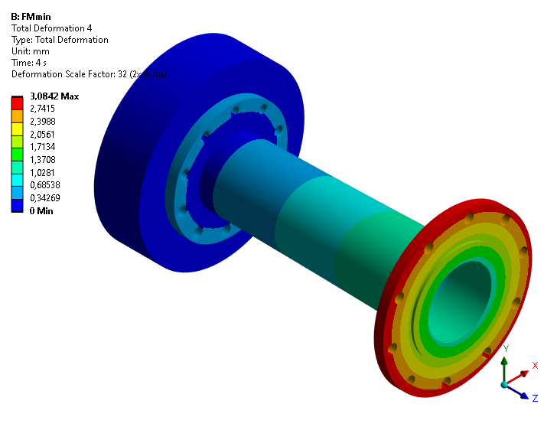
Adapter to cardan shaft
Extreme Results LC 4
Deformation
Sliding at full load!

Slide 14
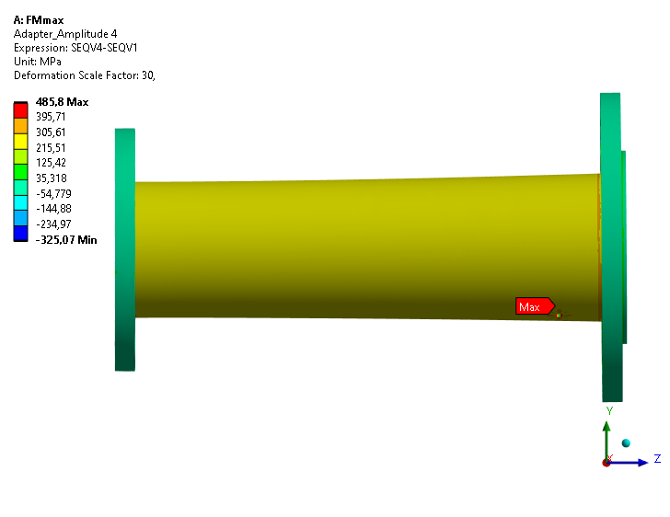
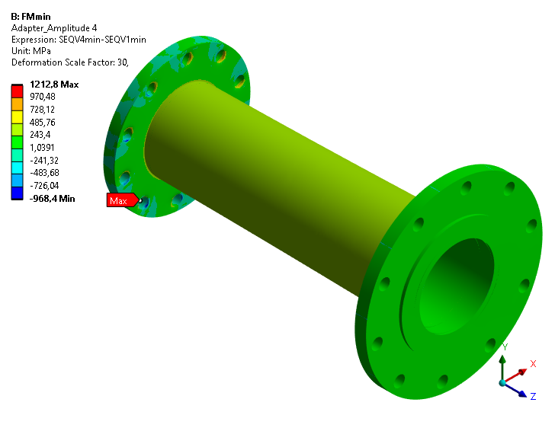
Adapter to cardan shaft
Extreme Results LC 4
vonMises stress (pretension subtracted)
Bolt overload at max load!

Slide 15
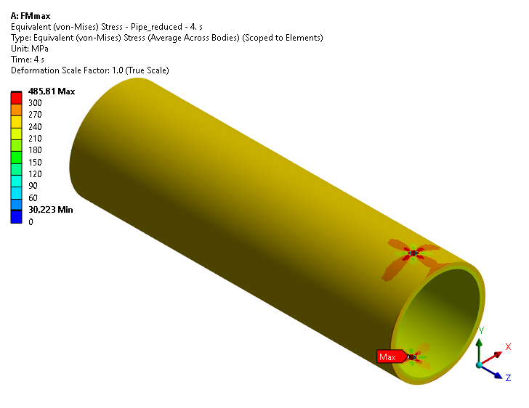

Adapter to cardan shaft
Extreme Results LC 4
vonMises stress (pretension subtracted)
→ tube stress at 262 MPa < 300 MPa (S355)
→ Holes in the tube are not recommended

Slide 16
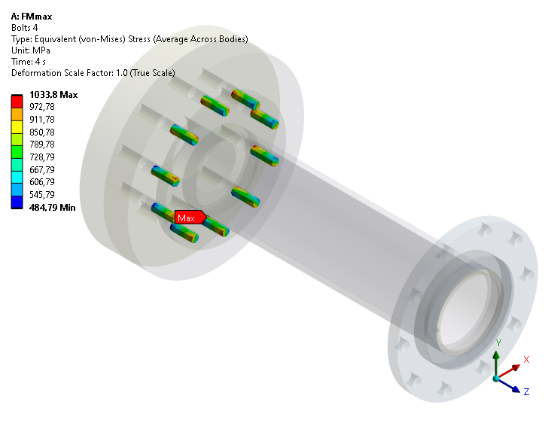
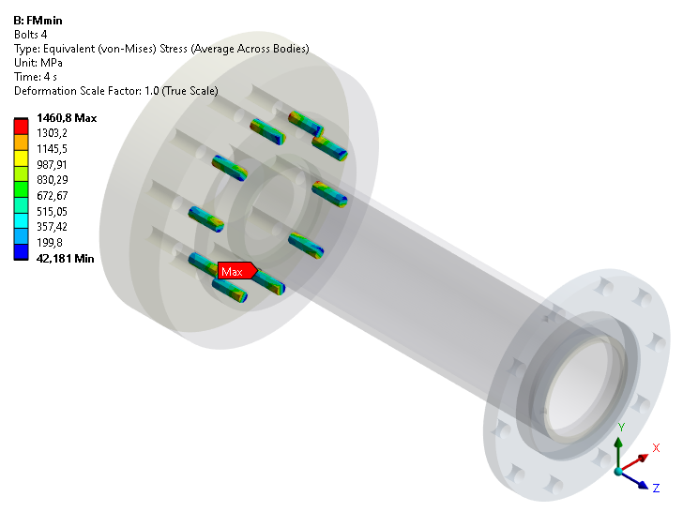
Adapter to cardan shaft
Extreme Results LC 4
Bolt stress range (LC4) < 940 MPa?
Bolts are overloaded at full load because of sliding in contact
Analytical check against sliding
Minimum pretension FMmin = 185.8kN / 1.4 = 132.7kN per bolt
Friction coefficient µ = 0.2
Bolt circle radius rb = 130mm
Number of bolts nb = 10
Max. Torque Tmax = FMmin * µ * nb * rb
Max. Torque Tmax = 132.7kN * 0.2 *10 * 0.13m
Max. Torque Tmax = 34.5 kNm

Slide 17
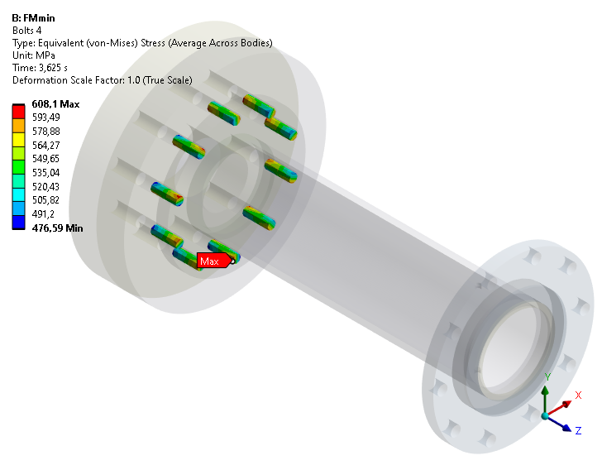
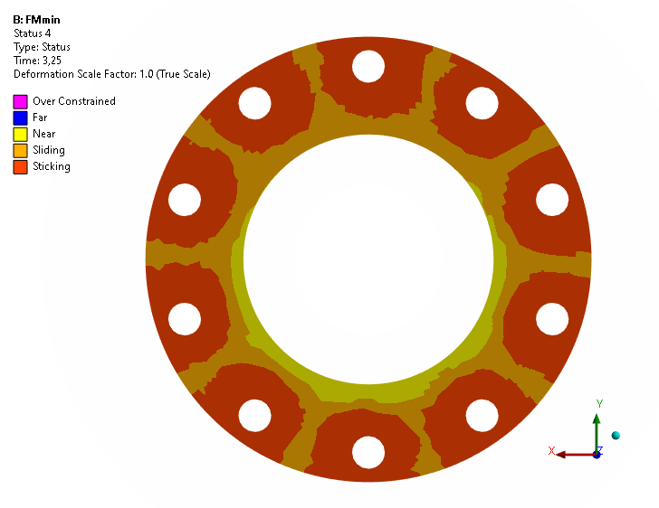

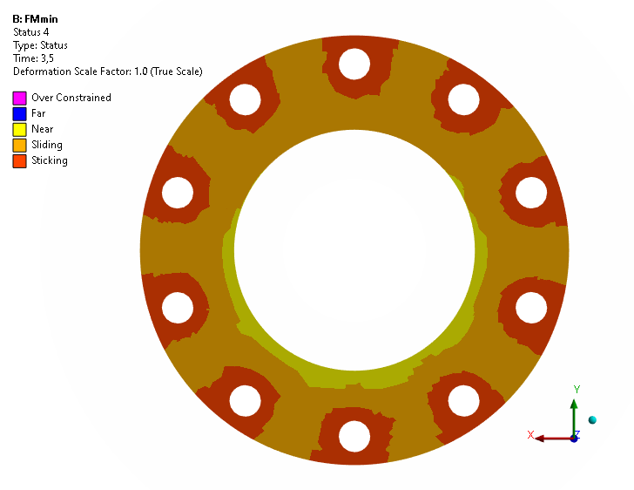
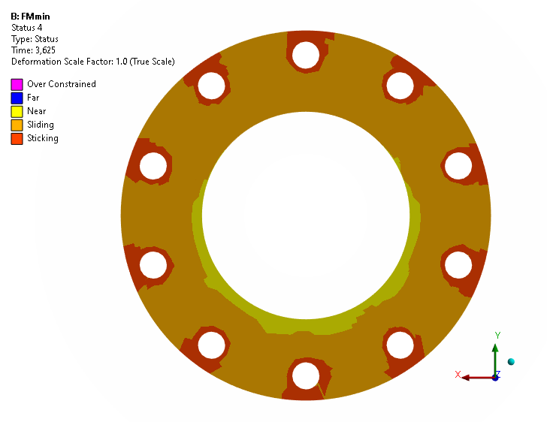
Adapter to cardan shaft
Extreme: Applicable Torque are limited due to bolts
Bolt stress range (LC4) < 940 MPa?
→ up to 35 kNm no sliding expected
Contact Status Sticking?
→ up to 35 kNm sticking around the bolts
→ Max. Torque load of 56 kNm can damage the bolts
Torque: 14 kNm
21 kNm
28 kNm
35 kNm

Slide 18
Adapter to cardan shaft
Conclusion
Fatigue utilization for 2e6 cycles:
tube/weld stress range utilization → 83%
Bolt stress range → 2%
Extreme (max. Torque = 56 kNm) utilization:
Tube/weld stress → 87% (without holes)
Bolt stress range → 155% → Torquelimit to 35 kNm
Bolt contact flange sliding → ≈160% → Torquelimit to 35 kNm
Extreme (Torquelimit = 35 kNm) utilization:
Tube/weld stress → 87% (without holes)
Bolt stress range → ≈100%
Bolt contact flange sliding → ≈100%
Notes:
Gusswelle wurde mit ~17,5kNm abgeschätzt. Wirkungsgrad für Pendel- und Zylinder-rollenlager liegt bei 98-99% und für Kegelrollenlager bei 97-98%.

Slide 19
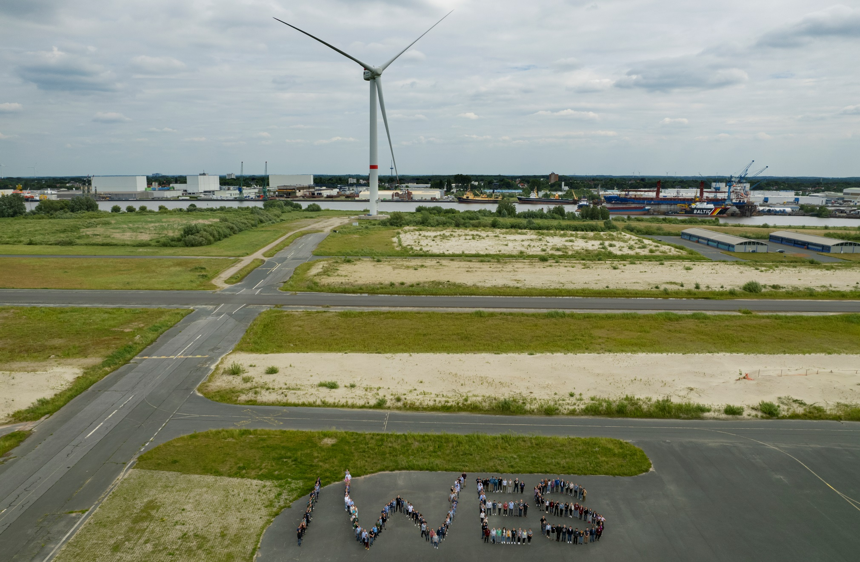
Vielen Dank für Ihre Aufmerksamkeit!
—
© Fraunhofer IWES/Frank Bauer

