Slide 1
Vision Based Automation of Sodium Disposal

Slide 2
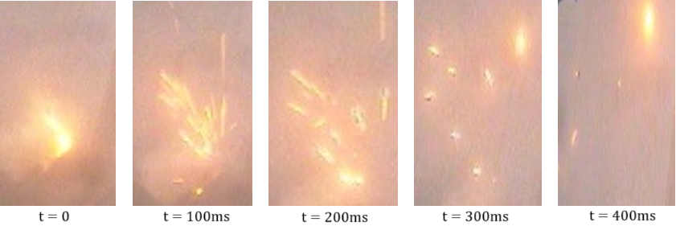



Problem Statement
Water
Supply
Na + H₂O = NaOH
+ H₂↑ + Heat
Pump
Hydrogen Ignition
Nozzle
Manual
Control
Sodium
1

Slide 3
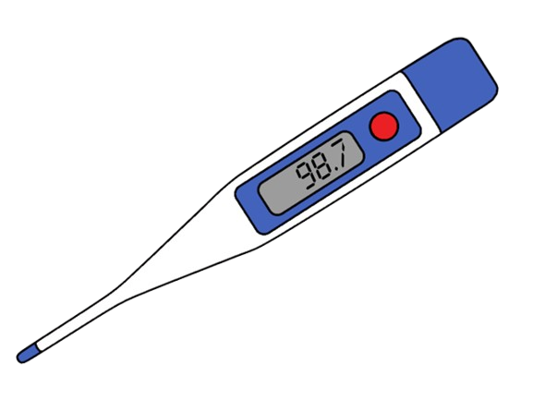
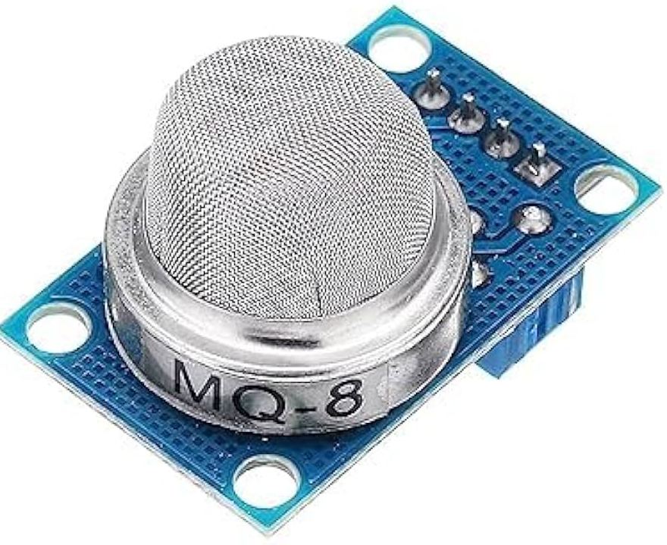

Approach
Hydrogen Sensor
Temperature Based
Vision Based
Captures Local Information
Suitable for emergency cutoff
Replicates human in the loop
Inefficient at higher temperatures
Dynamic Temperature Threshold
Faster Response
Slow Response Time
Slow Response Time
Requires Complex Hardware
1

Slide 4
Vision Based Approach
Raw Image
Advantages
Advantages
Simple and low cost solution
Raw Image
High performance
Image Pre processing
Image Pre processing
Suitable for dynamic environment
Background Subtraction
Limitations
Inherent Feature Extraction
Not adaptable to dynamic environment
ML Model
Feature Extraction
Limitations
Manual feature extraction
Data Hungry
Classification
Thresholding
Poor Performance
Manual labelling
Classification
1

Slide 5
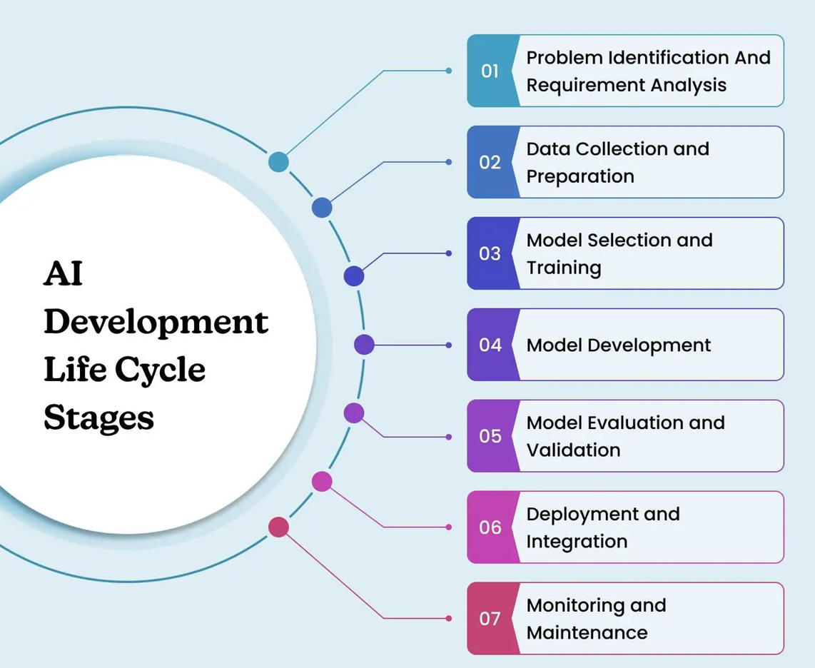
What is AI
Artificial Intelligence
Machine Learning
Neural Networks
Deep Learning
Generative AI
Large Language Models
1

Slide 6
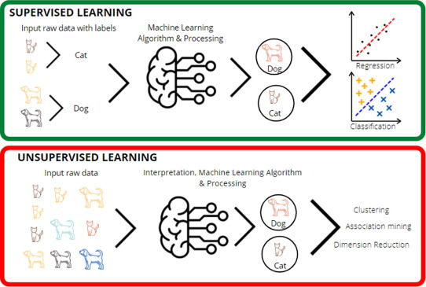
Machine Learning Approach
1

Slide 7
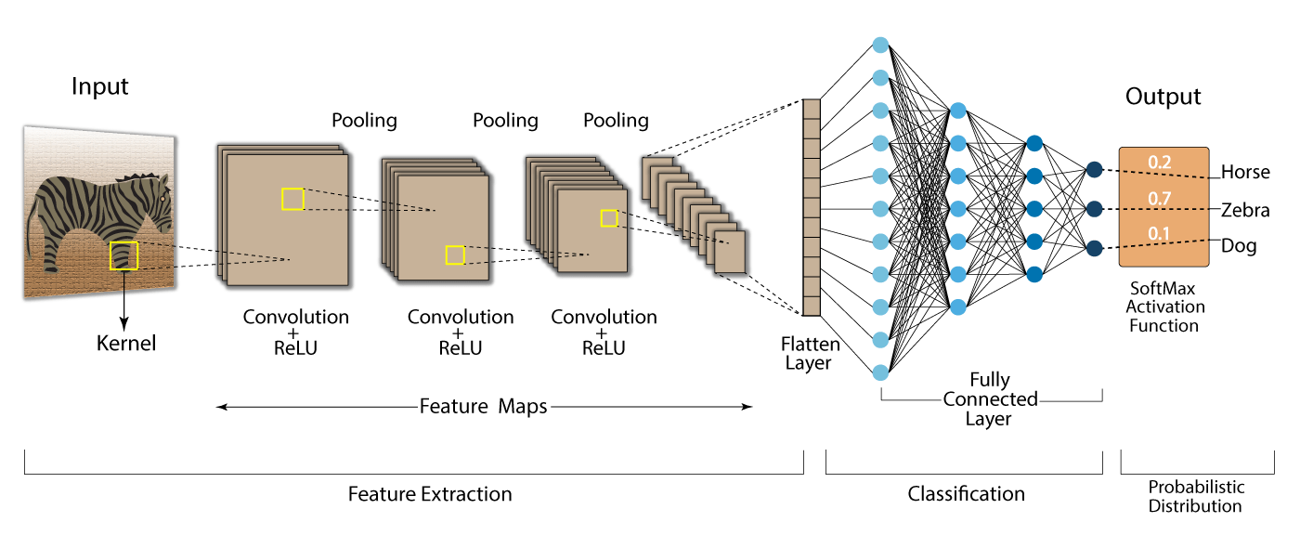
ML for Vision
X
W2
W1
W3
tanh
Y
1

Slide 8
Methodology
Start
Data Generation
Data Annotation
Image Pre-Processing
Model Training
Model Preparation
Tune Hyper-parameters
Performance?
Classification
Poor
End
1

Slide 9
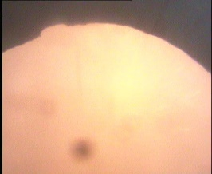
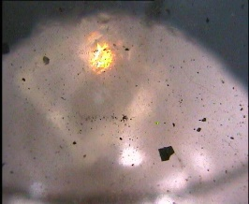
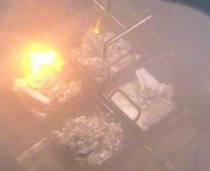
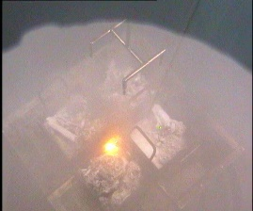
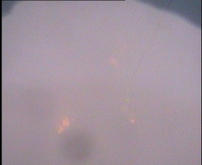
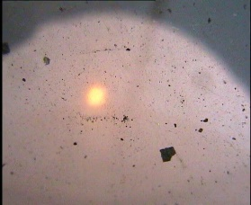
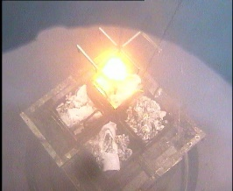
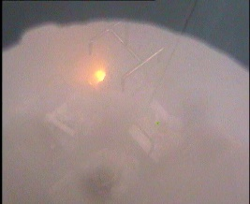
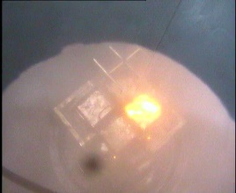
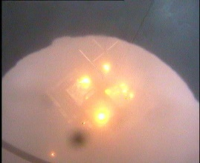
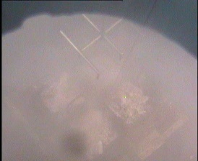

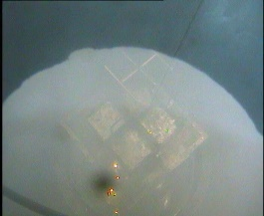
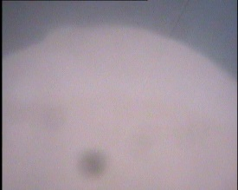

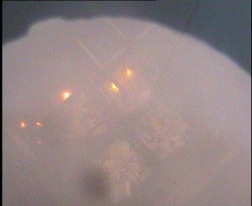
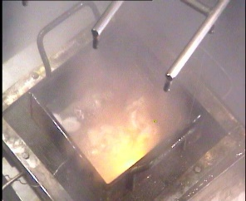
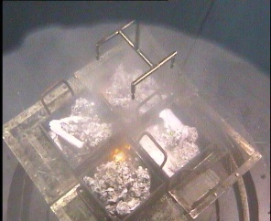


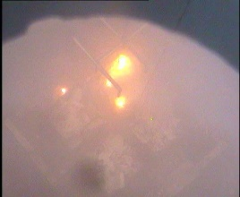
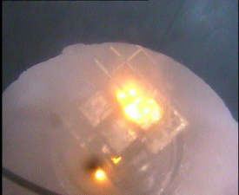
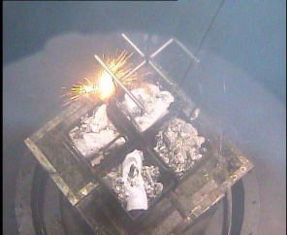
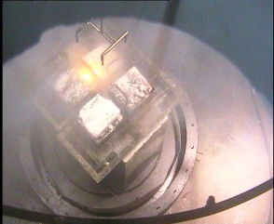
Experimental Data Collection
Fire Intensity
\
Fire Zones
Visibilities
Camera Colour
Multi Fire
Setup
1

Slide 10
CNN Approach
CNN
LSTM
Advantages
Challenges
Image
Is Sputtering?
Simple Training Loop
Big Classification Dataset for Training
Advantages
CNN
Feature Extraction
LSTM
Pre-Trained CNN
Image
Is Sputtering?
Big Classification Dataset not Required
1

Slide 11
Proposed Pipeline
Segmentation Model
Feature Extraction
Sequence Model
Detects Bounding Boxes
Extract Features
Process Sequence of masks
Extract Segmentation Masks
No. of Fire Zones, Fire Strength, BBox Area
Performs Classification
1

Slide 12
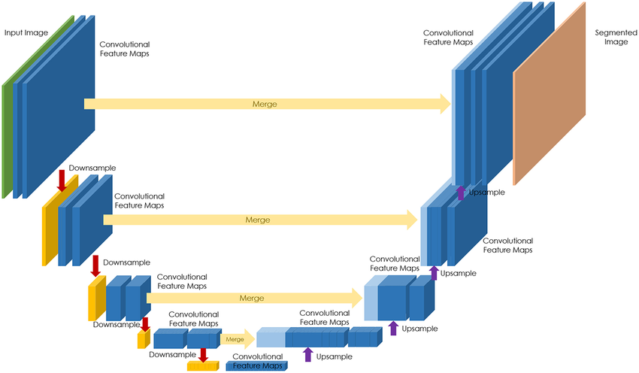
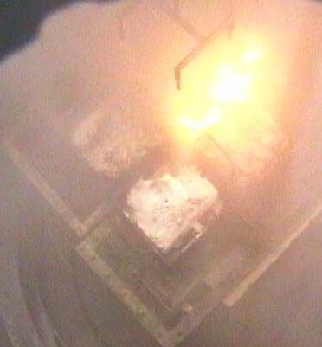

Segmentation Task : Model Architecture
1

Slide 13
Feature Extraction
Fire Zones Count
Visibility
Number of Fire Zones
Estimate the visibility level of image
Mask Area
Bounding Box Area
Average Mask Area of each fire zones
Average Area of each Bounding Boxes
D
Mask Centroids
Bounding Box Height
Average Centroid coords of all Masks
H
Average height of each Bounding Boxes
Centroid Distance
Bounding Box Width
W
Average distance between centroids
Average width of each Bounding Boxes
1

Slide 14
Sequence Model : Data Preparation
Sputtering Event
1 | 2 | 3 | 4 | 5 | 6 | 7 | 8 | 9 | 10 | 11 | 12 | 13 | 14 | 15 | 16 | 17 | 18 | 19 | 20 | 21 | 22 | 23 | 24 | 25 | 26 | 27 | 28 | 29 | 30
5 | 6 | 7 | 8 | 9 | 10 | 11 | 12 | 13 | 14
No Event
6 | 7 | 8 | 9 | 10 | 11 | 12 | 13 | 14 | 15
Event Triggered
7 | 8 | 9 | 10 | 11 | 12 | 13 | 14 | 15 | 16
Event Triggered
…
16 | 17 | 18 | 19 | 20 | 21 | 22 | 23 | 24 | 25
Event Triggered
17 | 18 | 19 | 20 | 21 | 22 | 23 | 24 | 25 | 26
No Event
1

Slide 15




Sequence Model : LSTM Architecture
Sequence of
Frames
LSTM
Model
Output
Hydrogen Sparks
…
0
LSTM
Cell
LSTM
Cell
LSTM
Cell
LSTM
Cell
1
t=n
t=n-1
t=n-2
t=0
FE
FE
FE
FE
…
1

Slide 16


Broader Applicability
Fire Detection
Sequence Modeling
Fire Breakouts
Video Captioning
Flame Analysis
Time series Analysis
Thermal Imaging
Video Analytics
1

Slide 17

Future Work
Explainable AI Techniques
Deployment
Redundant Systems
Diversified Systems
1

