Slide 1

Declarative-X
Exceptions & Condition handling in declarative way

Slide 2
Declarative Programming for
Exception handling
Conditions
….

Slide 3
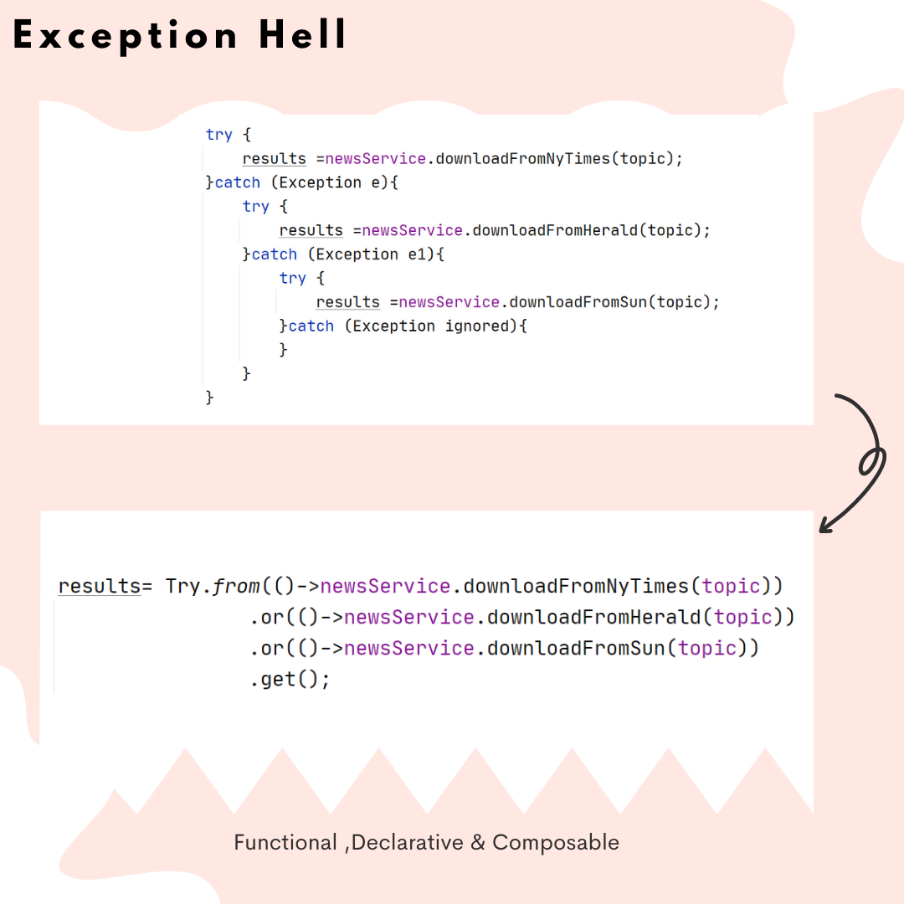

Slide 4
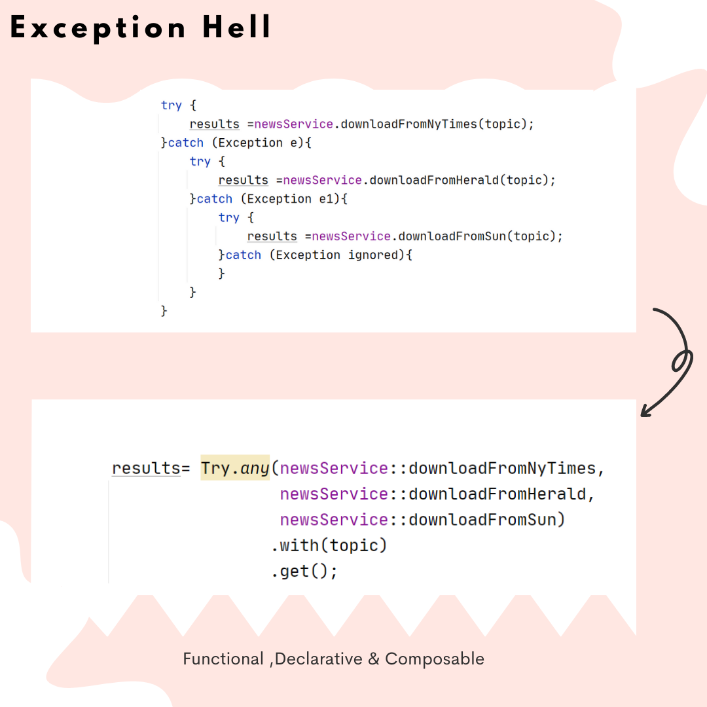

Slide 5
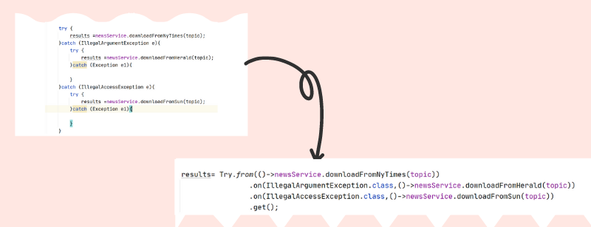

Slide 6
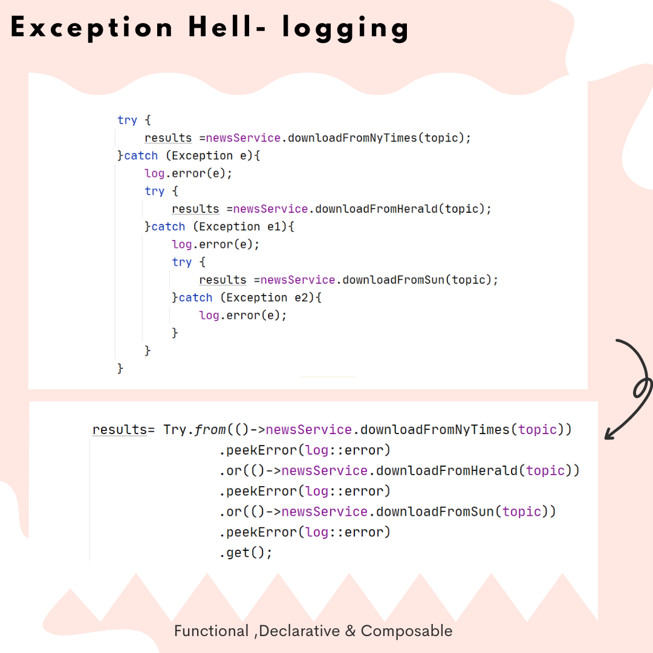

Slide 7
