Slide 1
O-Fetcher
Track Time Crawler

Slide 2
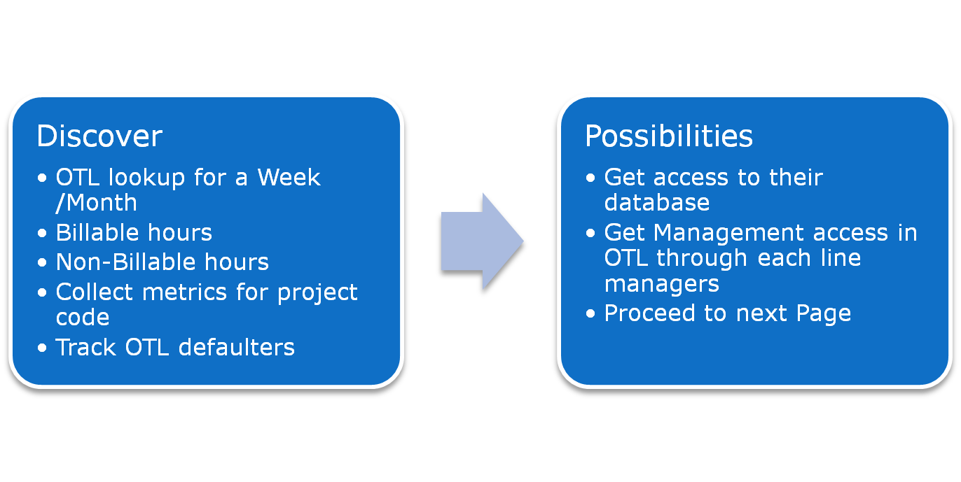
Overview

Slide 3
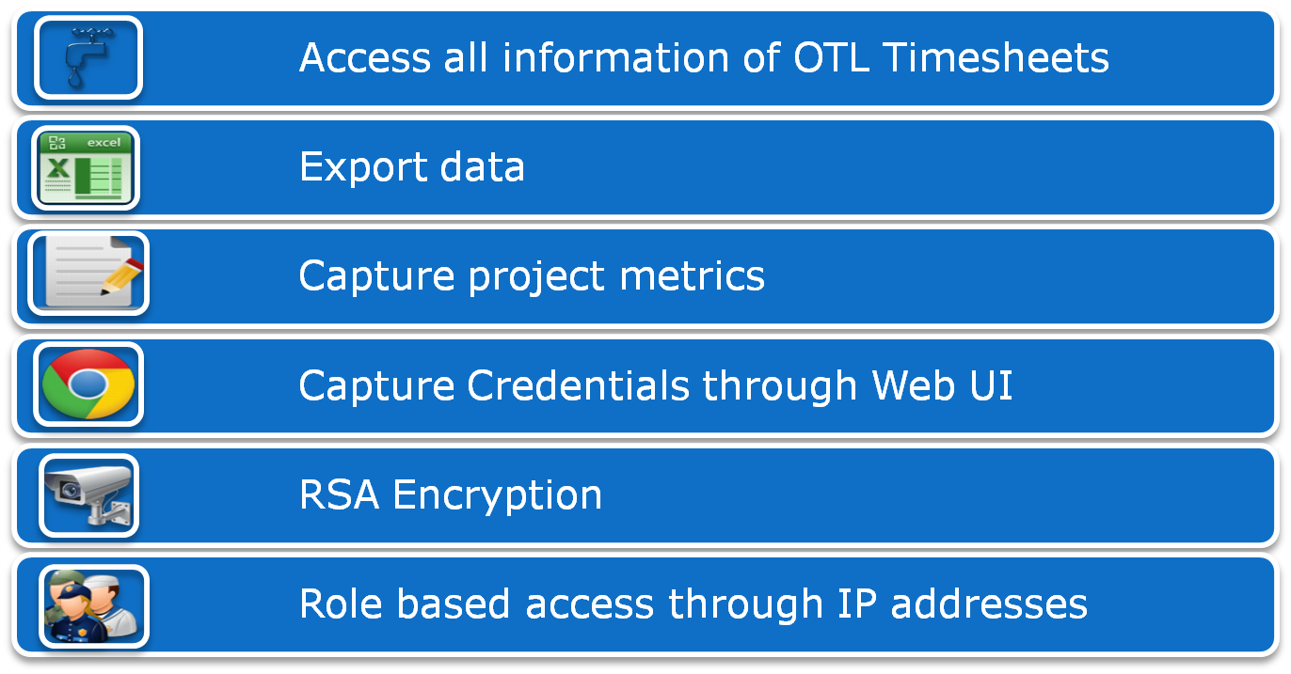
Features and Benefits

Slide 4
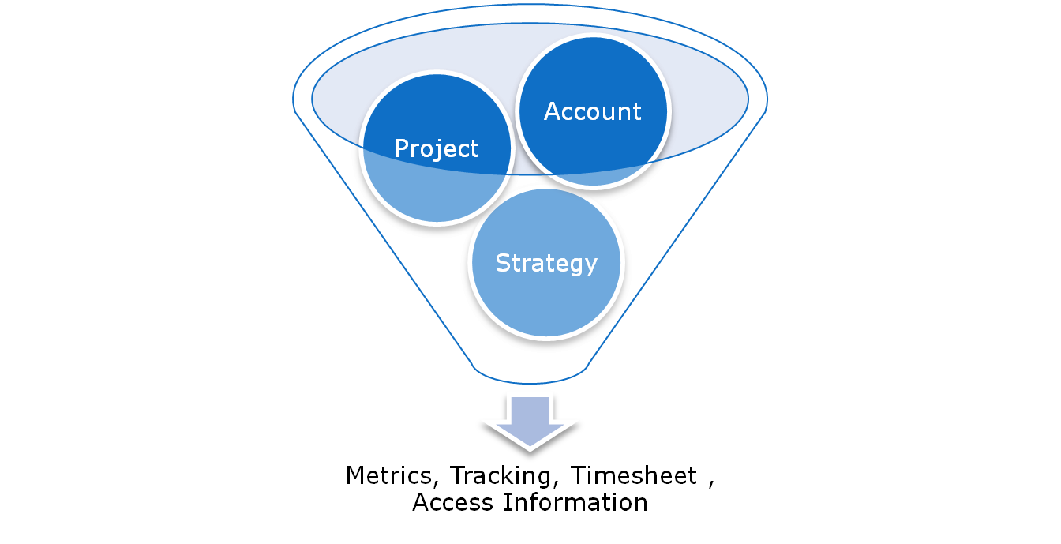
Applications

Slide 5

Architecture
Users
Admin
Embedded Server
REST Interface
Asynchronous
Crawler
Local File DB
OTL Site

Slide 6
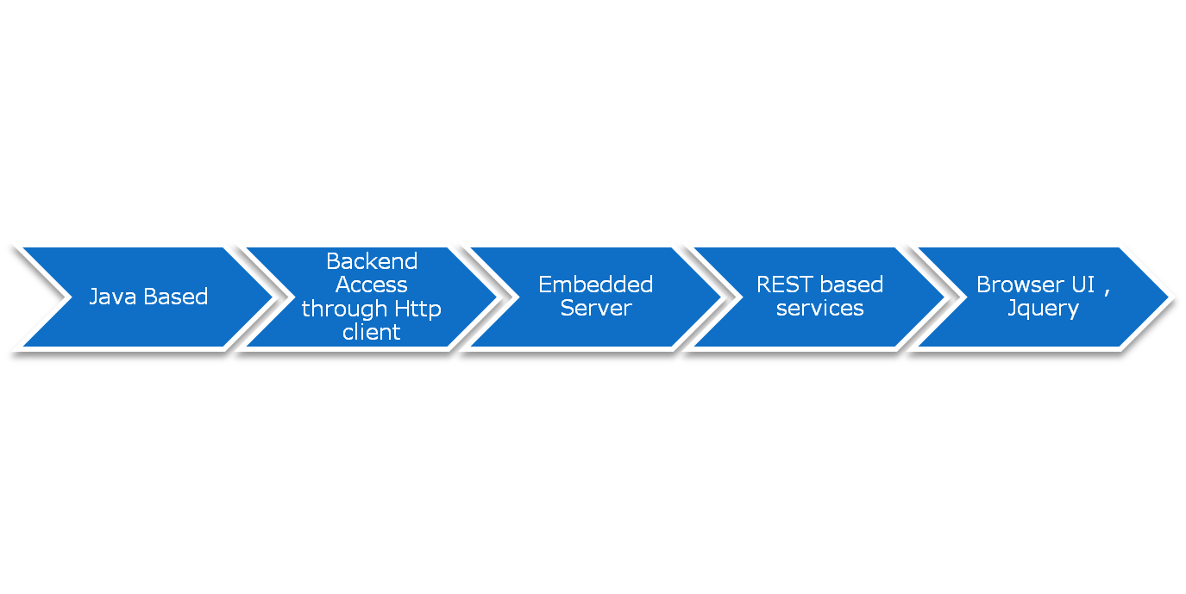
Specifications

Slide 7
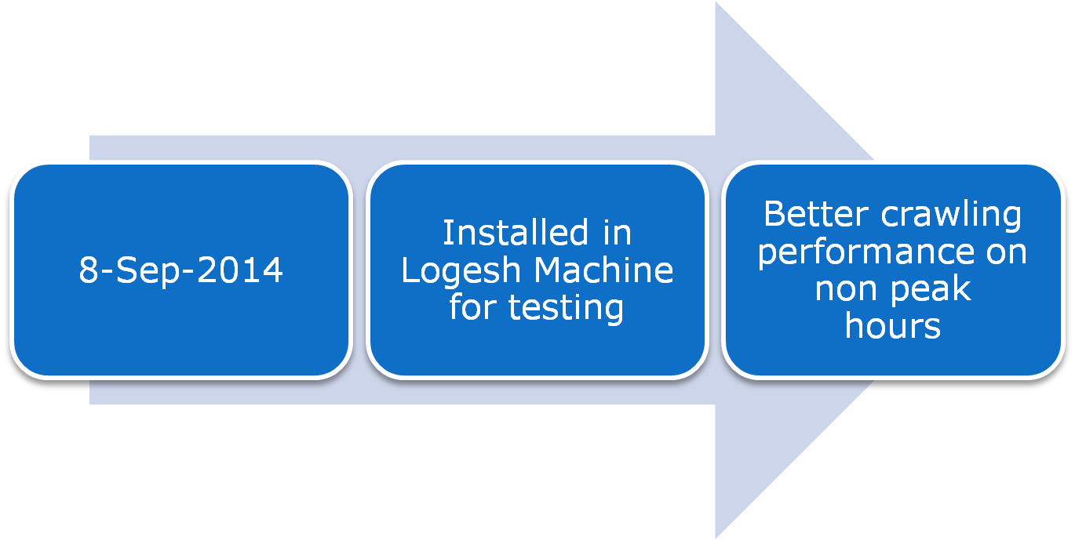
Availability

Slide 8
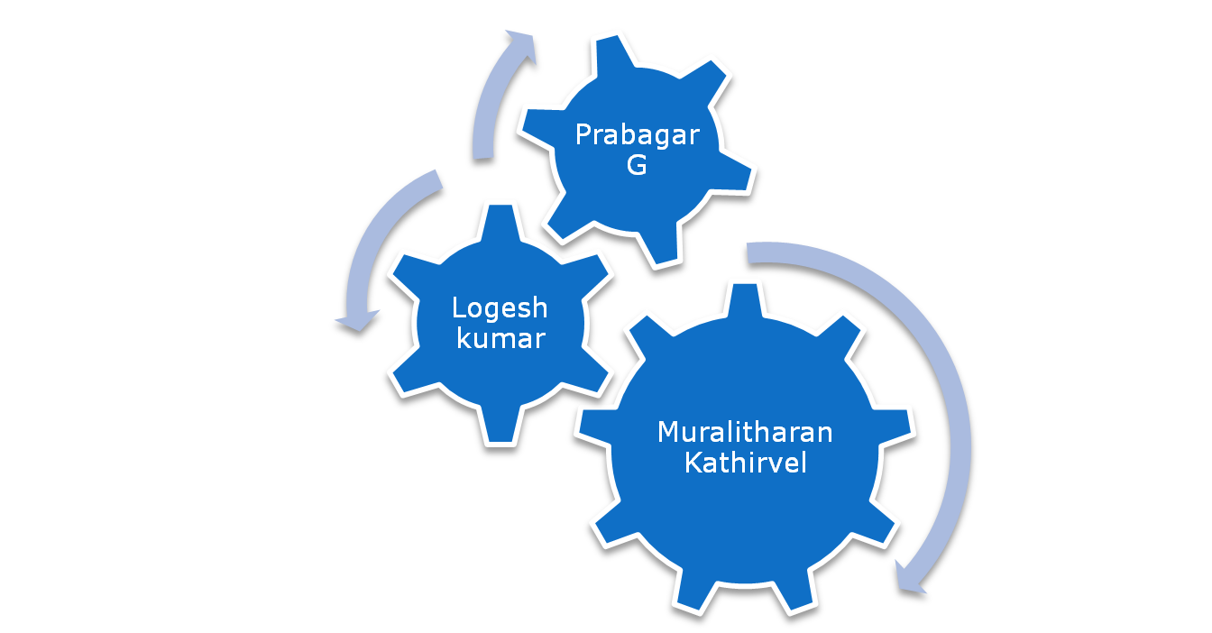
Special Thanks

Slide 9
Demo

