Slide 1

NEXT-GENERATION VERIFICATION PLATFORM
JOY TRUE PROFILE
Fast, Accurate & Direct Workforce Background Verification
A complete cloud platform that checks employee and vendor records directly from government and banking databases in under 45 seconds.
Developed & Operated by JOY Corporate Solutions Private Limited, Coimbatore.
JOY TRUE PROFILE
Direct Digital Verification Rail
Connecting HRs, Candidates & Vendors
⚡ Under 45 Seconds
Instant Government API Checks
🛡️ 100% Legal & Safe
Full DPDP Act 2023 Compliance
💰 Pay-Per-Use
Zero Advance Fees & Simple Pricing
JOY TRUE PROFILE • JOY CORPORATE SOLUTIONS PRIVATE LIMITED • CONFIDENTIAL
1 / 14

Slide 2
PROBLEM & PURPOSE
Purpose of This Project: Why We Built Joy True Profile
❌ THE OLD WAY OF CHECKING (SLOW & RISKY)
• Takes 15 to 20 Days: Long waiting times cause selected candidates to join competitors.
• Fake Certificates & Papers: Easy to fake relieving letters, salary slips, and photocopied IDs.
• Double Job (Moonlighting) Risk: No quick way to check if an employee is working two jobs simultaneously.
• Ghost Contractor Billing: Contractor agencies billing for fake workers who never worked on site.
• Heavy Monthly Advance Fees: Traditional agencies charge high fixed monthly retainer fees.
✔ THE JOY TRUE PROFILE SOLUTION (FAST & RELIABLE)
✔ Instant Sub-45 Second Checks: Connects directly to government and bank servers for real-time results.
✔ 100% Genuine Digital Proof: Tamper-proof PDF report with a scannable QR code to confirm authenticity.
✔ Automatic Double Job Alert: Checks PF records to instantly find overlapping employment histories.
✔ Labor Law Compliance (Form XVI): Matches gate entries with PF deposits to eliminate ghost contractor billing.
✔ Simple Pay-Per-Candidate Model: No setup fees, no monthly retainers. Pay only for verified profiles.
JOY TRUE PROFILE • JOY CORPORATE SOLUTIONS PRIVATE LIMITED • CONFIDENTIAL
2 / 14

Slide 3
CORE FEATURES
Features of JOY TRUE PROFILE: What the System Does
🆔 1. Identity Verification
🏦 2. Bank Account Test
🏢 3. PF & Job History Check
📱 4. Mobile Portal & DigiLocker
• Aadhaar OTP & instant demographic match
• PAN card verification with name match score
• Driving License and Vehicle RC check
• Passport verification for global roles
• ₹1 Penny Drop test via IMPS banking network
• Confirms exact registered account holder name
• Validates bank branch and active account status
• Eliminates salary transfer mistakes & fraud
• Direct EPFO Universal Account Number lookup
• Full employment timeline and company history
• Flags double employment & moonlighting
• Nationwide court and litigation record check
• 1-Click WhatsApp invite link with secure PIN
• Pulls original college degrees via DigiLocker
• 3D live camera selfie to match Aadhaar photo
• Certified PDF report ready to download
JOY TRUE PROFILE • JOY CORPORATE SOLUTIONS PRIVATE LIMITED • CONFIDENTIAL
3 / 14

Slide 4
END-TO-END PROCESS
Short Workflow of the Project: 5 Simple Steps
Step 1: HR Enters Candidate
HR enters candidate basic details or uploads an Excel sheet with 500+ candidates in one click.
Step 2: WhatsApp Link Sent
Candidate automatically receives a personal WhatsApp and SMS link with a secure 4-digit PIN.
Step 3: Candidate Verifies on Phone
Candidate opens the link, enters PIN, completes Aadhaar OTP, pulls DigiLocker degree, and takes a selfie.
Step 4: Sub-45s Instant Database Check
System instantly checks Aadhaar, PAN, Bank account, and PF job history directly from official servers.
Step 5: Download Certified PDF Report
HR downloads the official background verification dossier complete with corporate logo and scannable QR code.
JOY TRUE PROFILE • JOY CORPORATE SOLUTIONS PRIVATE LIMITED • CONFIDENTIAL
4 / 14

Slide 5
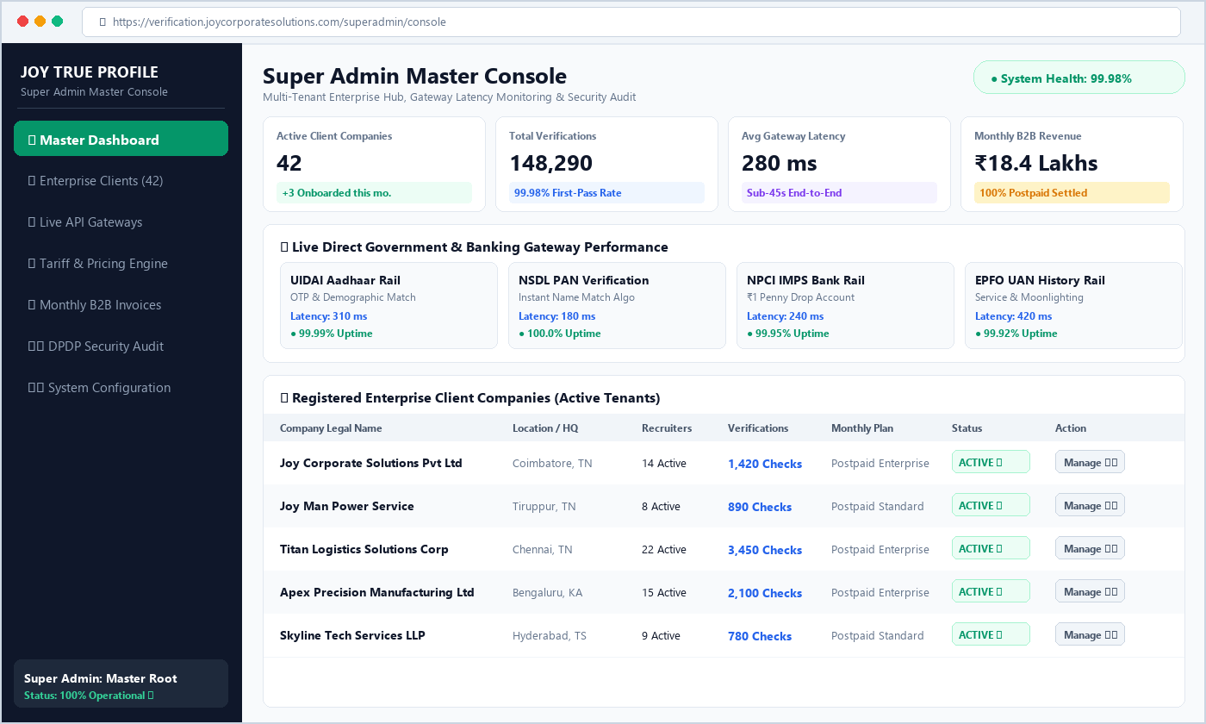
PORTAL ARCHITECTURE (1/5)
Portal 1: Super Admin Portal — Master Control Console
👑 SUPER ADMIN PORTAL — FEATURES & WORKFLOW
• Manage All Client Companies: Onboard client companies, verify CIN/GSTIN, and activate accounts.
• Live API Speed & Uptime Tracker: Real-time tracker for Aadhaar, PAN, Bank, and EPFO servers.
• Custom Pricing & Credit Setup: Set custom per-check tariffs and postpaid credit limits per company.
• Complete System Security Audit: Oversee platform activity, export logs, and DPDP compliance records.
⚙️ Super Admin Operational Workflow:
1. Add Company ➔ 2. Set Custom Price ➔ 3. Monitor Live API Speed ➔ 4. Oversee Monthly Invoices
🖥️ Live Super Admin Workstation View
Direct registry control center monitoring tenant enterprise client activations, gateway latency, and platform security.
JOY TRUE PROFILE • JOY CORPORATE SOLUTIONS PRIVATE LIMITED • CONFIDENTIAL
5 / 14

Slide 6
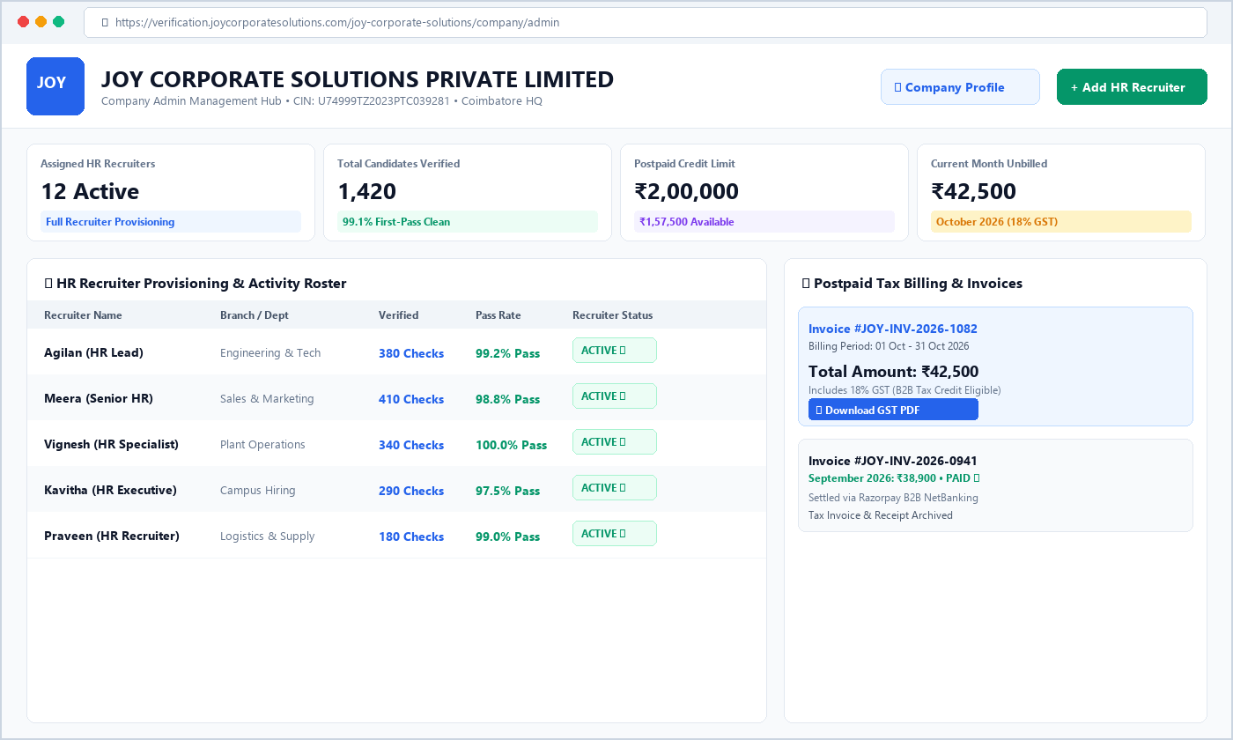
PORTAL ARCHITECTURE (2/5)
Portal 2: Company Admin Portal — Corporate Headquarters
🏢 COMPANY ADMIN PORTAL — FEATURES & WORKFLOW
• Company Profile & Logo: Upload corporate logo, manage office addresses, CIN, GSTIN, and company PAN.
• HR Recruiter Provisioning: Add and manage HR recruiters, allocate verification quotas, and configure recruiter access.
• Postpaid Monthly Billing: Dashboard showing verified candidates, pending balance, and monthly 18% GST tax invoices.
• Contractor Compliance Oversight: Monitor third-party contractor workforce registers and ensure full statutory labor compliance.
⚙️ Company Admin Operational Workflow:
1. Set Company Logo ➔ 2. Add HR Recruiters ➔ 3. Monitor All Candidate Checks ➔ 4. Pay Monthly 18% GST Bill
🖥️ Live Company Admin Console View
Executive management hub for HR team oversight, branch control, postpaid wallet monitoring, and 1-click tax invoice settlement.
JOY TRUE PROFILE • JOY CORPORATE SOLUTIONS PRIVATE LIMITED • CONFIDENTIAL
6 / 14

Slide 7
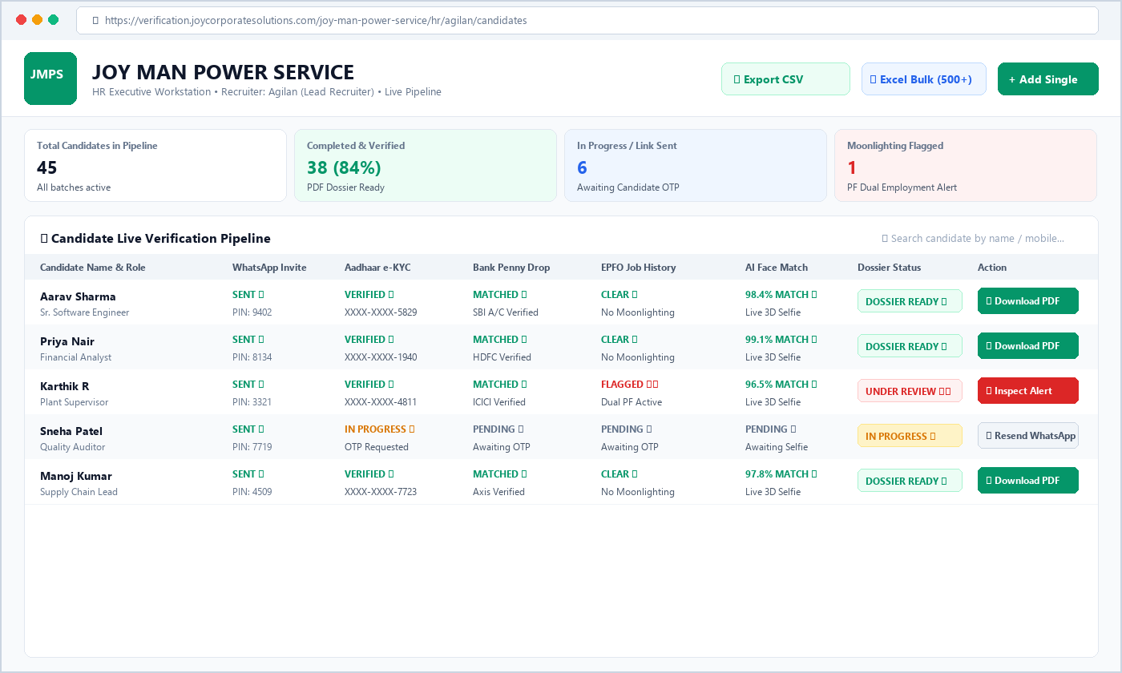
PORTAL ARCHITECTURE (3/5)
Portal 3: HR Executive Workstation — Recruiter Dashboard
👔 HR EXECUTIVE WORKSTATION — FEATURES & WORKFLOW
• Single & 500+ Excel Bulk Import: Enter candidate info individually or upload a batch of 500+ candidates using an Excel sheet.
• 1-Click WhatsApp Magic Links: Send invitation links via WhatsApp and SMS with automatically generated 4-digit security PINs.
• Live Candidate Progress Board: Track who has opened the link, who is filling the form, and whose checks are completed in real time.
• AI Photo & Face Matching: Compares candidate's live camera selfie with their official Aadhaar photo and shows match percentage.
• 1-Click Master PDF Dossier: Download the complete verified report stamped with company logo, QR code, and digital seal.
⚙️ HR Recruiter Daily Workflow:
1. Enter Candidate / Excel ➔ 2. Send WhatsApp Link ➔ 3. Watch Live Status ➔ 4. Download PDF Dossier
🖥️ Live HR Executive Workstation View
Recruiter pipeline with employer company branding, bulk actions, candidate status filters, and instant one-click dossier export.
JOY TRUE PROFILE • JOY CORPORATE SOLUTIONS PRIVATE LIMITED • CONFIDENTIAL
7 / 14

Slide 8
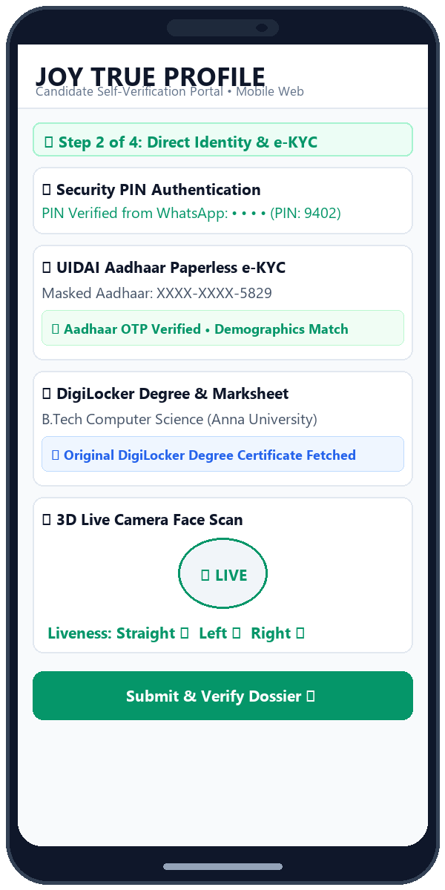
PORTAL ARCHITECTURE (4/5)
Portal 4: Candidate Portal — Frictionless Mobile Web App
📱 CANDIDATE PORTAL — FEATURES & WORKFLOW
• Zero Mobile App Install: Candidates open the link directly in their mobile browser without installing any app.
• 4-Digit PIN Security: Each candidate receives a personal PIN on WhatsApp to ensure only they can access their link.
• Aadhaar OTP e-KYC: Instant paperless identity verification with automatic number masking (XXXX-XXXX-1234).
• DigiLocker Degree Fetch: 1-Click connect to DigiLocker to pull verified 10th/12th marksheets, degrees, and licenses.
• 3D Camera Selfie Scan: Takes front, left, and right camera photos to confirm the person is real and prevent fake photos.
⚙️ Candidate 2-Minute Onboarding Flow:
1. Open WhatsApp Link ➔ 2. Enter 4-Digit PIN ➔ 3. Enter Aadhaar OTP ➔ 4. Take Selfie & Submit
📱 Frictionless Mobile Web App: 4-Digit PIN, Aadhaar e-KYC & 3D Selfie
JOY TRUE PROFILE • JOY CORPORATE SOLUTIONS PRIVATE LIMITED • CONFIDENTIAL
8 / 14

Slide 9
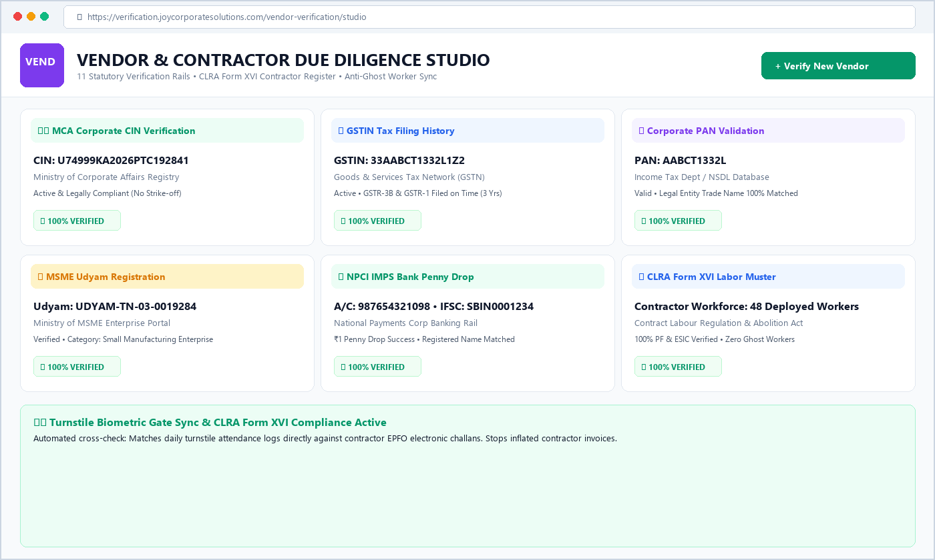
PORTAL ARCHITECTURE (5/5)
Portal 5: Vendor & Contractor Portal — CLRA Compliance
🤝 VENDOR & CONTRACTOR DUE DILIGENCE — FEATURES
• Vendor Legal Checks: Checks vendor Ministry of Corporate Affairs CIN, GSTIN status, Corporate PAN, and MSME registration.
• ₹1 Bank Account Test: Penny drop check confirms the vendor's bank account name exactly matches their trade legal name.
• CLRA Form XVI Labor Register: Generates government-approved Contract Labor (Regulation & Abolition) muster automatically.
• Anti-Ghost Worker Sync: Matches deployed factory workers against active PF/ESIC records to stop fraudulent billing.
⚙️ Vendor Due Diligence Workflow:
1. Enter Vendor GSTIN ➔ 2. Direct Legal & Bank Check ➔ 3. Audit Contractor Workers ➔ 4. Export Due Diligence PDF
🖥️ Live Vendor Verification Studio View
Automated statutory audit studio checking contractor legal authenticity, bank solvency, and contract labor compliance.
JOY TRUE PROFILE • JOY CORPORATE SOLUTIONS PRIVATE LIMITED • CONFIDENTIAL
9 / 14

Slide 10
COMPARISON MATRIX
How JOY TRUE PROFILE is Different & Better
Key Area | Old Traditional BGV Agencies | JOY TRUE PROFILE (Direct Rail)
Verification Speed | ❌ 15 to 20 Days (Manual phone calls) | ✔ Under 45 Seconds (Direct database query)
Data Accuracy | ❌ High error rate from manual paper checks | ✔ 100% Genuine (Direct Government & Bank APIs)
Double Job (Moonlighting) | ❌ No check available (Zero PF visibility) | ✔ Smart Live PF Check (Flags active double jobs)
Report Security | ❌ Static PDF (Easy to manipulate) | ✔ Tamper-Proof PDF + Scannable QR Code
Contractor Labor Check | ❌ Manual paper records with ghost workers | ✔ Automated Form XVI Register & Gate Sync
Commercial Pricing | ❌ Expensive advance retainers & lock-ins | ✔ 100% Pay-Per-Use with 18% GST Invoice
JOY TRUE PROFILE • JOY CORPORATE SOLUTIONS PRIVATE LIMITED • CONFIDENTIAL
10 / 14

Slide 11
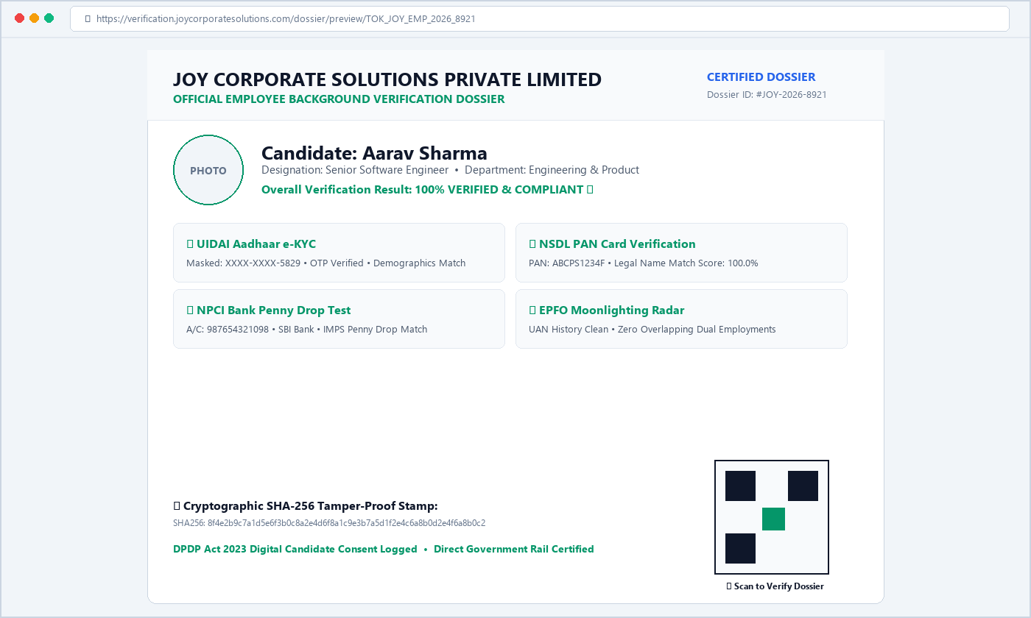
INNOVATION HIGHLIGHTS
Unique Ideas & Smart Innovations in This Project
💡 5 PIONEERING INNOVATIONS
✔ ⚡ Sub-45s Direct Government Rail: No middleman screening agencies. Direct parallel API lookups to UIDAI, NSDL, NPCI, and EPFO.
✔ 🛡️ Smart Moonlighting Radar: Analyzes active PF contribution records to immediately catch candidates secretly working two jobs.
✔ 📸 3D Live Selfie & Face Match: Interactive camera selfie scan matches face features with official Aadhaar photo to defeat deepfakes.
✔ 🏗️ CLRA Form XVI Gate Sync: Connects turnstile biometric entries directly to contractor PF/ESIC rolls, stopping fake worker billing.
✔ 🔐 Scannable QR Code on PDFs: Every dossier carries a live QR code. Anyone can scan with their phone to confirm authentic records.
📄 Certified Dossier with Scannable QR Code
Master PDF report generated dynamically with official company logo, scannable QR verification badge, and SHA-256 digital seal.
JOY TRUE PROFILE • JOY CORPORATE SOLUTIONS PRIVATE LIMITED • CONFIDENTIAL
11 / 14

Slide 12
SECURITY & DPDP ACT 2023
Data Security & Privacy: 100% Safe, Legal & Compliant
🔒 1. 100% DPDP Act 2023 Compliant
🛡️ 2. Bank-Grade 256-Bit Encryption
👁️ 3. Automatic Number Masking
🏢 4. Multi-Company Data Privacy
• Candidate gives clear digital consent before any check
• Timestamped consent log saved with IP and location
• Candidate has full right to view & manage their data
• 100% compliant with Indian Data Protection laws
• All stored files protected with 256-bit AES encryption
• TLS 1.3 secure network connection during verification
• Candidate passwords stored with salted cryptographic hash
• Zero unauthorized data leaks or external access
• Aadhaar numbers masked automatically to XXXX-XXXX-1234
• PAN and Bank account details masked on preview screens
• Zero raw biometric fingerprint storage on servers
• Follows strict UIDAI government security rules
• Each company's candidate data is completely separate
• No company or recruiter can view another company's data
• Auto session logouts to protect unattended screens
• Instant security alerts for any suspicious activity
JOY TRUE PROFILE • JOY CORPORATE SOLUTIONS PRIVATE LIMITED • CONFIDENTIAL
12 / 14

Slide 13
MONETIZATION & ROI
Simple Postpaid Pricing & High Business Value
⏱️ 95% Faster Hiring Speed
📉 60% Cost Reduction
Reduces verification turnaround from 20 days to under 45 seconds, stopping selected candidates from joining competitors.
100% postpaid pay-per-candidate pricing eliminates expensive monthly agency retainers and overhead fees.
🎯 99.98% Verification Accuracy
🧾 Automated 18% GST Invoicing
Direct queries to UIDAI, NSDL, NPCI and EPFO eliminate human screening errors and fake certificates.
System generates monthly B2B 18% GST tax invoices with 1-click Razorpay, UPI, or NetBanking payment.
JOY TRUE PROFILE • JOY CORPORATE SOLUTIONS PRIVATE LIMITED • CONFIDENTIAL
13 / 14

Slide 14
THANK YOU FOR YOUR TIME & ATTENTION
Thank You! Let's Build Trust Together.
Transform your workforce and vendor verification with sub-45-second direct government rails.
🏢 Corporate Office
JOY CORPORATE SOLUTIONS PRIVATE LIMITED
Coimbatore, Tamil Nadu, India
PIN: 641001
📧 Enterprise Email & Web
Email: info@joycorporatesolutions.com
Web: verification.joycorporatesolutions.com
HR Suite: joypeoplehr.com
📞 Direct Phone & Demos
Phone / WhatsApp: +91 99946 99044
Operational Hours: Monday - Saturday
9:00 AM - 7:00 PM IST
JOY TRUE PROFILE • JOY CORPORATE SOLUTIONS PRIVATE LIMITED • CONFIDENTIAL
14 / 14

