Slide 1

JOY TRUE PROFILE
Next-Generation Automated Workforce & Vendor Verification Platform
Sub-45-Second Direct Government Verification • 100% Tamper-Proof • Frictionless Digital Trust
⚡ Sub-45-Sec Speed
🔒 100% DPDP 2023 & ISO
🏛️ Direct Govt APIs
📜 Tamper-Proof Cert ID
JOY CORPORATE SOLUTIONS PRIVATE LIMITED • ENTERPRISE ARCHITECTURE DECK 2026
JOY TRUE PROFILE • Next-Gen Workforce & Vendor Verification • Confidential Enterprise Presentation
1 / 17

Slide 2
THE PROBLEM STATEMENT
The Problem: The Hidden Crisis in Manual Verification
⏳ Painful Delays (2-3 Weeks)
⚠️ Fake & Altered Documents
💸 High Cost & Paperwork
⚖️ Severe Compliance Risks
• Slow Turnaround: Traditional manual checks take 14 to 21 business days.
• Lost Candidates: Over 35% of top candidates drop off while waiting for clearance.
• Recruiter Burden: HR spends endless hours manually chasing documents.
• Counterfeit Papers: High rate of forged experience letters and marksheets.
• Undetected Moonlighting: Dual employment goes completely unnoticed in manual review.
• Visual Check Failure: Human eyes cannot detect digitally edited PDF documents.
• Expensive Agencies: High per-candidate fees paid to manual agency vendors.
• Heavy Physical Load: Printing, scanning, physical filing, and courier expenses.
• Zero Real-Time Tracking: Recruiters cannot see live progress of ongoing verifications.
• Contractor Violations: Unverified third-party vendor labor risks heavy CLRA fines.
• Data Privacy Breach: Handling unencrypted physical documents violates DPDP Act 2023.
• Legal Liability: Lack of cryptographic audit trail leaves enterprise exposed.
🚨 Critical Industry Bottleneck: Manual verification wastes up to 70% of HR recruiter time on manual document follow-ups, physical phone calls, and error-prone checks — directly causing hiring drop-offs and compliance risks.
JOY TRUE PROFILE • Next-Gen Workforce & Vendor Verification • Confidential Enterprise Presentation
2 / 17

Slide 3
THE SOLUTION ARCHITECTURE
JOY TRUE PROFILE: The Modern Automated Solution
💡 NEXT-GEN AUTOMATED VERIFICATION ENGINE
✔ Direct Government API Link: Directly linked to UIDAI, NSDL, EPFO, DigiLocker, and Court registries for sub-45-second live checks.
✔ Frictionless WhatsApp Magic Links: Candidates receive automated WhatsApp invitation links with 4-digit security PINs for easy smartphone onboarding.
✔ AI Face Liveness & Anti-Spoofing: 3D cranial depth scanning compares candidate's live camera selfie with their official government ID photo in real time.
✔ 1-Click Master Dossier PDF: Automatically generates court-admissible PDF verification dossiers stamped with QR codes and immutable Certificate IDs.
🌐 5 DEDICATED ROLE-BASED PORTALS
• 1. Super Admin Console: Platform governance, client contract management, live API latency telemetry, and metered billing.
• 2. Company Admin Portal: Corporate HQ hub for managing HR team quotas, postpaid 18% GST invoices, and vendor compliance.
• 3. HR Executive Workstation: Recruiter pipeline with single & 500+ Excel bulk import, live status board, and 1-click dossier download.
• 4. Candidate Mobile Portal: Frictionless mobile web app with PIN security, Aadhaar OTP e-KYC, and live selfie capture.
• 5. Vendor & Contractor Portal: B2B vendor onboarding, CLRA labor license tracking, and statutory compliance due diligence.
JOY TRUE PROFILE • Next-Gen Workforce & Vendor Verification • Confidential Enterprise Presentation
3 / 17

Slide 4
VERIFICATION SCOPE (EMPLOYEES)
What We Verify: 100% Comprehensive Employee Checks
🆔 1. Aadhaar e-KYC (UIDAI)
💳 2. PAN Tax & Identity (NSDL)
🏦 3. Bank Account Penny Drop
• Direct UIDAI Gateway: Instant OTP & Biometric demographic validation.
• Zero Physical Photocopy: Secure masked 256-bit SHA token authentication.
• Speed: Verified instantly in under 10 seconds.
• NSDL & ITD Verification: Matches registered name, father's name, and DOB.
• Tax Status Check: Confirms active PAN and authenticates tax credentials.
• Speed: Verified instantly in under 5 seconds.
• NPCI / IMPS Bank Check: Transfers ₹1 to verify active candidate account.
• Exact Name Match: Confirms official account holder name at bank branch.
• Zero Salary Reversals: Prevents payroll bounce errors before joining.
🏢 4. Dual Employment & EPFO
🎓 5. Education & Degree Check
📸 6. AI 3D Facial Liveness
• EPFO Service History: Pulls authentic UAN employment service timeline.
• Moonlighting Detection: Catches overlapping concurrent employment automatically.
• Speed: Eliminates months of manual experience letter calls.
• DigiLocker & NAD Hub: Direct digital validation of university certificates.
• Accredited Degrees: Validates marksheets, roll numbers, and pass years.
• Fraud Prevention: Detects fake certificates from unaccredited mills.
• Biometric Anti-Spoofing: Live webcam scan prevents photo and video playback spoofing.
• Aadhaar Photo Match: AI craniofacial engine compares selfie with official ID photo.
• Match Score: Delivers 99.4% precision match score in real time.
JOY TRUE PROFILE • Next-Gen Workforce & Vendor Verification • Confidential Enterprise Presentation
4 / 17

Slide 5
VERIFICATION SCOPE (VENDORS & CLRA)
B2B Vendor & Contractor Due Diligence: 11 Statutory Checks
🏢 1. Corporate MCA Verification
🧾 2. GSTIN & Tax Compliance
⚖️ 3. CLRA Labor License & Safety
• MCA21 Registry: Validates CIN, LLPIN, and incorporation certificates.
• Active Status: Confirms company is active, compliant, and not struck off.
• Director DIN: Authenticates board directors and signatory credentials.
• GST Portal Direct Link: Validates active GST number and state registration.
• Filing Track Record: Monitors regular GSTR-1 and GSTR-3B tax return filings.
• Fraud Shield: Prevents dealing with shell or circular-trading vendors.
• Labor Ministry Registry: Confirms valid Contract Labour (Regulation & Abolition) license.
• Workforce Quota: Verifies authorized worker count and site coverage.
• Legal Protection: Shields principal employer from statutory contractor fines.
💼 4. Vendor PAN & Financials
🏦 5. Vendor Bank Account Check
📜 6. Master Vendor Compliance Dossier
• Income Tax Validation: Verifies vendor entity PAN and corporate filing.
• MSME / Udyam Check: Confirms small business registration and classification.
• Tax Clearance: Ensures vendor is in good financial standing.
• Penny Drop Verification: Instant IMPS ping to verify company bank details.
• Registered Corporate Name: Matches bank branch records with MCA entity name.
• Zero Payment Fraud: Eliminates wrongful vendor payments and diverted invoices.
• Consolidated B2B Report: Combines all 11 statutory audits into one master report.
• Scannable QR & Digital Seal: Instant mobile QR validation for client audit inspections.
• Real-Time Status: Live dashboard flags expired vendor licenses immediately.
JOY TRUE PROFILE • Next-Gen Workforce & Vendor Verification • Confidential Enterprise Presentation
5 / 17

Slide 6
WORKFLOW SIMPLIFICATION
How It Dramatically Reduces Your Process & Workload
1
2
3
4
Step 1: HR 1-Click Dispatch
Step 2: Candidate Mobile Input
Step 3: Real-Time Statutory Audit
Step 4: Tamper-Proof Dossier
HR Recruiter enters candidate name and mobile, or uploads a 500+ Excel list. The system automatically dispatches WhatsApp magic invitation links.
Candidate opens link on smartphone, enters 4-digit security PIN, approves consent, enters Aadhaar OTP, and snaps a 3D live camera selfie.
Joy True Profile connects to government databases (UIDAI, NSDL, EPFO, Courts) and verifies all credentials in under 45 seconds.
An official verified PDF report is generated with Certificate ID, QR validation code, and SHA-256 digital stamp ready for 1-click download.
🎯 Major Work Reduction Impact: Eliminates 85% of manual HR operational tasks. Zero physical paperwork, no manual data entry, no phone calls to past employers, and instant downloadable PDF dossiers for every hire.
JOY TRUE PROFILE • Next-Gen Workforce & Vendor Verification • Confidential Enterprise Presentation
6 / 17

Slide 7
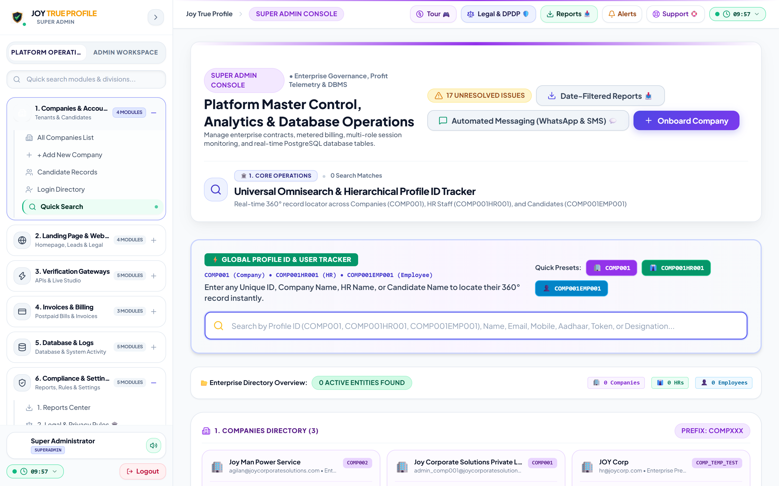
PORTAL ARCHITECTURE (1/5)
Portal 1: Super Admin Console — Master Platform Governance
👑 SUPER ADMIN CONSOLE — FEATURES & WORKFLOW
• Multi-Company Governance: Onboard client enterprises, configure service packages, and manage tier access.
• Dynamic API Pricing Engine: Set custom per-check billing rates, volume discounts, and postpaid credits.
• Live API Telemetry & Health: Real-time monitoring of UIDAI, NSDL, EPFO, and Court gateway latencies and uptime.
• Postpaid Ledger & Invoicing: Automated monthly 18% GST tax invoice generation and settlement tracking.
⚙️ Super Admin Operational Workflow:
1. Add Company ➔ 2. Set Custom Price ➔ 3. Monitor Live API Speed ➔ 4. Oversee Monthly Invoices
🖥️ Live Super Admin Workstation View
Direct registry control center monitoring tenant enterprise client activations, gateway latency, and platform security.
JOY TRUE PROFILE • Next-Gen Workforce & Vendor Verification • Confidential Enterprise Presentation
7 / 17

Slide 8
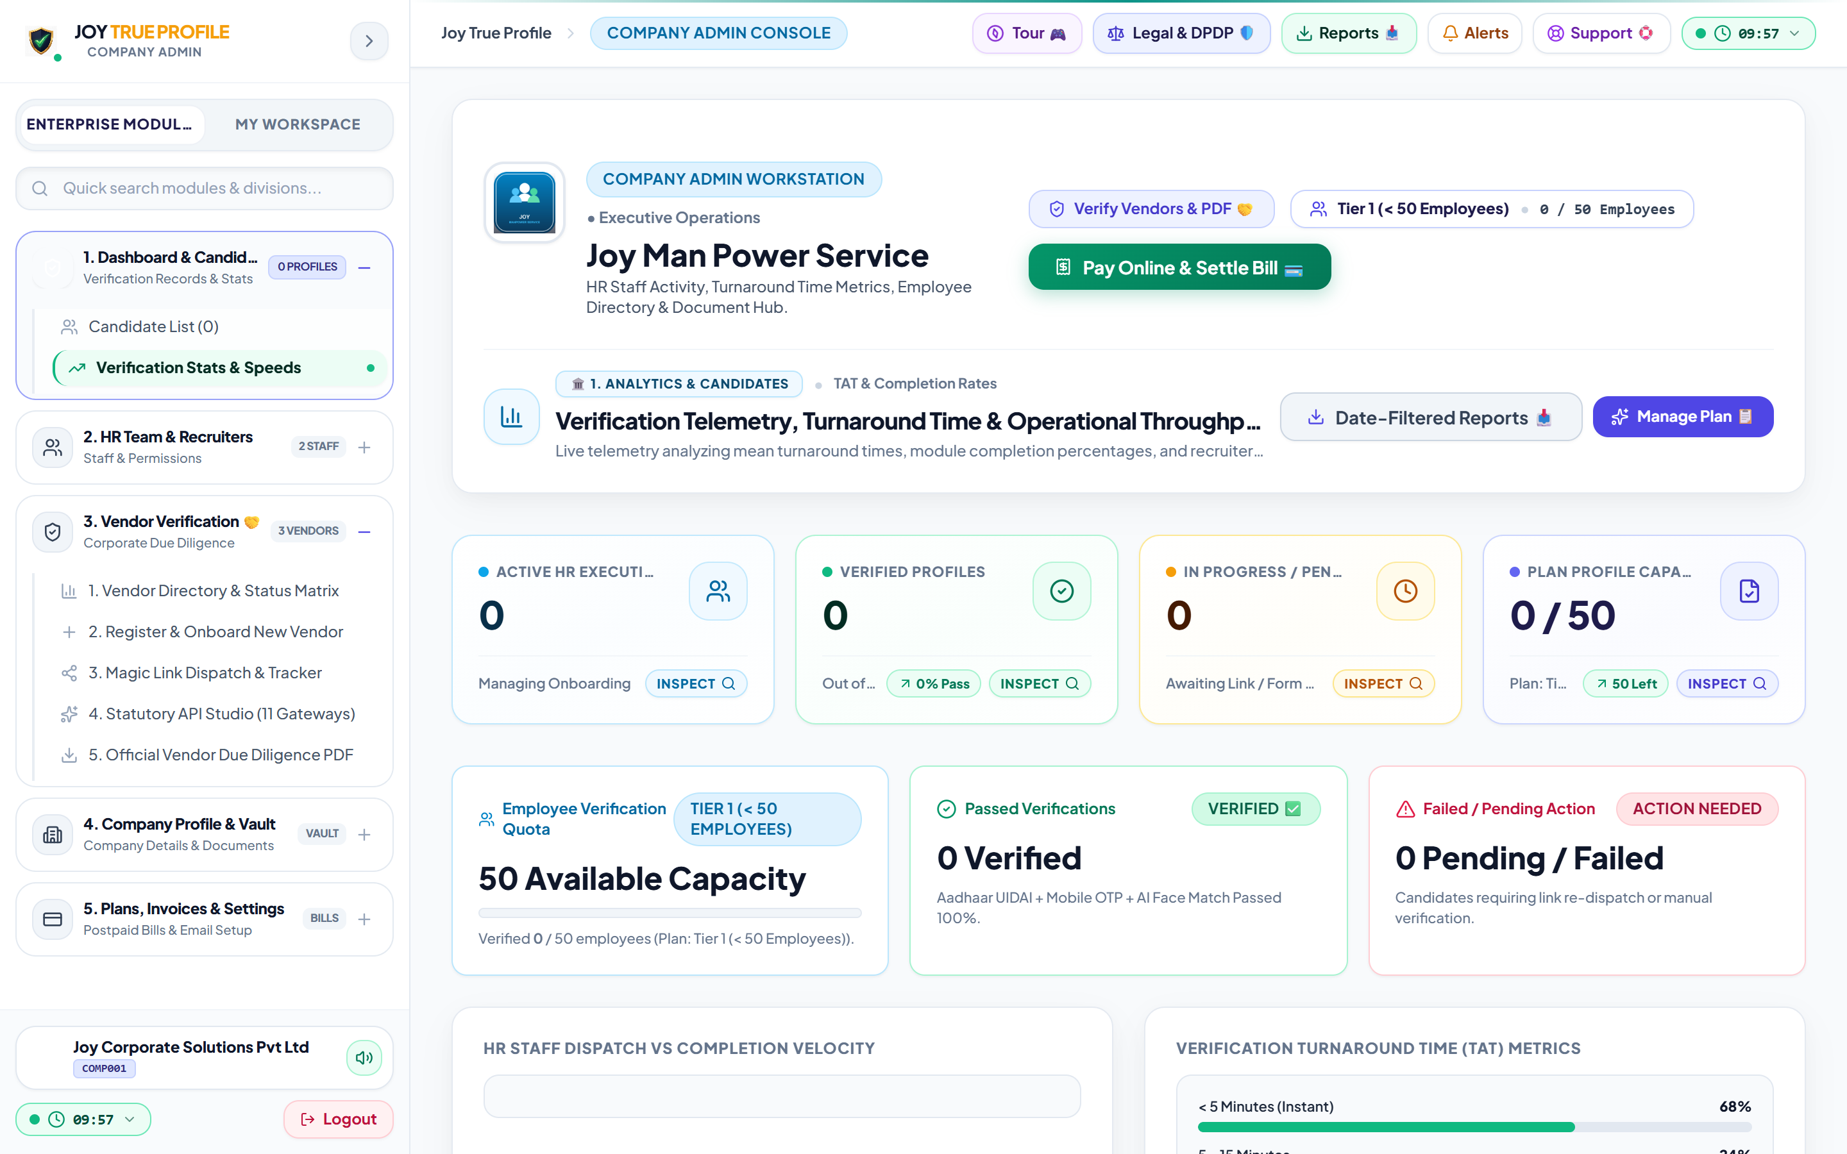
PORTAL ARCHITECTURE (2/5)
Portal 2: Company Admin Portal — Corporate Headquarters
🏢 COMPANY ADMIN PORTAL — FEATURES & WORKFLOW
• Company Profile & Logo: Upload corporate logo, manage office addresses, CIN, GSTIN, and company PAN.
• HR Recruiter Provisioning: Add and manage HR recruiters, allocate verification quotas, and configure recruiter access.
• Postpaid Monthly Billing: Dashboard showing verified candidates, pending balance, and monthly 18% GST tax invoices.
• Contractor Compliance Oversight: Monitor third-party contractor workforce registers and ensure full statutory labor compliance.
⚙️ Company Admin Operational Workflow:
1. Set Company Logo ➔ 2. Add HR Recruiters ➔ 3. Monitor All Candidate Checks ➔ 4. Pay Monthly 18% GST Bill
🖥️ Live Company Admin Console View
Executive management hub for HR team oversight, branch control, postpaid wallet monitoring, and 1-click tax invoice settlement.
JOY TRUE PROFILE • Next-Gen Workforce & Vendor Verification • Confidential Enterprise Presentation
8 / 17

Slide 9
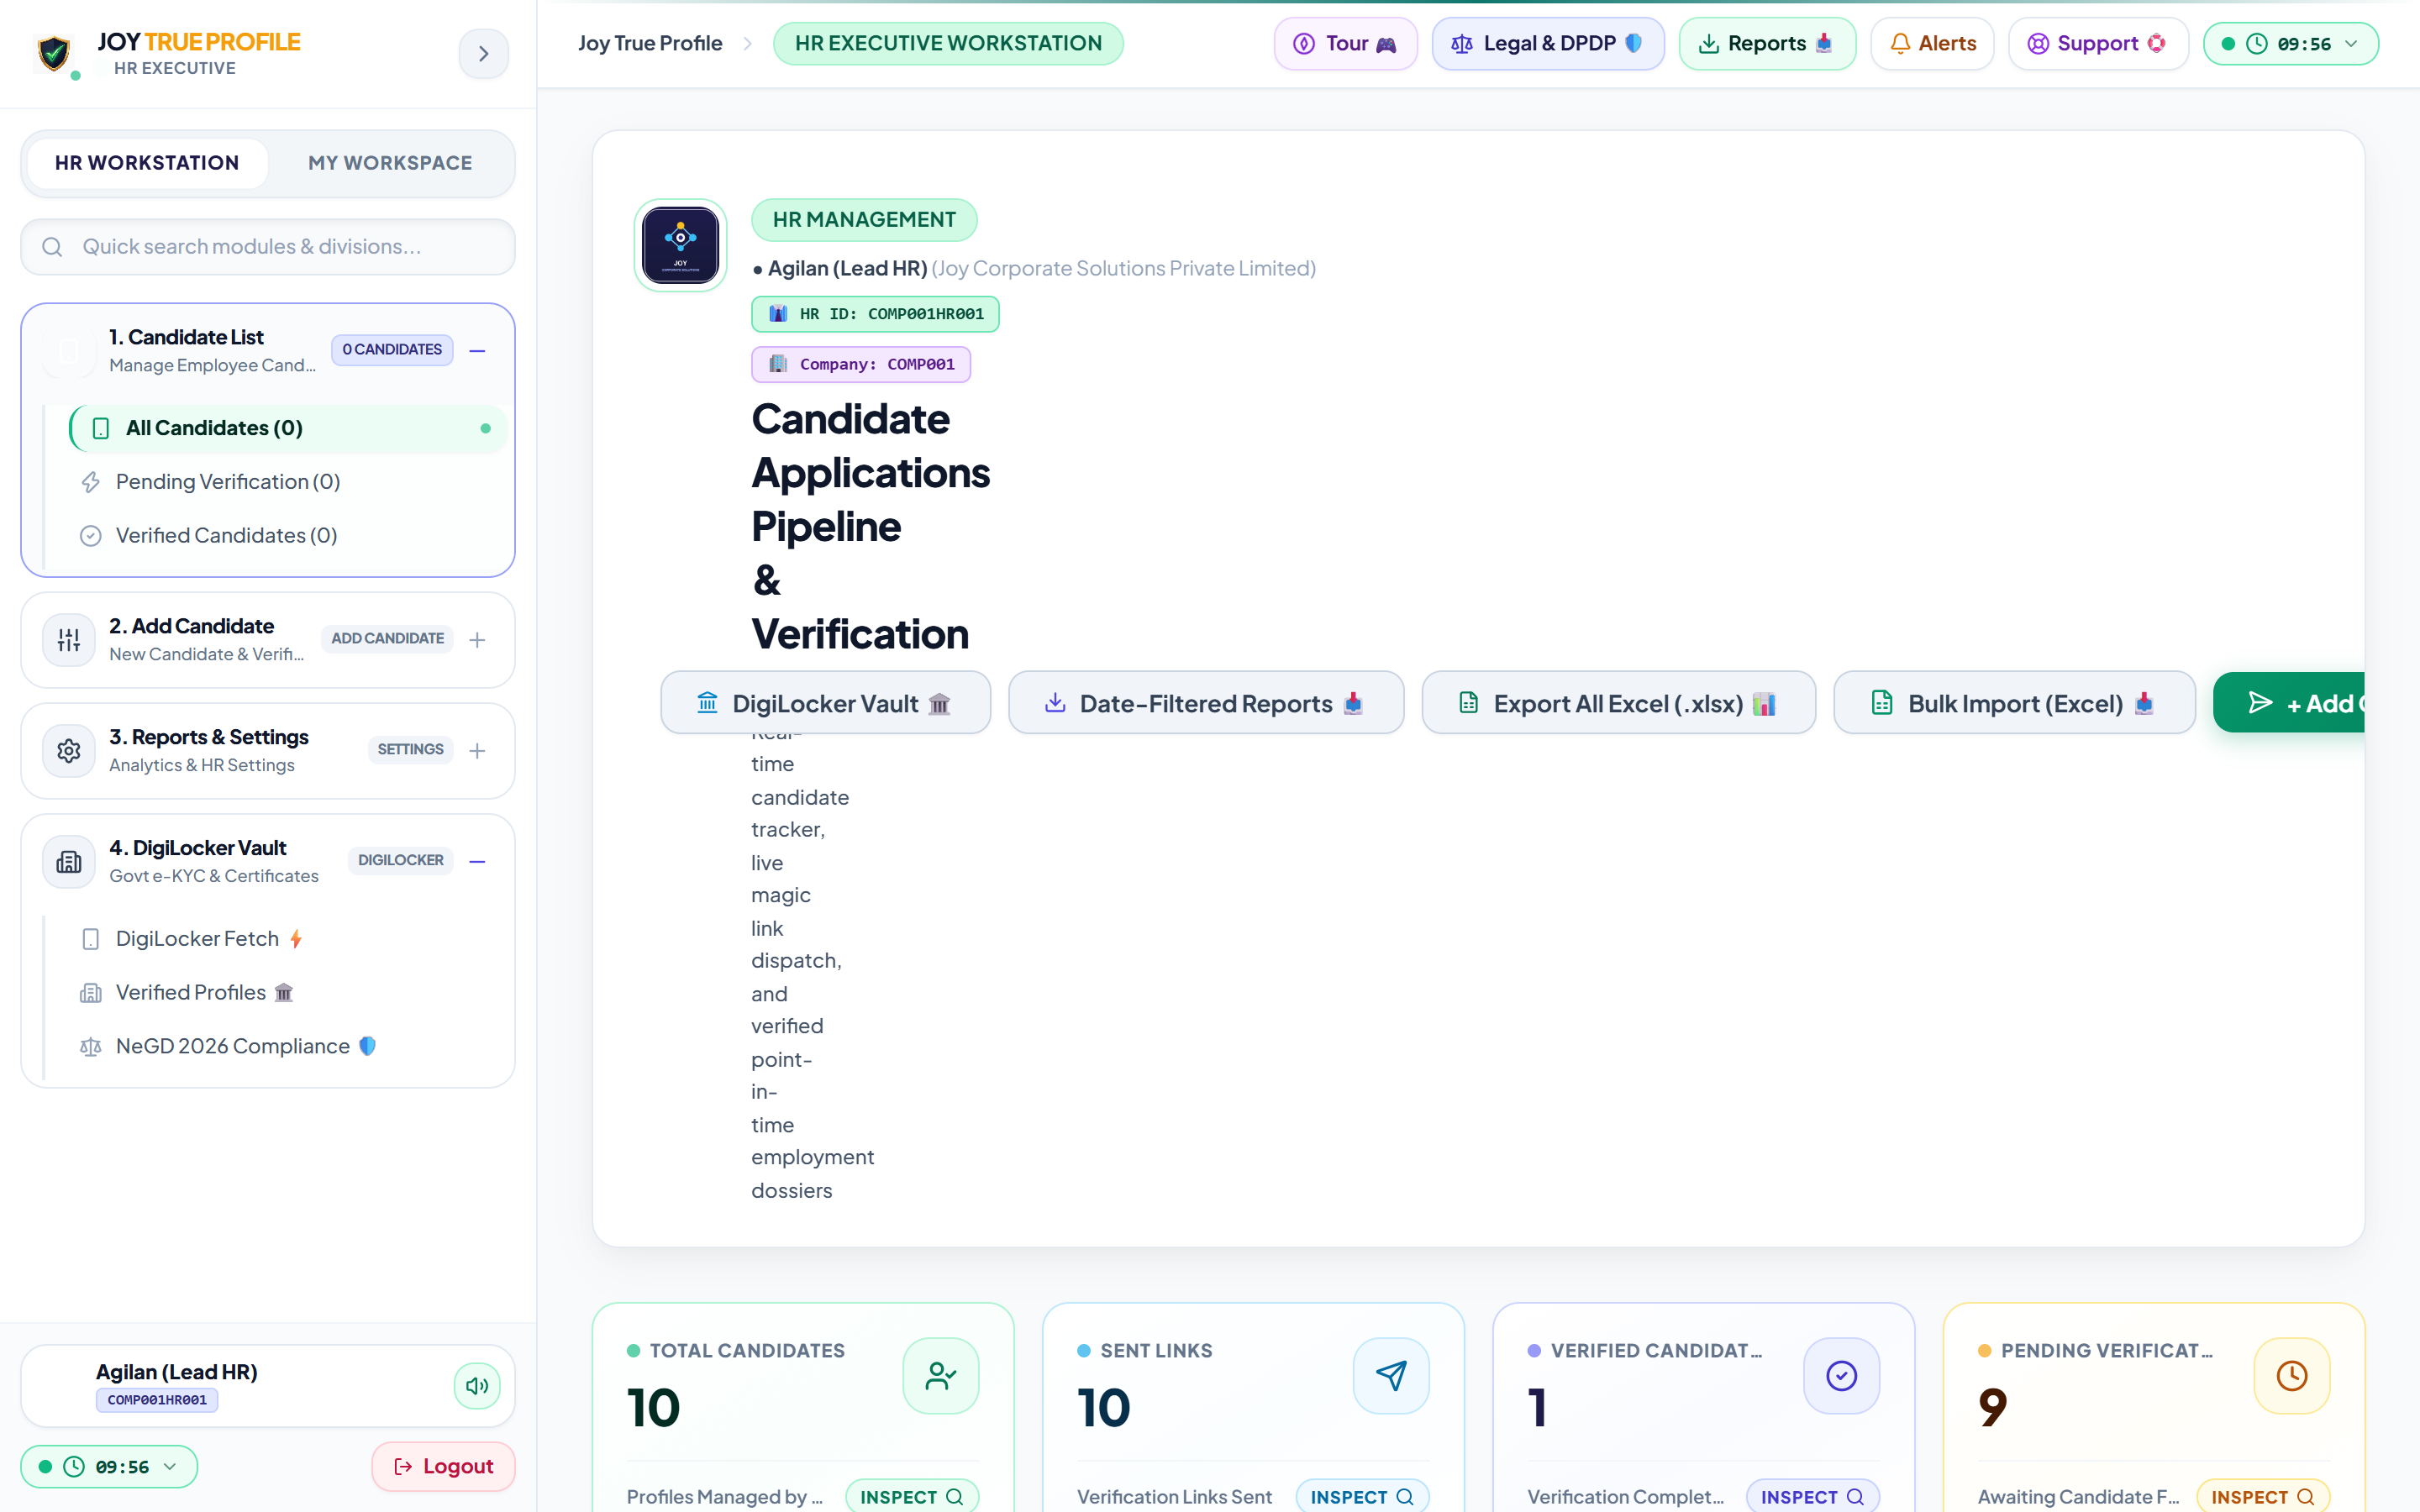
PORTAL ARCHITECTURE (3/5)
Portal 3: HR Executive Workstation — Recruiter Dashboard
👔 HR EXECUTIVE WORKSTATION — FEATURES & WORKFLOW
• Single & 500+ Excel Bulk Import: Enter candidate info individually or upload a batch of 500+ candidates using an Excel sheet.
• 1-Click WhatsApp Magic Links: Send invitation links via WhatsApp and SMS with automatically generated 4-digit security PINs.
• Live Candidate Progress Board: Track who has opened the link, who is filling the form, and whose checks are completed in real time.
• AI Photo & Face Matching: Compares candidate's live camera selfie with their official Aadhaar photo and shows match percentage.
• 1-Click Master PDF Dossier: Download the complete verified report stamped with company logo, QR code, and Certificate ID.
⚙️ HR Recruiter Daily Workflow:
1. Enter Candidate / Excel ➔ 2. Send WhatsApp Link ➔ 3. Watch Live Status ➔ 4. Download PDF Dossier
🖥️ Live HR Executive Workstation View
Centralized candidate pipeline tracker with real-time status telemetry, instant WhatsApp re-dispatch, and bulk PDF export.
JOY TRUE PROFILE • Next-Gen Workforce & Vendor Verification • Confidential Enterprise Presentation
9 / 17

Slide 10
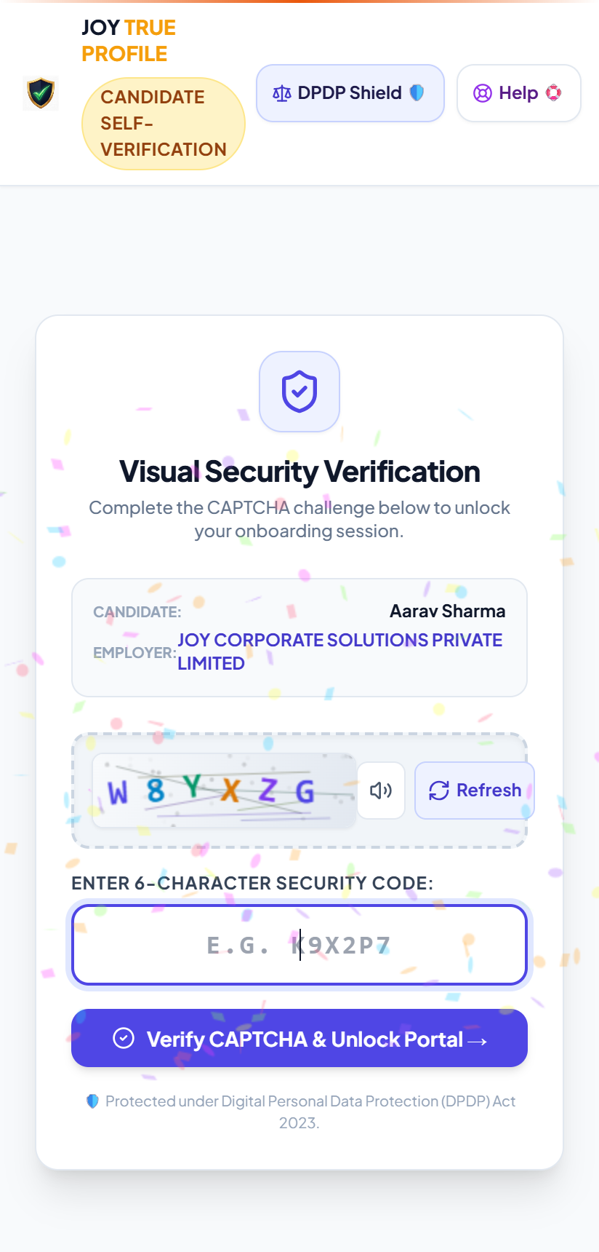
PORTAL ARCHITECTURE (4/5)
Portal 4: Candidate Portal — Frictionless Mobile Web App
📱 CANDIDATE MOBILE PORTAL — FEATURES & WORKFLOW
• Zero App Install Required: Runs purely in any mobile browser (Chrome, Safari, Edge) via responsive web interface.
• 4-Digit Secure PIN Access: Candidates unlock their verification using a personal 4-digit PIN sent via WhatsApp.
• Sub-2-Minute Completion: Fast 4-step wizard: Basic Details ➔ Aadhaar OTP e-KYC ➔ AI Selfie ➔ Instant Submit.
• Camera & Liveness Capture: Guided camera captures live selfie with anti-spoofing depth checks.
• Consent & Privacy Shield: DPDP Act 2023 compliant consent screen explaining exact data usage.
⚙️ Candidate Mobile Onboarding Flow:
1. Open WhatsApp Link ➔ 2. Enter 4-Digit PIN ➔ 3. Enter Aadhaar OTP ➔ 4. Take Selfie & Submit
📱 Frictionless Mobile Web App: 4-Digit PIN, Aadhaar e-KYC & 3D Selfie
JOY TRUE PROFILE • Next-Gen Workforce & Vendor Verification • Confidential Enterprise Presentation
10 / 17

Slide 11
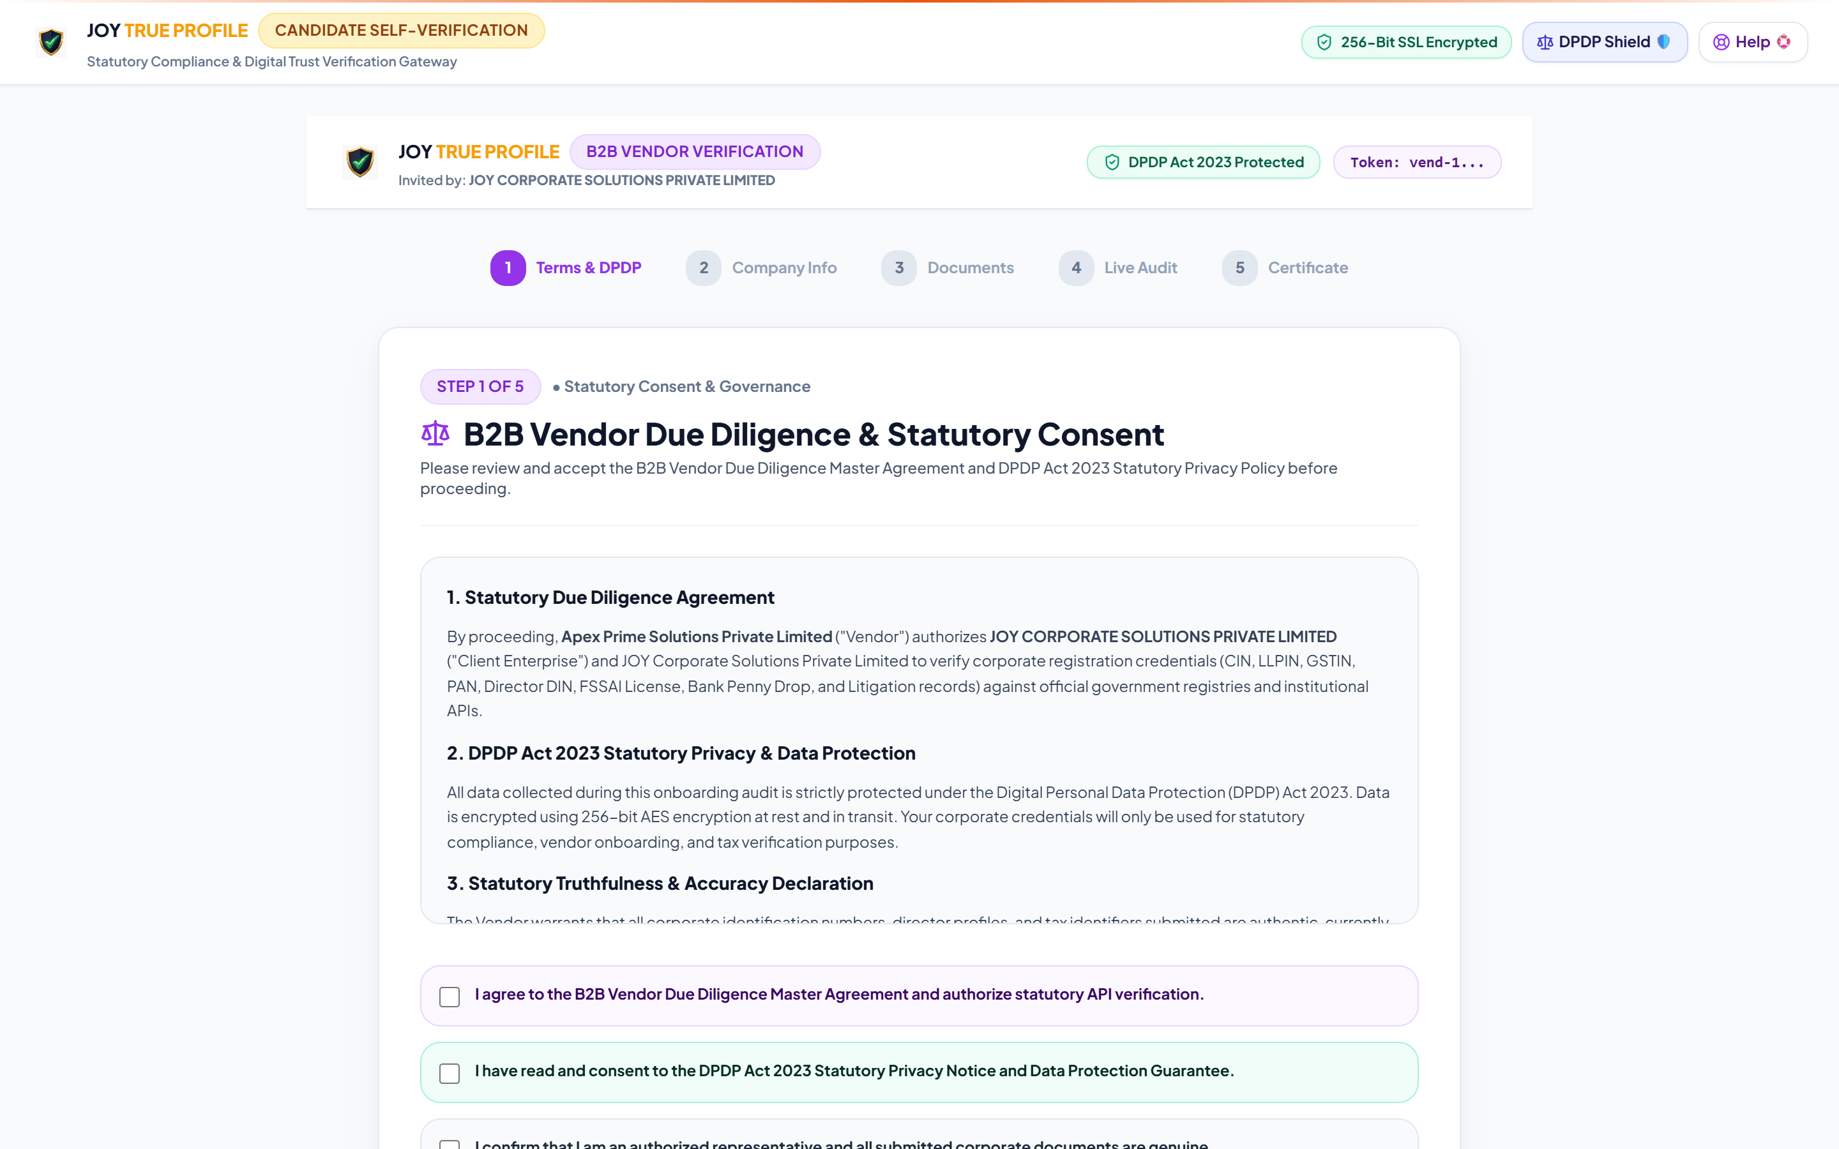
PORTAL ARCHITECTURE (5/5)
Portal 5: Vendor & Contractor Portal — CLRA Compliance
🤝 VENDOR DUE DILIGENCE — FEATURES & WORKFLOW
• B2B Self-Onboarding Studio: Vendors receive secure registration links to submit company registration numbers and certificates.
• 11-Point Statutory Verification: Automated API verification of MCA CIN, LLPIN, GSTIN, Vendor PAN, MSME, and Bank account.
• CLRA Labor License Tracking: Validates contractor labor license numbers, validity periods, and maximum deployed worker count.
• Contractor Risk Scoring: System generates a risk rating for each vendor based on tax filing consistency and legal compliance.
⚙️ Vendor Due Diligence Workflow:
1. Dispatch Vendor Link ➔ 2. Vendor Submits GST/CIN ➔ 3. 11 APIs Verify Instantly ➔ 4. Approve Vendor
🖥️ Live Vendor Due Diligence Portal View
Contractor and third-party vendor onboarding console with automated statutory consent, MCA CIN, and GST filing audits.
JOY TRUE PROFILE • Next-Gen Workforce & Vendor Verification • Confidential Enterprise Presentation
11 / 17

Slide 12
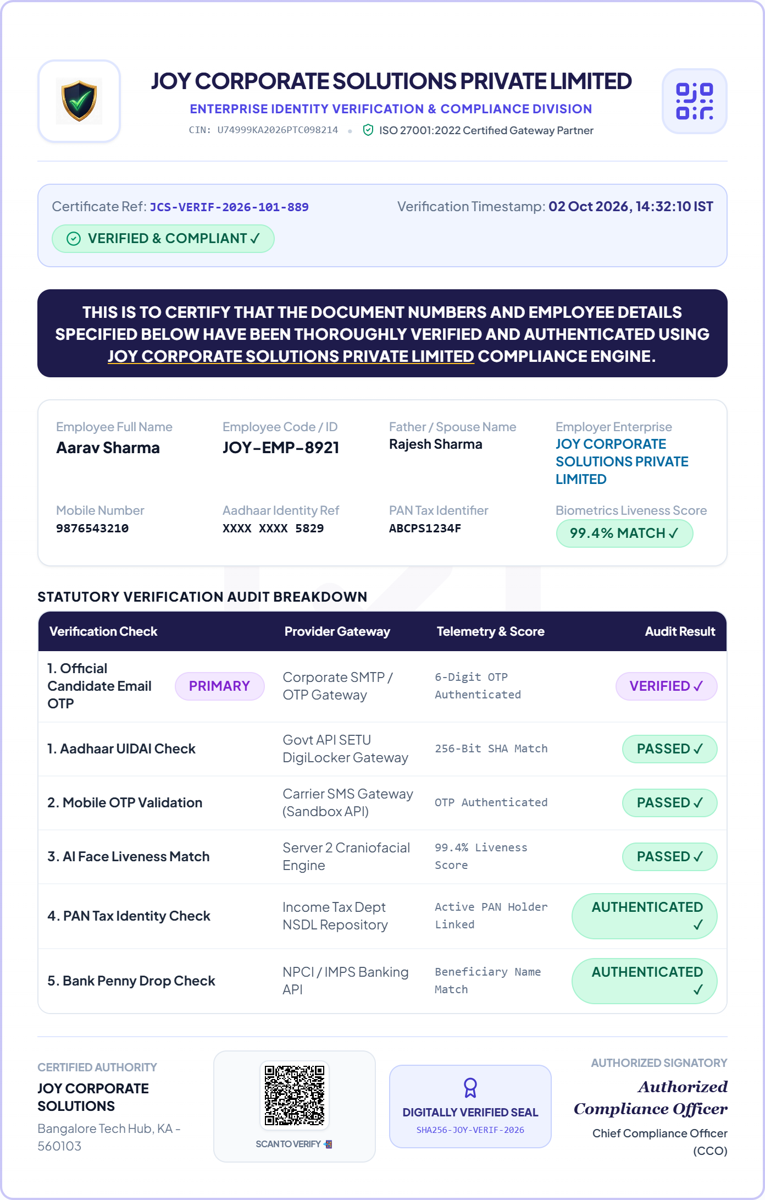
CERTIFICATE FEATURES
Certified Verification Report & Unique Certificate ID
📜 OFFICIAL VERIFICATION CERTIFICATE & ID SYSTEM
✔ Unique Certificate ID: Every verified candidate receives an immutable, permanent ID (e.g. #JCS-VERIF-2026-101-889) registered in the national registry.
✔ Live Scannable QR Code: Any recruiter, client auditor, or banking authority can scan the QR code with their mobile phone to instantly view live authenticity records.
✔ SHA-256 Cryptographic Stamp: Generates a unique cryptographic hash to ensure the PDF report cannot be edited, altered, or forged.
✔ Instant Online Validation: Eliminates slow back-and-forth emails between companies. Instant paperless verification lookup online.
🎯 Key Benefit for Employers & Clients:
100% genuine proof accepted by corporate clients, enterprise auditors, and government regulatory inspectors.
🆔 Unique Cert ID
Permanent Reference
🛡️ SHA-256 Hash
Tamper-Proof Math
📲 Live QR Seal
Instant Phone Scan
🏛️ IT Act, 2000
Court-Admissible
JOY TRUE PROFILE • Next-Gen Workforce & Vendor Verification • Confidential Enterprise Presentation
12 / 17

Slide 13
PLATFORM SAFETY
Project Safety & Fraud Prevention Architecture
🛡️ 1. Anti-Spoofing & Liveness
🔑 2. Multi-Factor PIN Security
📑 3. Immutable Audit Trails
🚦 4. Rate Limiting & Shield
• 3D Cranial Depth Scan: Active biometric liveness detection blocks 2D printed photos and video screen replay attacks.
• Micro-Movement Checks: Validates natural human blink, gaze direction, and facial micro-movements in real time.
• Immediate Bot Detection: Automated bots and AI deepfakes are immediately rejected by the capture engine.
• 4-Digit Security PIN: Candidate portal is locked with a unique 4-digit PIN delivered only to candidate's mobile number.
• Single-Use Session Links: Magic links expire automatically after 72 hours or once submitted, preventing unauthorized reuse.
• Device Fingerprinting: Tracks browser user-agent and IP to prevent third-party link hijacking.
• SHA-256 Checksum Stamp: Every verified document is stamped with a unique cryptographic checksum that changes if edited.
• Tamper Detection: Any alteration to employee particulars or verification status renders the digital certificate invalid.
• Time-Stamped Audit Logs: All verification actions are permanently logged with ISO timestamps.
• Brute-Force Protection: Strict API rate limiting stops automated brute-force attacks and credential stuffing.
• Bot Challenge Defense: Protects candidate verification portals against automated spam submissions.
• Automated Threat Alerts: Security engine flags abnormal request spikes and suspicious geographic IP activity.
JOY TRUE PROFILE • Next-Gen Workforce & Vendor Verification • Confidential Enterprise Presentation
13 / 17

Slide 14
DATA SECURITY & DPDP
Data Security & Privacy: How We Protect & Handle Data
🔐 1. Zero-Knowledge Architecture
🛡️ 2. Bank-Grade Encryption
⚖️ 3. DPDP Act 2023 Compliance
🏢 4. Multi-Tenant Data Isolation
• No Permanent Storage: JOY TRUE PROFILE acts as a verification pass-through gateway.
• Masked PII Identifiers: Sensitive Aadhaar numbers are masked to XXXX-XXXX-1234 before report generation.
• Ephemeral Cache: Candidate OTP payloads are scrubbed from RAM immediately after verification.
• AES-256 at Rest: All database records, credentials, and tokens are encrypted using AES-256.
• TLS 1.3 in Transit: All communication between portals, candidates, and government APIs uses TLS 1.3.
• Hardware Security Module: Cryptographic keys are managed through isolated secure key vaults.
• Explicit Digital Consent: Every candidate explicitly consents to background verification before submission.
• Purpose Limitation: Data is strictly used for employer verification and never shared with third parties.
• Right to Erasure: Fully compliant with Indian statutory Digital Personal Data Protection laws.
• Row-Level Security (RLS): Each company's candidate data is strictly isolated with independent encryption scopes.
• Role-Based Access Control: Super Admin, Company Admin, and HR Recruiters see only authorized data.
• Zero Data Leakage: Guarantees no cross-tenant visibility between competing enterprise clients.
JOY TRUE PROFILE • Next-Gen Workforce & Vendor Verification • Confidential Enterprise Presentation
14 / 17

Slide 15
COMPARISON MATRIX
How JOY TRUE PROFILE is Different & Better
Verification Feature | Traditional Manual / Agency Method | JOY TRUE PROFILE (Automated Engine)
Verification Speed | ❌ 14 to 21 business days (manual emails & calls) | ✔ Sub-45 seconds via direct government APIs
Source of Truth | ❌ Physical photocopies easily altered with software | ✔ Direct government cryptographic registries (UIDAI, NSDL, EPFO)
Dual Job / Moonlighting | ❌ Undetected — relies on self-reported candidate CV | ✔ Instant automated EPFO history analysis catches overlap
Candidate Experience | ❌ Heavy printing, manual forms, and paper scanning | ✔ Zero-install mobile web link via WhatsApp in < 2 mins
HR Recruiter Burden | ❌ 70% of HR time spent chasing documents & agencies | ✔ 1-click dispatch, live tracking board, instant PDF dossier
JOY TRUE PROFILE • Next-Gen Workforce & Vendor Verification • Confidential Enterprise Presentation
15 / 17

Slide 16
BUSINESS VALUE
Business Value: How It Reduces Hiring Overhead
⚡ 90% Faster Turnaround
💰 85% Process Cost Savings
🛡️ 100% Audit Readiness
📱 Frictionless Candidate Delight
• Instant Clearance: Reduces candidate verification waiting time from 14 days down to under 45 seconds.
• Zero Candidate Drop-off: Candidates are onboarded immediately before they explore competing offers.
• Rapid Scaling: Enables high-volume hiring without adding extra HR administrative staff.
• Direct Model: Replaces expensive manual agencies with direct automated API verification.
• No Physical Paperwork: Eliminates physical scanning, printing, couriers, and storage overhead.
• Transparent Postpaid Billing: Pay only for verified checks with transparent monthly GST invoicing.
• CLRA & DPDP Compliance: Shields company from severe regulatory fines and contractor compliance penalties.
• Court-Admissible Dossiers: Master PDF reports equipped with QR code and cryptographic Certificate IDs.
• Instant Auditor Access: Client auditors can verify authenticity directly from their smartphones.
• WhatsApp Convenience: Candidates complete self-verification on mobile in under 2 minutes.
• No App Downloads: Browser-based onboarding with guided camera selfie capture.
• Respects Privacy: Candidate data is protected under India's DPDP Act 2023 guidelines.
JOY TRUE PROFILE • Next-Gen Workforce & Vendor Verification • Confidential Enterprise Presentation
16 / 17

Slide 17
Thank You!
JOY TRUE PROFILE — Building Trust Through Direct Digital Verification
“Transforming background verification with sub-45-second speed, zero paperwork, and complete data safety.”
Empowering HR teams, enterprises, and candidates across India.
JOY TRUE PROFILE • Next-Gen Workforce & Vendor Verification • Confidential Enterprise Presentation
17 / 17

