Slide 1
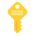



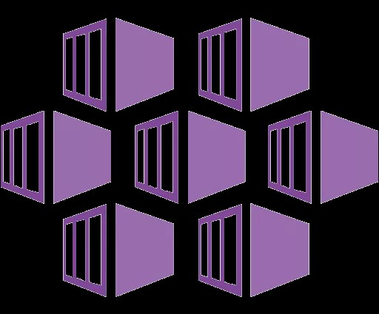








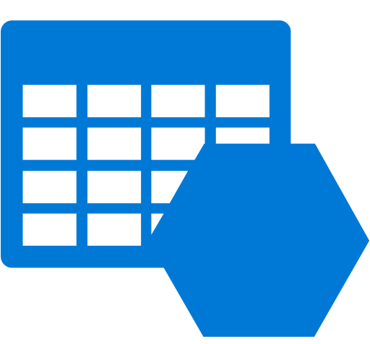







Clairvoyant Data Platform – Data Lake – Non-Prod
ITM Resource Group
Services-VNET
Services-Subnet
Ingress-Subnet
Azure Kubernetes Service(AKS)
Flink Cluster
Kafka Cluster
Akka Cluster
Event Hub
<TBD>
Azure Load Balancer
Azure Redis Cache
Azure Container Registry
Cosmos DB (Cassandra API)
Subnet /20
Azure
Blob Storage
Storage-Subnet
Subnet /26
Cosmos DB (Cassandra API)
Azure MySQL
APIM-Subnet
Subnet /26
ML-Subnet
DB-Subnet
Azure APIM
Azure ML
<TBD>
Azure Databricks
<TBD>
Subnet /26
Subnet /26
Subnet /26
Azure Key Vault
Shared-VNET
Shared-Subnet
Azure Blob Storage
Azure Storage
(Table, File)
RHEL VMs to build Docker Images
Azure Monitor
Subnet /26

