Slide 1

Digital Portfolio
STUDENT NAME: Muthukumaran
REGISTER NO AND NMID:D6700FCB435643F8E1B445A471041785
DEPARTMENT: B. Sc. Computer science
COLLEGE: COLLEGE/ UNIVERSITY: Srimath Sivaganga Balaya Swamigal tamil arts, science college, mailam./Annamalai university
1
Notes:
1
1
1
1
1
1
1
1

Slide 2

PROJECT TITLE
Student digital portfolio
2
Notes:
2
2
2
2
2
2
2

Slide 3



AGENDA
Problem Statement
Project Overview
End Users
Tools and Technologies
Portfolio design and Layout
Features and Functionality
Results and Screenshots
Conclusion
Github Link
3/21/2024 Annual Review
3
Notes:
3
3
3
3
3
3
3

Slide 4

PROBLEM STATEMENT
In today's digital era, traditional resumes alone are not enough to showcase skills and projects effectively. Many students and professionals lack a structured online presence to highlight their work. A digital portfolio provides an interactive and accessible platform to present achievements, skills, and experiences.
4
Notes:
4
4
4
4
4
4
4

Slide 5

PROJECT OVERVIEW
Brief summary of your project.
“A modern violet-themed portfolio showcasing muthukumaran’s web development skills and sample projects.
Built with clean, responsive design and smooth animations for an engaging user experience.
Includes sections for About, Projects, and Contact to highlight expertise and make connections.”
5
Notes:
5
5
5
5
5
5
5

Slide 6

WHO ARE THE END USERS?
Students (academic projects, resumes).
Job seekers (to share with recruiters). Freelancers (to show clients).
Professionals (to highlight experience and achievements).
6
Notes:
6
6
6
6
6
6
6

Slide 7

TOOLS AND TECHNIQUES
HTML Structure (pages, sections).
CSS Styling (colors, layouts, responsiveness).
JavaScript Interactivity (navigation menu, animations, form validation).
Mention code editor (VS Code) or CODEPEN and hosting platform (GitHub Pages),
7
Notes:
7
7
7
7
7
7
7

Slide 8
POTFOLIO DESIGN AND LAYOUT
🔹 Sections in Your Portfolio:
️ 📌 Header / Navbar Section
1. Hero Section (Top Banner) – Violet gradient background with your name (“muthu kumaran), role (“Web Developer”), and a call-to-an button.
8
Notes:
8
8
8
8
8
8
8

Slide 9
2. About Section – Simple centered text block about you, plus a row of skill badges.
Notes:
9
9
9
9
9

Slide 10
📌 Skills Section
Frontend: HTML, CSS, JavaScript, React
Backend (optional): Node.js, Express
Other Tools: Git, Figma
Notes:
10
10
10
10
10
10
10

Slide 11
📌 Projects Section
Overview:
Grid layout (3 cards in desktop, stacked in mobile) with hover effects.
Notes:
11
11
11
11
11
11
11

Slide 12
📌Contact Section
Clean form (name, email, message) in the center.
Notes:
12
12
12
12
12
12
12

Slide 13
📌 Footer
© 2025 muthukumaran All rights reserved.
Small violet bar with copyright text or social links.
Notes:
13
13
13
13
13

Slide 14
FEATURES AND FUNCTIONALITY
1. Violet-themed, responsive design for all devices.
2. Smooth animations and hover effects.
3. Clear sections for About, Skills, Projects, and Contact.
4. Clickable project cards to showcase your work.
5. Simple contact form for quick communication.
Notes:
14
14
14
14
14
14
14

Slide 15

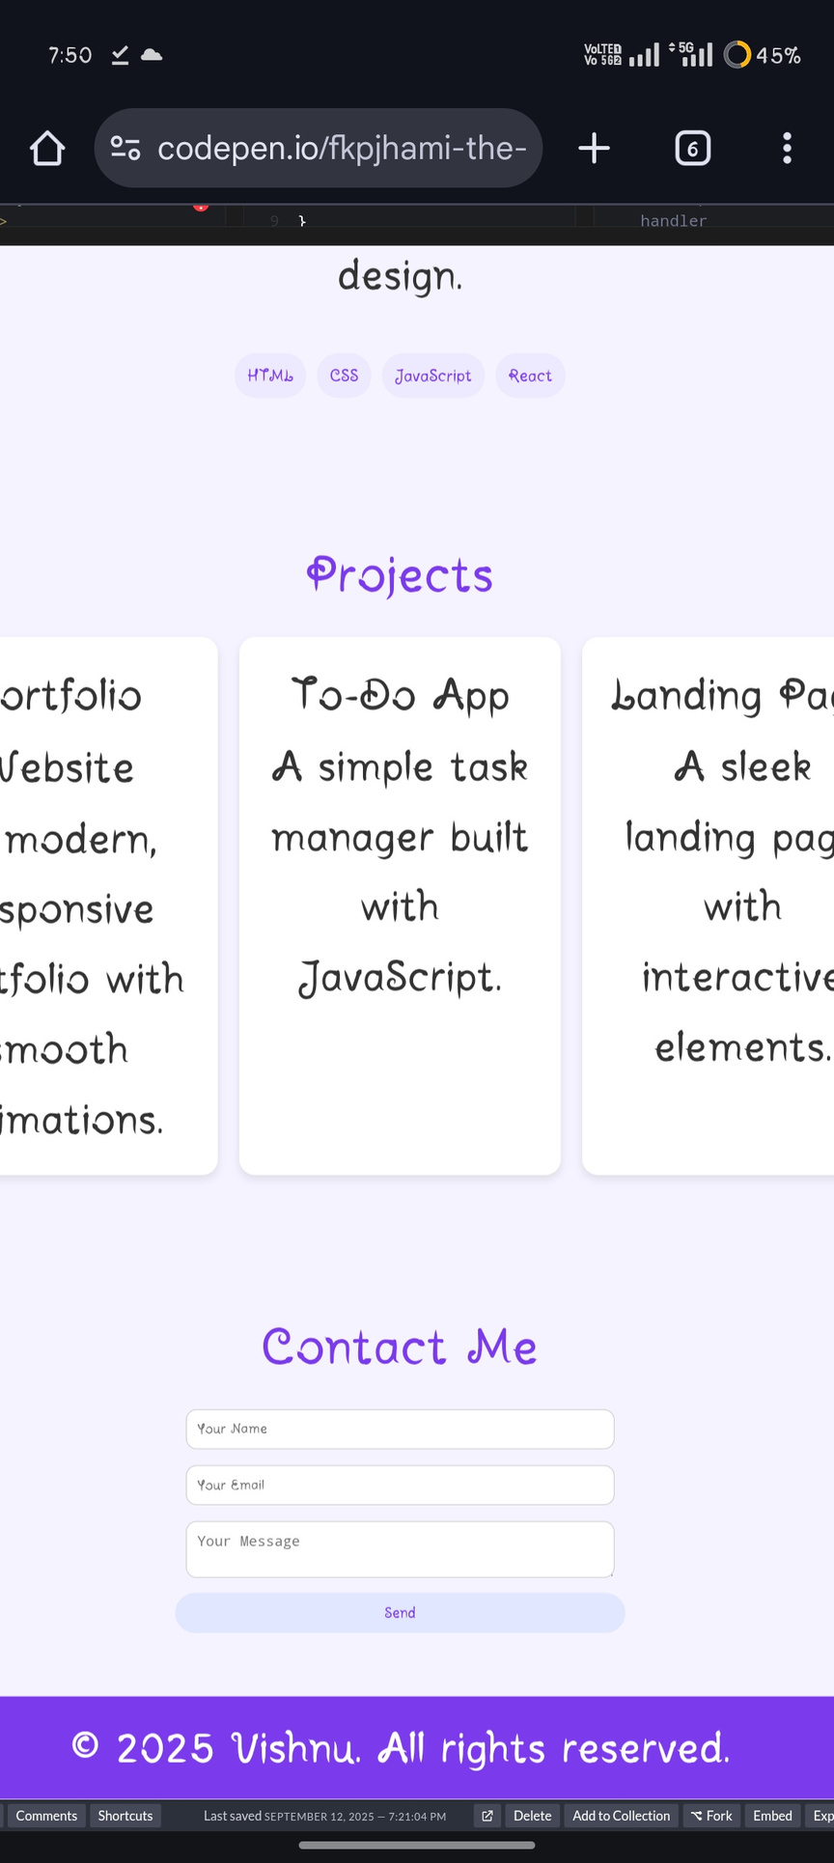
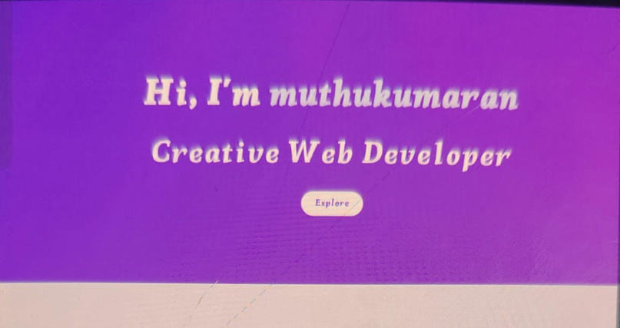
RESULTS AND SCREENSHOTS
•Screenshots of each section
•Before vs After (plain HTML with CSS & JS).
3/21/2024 Annual Review
15
Notes:
15
15
15
15
15
15
15

Slide 16
? Portfolio Project Highlights
1️⃣
CONCLUSION
🔥 Portfolio Project Highlights
🚀Showcases Vishnu’s web development skills.
🚀Features responsive design and smooth animations.
🚀Includes About, Skills, Projects, and Contact sections.
🚀Projects displayed with interactive cards.
🚀Easy way for visitors to connect via contact form.
16
Notes:
16
16
16
16
16
16
16

Slide 17
🔥Final summary
“A violet-themed, responsive portfolio showcasing Vishnu’s web development skills with smooth animations, interactive projects, and an easy contact form.”
Notes:
17
17
17
17
17
17
17

Slide 18
🔥Benefits to society
📌Helps employers and clients easily find and evaluate Vishnu’s skills.
📌Inspires other developers with modern, clean design ideas.
📌Promotes professional networking through the contact form.
📌Demonstrates best practices in responsive web design and animations.
📌Contributes to the digital community by sharing projects and knowledge.
.
Notes:
18
18
18
18
18
18
18

