Slide 1
AASD 4014 · DEEP LEARNING II · FINAL PROJECT
FlameGuard AI
Real-Time Fire & Smoke Detection Using Transfer Learning
GROUP [GROUP #]
SUBMITTED
[Team member names]
[Submission date]
Notes:
Open: fire kills, and the clock starts at ignition, not at alarm. Introduce the team and the one-line goal: detect fire and smoke in images, video and live camera, using a model we fine-tuned ourselves. ~45s.

Slide 2
ROADMAP
Agenda
01
02
The Data — and What Was Wrong With It
The Problem & the Goal
03
The Model & the Experiments
04
Results — and Where It Fails
05
The Application & Live Demo
06
How We Worked & Takeaways
02 / 16
Notes:
Quick roadmap of where the talk is going. Keep it to 20 seconds.

Slide 3
MOTIVATION
The Problem
Conventional smoke detectors only trigger once smoke physically reaches the device . In large or open spaces that can take minutes — or never happen at all.
WHY IT IS HARD
Smoke is semi-transparent and easily confused with fog, steam, dust and cloud . Sunsets and orange lamps mimic flame.
Cameras already watch those spaces. A vision model can monitor a wide area continuously and localise a hazard the moment it appears.
A useful detector must balance recall (never miss a fire) against precision (never cry wolf).
FLAMEGUARD AI
03 / 16
Notes:
A smoke detector needs smoke to physically reach it — in a warehouse, atrium or forest that takes minutes or never happens. Cameras already watch these spaces. The hard part: smoke looks like fog, steam and cloud; sunsets look like fire. So the model must balance missing a real fire against crying wolf. ~1m15.

Slide 4
SCOPE
Objective & Scope
Detect and localise every visible instance of Fire and Smoke in an image, video or live camera stream — in near real time, on commodity hardware, with a locally-trained model and no paid inference API.
In scope
Out of scope
Constraints
Two classes: Fire, Smoke
Transfer learning from pretrained weights
Dataset validation, EDA & tuning
A deployable app + downloadable outputs
Certified safety operation
Thermal / infrared input
Multi-camera fusion & alert dispatch
Any face or identity recognition
A single 4 GB laptop GPU
A public dataset we may not re-annotate
A fixed timeline of four sprints
FLAMEGUARD AI
04 / 16
Notes:
State scope crisply: two classes, transfer learning (the course forbids presenting an unchanged pretrained model), a real application, and honest evaluation. Mention the constraint that shaped everything: one 4GB laptop GPU. ~1m.

Slide 5
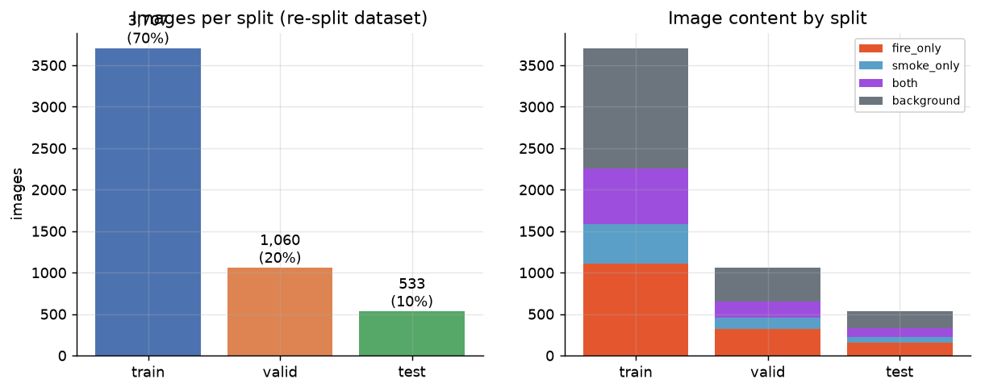
DATA
The Dataset
Roboflow Universe fire & smoke v1 · CC BY 4.0 · 640×640 · YOLOv8 format
5,300
7,225
images
annotations
2
2.3:1
classes — Fire & Smoke
fire-to-smoke imbalance
2,076 images (39%) contain neither class. These are not waste — they teach the model not to alarm on a sunset.
Images per split and the content mix within each
FLAMEGUARD AI
05 / 16
Notes:
Give the shape of the data: 5,300 images, 7,225 boxes, imbalanced ~2.3 to 1 toward fire. Emphasise the 2,076 background images — they are not waste, they are how the model learns not to alarm on a sunset. ~1m.

Slide 6
DATA INTEGRITY — THE HEADLINE FINDING
Data Leakage
The trap
64%
The model would have already seen the test scenes during training. Any metric on that split measures memorisation, not generalisation .
of all images — 3,379 across 409 groups — had near-duplicate copies (mirrored, noise-injected, or sequential frames) scattered across train, validation and test.
The repair
We clustered images by perceptual hash and rebuilt the splits group-wise (seed 42). Afterwards, 0 groups span splits.
Every number in this talk comes from the repaired data.
06 / 16
Notes:
Slow down here. The dataset ships mirrored and noise-injected copies of its own images, scattered across train, validation and test. 409 groups — 64% of all images — had members in more than one split. Training on that and reporting test numbers measures memorisation. We grouped images by perceptual hash and rebuilt the splits group-wise. Every number in this talk comes from the repaired data. If you take one thing from this talk, take this. ~2m.

Slide 7
EDA
Data-Driven Design Choices
Every EDA finding fed a concrete modelling decision.
15%
↑ / ↓
~10%
of boxes are small objects — distant flames only a few pixels across.
Smoke rises and sits high in the frame; fire sits lower and central.
of images are dark — night fires, the hardest and most important case.
Decision →keep the full 640 px input; don't downscale for speed.
Decision →disable vertical-flip ; an upside-down plume never occurs.
Decision →keep brightness jitter moderate so dark scenes survive.
FLAMEGUARD AI
07 / 16
Notes:
Three findings that changed decisions: 15% of boxes are small, so we kept the full 640px input instead of downscaling for speed. Smoke sits high in the frame and fire sits low — which is why we disabled vertical-flip augmentation. And a tenth of the images are dark night fires, so we kept brightness jitter moderate. ~1m15.

Slide 8
METHOD
The Model
ONE FORWARD PASS
Transfer learning, not from scratch
COCO has 80 classes and none of them is fire — so a pretrained model cannot detect fire at all.
Backbone
Extracts features — carries the transferred COCO knowledge
What it does bring is generic vision — edges, textures and shapes learned from 118,000 images. We fine-tune all layers on the fire/smoke data.
▼
Neck (PAN/FPN)
Fuses fine detail with deep semantics for small & large objects
Final model: YOLO11n — a single-stage, anchor-free detector (~5 MB). One forward pass = real-time video & webcam.
▼
Head → NMS
Predicts boxes & classes at 3 scales, then removes duplicates
FLAMEGUARD AI
08 / 16
Notes:
Transfer learning in one breath: COCO has 80 classes and none is fire, so the pretrained model cannot detect fire at all. What it brings is generic vision — edges, textures, shapes — from 118,000 images. We fine-tune ALL layers on our data. Single-stage detection is what makes the live webcam demo possible. ~1m30.

Slide 9
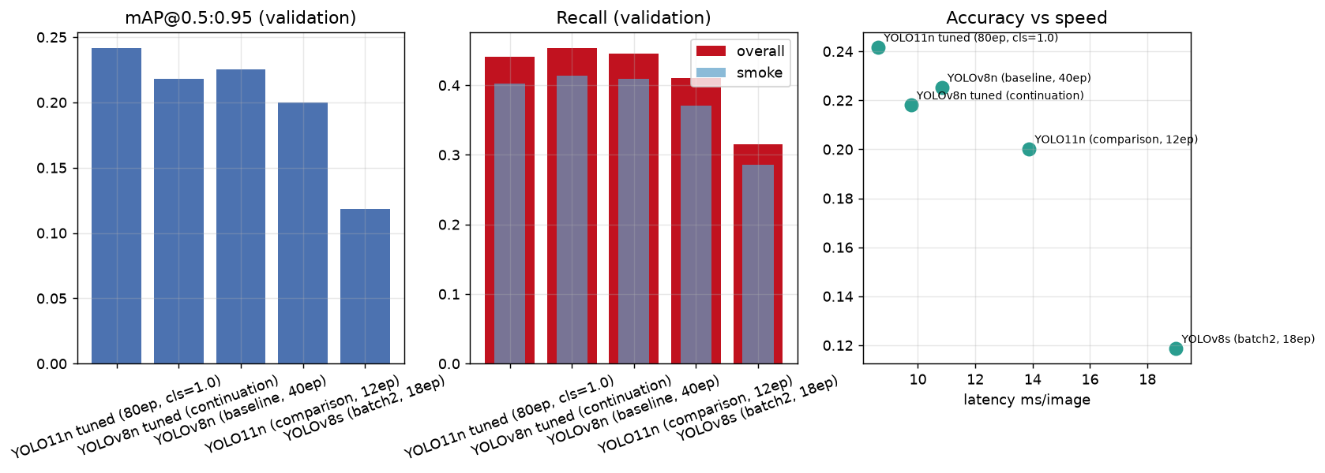
TRAINING
The Experiments
The compute wall
A 4 GB GTX 1650 Ti. AMP auto-disabled (NaN losses on GTX 16xx), so training ran in FP32 — roughly 2× epoch time .
We measured before assuming
YOLOv8s needs 7.94 GB @batch 8 and 6.08 GB @batch 4 — both spill to system RAM. Only batch 2 (1.0 GB) fits. It completed — and still did not beat the baseline at equal epochs.
All models on the repaired validation split — accuracy, recall & the speed trade-off
FLAMEGUARD AI
09 / 16
Notes:
Be honest about the compute wall: FP32 was forced on us because AMP produces NaN losses on GTX 16xx GPUs. We measured YOLOv8s memory before training it — batch 8 wants ~7.9GB, batch 4 ~6.1GB, both spilling to system RAM — so we trained it at batch 2, the only size that fits, with gradient accumulation to a nominal batch of 64. It completed, and the bigger backbone still did not beat the baseline at our budget. ~1m30.

Slide 10
TUNING
Hyperparameter Tuning
A controlled design: one control at a fixed budget, then three probes that each change exactly one variable . Any difference is therefore attributable.
Run — one variable changed
mAP@.5:.95
WINNER → FINAL MODEL
Control (default recipe)
0.137
Probe C: classification-loss weight doubled
A · lower learning rate
0.164 ▲
B · stronger augmentation
0.126 ▼
Negative results are reported as measured. A probe that fails to beat the control is evidence about the data , not an embarrassment to hide.
C · classification weight ×2
0.170 ▲
FLAMEGUARD AI
10 / 16
Notes:
The design matters more than the result: a control run at the same budget, then three probes each changing exactly one thing. That makes any difference attributable. Report the outcome honestly — including probes that did not beat the control. The classification-loss probe won and went into the final model. ~1m15.

Slide 11
EVALUATION
Final Results
Test split evaluated exactly ONCE
.505
PER-CLASS AP@0.5 — SMOKE IS HARDER
Fire
0.513
mAP @0.5
Smoke
0.498
.246
.591
.476
55
15.2
mAP@.5:.95
precision
recall
FPS on GPU (18.2 ms)
FPS on CPU — still usable
FLAMEGUARD AI
11 / 16
Notes:
Stress the discipline: the threshold was chosen on validation, then the test set was touched once. Overall mAP@0.5 is 0.505. The per-class gap is the story — Fire AP 0.513 vs Smoke 0.498. Smoke is harder, exactly as the EDA predicted. ~1m45.

Slide 12
LIMITATIONS
Failure Modes
1
THE DIAGNOSTIC THAT EXPLAINS IT
A plain orange rectangle — no fire, no texture — is read as Fire, 0.74 . Random noise gives zero.
fire-vs-smoke class confusion in the entire test set
The errors are almost never about what a thing is — they are about whether it is there at all (missed faint plumes, distant flames, false alarms on warm scenes).
The model learned a colour prior , not the structure of flame. That is why the next step is hard-negative mining , not a bigger network.
12 / 16
Notes:
Do not skip this. The model makes almost no class confusions — 1 in the whole test set — its errors are about whether something is there at all. Then the punchline: we fed it a plain orange rectangle, no fire, no texture, no structure, and it said Fire with 0.74 confidence, while random noise gives zero. The model learned a colour prior, not a concept of flame. That explains the entire false-positive gallery, and it is why hard-negative mining beats architecture search as the next step. ~1m45.

Slide 13
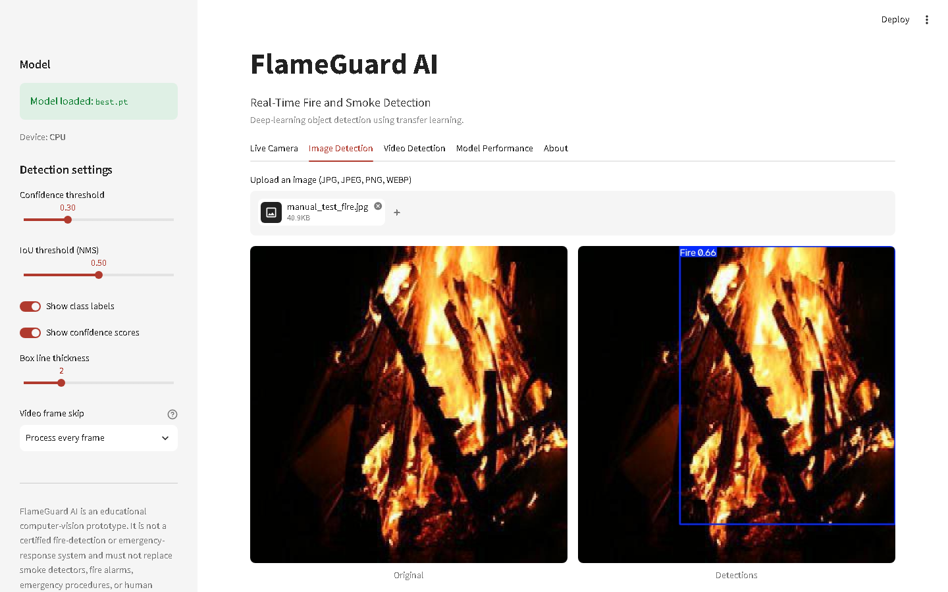
PRODUCT
The Application
Image
Video
Live camera
Performance
About
One shared inference engine. Image, video and webcam all call the same predict path — a threshold means the same thing everywhere, and there is exactly one place a bug could hide.
OpenCV desktop fallback. Browser camera access fails in exactly the situation where a demo must not — so there is an offline path that always works.
Private by design. Everything runs locally — no frame ever leaves the machine. Two classes only; no face or identity recognition.
FLAMEGUARD AI
13 / 16
Notes:
Point out the engineering: image, video and webcam all call the same predict path, so a threshold means the same thing everywhere and there is exactly one place a detection bug could hide. Mention the OpenCV fallback and why it exists — browser camera access fails in exactly the situation where a demo must not fail. ~1m15.

Slide 14
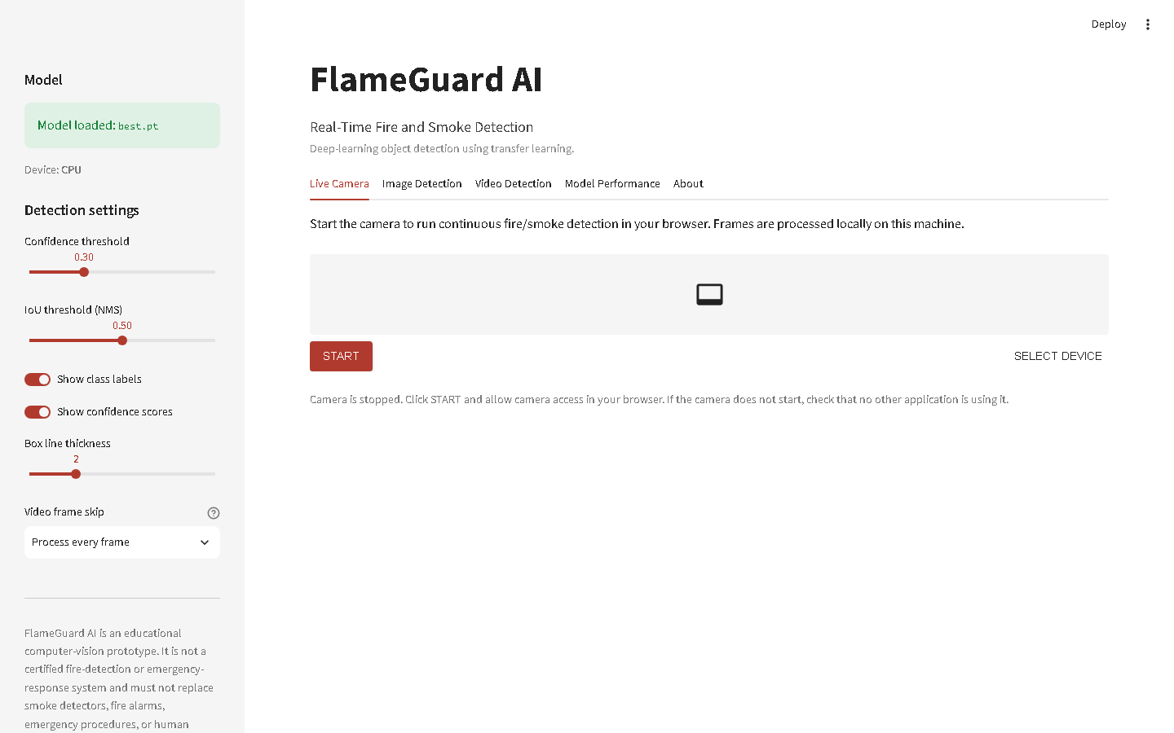
DEMO
Live Demonstration
DEMO ORDER
Model & device status in the sidebar
Upload a fire image → boxes, counts, downloads
A smoke image, then a both-classes image
A hard / negative image — let it be wrong, explain why
Run the short video, then start the webcam
Open the Model Performance tab
If anything fails: OpenCV fallback → backup video. Never debug live.
14 / 16
Notes:
DEMO ORDER: 1) show model + device status in the sidebar; 2) upload a fire image; 3) a smoke image; 4) a both-classes image; 5) a negative/difficult image — let it be wrong and explain why; 6) run the short video; 7) start the webcam; 8) show the performance tab. If the webcam fails, switch to the OpenCV fallback; if that fails, play the backup video. Never debug live — fall back. ~2m30.

Slide 15
PROCESS
How We Worked
Four one-week Scrum sprints · five roles · 84 story points.
Sprint 1
Sprint 2
Sprint 3
Sprint 4
Planning, dataset validation, leakage repair, EDA
Environment, baseline, YOLOv8s, evaluation
Tuning probes, final model, Streamlit app, webcam
Test eval, error analysis, report, slides, packaging
22 pts
14 pts
26 pts
22 pts
Risk management earned its keep: the leakage risk was caught in Sprint 1 planning and fixed before a single GPU-hour was spent on a model whose evaluation would have been meaningless.
66 ✓
automated tests pass
FLAMEGUARD AI
15 / 16
Notes:
Keep it short. The point: the risk register earned its keep — we identified the leakage risk during Sprint 1 planning and mitigated it before spending GPU time on a model whose evaluation would have been worthless. 66 automated tests pass. ~1m.

Slide 16
WRAP-UP
Conclusion & Future Work
THREE LESSONS WORTH CARRYING
FUTURE WORK
1
Dataset hygiene moved results more than any hyperparameter. Two-thirds of the images leaked across splits.
Hard-negative mining
Thermal / RGB fusion
Temporal modelling
Higher resolution (960 px)
2
The errors are detection errors, not classification errors — so hard negatives and faint-plume sensitivity come next.
Edge deployment
3
The confidence threshold is a safety decision, not a library default to accept silently.
Educational prototype only. Not a certified fire-detection or emergency system — never a replacement for smoke detectors, alarms, procedures or human supervision.
Thank you — questions?
FlameGuard AI
Notes:
Land the three lessons. Then the disclaimer — say it out loud, do not just leave it on the slide. Finish by inviting questions. ~1m15.

