Slide 1

Sales and Profit Analysis for a Superstore
MUTHUKUMARAN E
STU65b8f32f89f4f1706619695
PERIYAR UNIVERSITY
DEPARTMENT OF STATISTICS
II.M.SC.STATISTICS

Slide 2

PROBLEM STATEMENT
The goal of this project is to analyze sales performance and profit trends across various regions, product categories, and segments. The company aims to identify areas for improvement and opportunities to maximize profits.
Key Questions:
Which product categories and sub-categories generate the most profit?
How do sales and profit vary by region and customer segments?
Are there any significant trends in shipping modes affecting profits?

Slide 3
Project Description
This project focuses on performing an exploratory data analysis (EDA) using the superstore dataset to uncover insights into the store’s performance. The dataset includes information on sales, profits, categories, regions, and customer segments.
Steps Involved:
Data Cleaning: Remove missing or duplicate entries and ensure data consistency.
Exploratory Data Analysis: Analyze relationships between sales, profit, categories, and regions.
Data Visualization: Use charts and graphs to present findings.

Slide 4

WHO ARE THE END USERS?
Business Managers: To make informed decisions about product strategies.
Regional Sales Teams: To understand performance trends by region.
Marketing Teams: To target high-profit customer segments effectively.

Slide 5

Technology Used
Python: Pandas, Matplotlib, Seaborn for data analysis and visualization.
Jupyter Notebook/Google Colab: For running the analysis.
Libraries: Pandas (for data handling), Seaborn & Matplotlib (for visualization).

Slide 6
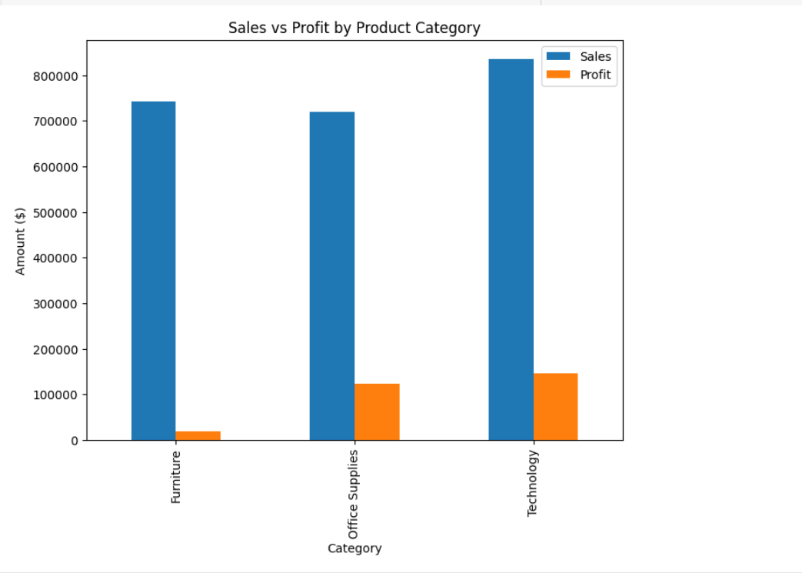
RESULTS
1. Sales vs Profit by Product Category
Technology Leads: Technology dominates in both sales and profit.
Office Supplies Profitable: Office Supplies have higher profit margins.
Furniture Struggles: Furniture lags in sales and profit.

Slide 7
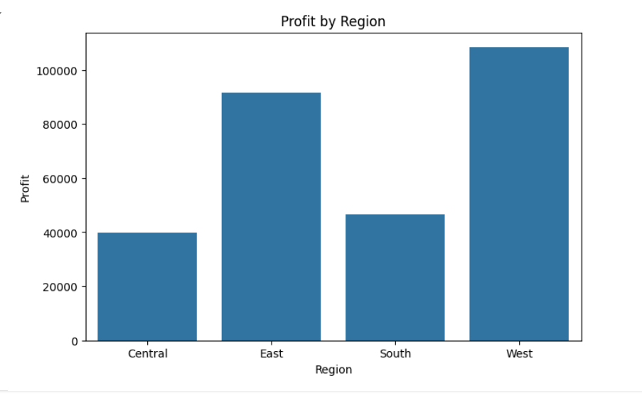
RESULTS
2. Profit by Region
The West and East regions are the most profitable, while the South region shows minimal profit, indicating an area for improvement.
Marketing efforts or operational costs could be optimized in underperforming regions.

Slide 8
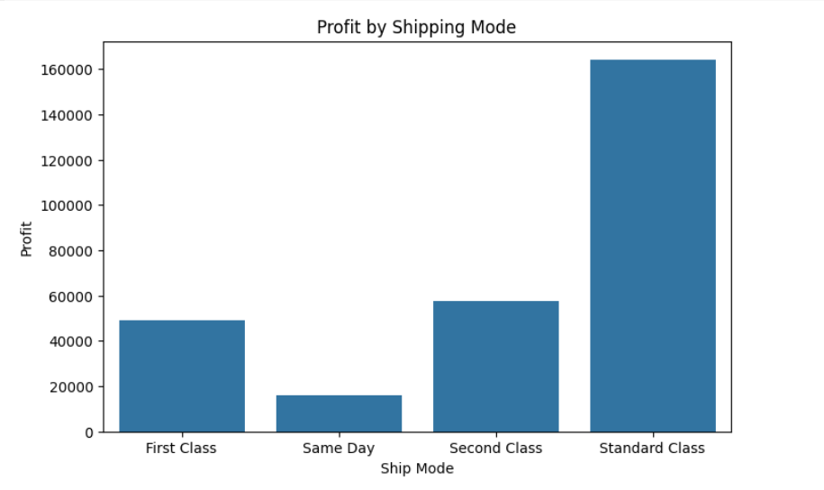
RESULTS
3. Impact of Shipping Mode on Profit
Same Day and Second Class shipping modes show higher profits, indicating customers' willingness to pay for faster deliveries.
Standard Class has lower profit margins, possibly due to higher operational costs.

Slide 9
Thank You
.
.

