Slide 1
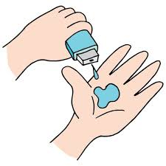
Doctor Visits Analysis
MUTHUKUMARAN E,
APPLY_172677326666ec7812bb3ed,
PERIYAR UNIVERSITY,
DEPARTMENT OF STATISTICS,
II.M.Sc.Statistics.

Slide 2

PROBLEM STATEMENT
The aim of this project is to analyze a dataset containing information about individual’s doctor visits, health conditions, and socio-economic factors. The objectives include:
Identifying patterns in illnesses, income, and healthcare visits.
Exploring gender-based differences in health conditions and reduced activity days.
Visualizing correlations between variables to gain insights into factors affecting doctor visits.

Slide 3
Project Description
This project investigates how various factors, such as income, gender, health conditions, and insurance status, influence doctor visits.
The dataset comprises 5,190 observations on 12 variables, including illness count, reduced activity days, and insurance status. Key tasks include:
Identifying duplicates and missing values.
Analyzing illness patterns and their impact on activity reduction.
Exploring income's effect on healthcare access and doctor visits.

Slide 4

WHO ARE THE END USERS?
Healthcare Providers: To understand patient patterns and allocate resources effectively.
Policy Makers: To identify gaps in healthcare access and devise insurance policies.
Researchers and Analysts: To analyze correlations between socio-economic and health variables for academic studies.

Slide 5

Technology Used
Programming Language: Python
Libraries:
Data Analysis and Cleaning: pandas, numpy
Visualization: matplotlib, seaborn

Slide 6
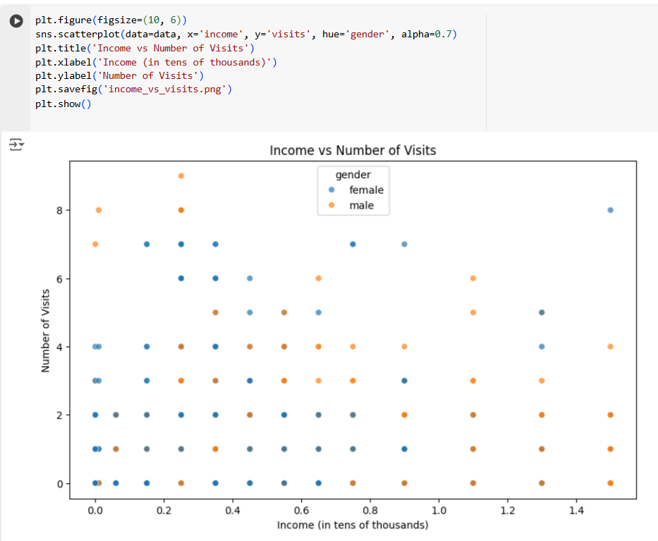
RESULTS
1. Income vs. Hospital Visits
The scatter plot shows the relationship between income and the number of hospital visits for both males and females. There seems to be a slight positive correlation between income and the number of visits. However, the relationship is not very strong, and there is a lot of overlap between the data points for males and females.

Slide 7
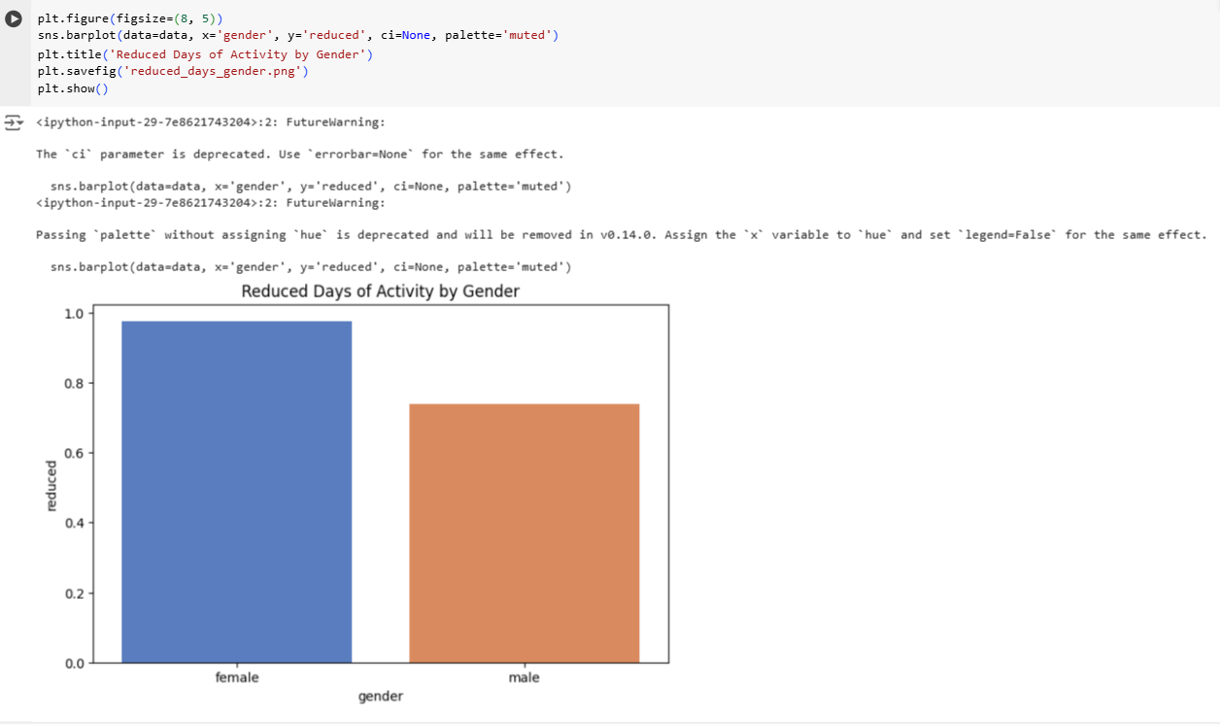
RESULTS
2. Reduced Activity Days by Gender
The bar plot shows that females have more reduced activity days than males.

Slide 8
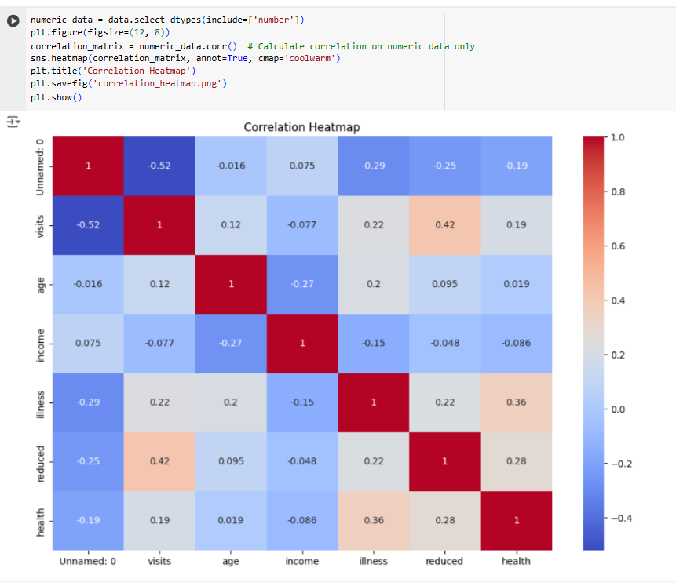
RESULTS
3. Correlation Heatmap
The heatmap shows the correlation between different numerical variables in the dataset. The color intensity represents the strength of the correlation, with red indicating positive correlation and blue indicating negative correlation. For example, reduced activity days have a strong positive correlation with illness, meaning that as the number of illnesses increases, the number of reduced activity days also increases.

Slide 9
Thank you
.
.

