Slide 1

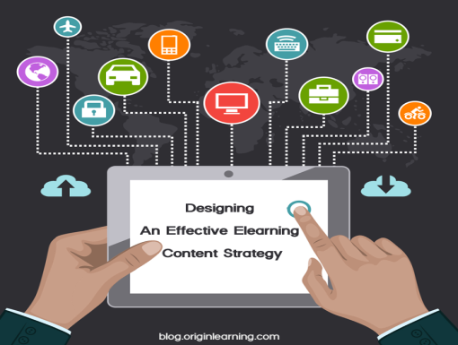


My Elearning Center
Traditional to eLearning
Bring the content of a book into internet learning format and make the benefit available to all and Globally.
A Book can be used/borrowed by only one person at a time. If the same book is converted into e Learning format, then it can be used by everyone in the world. Tracking who is ready is easy. There is no need to take the book in hand or material in hand. Learn while you travel, leisure or any specific time in your own pace

Slide 2

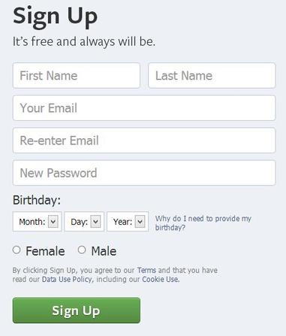
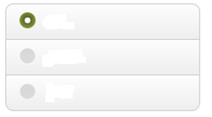
You can signup for a user in this page. You can sign up as a Student, Course Content Creator or a Guest to just browse. It’s Free to signup. The elearning portal is created for the purpose to make the learning available FREE to all irrespective race, religion, rich or poor or any person in any part of the world. Learning is privilege and cannot be stopped because of the above.
As Student
As Content Writer
Guest

Slide 3
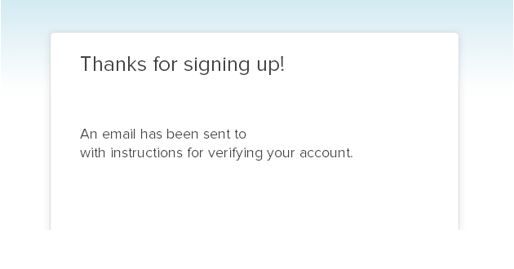



Your email id
Please check the mail. After you verify through email, please come and login and enjoy the benefits of this learning. A) if you signed up as Student, then you can upgrade it to become a Content Creator and help creating any content for the world/people. B) if you signed up as Content Creator, please feel free to put your content and help the world c) if you are a guest.. Please do not be a Guest. We want you to be committed to our learning portal. Please choose one of (A) or (B) and help the site growing.
This site cannot be run without your contribution. This whole site is run using your dollar amount. So please open your heart and wallet for us. Please register and donate so that your name and email id is provided for us to send tax receipt.

Slide 4

After Logged In
Re
Welcome Muthukumar (Student)
Sign Out
My Dashboard
MyAccount
Search for Courses
Available Course – Subscribe to Attend
My Donation
Refere your friend
Upgrade Your Account to Content Creator

Slide 5
After Logged In
Re
Welcome FirstName (Content Creator)
Sign Out
My Dashboard
MyAccount
Search for Courses
Contents Created By Me
My Donation
Refere your friend
Create Content
Upgrade Your Account to Content Creator

Slide 6
OnLine Elearning Center
Entity Relationship
User table
Id(key)
First name(character60)
Last name(character60)
Email id (character100)
User type=usertype.id (Foreign key)
User Type
-----------------
Id (key)
Usertype(char10)
Description(charc60)
Many:1
1:M
Courses Table
Id(key)
Course Title (Character 200)
Course Description Text size
Course File (File Location where the course is provided as .doc,.txt or .ppt)
Course Created By (user. id foreignkey
Cost of the course
Course Attended
Id(key)
User.id
Course.id
Cost
1:M
M:M
DonatedBy
Id(key)
User.id
Date donated
Amount donated

