Slide 1
Predicting satisfaction among the students on e-learning under the pandemic situation
Muthumal A.L.
219371U

Slide 2
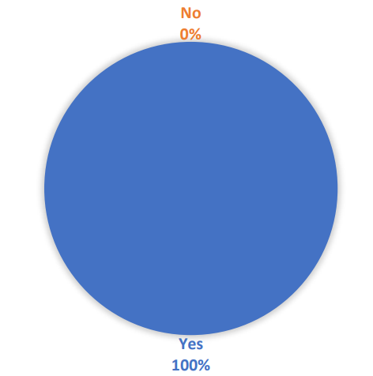
Introduction
Target population is undergraduate students in universities
Questionnaire was prepared using Google forms
Data collected online by sharing form among the students
Total of 33 responses, all of them were experiencing e-learning the pandemic situation

Slide 3
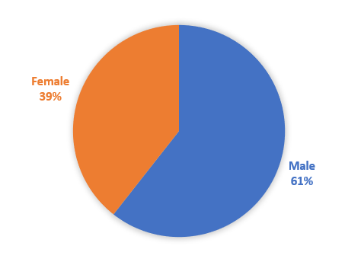
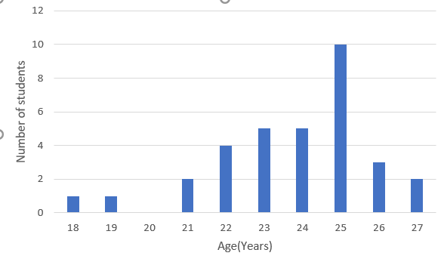
Respondents: Gender and Age

Slide 4
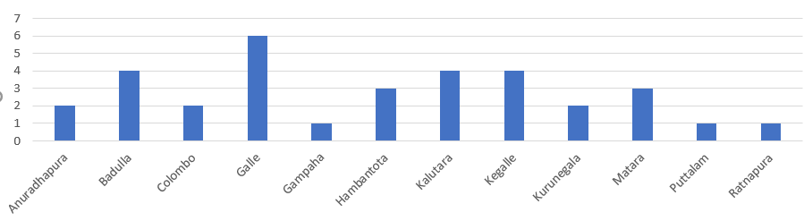
Respondents: Current place of living (District)

Slide 5
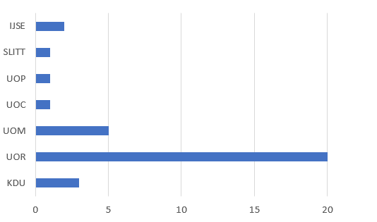
Respondents: University

Slide 6
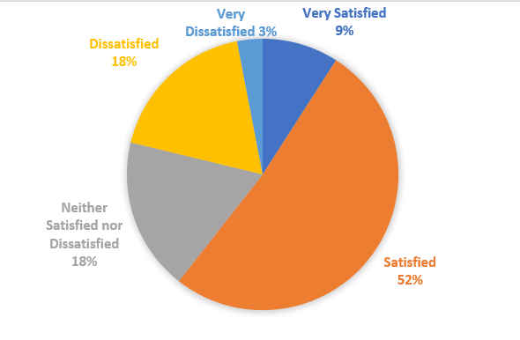
How much respondents satisfied with the e-learning under the pandemic situation

Slide 7
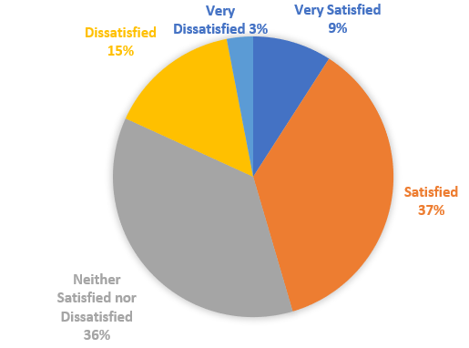
How much respondents satisfied with the online interaction they had with the lecturers

Slide 8
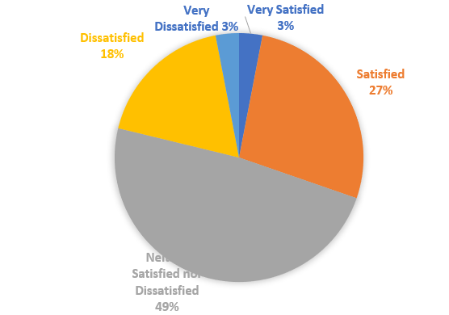
How much respondents satisfied with the course level of engagement

Slide 9
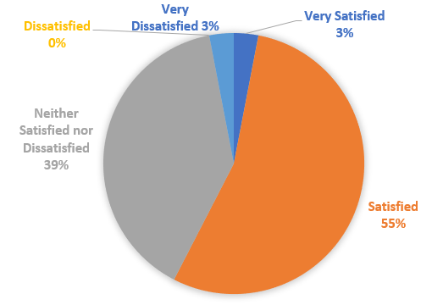
How much respondents satisfied with the lecture's various online teaching approaches

Slide 10
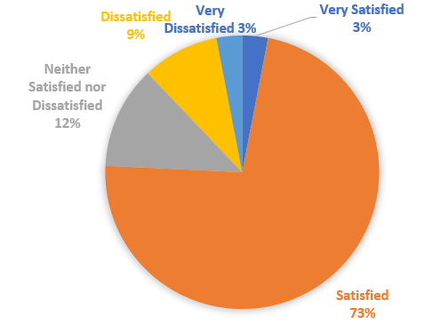
How much respondents satisfied with the e-learning materials

Slide 11
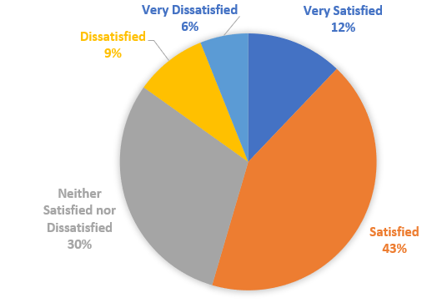
How much respondents satisfied with their grades

Slide 12
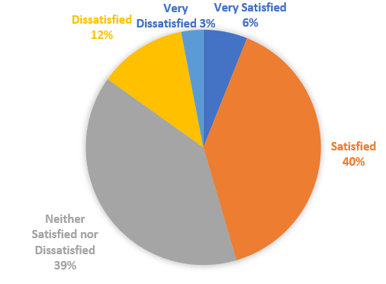
How much respondents satisfied with staff responsiveness to technical support

Slide 13
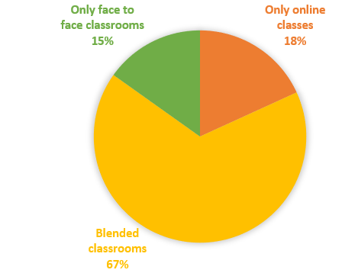
What type of learning method respondents recommended as future learning

Slide 14
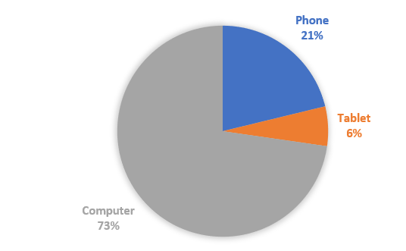
What kind of device respondents used for e-learning

Slide 15
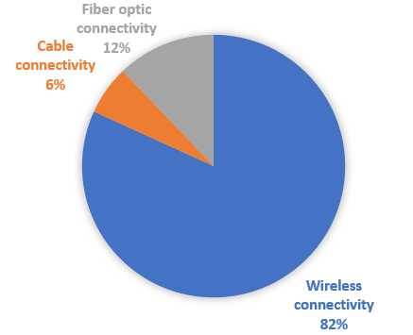
How much respondents satisfied with the e-learning under the pandemic situation

Slide 16
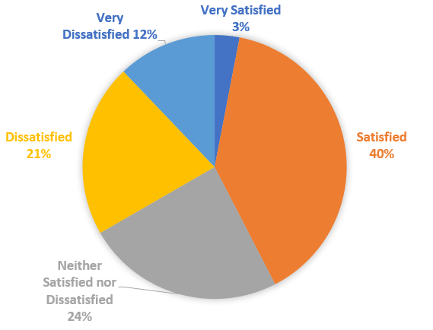
How much respondents satisfied with the internet connectivity

Slide 17
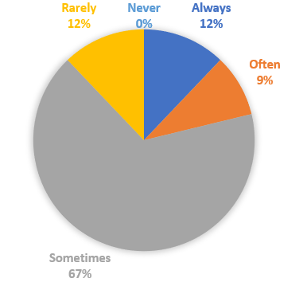
How much respondents face connection interruptions during lectures

Slide 18
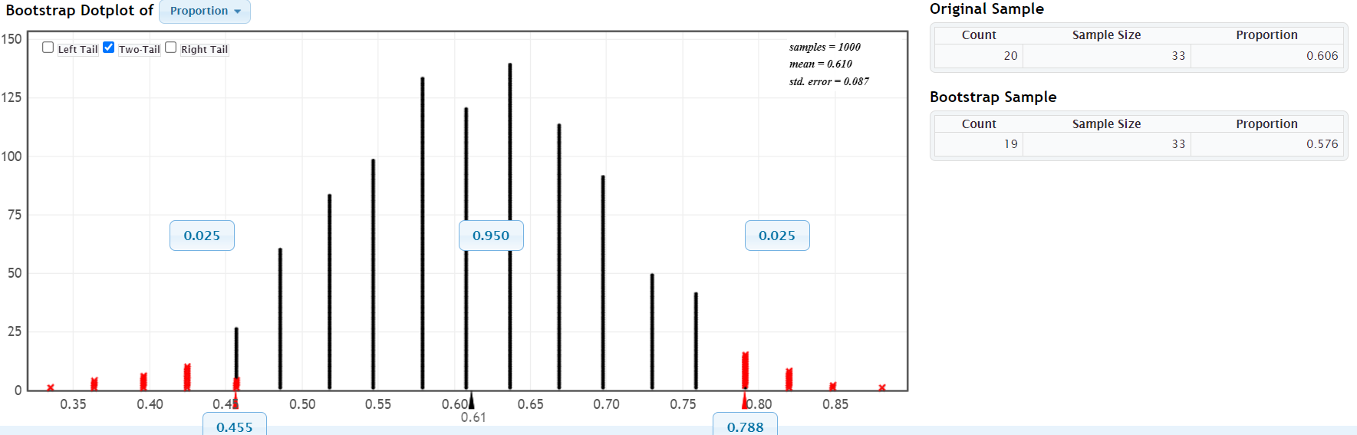
Bootstrap Distribution
Does undergraduates are satisfied with e-learning under the pandemic situation
I’m 95% confident that 45.5% to 78.8% undergraduates are satisfied with e-learning under the pandemic situation

Slide 19
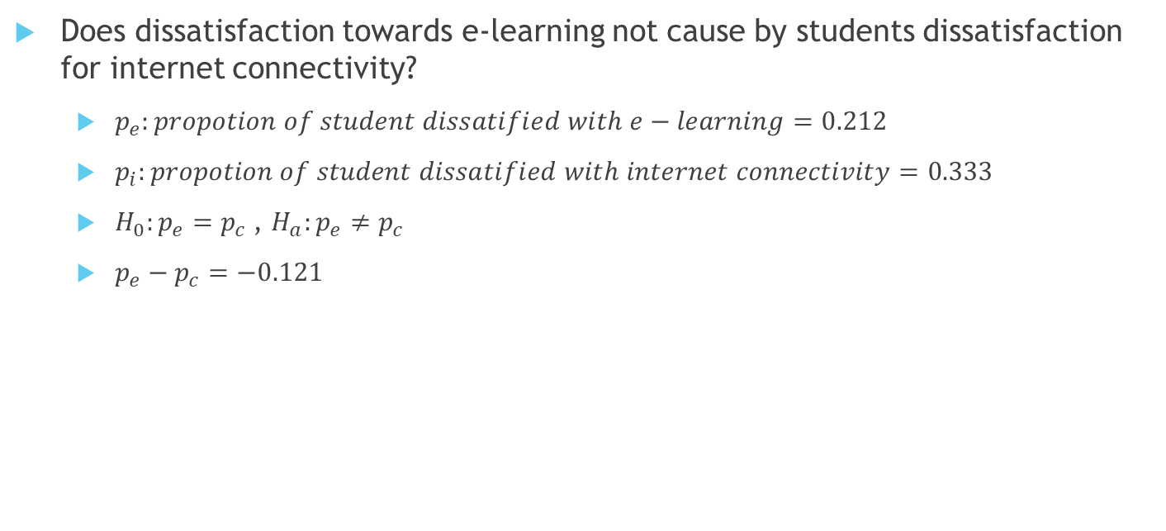
Hypothesis Testing
Does dissatisfaction towards e-learning not cause by students dissatisfaction for internet connectivity?
$p_{e}:propotion of student dissatified with e−learning=0.212$
$p_{i}:propotion of student dissatified with internet connectivity=0.333$
$H_{0}:p_{e}=p_{c}$, $H_{a}:p_{e}≠p_{c}$
$p_{e}−p_{c}=−0.121$

Slide 20
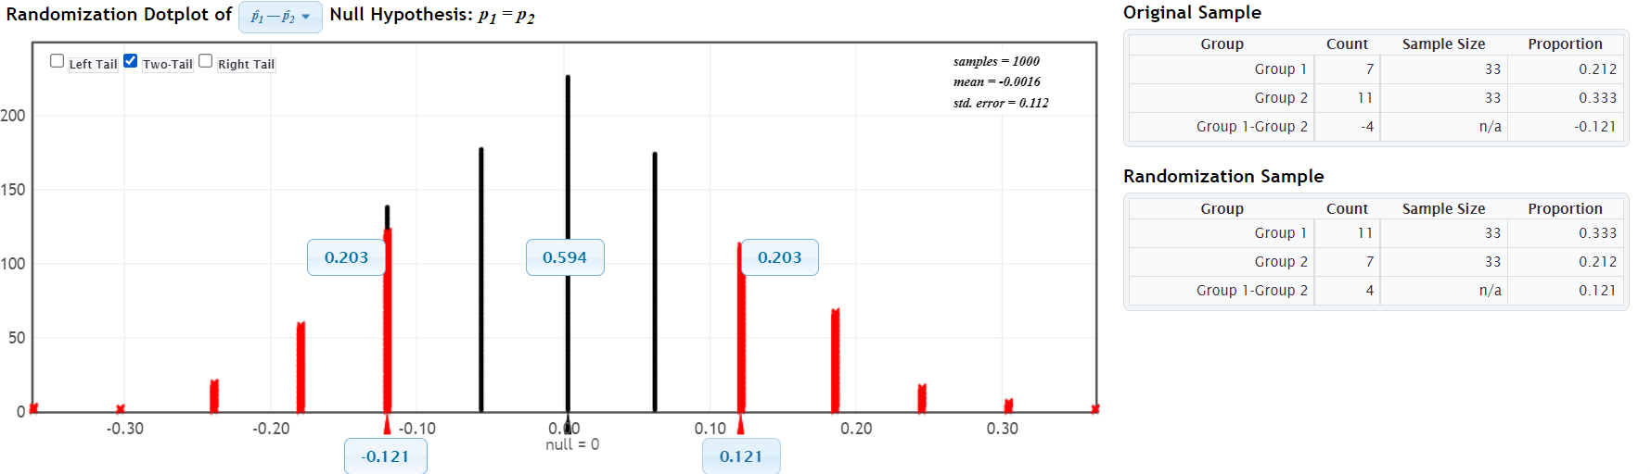
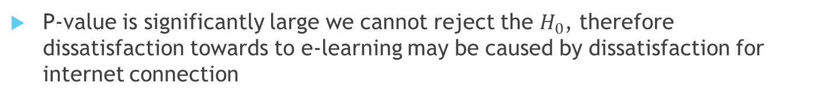

Hypothesis Testing
$$p−value=0.406$$
P-value is significantly large we cannot reject the $H_{0}$, therefore dissatisfaction towards to e-learning may be caused by dissatisfaction for internet connection

Slide 21
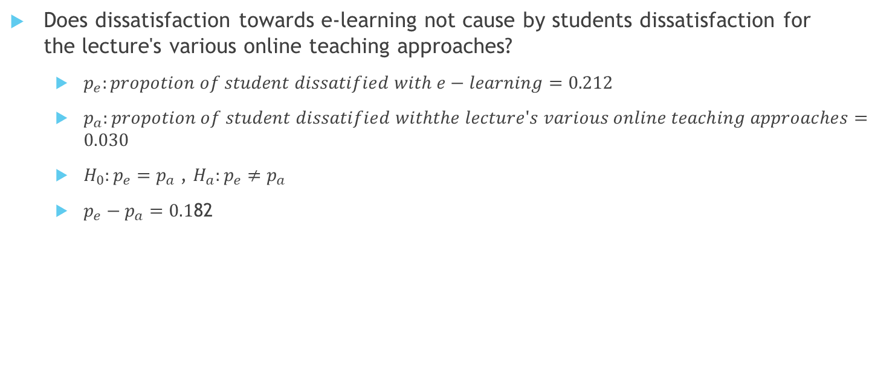
Hypothesis Testing
Does dissatisfaction towards e-learning not cause by students dissatisfaction for the lecture's various online teaching approaches?
$p_{e}:propotion of student dissatified with e−learning=0.212$
$p_{a}:propotion of student dissatified withthe lecture's various online teaching approaches=0.030$
$H_{0}:p_{e}=p_{a}$, $H_{a}:p_{e}≠p_{a}$
$p_{e}−p_{a}=0.1$82

Slide 22
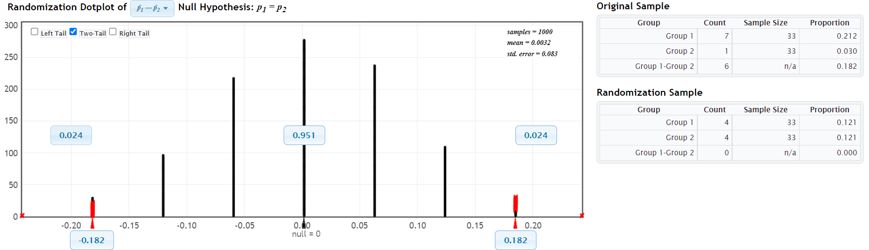
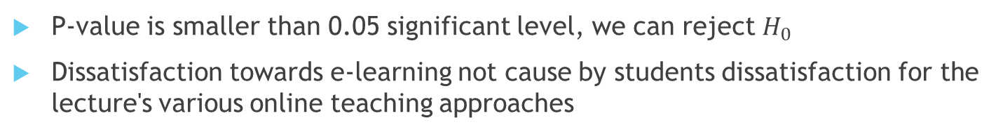

Hypothesis Testing
$$p−value=0.048$$
P-value is smaller than 0.05 significant level, we can reject $H_{0}$
Dissatisfaction towards e-learning not cause by students dissatisfaction for the lecture's various online teaching approaches

Slide 23
Conclusion
The sample is not truly random it may include volunteer biased therefore cannot finalize the conclusions for population.
I’m 95% confident that 45.5% to 78.8% undergraduates are satisfied with e-learning under the pandemic situation
Dissatisfaction towards e-learning not cause by students dissatisfaction for the lecture's various online teaching approaches
Dissatisfaction towards to e-learning may be caused by dissatisfaction for internet connection

