Slide 1
Frequency-Domain Attributes of a Clock Signal
Presented By: Muthupandi K

Slide 2
Introduction
Definition
Frequency-domain analysis studies how signal power is distributed over frequency.
Time domain → timing view
Frequency domain → spectral view
Uses:
PSD (Power Spectral Density)
Phase Noise
Instead of time, we analyse the signal in frequency to understand noise behaviour.

Slide 3
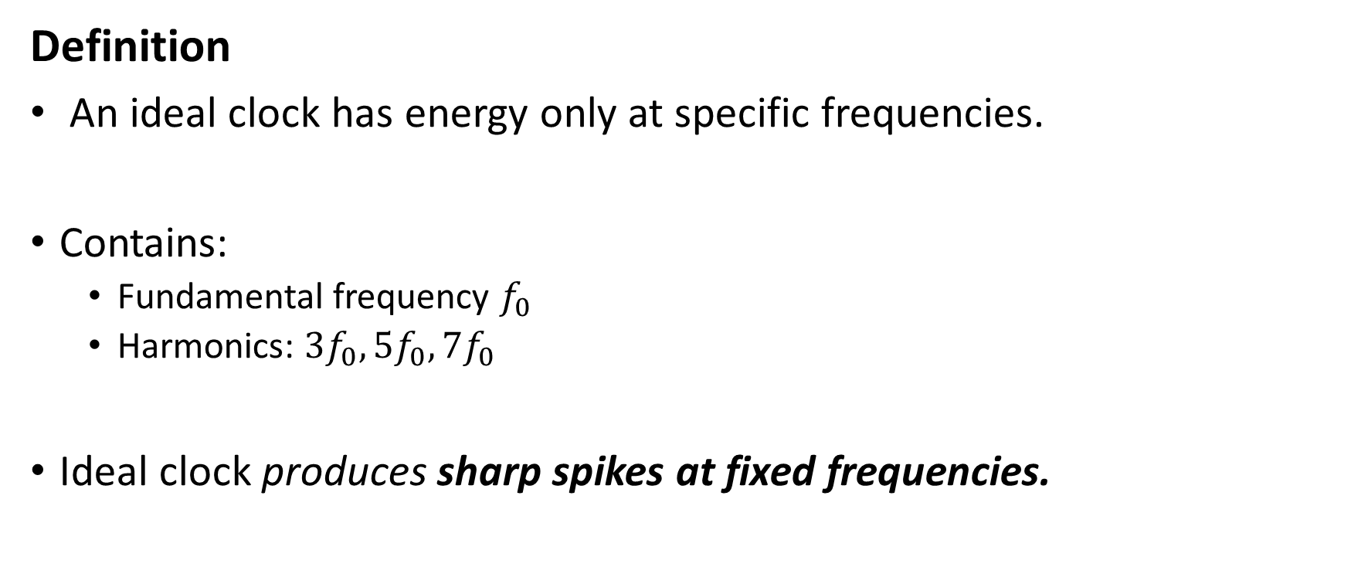
Ideal Clock in Frequency Domain
Definition
An ideal clock has energy only at specific frequencies.
Contains:
Fundamental frequency $f_{0}$
Harmonics: $3f_{0},5f_{0},7f_{0}$
Ideal clock produces sharp spikes at fixed frequencies.

Slide 4
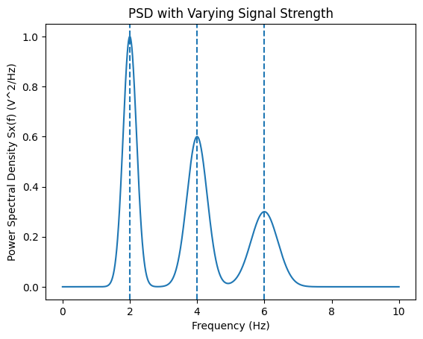
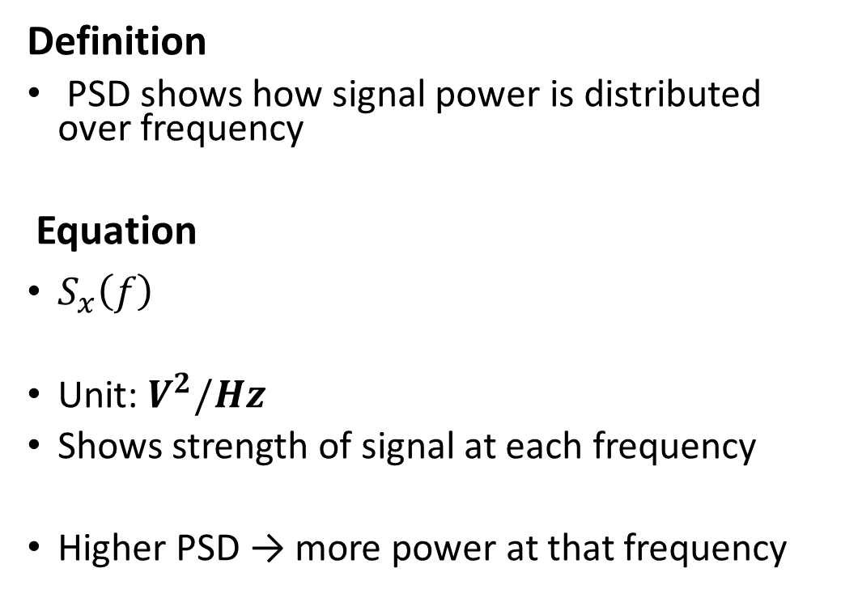
PSD (Power Spectral Density)
Definition
PSD shows how signal power is distributed over frequency
Equation
$S_{x}\left(f\right)$
Unit: $V^{2}/Hz$
Shows strength of signal at each frequency
Higher PSD → more power at that frequency

Slide 5
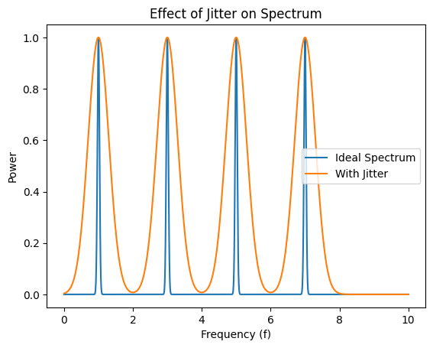
Effect of Jitter on Spectrum
Definition
Jitter spreads energy around frequency components.
Ideal → sharp spikes
With jitter → spread (sidebands)
Noise causes energy to spread → reduces signal quality

Slide 6
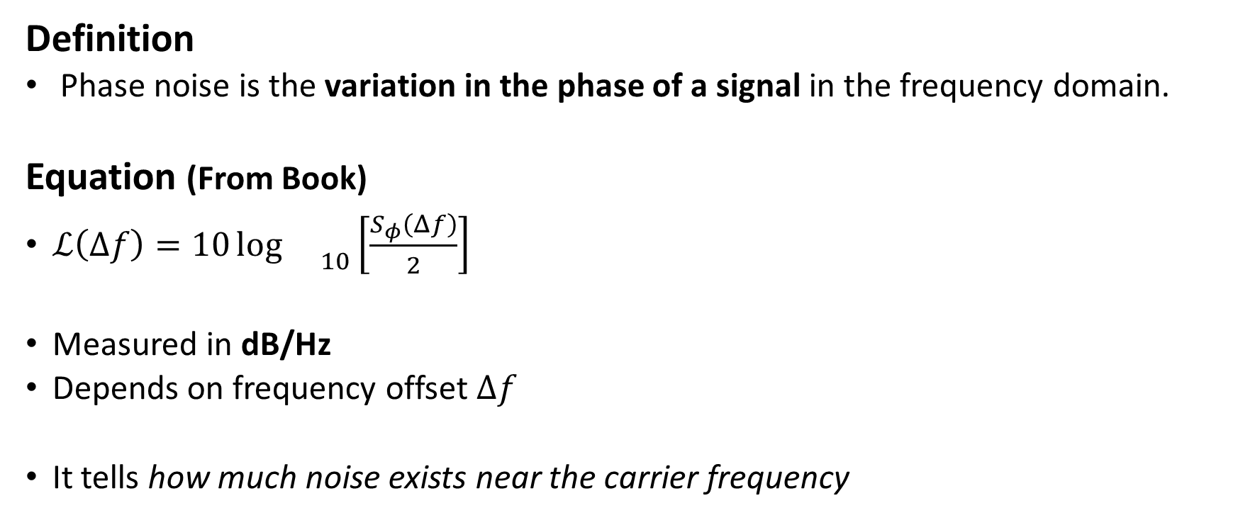
Phase Noise
Definition
Phase noise is the variation in the phase of a signal in the frequency domain.
Equation (From Book)
$ℒ\left(Δf\right)=10{\log{}}_{10}\left[\frac{S_{φ}\left(Δf\right)}{2}\right]$
Measured in dB/Hz
Depends on frequency offset $Δf$
It tells how much noise exists near the carrier frequency

Slide 7

Phase Noise Using PSD Ratio
Equation:
$ℒ\left(Δf\right)=10{\log{}}_{10}\left[\frac{S_{x}\left(f_{0}+Δf\right)}{S_{x}\left(f_{0}\right)}\right]$
Ratio of:
Noise power
Carrier power
Compares noise level with main signal

Slide 8
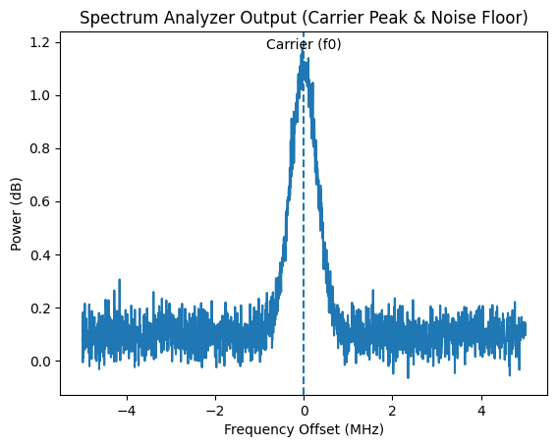
Spectrum Analyser Measurement
Definition
Instrument used to measure PSD and phase noise
Displays:
Carrier peak
Noise floor
Used in real measurements

Slide 9
Relation Between Time & Frequency Domain
Time jitter ↔ Phase noise
Both represent the same concept in different domains
Time variation becomes spectral spreading

Slide 10
Why Frequency Analysis is Important
Detect noise sources
Analyse signal quality
Improve system performance
Helps design high-speed and reliable systems

Slide 11
Applications
RF systems
PLL design
Communication systems
High-speed processors

Slide 12
Conclusion
Frequency domain shows:
Power distribution
Noise behaviour
“Phase noise and PSD help analyse clock quality in high-frequency systems”

