Slide 1
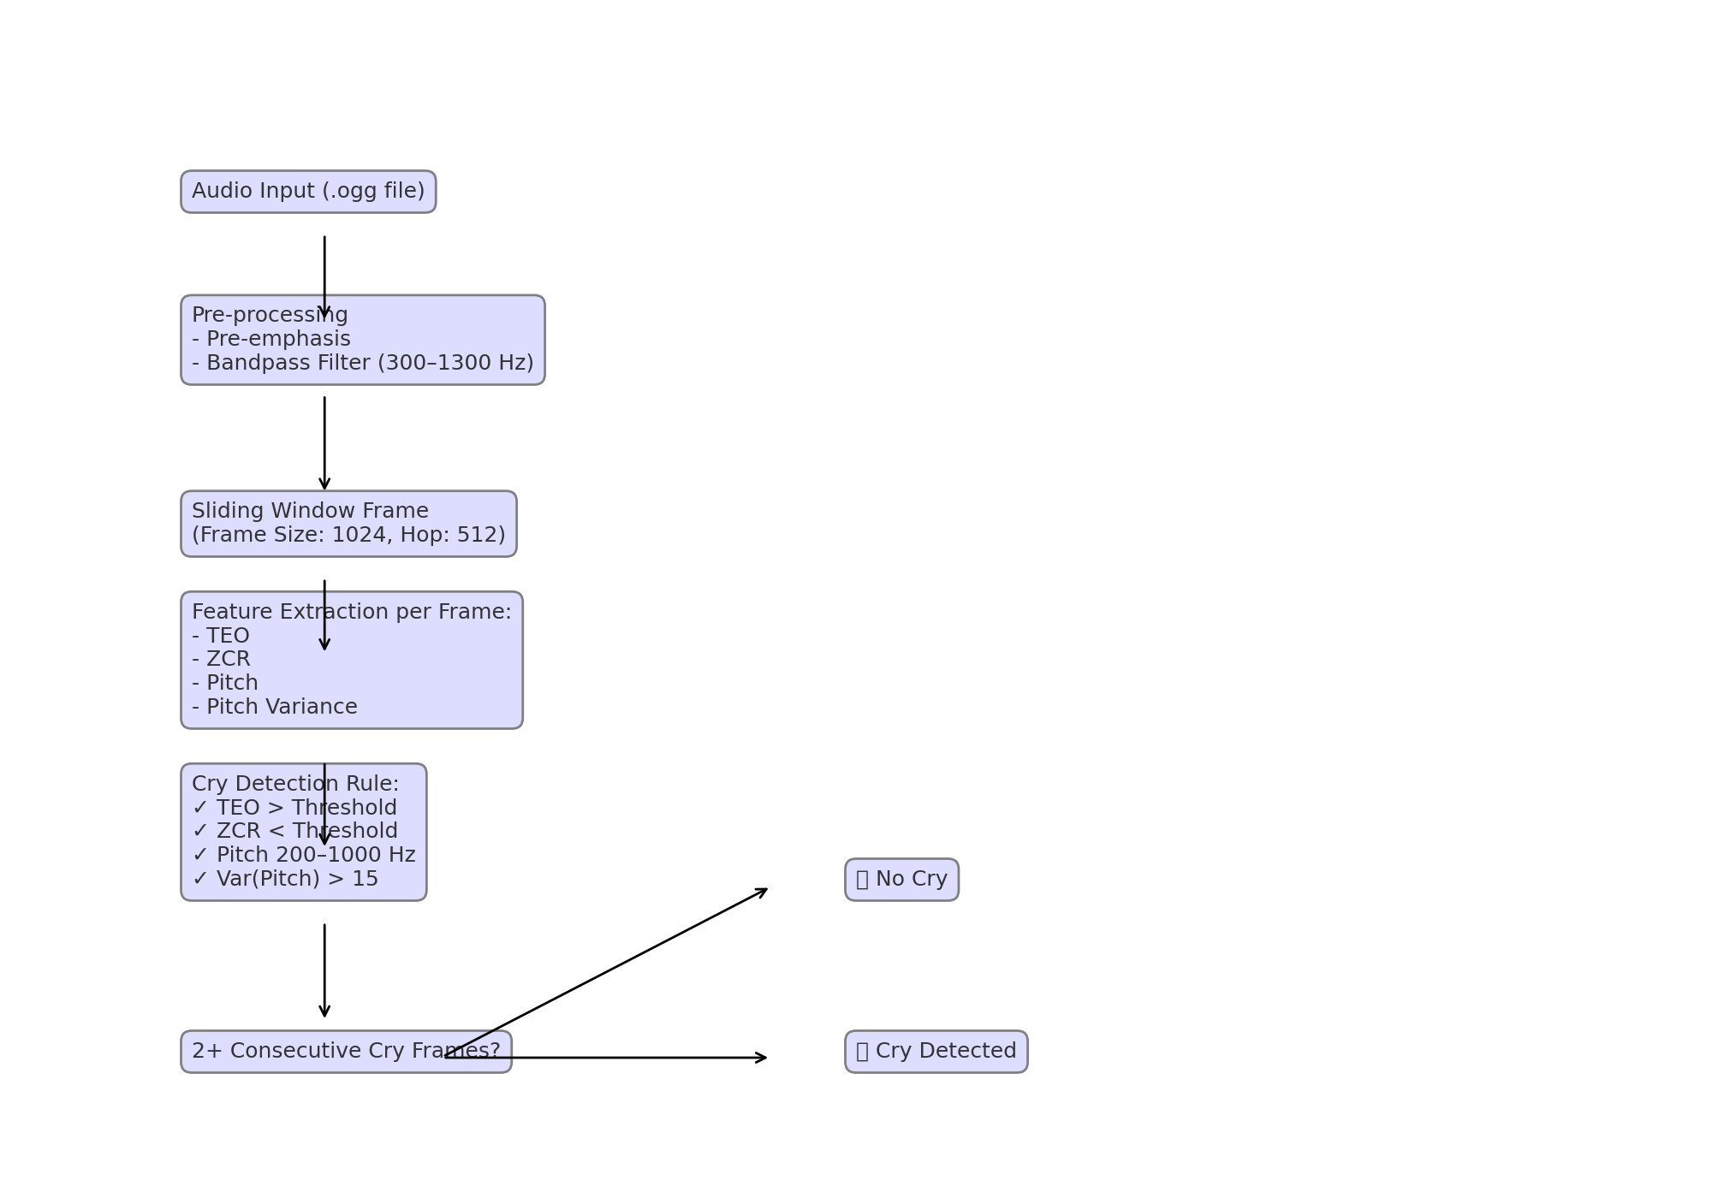
Cry Detection Logic Flowchart

Slide 2
Cry Detection Logic Flowchart
Input: .ogg audio file (e.g., from a baby monitor)
Pre-processing:
Pre-emphasis: Enhances high frequencies (e.g., sharp cries).
Bandpass Filter (300–1300 Hz): Isolates typical cry frequencies.

Slide 3
Sliding Window Analysis
Frame Size: 1024 samples (~20–50 ms)
Hop Size: 512 samples (50% overlap)

Slide 4
Feature Extraction (Per Frame)
Feature Purpose Example
TEO Measures sudden loudness "WAH!" → High TEO
ZCR Checks for smooth sounds Cry → Low ZCR; Noise → High
Pitch Tracks fundamental frequency 200–1000 Hz = Cry range
Pitch Var Detects wavering cries "waa-waa" → High variance

Slide 5
Cry Detection Rules
A frame is a cry only if all conditions are met:
✅ TEO > Threshold
✅ ZCR < Threshold
✅ Pitch = 200–1000 Hz
✅ Pitch Variance > 15

Slide 6
Decision Logic
No Cry: Any condition fails (e.g., sneeze, hum).
Cry Detected: 2+ consecutive frames classified as cries (reduces false alarms).

