Slide 1

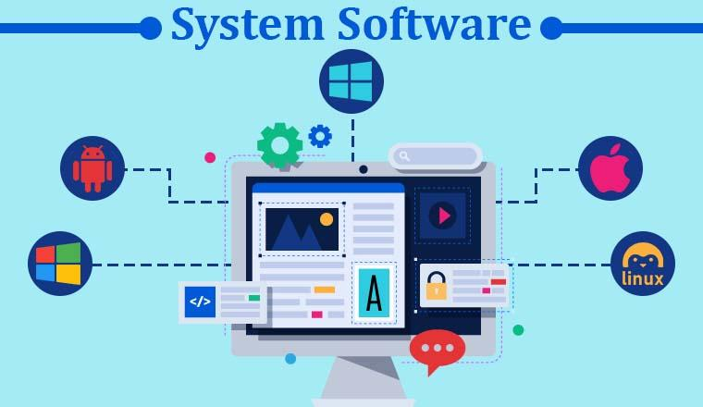
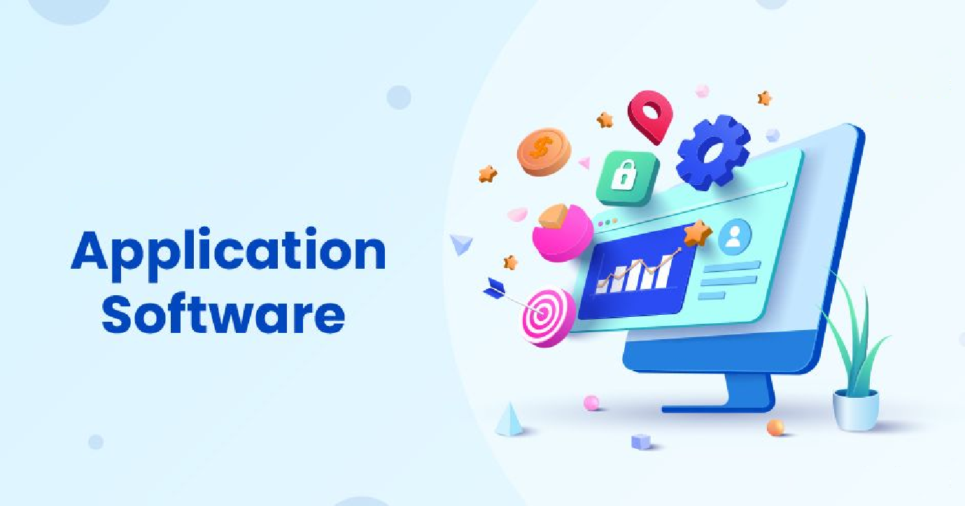
Day – 1
Software Categories

Slide 2
Day – 1
Software Categories
System Software
It is a type of computer software.
It provides a platform for running application software .
It manages computer hardware.
It serves as an intermediary between the user and the hardware.
It provides a set of services that allow the user to interact with the computer.
Examples
An example of system software is an operating system (OS), such as Microsoft Windows, macOS, or Linux.
Other examples of system software include device drivers, firmware, and utility programs.

Slide 3
Day – 1
Software Categories
Application Software
Application software, also known as "apps," is designed to perform specific tasks or functions for the user.
It is designed to interact directly with the user.
Examples
Web browsers, such as Google Chrome, Mozilla Firefox, and Microsoft Edge, which allow users to access and browse the internet.
Office productivity suites, such as Microsoft Office, Google Workspace, and LibreOffice, which provide tools for creating documents, spreadsheets, presentations, and other types of digital content.
Media players, such as VLC, iTunes, and Windows Media Player, which allow users to play audio and video files.
Games, such as Fortnite, Minecraft, and Among Us, which provide entertainment and engagement for users.

Slide 4
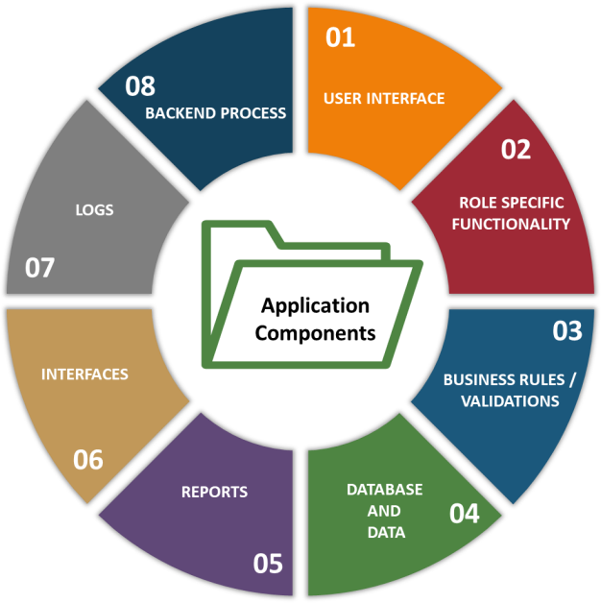
Day – 1
Application Components

Slide 5
Day – 1
Application Components
Application Components | Component Description
User Interface | Used to get input from the user and displays the data, helps in navigation, etc. It includes multiple components like text box, check box, list box, etc.
Role Specific Functionality | Role denotes group of users performing similar tasks and having similar level of permissions. Based on the group, the functionality differs. For example, role of project managers and HR professionals differ and the modules they use will be different even though they use same application for performing the task.
Business Rules | Set of rules enforced on the application. For example, leave that is applied by the employee is marked as “Sanctioned” in the application only if the manager approves it.
Validations | Ensures the correctness of the data and related functionalities. For example, the date can be entered in ‘DD-MM-YYYY’ format only.
Database | Used to store the data that is collected by the application through user input.

Slide 6
Day – 1
Application Components
Application Components | Component Description
Data | Master Data: Fixed data like department names, designations, etc. Transactional Data: It changes based on the user interactions like age, marital status, employee id, etc. Configurational Data: Those data that are needed by the application to start or to run
Reports | Consolidated information as per the needs of the user which is displayed in user friendly format.
Interfaces | Interactions with other applications or devices happens through interfaces. For example, biometric verification, etc.
Logs | Used for recording the information that will be needed in tracking, auditing, troubleshooting and other processes. Examples includes error log, installation log, change log, etc.
Backend Process | Automated and scheduled jobs that runs without the user interactions (unattended fashion).

Slide 7
Day – 1
Application Components
Application’s functionality and the related component’s requirements are documented into the requirement specification documents.
These requirements form the basis for checking the application’s functionality in software testing.

Slide 8
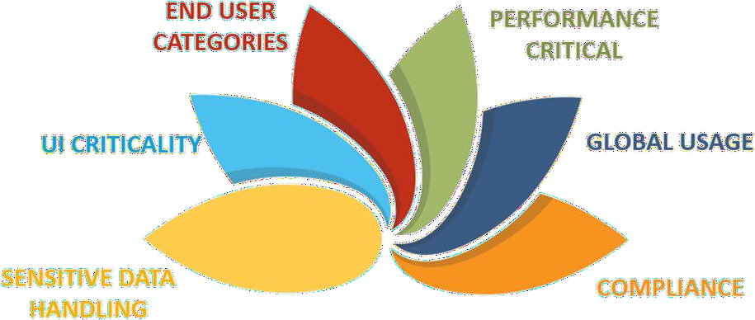
Day – 1
Application Characteristics

Slide 9
Day – 1
Application Characteristics
Application Characteristics | Example
Performance Critical | Share market application should process and show information quickly for trading.
Global Usage | Some websites are used across the globe in different languages.
Compliance | Pharmaceutical applications in USA have to follow the FDA regulations.
Sensitive Data Handling | Personal Information, Credit card data, etc.
UI Criticality | Health care application that displays ECG on ICU monitors.
End user categories | Technically expert users, regular business users, novice users, differently abled users, etc.

Slide 10
Day – 1
Application Characteristics
Application characteristics are typically documented as non-functional requirements in requirement specification documents.
These requirements form the basis for checking application’s non-functional requirements during software testing.

Slide 11
Day – 1
Application Domains
Domain denotes the field or area which the application belongs to. Some applications are specifically developed for an industry, and some may address Enterprise Business Process across industries.
Industry Specific Domains | Enterprise Business Process Domains
Banking, Financial Services and Insurance. (BFSI) | Supply Chain Management. (SCM)
Pharmaceutical, Medical Services. (Healthcare) | Human Resource Management. (HRM)
Communication, Media, Entertainment. | Customer Relationship Management. (CRM)
Manufacturing. | Planning and Purchase. (Procurement)
Telecom. | Material Management.
Infrastructure, Travel and Logistics. | Finance and Accounting.
Retail, Utilities and Consumer services. | Quality Management
E-Commerce

Slide 12
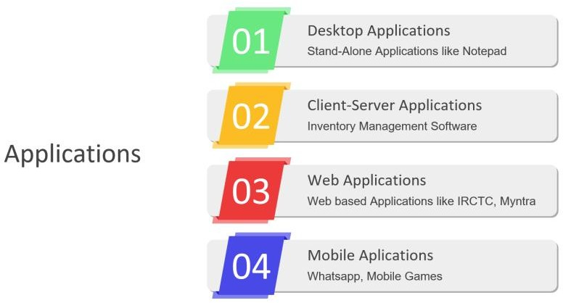
Day – 1
Application Architecture

Slide 13
Day – 1
Application Architecture – Standalone Applications
Standalone:
This means something that can operate by itself without needing anything else.
Think of a standalone coffee maker—it doesn't need to be connected to anything else to work.
Application:
An application, or "app" for short, is a program or software designed to perform a specific task or set of tasks.
For example, a text editor like Notepad is an application used for creating a text document.
Standalone Application:
It's a software program that you can run on your computer or device without needing to be connected to the internet or any other software.
Just like how you can use a calculator on your phone without needing to be connected to the internet, a standalone application works independently on your device, serving its purpose without relying on anything else.
For instance, a game you play on your phone or a photo-editing software (Ms – Paint) you use on your computer can be standalone applications—they function on their own without needing to be part of a larger system or network.

Slide 14
Day – 1
Application Architecture – Client – Server Applications
Client:
A client is like a customer or user.
In the context of computing, it refers to a device (like a computer, smartphone, or tablet) or software that requests and uses services or resources from another computer program, which is called the server.
For example, when you use a web browser to access a website, the web browser is the client.
Server:
A server is like a waiter at a restaurant.
It's a computer program or device that provides services or resources to other programs or devices, known as clients.
Servers can store data, manage network resources, host websites, and perform various other tasks.
For instance, when you access a website, the server is the computer that stores and serves the website's content to your web browser.
Client – Server Application:
It's a type of software architecture where one program (the client) requests services or resources from another program (the server) over a network.
The client sends requests to the server, and the server responds by providing the requested services or resources.
This architecture is commonly used in many applications and systems, such as websites, email clients, online games, and more.
For example, when you use a web browser to access a website, the browser (client) sends a request to the web server, which then sends back the website's content to be displayed in your browser.

Slide 15
Day – 1
Application Architecture – Web Applications
Web:
This refers to the World Wide Web, which is a system of interconnected documents and resources that are accessed over the internet.
When you open a web browser like Google Chrome or Mozilla Firefox, you're accessing the web.
Web Application:
It's a type of software program or application that you access and use through a web browser over the internet.
Instead of being installed directly on your computer or device like traditional software, a web application runs on a remote server and is accessed through a web browser.
This means you don't need to download or install anything on your device to use it—just open your web browser and visit the web application's website.
Web applications can perform a wide range of tasks, from simple ones like checking the weather forecast or reading news articles to more complex tasks like online banking, social media, and online shopping.
Examples of web applications include Gmail for email, Facebook for social networking, and Google Docs for document editing—all of which you can access and use through your web browser.

Slide 16
Day – 1
Application Architecture – Mobile Applications
Mobile:
This refers to something that is designed to be easily carried or moved.
In the context of technology, it usually refers to devices like smartphones and tablets that you can easily carry with you wherever you go.
Mobile Application:
It's a type of software program or app that you can install and use on your smartphone or tablet.
These apps are specifically designed to work on mobile devices, taking advantage of features like touchscreens, GPS, cameras, and other sensors commonly found in smartphones and tablets.
Mobile applications can perform a wide range of functions, from productivity tools like calendars and email clients to entertainment apps like games and streaming services.
They're available for download from app stores like the Apple App Store for iPhones and iPads, or the Google Play Store for Android devices.
Mobile applications are programs designed to run on smartphones and tablets, providing users with various functionalities and services to make their lives easier, more productive, or more enjoyable while on the go.

Slide 17
Day – 1
Application Architecture
Application architecture leads to imparting specific characteristics to an application which decides what kind of testing needs to be done on the application.

Slide 18
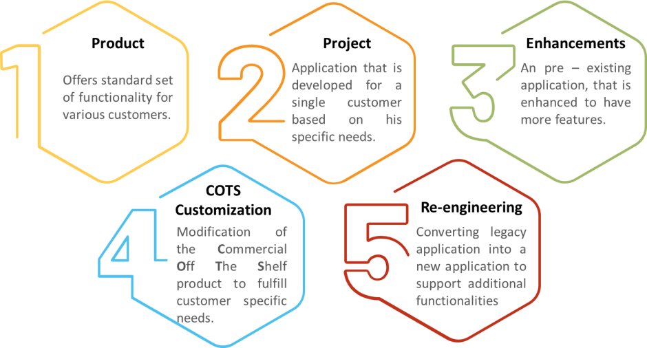
Day – 1
Application Service Model

Slide 19
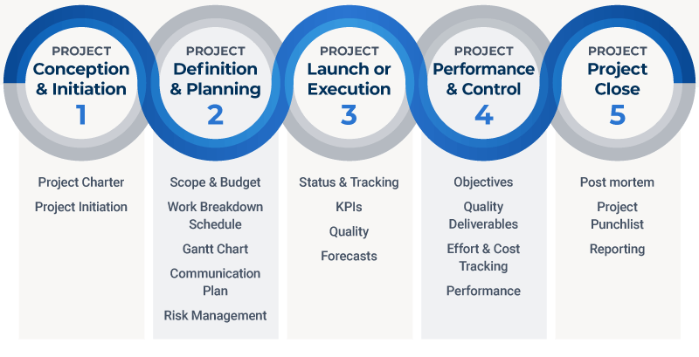
Day – 1
Project Phases

Slide 20
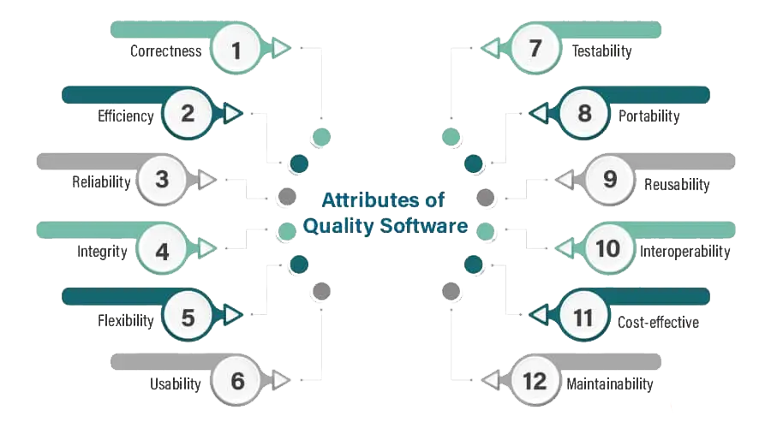
Day – 1
Attributes of a Quality Software

Slide 21
Day – 1
Attributes of a Quality Software
Correctness:
It means the required functionality and correct results.
Customer satisfaction depends on the degree to which customer requirements and expectations have been met.
It should provide all the functionality desired by the customer.
Efficiency:
It means the efficient use of resources.
The software design and architecture should be such that it gives you a response in the least processing time, using the resources in the best possible way.
Reliability:
It means bug-free execution, i.e., assured performance, fully verified and validated processes, secured and safe to work when breaking down or power crisis.
It should be reliable in all conditions.

Slide 22
Day – 1
Attributes of a Quality Software
Integrity:
Integrity is related to the extent of access to the software by unauthorized users that can be controlled.
Flexibility:
It means the capacity of a system to be adapted for different environments and situations to face changes related to business environment policies and rules.
Usability:
It means that the software must be user-friendly.
The software should have hood documentation and a user manual, which may include the installation and the software’s process.
This makes it easy for the new to learn and operate, says studying the manual.

Slide 23
Day – 1
Attributes of a Quality Software
Testability:
It should need less effort to test the program so that it performs its intended function.
As the complexity of the program increase, the steps to test the software also increase.
Portability:
It means the software should be able to transfer the software from one environment to another.
Reusability:
It gives you the concept of writing once and uses it many times.
For example, you are writing functions or sub-procedures to receive variable parameters.
The calling code passes the value to the parameters, and the called procedure processes them as needed.

Slide 24
Day – 1
Attributes of a Quality Software
Interoperability:
The software development should be to interact with other products.
For example, the word processor can interpolate charts from Excel or data from databases.
It deals with the interface between software products over a communication network.
Cost-effective:
The software development within cost and budget depends on efficient design and high project management effort.
Maintainability:
For all the changes the customer or user desires, the developer must respond fast.
The difference could be to correct the mistake and expand its scope.

Slide 25
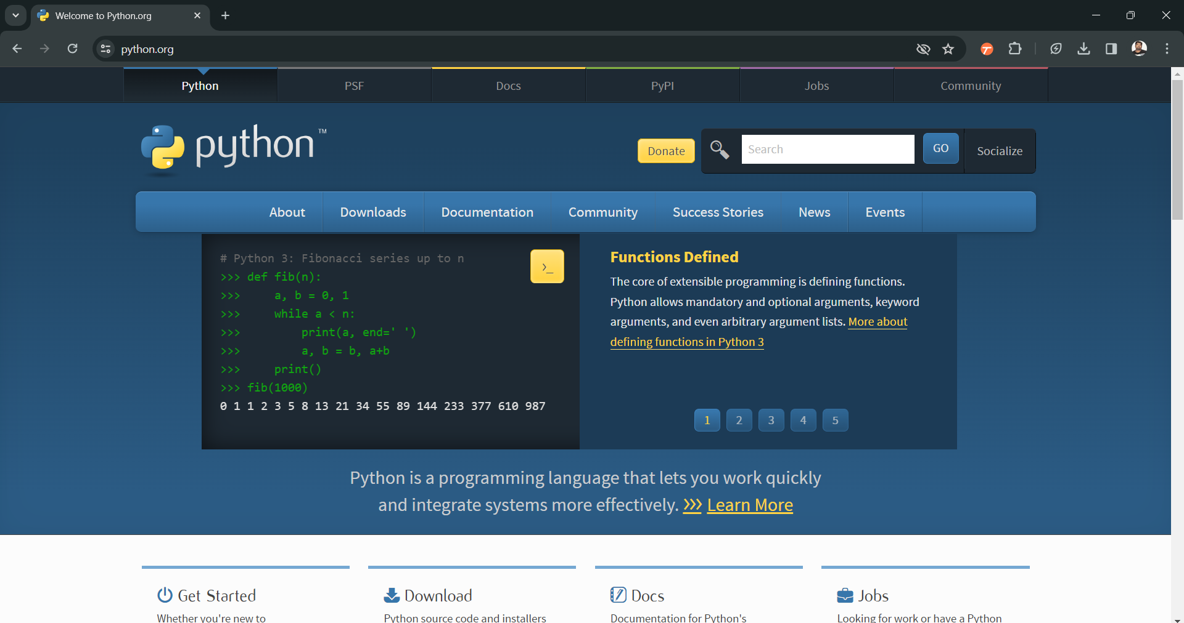
Day – 2
Python Installation

Slide 26
Day – 2
Python Installation

Slide 27
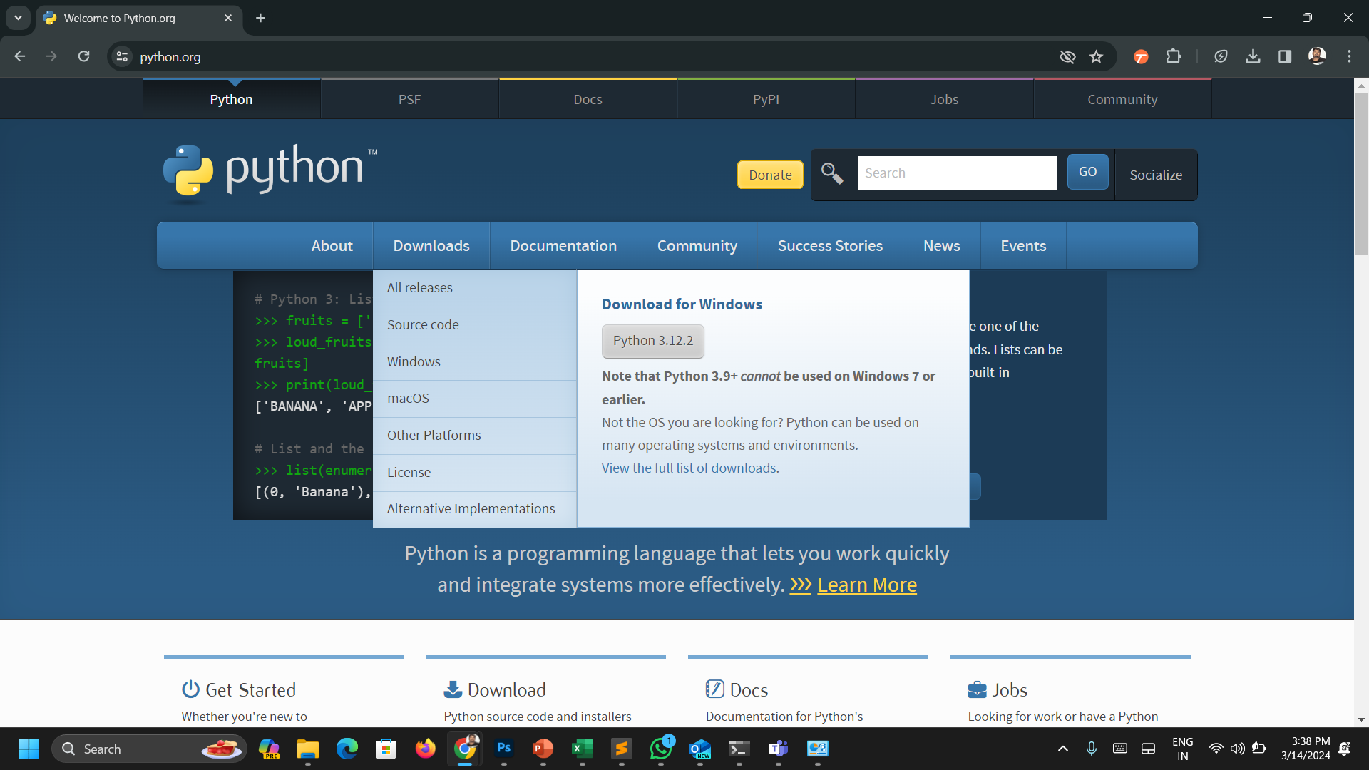
Day – 2
Python Installation

Slide 28
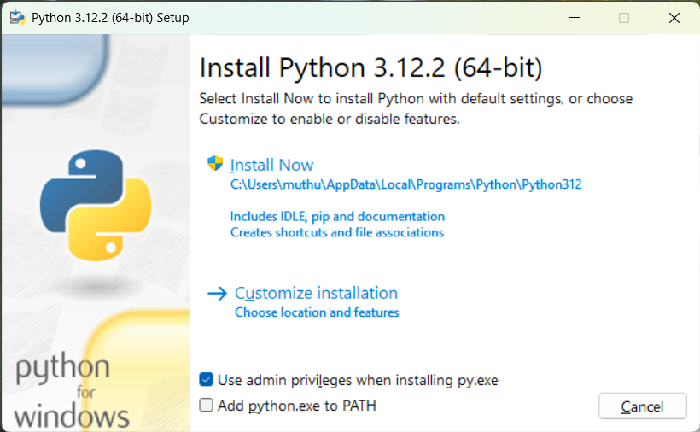
Day – 2
Python Installation

Slide 29
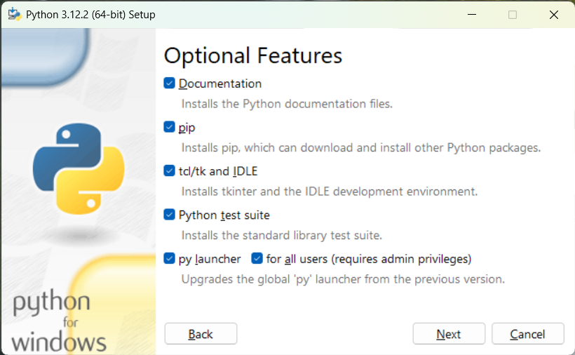
Day – 2
Python Installation

Slide 30
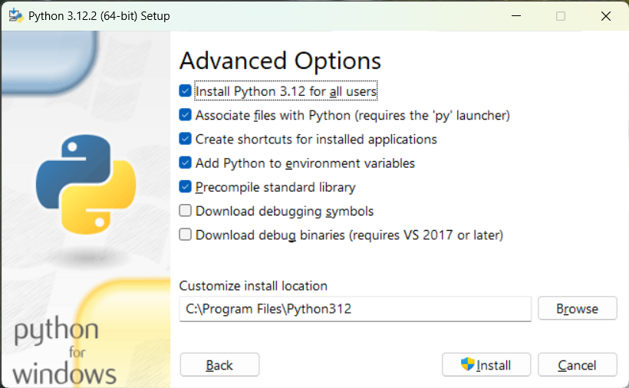
Day – 2
Python Installation

Slide 31
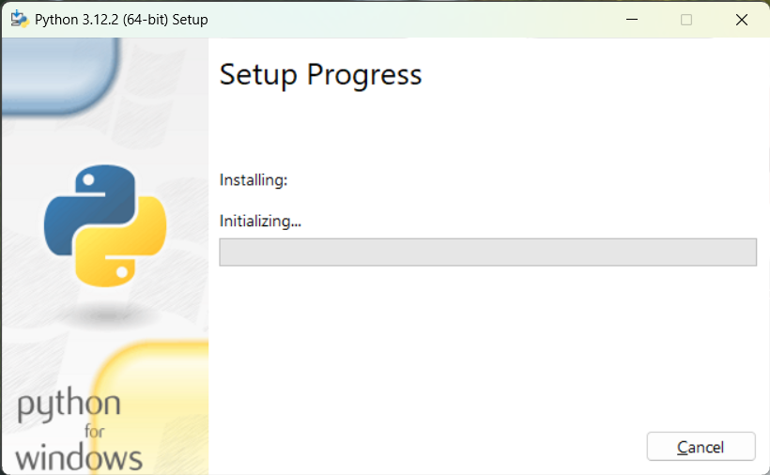
Day – 2
Python Installation

Slide 32
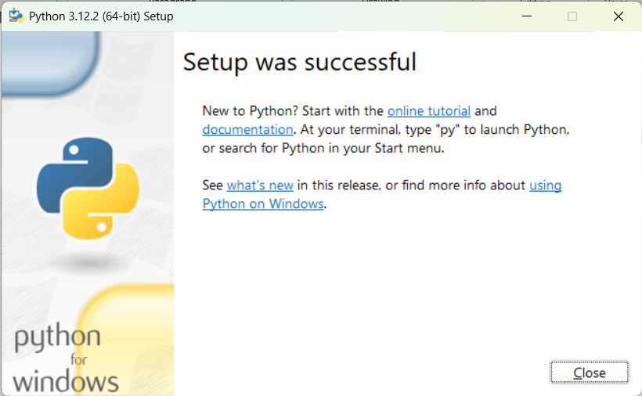
Day – 2
Python Installation

