Slide 1


Exception Handling
Every rule has an exception, and it's usually remedial

Slide 2
Exception – What it is?
It is a runtime interruption which makes the program to stop from executing.
Exception occurs only during runtime and when it occurs, program gets terminated.
Exception never occurs at compile time.
Exception is thrown by JVM.

Slide 3
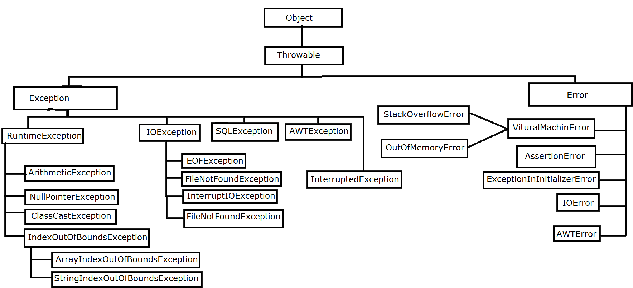
Exception Hierarchy

Slide 4
Exception Handling
When an exception occurs, the program definitely terminates. If the exceptions are handled, then we can avoid program termination but the program may not give the expected output.
How to handle?
By using try and catch blocks
One or multiple lines of code which possibly gives an exception must be enclosed in try block followed by the immediate catch block.
If the exception did not occur in try block, catch block will not get executed.

Slide 5
How to handle?
catch block gets executed only if exception happens in the try block and if the exception matches the catch block.
When exception occurs in the try block, then the control immediately comes out of try block without executing the remaining lines of code with in the try block and executes the matching catch block.
If the matching catch block is not found, then the program gets terminated.
Once the control comes out of try block, it will not got to try block again.
There must not be any executable code in between try and catch blocks.
Handling scenarios must be written within the catch block.

Slide 6
How to handle?
Exception means, jvm creates object of appropriate exception class and that object is thrown.
Reference type used in the catch block must belong to exception category. That is, it must be directly or indirectly a sub class of throwable.

Slide 7
try with multiple catch
try
{
… math operation …
… save the results to file …
… save the results to a database …
}
catch(ArithmeticException ae)
{
Handling scenarios
}
catch(IOException ioe)
{
Handling scenarios
}
catch(SQLException sqle)
{
Handling scenarios
}

Slide 8
Nested try and catch blocks
try
{
… math operation …
try {
… save the results to file …
}
catch(IOException ioe)
{
Handling scenarios
}
try {
… save the results to a database …
}
catch(SQLException sqle)
{
Handling scenarios
}
}
catch(ArithmeticException ae)
{
Handling scenarios
}

Slide 9
Nested try and catch blocks
try
{
… math operation …
try {
… save the results to file …
}
catch(IOException ioe)
{
Handling scenarios
}
try {
… save the results to a database …
}
catch(SQLException sqle)
{
Handling scenarios
}
}
catch(ArithmeticException ae)
{
Handling scenarios
}

Slide 10
Points to Remember
We can write try and catch block inside another
try block
catch block
finally block
If the handling scenario is the same for multiple exceptions, then we write single catch block.
If the handling scenario is different for different exceptions, then we write multiple catch blocks.
From jdk 1.7 onwards, we can handle multiple exceptions in a single catch block.
In case of multiple catch blocks, the sequence must always be sub class to super class.

Slide 11
Heavy weight objects
Those objects which consumes system or network resources.
It is very important to close such resources otherwise, the application becomes slow and creates performance issues.
Heavy weight object examples:
Scanner
File Reader
File Writer
Data Base Connection
How to close?
Scanner sc = new Scanner(System.in);
int c = sc.nextInt();
…. remaining lines of code ….
sc.close();

Slide 12
finally block
finally is a block which is used in exception handling.
It always gets executed irrespective of whether the exception occurs or not.
Single try block can have only one finally block.
Usually costly (heavy weight object) resources are closed inside finally block.

Slide 13
Checked Exception
Those exception for which the compiler checks at the compile time, whether the exception is handled by the developer inside the code or not.
If the exception is not handled, then the compiler gives an error and force the developer to handle the exception.
The exception certainly happens only at the runtime but the compiler checks whether it is handled or not.
Checked exception classes never extends RuntimeException class.

Slide 14
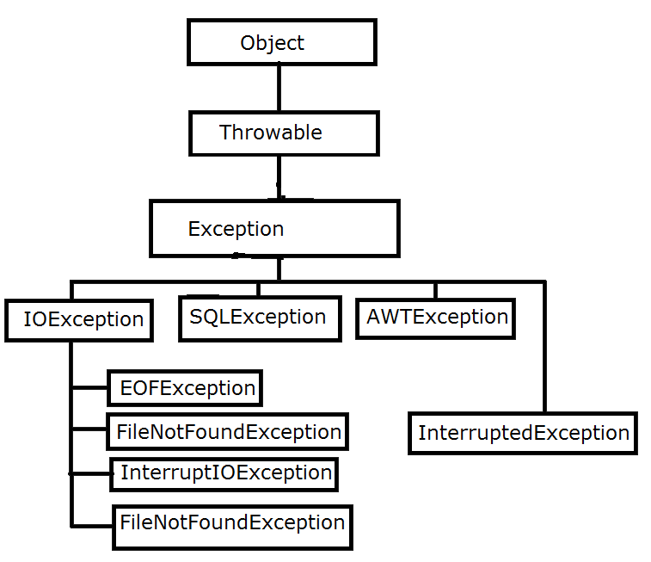
Checked Exception

Slide 15
Unchecked Exception
Those exception for which the compiler does not checks at the compile time, whether the exception is handled by the developer inside the code or not.
If the exception is not handled, then the compiler does not give any error and will not force the developer to handle the exception.
Unchecked exception classes always extends RuntimeException class.

Slide 16
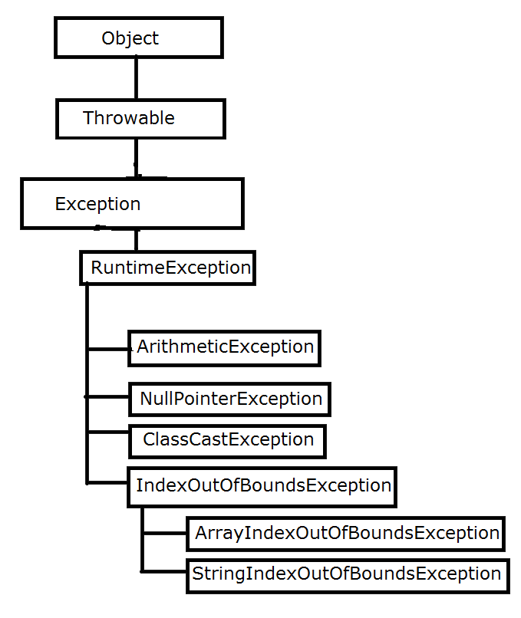
Unchecked Exception

