Slide 1

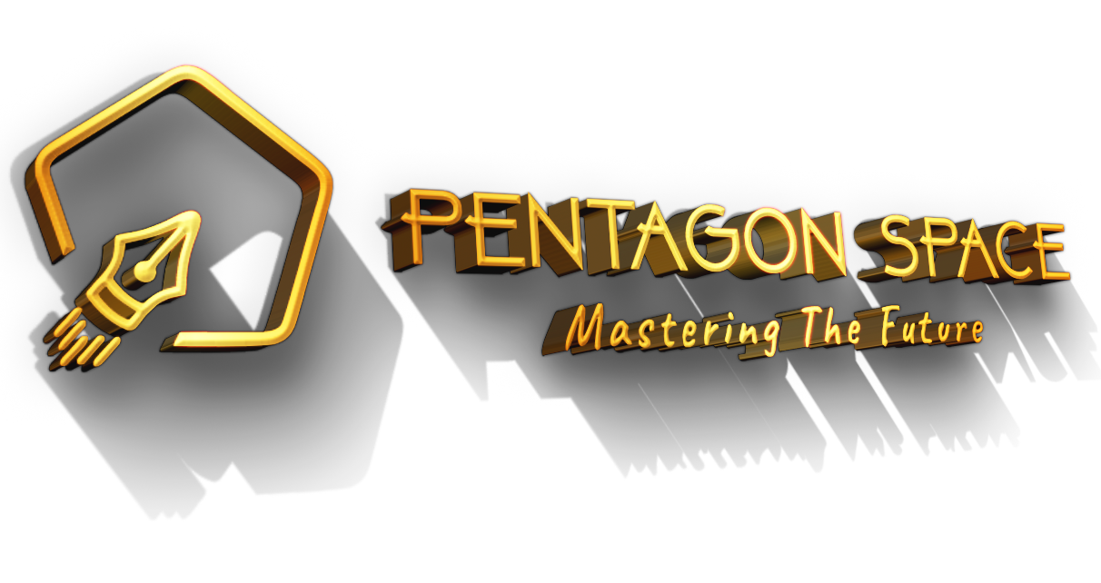
Java Full Stack Development
Java Full Stack Development

Slide 2
Agenda
Industry Overview Module
www.pentagonspace.in
Elite Mastery Module

Slide 3
Industry Overview Module
What is IT Industry?
Evolution of IT
IT INDUSTRY
Key Players in the IT Industry
Trends Shaping the IT Landscape
Career Opportunities in IT
www.pentagonspace.in
Elite Mastery Module

Slide 4
Industry Overview Module
What is IT Industry?
The IT (Information Technology) Industry encompasses the design, development, implementation, support, and management of computer hardware, software, and networks.
Leveraging technology to solve complex problems, improve efficiency, and drive innovation across various sectors.
Evolution of IT
Milestones:
1950s-1960s: Mainframe Computers
1970s: Personal Computers (PCs)
1980s: Internet and Networking
1990s: World Wide Web (WWW)
2000s: Mobile and Cloud Computing
2010s: Big Data and Artificial Intelligence (AI)
Constant innovation and disruption characterize the IT industry's evolution.
www.pentagonspace.in
Elite Mastery Module

Slide 5
Industry Overview Module
Key Players in the IT Industry
Microsoft
Apple
Google (Alphabet Inc.)
Amazon
IBM
Trends Shaping the IT Landscape
Full Stack Development: Facilitated by technology during global shifts like the COVID-19 pandemic.
Cloud Computing: Scalable, cost-effective solutions.
Artificial Intelligence (AI) and Machine Learning (ML): Automation and predictive analytics.
Internet of Things (IoT): Interconnectivity of devices.
Cybersecurity: Protection against digital threats.
www.pentagonspace.in
Elite Mastery Module

Slide 6
Industry Overview Module
Career Opportunities in IT
Diverse Roles:
Software Developer
Data Scientist
Network Engineer
Cybersecurity Analyst
IT Project Manager
Test Automation Engineer
Skills in demand: Coding languages (Python, Java), data analysis, cybersecurity, cloud computing, Automation, etc.
Continuous learning and adaptation are key in this dynamic field.
www.pentagonspace.in
Elite Mastery Module

Slide 7
IT Products and Services, Off-shoring, and MNC India Centers
Introduction to IT Products and Services
Off-shoring in the IT Industry
Multinational Corporation India Centers
Advantages and Challenges
www.pentagonspace.in
Elite Mastery Module

Slide 8
Industry Overview Module
IT Products and Services, Off-shoring, and MNC India Centers
IT Products:
Physical devices or software solutions developed for specific purposes (e.g., laptops, smartphones, enterprise software).
IT Services:
Support, maintenance, consulting, and outsourcing services provided by IT companies (e.g., software development, cybersecurity, cloud computing).
Off-shoring in the IT Industry
The practice of relocating business processes or services to another country, typically to reduce costs or access specialized talent.
Common Off-shoring Destinations: India, Philippines, Eastern Europe, etc.
Reasons for Off-shoring: Cost savings, access to skilled labor, 24/7 service availability, and global market presence.
www.pentagonspace.in
Elite Mastery Module

Slide 9
Industry Overview Module
Multinational Corporation India Centers
Established by multinational companies to leverage India's talent pool and market potential.
Functions of MNC India Centers: Software development and testing, Research and development (R&D), Customer support and service, Back-office operations
MNC India Centers List: Microsoft India Development Center, Google India, IBM India, etc.
Advantages of Off-shoring and MNC India Centers
Cost Efficiency: Lower operational and labor costs compared to developed countries.
Access to Skilled Talent: India's large pool of engineers, developers, and IT professionals.
Time Zone Advantage: Enables 24/7 support and service delivery.
Market Expansion: Establishing a local presence in emerging markets.
Innovation and Collaboration: Opportunities for R&D and collaboration with local talent.
www.pentagonspace.in
Elite Mastery Module

Slide 10
Industry Overview Module
Challenges of Off-shoring and MNC India Centers
Cultural Differences: Communication barriers and cultural nuances can affect collaboration and productivity.
Quality Control: Ensuring consistent quality standards across geographically dispersed teams.
Data Security and Compliance: Addressing data protection laws and regulatory requirements.
Talent Retention: Competition for skilled professionals and employee retention strategies.
Time Zone Management: Coordination and scheduling challenges in global teams.
www.pentagonspace.in
Elite Mastery Module

Slide 11
Service Based, Product Based, Start-ups
Product-Based IT Companies
Service-Based IT Companies
Differentiating Factors
Startups in the IT Industry
www.pentagonspace.in
Elite Mastery Module

Slide 12
Service Based, Product Based, Start-ups
Service-Based IT Companies
Service-based IT companies primarily offer services such as software development, consulting, outsourcing, and maintenance.
Companies: Infosys, TCS (Tata Consultancy Services), Accenture, Cognizant, Wipro.
Revenue Model: Typically based on hourly rates, project-based contracts, or service-level agreements (SLAs).
Product-Based IT Companies
Product-based IT companies focus on developing and selling software products or solutions to customers.
Companies: Microsoft, Google, Adobe, Oracle, Salesforce.
Revenue Model: Generated from product sales, subscriptions, licensing, and maintenance fees.
www.pentagonspace.in
Elite Mastery Module

Slide 13
Service Based, Product Based, Start-ups
Startups in the IT Industry
Startups in the IT industry are newly established companies with innovative ideas, products, or services, often characterized by rapid growth and scalability.
Companies: Airbnb, Uber, Slack, Dropbox, Zoom.
Revenue Model: Subscriptions
www.pentagonspace.in
Elite Mastery Module

Slide 14
Service Based, Product Based, Start-ups
Service-Based IT Companies
Focus on providing services and solutions to clients.
Revenue of the company is primarily generated from client projects and contracts.
Organization emphasis on client satisfaction, project delivery, and service quality.
Product-Based IT Companies
Focus on developing and selling proprietary software products.
Revenue of the company is generated from product sales, subscriptions, and licensing.
Organization emphasis on product innovation, market penetration, and customer retention.
Startups
Focus on disruptive innovation, scalability, and rapid growth.
Often operate with limited resources and high uncertainty.
The revenue generation strategies may vary, including venture capital funding, freemium models, and monetization thru user base expansion.
www.pentagonspace.in
Elite Mastery Module

Slide 15
Agenda
Application Overview Module
www.pentagonspace.in
Elite Mastery Module

Slide 16

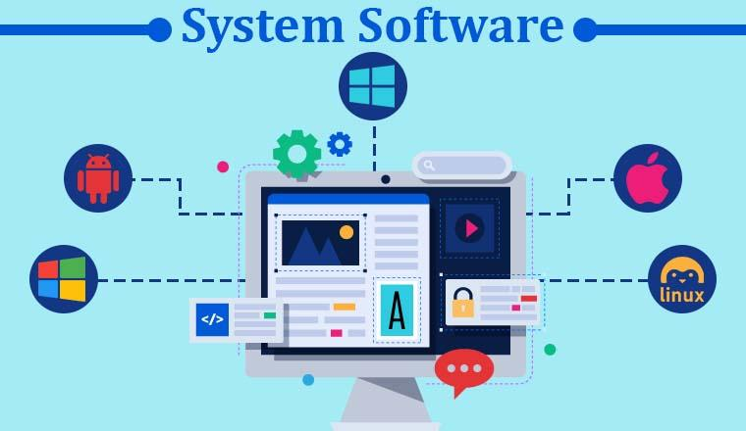
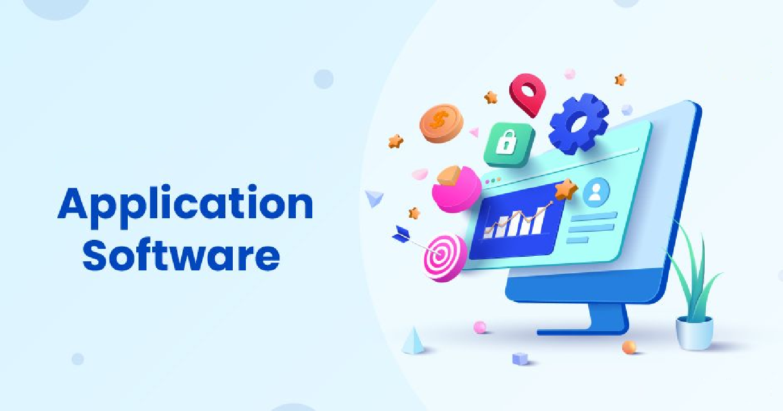
Application Overview Module
www.pentagonspace.in
Elite Mastery Module

Slide 17
Application Overview Module
System Software
It is a type of computer software.
It provides a platform for running application software .
It manages computer hardware.
It serves as an intermediary between the user and the hardware.
It provides a set of services that allow the user to interact with the computer.
Examples
An example of system software is an operating system (OS), such as Microsoft Windows, macOS, or Linux.
Other examples of system software include device drivers, firmware, and utility programs.
www.pentagonspace.in
Elite Mastery Module

Slide 18
Application Overview Module
Application Software
Application software, also known as "apps," is designed to perform specific tasks or functions for the user.
It is designed to interact directly with the user.
Examples
Web browsers, such as Google Chrome, Mozilla Firefox, and Microsoft Edge, which allow users to access and browse the internet.
Office productivity suites, such as Microsoft Office, Google Workspace, and LibreOffice, which provide tools for creating documents, spreadsheets, presentations, and other types of digital content.
Media players, such as VLC, iTunes, and Windows Media Player, which allow users to play audio and video files.
Games, such as Fortnite, Minecraft, and Among Us, which provide entertainment and engagement for users.
www.pentagonspace.in
Elite Mastery Module

Slide 19
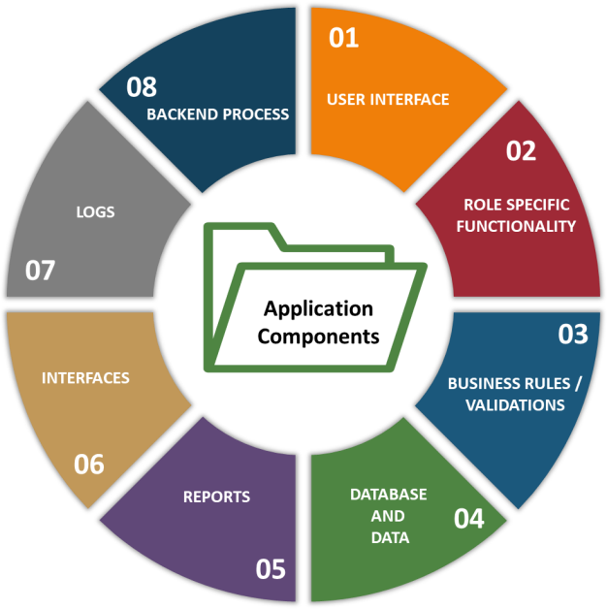
Application Overview Module
Application Components
www.pentagonspace.in
Elite Mastery Module

Slide 20
Application Overview Module
Application Components | Component Description
User Interface | Used to get input from the user and displays the data, helps in navigation, etc. It includes multiple components like text box, check box, list box, etc.
Role Specific Functionality | Role denotes group of users performing similar tasks and having similar level of permissions. Based on the group, the functionality differs. For example, role of project managers and HR professionals differ and the modules they use will be different even though they use same application for performing the task.
Business Rules | Set of rules enforced on the application. For example, leave that is applied by the employee is marked as “Sanctioned” in the application only if the manager approves it.
Validations | Ensures the correctness of the data and related functionalities. For example, the date can be entered in ‘DD-MM-YYYY’ format only.
Database | Used to store the data that is collected by the application through user input.
www.pentagonspace.in
Elite Mastery Module

Slide 21
Application Overview Module
Application Components | Component Description
Data | Master Data: Fixed data like department names, designations, etc. Transactional Data: It changes based on the user interactions like age, marital status, employee id, etc. Configurational Data: Those data that are needed by the application to start or to run
Reports | Consolidated information as per the needs of the user which is displayed in user friendly format.
Interfaces | Interactions with other applications or devices happens through interfaces. For example, biometric verification, etc.
Logs | Used for recording the information that will be needed in tracking, auditing, troubleshooting and other processes. Examples includes error log, installation log, change log, etc.
Backend Process | Automated and scheduled jobs that runs without the user interactions (unattended fashion).
Application’s functionality and the related component’s requirements are documented into the requirement specification documents.
www.pentagonspace.in
Elite Mastery Module

Slide 22
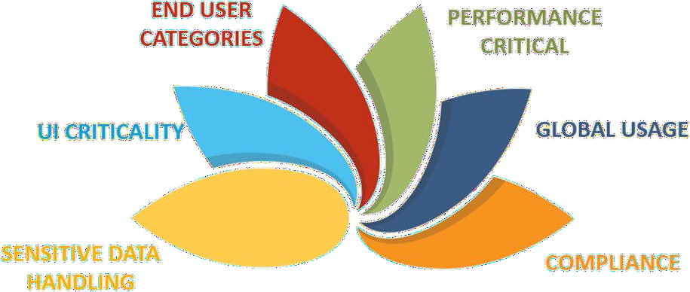
Application Overview Module
Application Characteristics
www.pentagonspace.in
Elite Mastery Module

Slide 23
Application Overview Module
Application Characteristics | Example
Performance Critical | Share market application should process and show information quickly for trading.
Global Usage | Some websites are used across the globe in different languages.
Compliance | Pharmaceutical applications in USA have to follow the FDA regulations.
Sensitive Data Handling | Personal Information, Credit card data, etc.
UI Criticality | Health care application that displays ECG on ICU monitors.
End user categories | Technically expert users, regular business users, novice users, differently abled users, etc.
Application characteristics are typically documented as non-functional requirements in requirement specification documents.
www.pentagonspace.in
Elite Mastery Module

Slide 24
Application Overview Module
Application Domains
Domain denotes the field or area which the application belongs to. Some applications are specifically developed for an industry, and some may address Enterprise Business Process across industries.
Industry Specific Domains | Enterprise Business Process Domains
Banking, Financial Services and Insurance. (BFSI) | Supply Chain Management. (SCM)
Pharmaceutical, Medical Services. (Healthcare) | Human Resource Management. (HRM)
Communication, Media, Entertainment. | Customer Relationship Management. (CRM)
Manufacturing. | Planning and Purchase. (Procurement)
Telecom. | Material Management.
Infrastructure, Travel and Logistics. | Finance and Accounting.
Retail, Utilities and Consumer services. | Quality Management
E-Commerce
www.pentagonspace.in
Elite Mastery Module

Slide 25
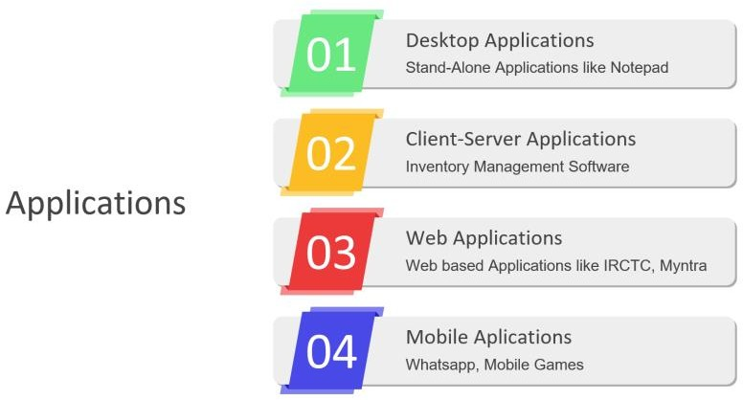
Application Overview Module
Application Architecture
Application architecture leads to imparting specific characteristics to an application which decides what kind of testing needs to be done on the application.
www.pentagonspace.in
Elite Mastery Module

Slide 26
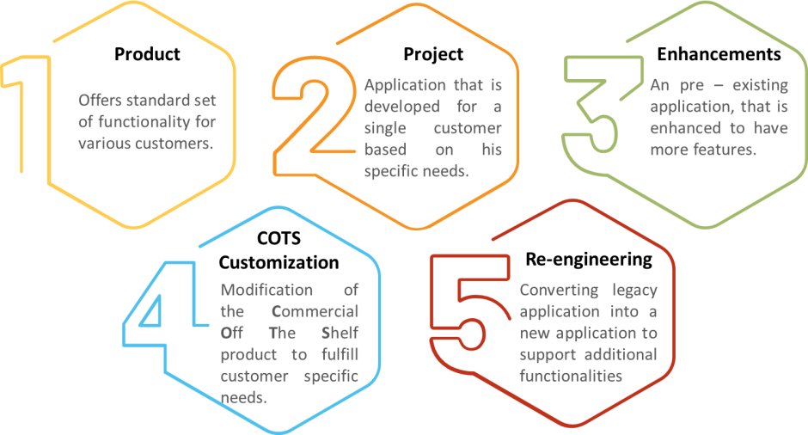
Application Overview Module
Application Service Model
www.pentagonspace.in
Elite Mastery Module

