Slide 1
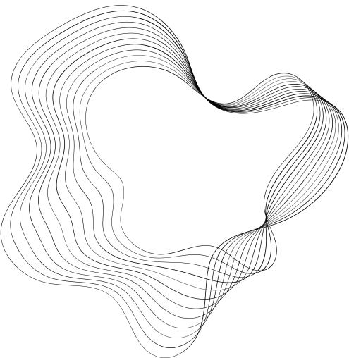

DEEP LEARNING
PROJECT

Slide 2

OUR TEAM
Abubakar
Muti Ur Rehman
Osama Ali
21i-1379
21i-0872
21i-0587
Everest Cantu
Drew Holloway
Ceo Of Ingoude Company
Ceo Of Ingoude Company

Slide 3
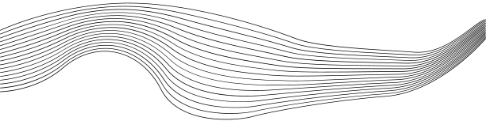
MODELS
01
CONVLSTM
02
PREDRNN
03
TRANSFORMER

Slide 4

CONVLSTM
ConvLSTM (Convolutional Long Short-Term Memory) is a specialized neural network architecture that combines convolutional layers with the temporal modeling capabilities of LSTMs. It is designed to handle spatiotemporal data, making it particularly effective for tasks like video prediction, precipitation nowcasting, and action recognition.

Slide 5
STATISTICS
Validation Loss : 0.0530

Slide 6
PREDRNN
PredRNN (Predictive Recurrent Neural Network) is an advanced spatiotemporal modeling framework designed for video prediction and other sequential data tasks. It improves upon traditional models by introducing a spatiotemporal memory flow mechanism, which allows it to capture both short-term dynamics and long-term dependencies more effectively.

Slide 7
STATISTICS
Validation Loss : 0.0268
Accuracy : 0.7023

Slide 8
TRANSFORMER
Transformer-based models for video prediction leverage self-attention mechanisms to capture long-range dependencies in both spatial and temporal dimensions. Unlike recurrent architectures, they process input sequences in parallel, enabling efficient handling of complex patterns across frames.

Slide 9
STATISTICS
Test Loss (MSE): 0.0357

Slide 10

THANK'S

