Slide 1



Slide 2
What is Docker?
Docker is a container management service. The keywords of Docker are develop, ship and run anywhere. The whole idea of Docker is for developers to easily develop applications, ship them into containers which can then be deployed anywhere.
Docker is an Open platform for developers and sysadmins to build, ship and run distributed applications.
It can run on most Linux distributions, Windows and Mac OS running Docker Engine (Toolbox).

Slide 3
Docker Features….
Light-Weight
Minimal overhead (cpu/io/network)
Based on Linux containers
Decrease storage consumption
Uses layered filesystem to save space (AUFS/LVM)
Portable
Run it Everywhere! - Linux, Mac OS or Windows operating system that has Docker installed.
Raspberry pi support.
Move from one environment to another by using the same Docker technology.
Self-sufficient
A Docker container contains everything it needs to run
Minimal Base OS
Libraries and frameworks
Application code
A Docker container should be able to run anywhere that Docker can run.

Slide 4
Images vs containers
Docker images are executable packages that include everything needed to run an application — the code, a runtime, libraries, environment variables, and configuration files.
Docker containers are a runtime instance of an image — what the image becomes in memory when executed (that is, an image with state, or a user process).

Slide 5
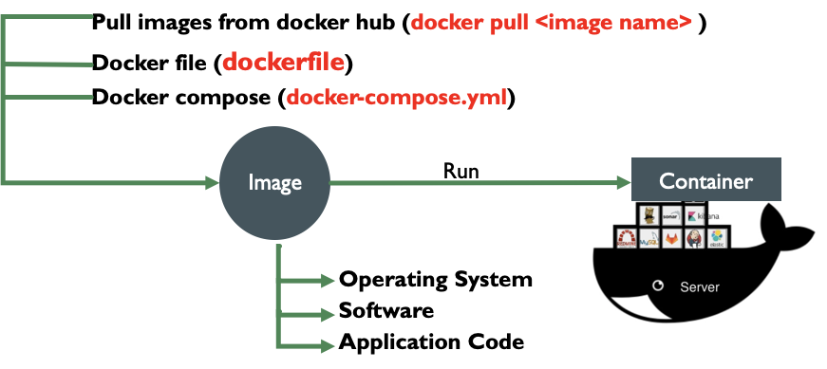
Docker flow

Slide 6
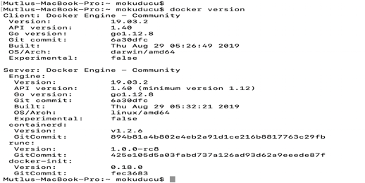
Most used commands
docker version

Slide 7
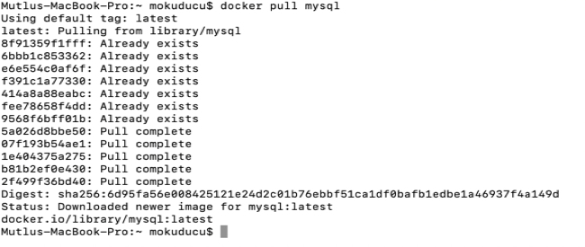
https://hub.docker.com/
docker pull < image name>

Slide 8
Images commands
Commands | image list
Docker images | image list
Docker images -q | q − It tells the Docker command to return the Image ID’s only.
Docker run <images > | Imaged run details
Docker rmi -f <image id> | Force image delete
Docker history <ImageID> | History of image
Docker inspect <imageid> | Details of images

Slide 9
Images commands
Docker images | image list
Docker images -q | q − It tells the Docker command to return the Image ID’s only.
Docker run <images > | Imaged run details
Docker rmi -f <image id> | Force image delete
Docker history <ImageID> | History of image
Docker inspect <imageid> | Details of images

Slide 10
docker pull nginx
docker images
REPOSITORY TAG IMAGE ID CREATED SIZE
nginx latest f949e7d76d63 2 weeks ago 126MB
docker run --name nginx -d -p 8080:80 nginx
Mutlus-MacBook-Pro:~ mokuducu$ docker ps –a
CONTAINER ID IMAGE COMMAND CREATED STATUS PORTS NAMES
85a54b8a660c nginx "nginx -g 'daemon of…" About an hour ago Up 37 minutes 0.0.0.0:8080->80/tcp nginx

Slide 11
Docker File
Dockerfile – Text file (recipe) used to create Docker images
Docker file name must be Dockerfile
Docker File Commands
ADD copies the files from a source on the host into the container’s own filesystem at the set destination.
CMD can be used for executing a specific command within the container.
ENTRYPOINT sets a default application to be used every time a container is created with the image.
ENV sets environment variables.
EXPOSE associates a specific port to enable networking between the container and the outside world.
FROM defines the base image used to start the build process.
MAINTAINER defines a full name and email address of the image creator.
RUN is the central executing directive for Dockerfiles.
USER sets the UID (or username) which is to run the container.
VOLUME is used to enable access from the container to a directory on the host machine.
WORKDIR sets the path where the command, defined with CMD, is to be executed.
LABEL allows you to add a label to your docker image.

Slide 12
Build Docker File
docker build .
# Ubuntu
FROM ubuntu MAINTAINER demousr@gmail.com
RUN apt-get update RUN apt-get install –y nginx CMD [“echo”,”Image created”]
•The first line "#This is a sample Image" is a comment.
•The next line has to start with the FROM keyword. It tells docker, from which base image you want to base your image from. In our example, we are creating an image from the ubuntu image.
•The next command is the person who is going to maintain this image. Here you specify the MAINTAINER keyword and just mention the email ID.
•The RUN command is used to run instructions against the image. In our case, we first update our Ubuntu system and then install the nginx server on our ubuntu image.
•The last command is used to display a message to the user.

Slide 13
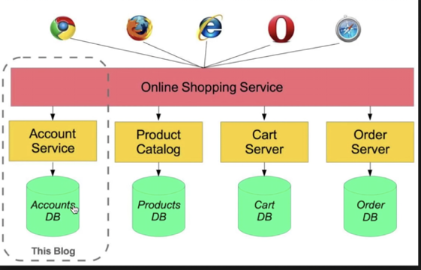

Slide 14
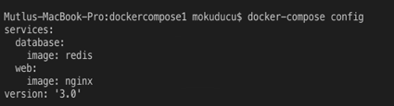
Docker-compose
Docker Compose is used to run multiple containers as a single service. For example, suppose you had an application which required NGNIX and Redis, you could create one file
Create Docker-Compose File at any location on your system
All Docker Compose files are YAML
File name docker-compose.yml
Check the validity of file by command
Docker-compose config
Run docker-compose.yml file by command
Docker-compose up –d
Down Docker compose
Docker-compose down

Slide 15
Docker compose
•Tool for defining & running multi-container docker application
•Use yaml files to configure application services
•Can start all services with a single command
•Docker-compose up
•Can stop all services with a single command
•Docker-compose down
•Can scale up selected services when required
Install Docker compose:
•Check docker-compose
•docker-compose version (-v)
•
Install Docker Compose:
•From github (https://github.com/docker/compose/releases)
•Using PIP
Pip install-U docker-compose

Slide 16
Scale
Docker-compose –help
scale Set number of containers for a service
docker-compose up -d --scale <service name>=number of instance
docker-compose up -d --scale database=4

