Slide 1
A REPORT On Battle of Neighborhoods
Of New York City
by
JAYANTH KUMAR

Slide 2
The problem
Grouping Different Neighborhoods of New York City into clusters of same type.
This Can be used by people who would want set up new business for finding best location for them

Slide 3
DATA
NeighborHood Data
Categories
Venue list
We get data of NYC Neighborhoods from here.
It is a JSON file. We
extract the Neighborhood, Borough, Longitude and Latitude information from
the file.
we get categories and subcategories that go into them from Foursquare
we get venues in the neighborhood from above latitude and longitude up to 1000 mt radius and Limit of 100 venues(that is max given by foursquare)

Slide 4
Methodology

Slide 5
Getting New York City Neighborhood Data
Get Venues nearby to neighborhood location
Use KMeans to Cluster the Neighborhoods
1
2
3
4
5
Get Categories and Sub Categories From Foursquare
PreProcess Data for Modelling

Slide 6
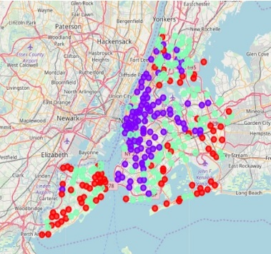
Resulting Cluster Map
Red - Cluster1
Violet - Cluster2
Green - Cluster3

Slide 7
Conclusion
We used Data analysis on New York City to get neighborhood types by using venues list from Foursquare API. The results show fine boundary between different clusters and also no of venues from the tables show decreasing order as we go away from violet to green to red. But there was a limitation as we get max 100 values for a query which could have give better insights

