Slide 1

Database Development with PL/SQL
PLSQL_Capstone_Project by
Mutoni Patience
Internship and Job Placement System
Problem Definition
Many universities struggle with managing internships and job placements due to inefficient manual processes. Companies find it hard to identify suitable candidates and students miss out opportunities due to lack of a structured system.

Slide 2

Project Objectives & Context
Project Goals
Automated matching process
Summary of the Problem Definition
Improved placement rates
Inefficient matching of students to internships and jobs
Enhanced data security
Context
The problem discussed above will be used by;
University career services department
Students - To apply for internships, jobs and track status
Career Centers- To manage student profiles and track placement
Companies- To post job openings and review applications
Target Users
Students, alumni, employers, faculty

Slide 3
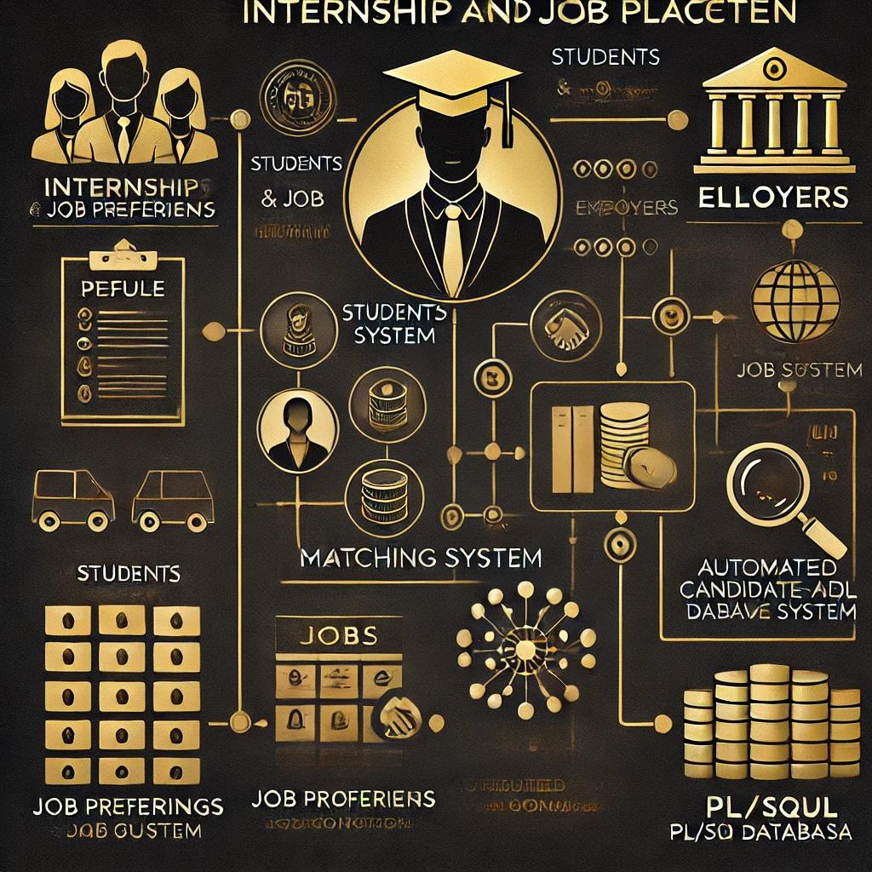



Database Entities & Benefits
Students
Profiles, resumes, preferences
Employers
Job postings, requirements
Matching
Algorithm-driven connections
Expected Benefits : Increased efficiency, better job matches, data-driven insights, enhanced student career development.

