Slide 1
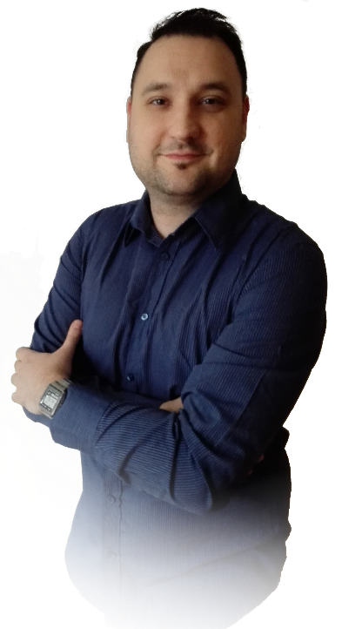















Peter
+36 304492755
Mutter
mutterptr@gmail.com
Peter Mutter
mutterptr@gmail.com
Junior PHP developer,
+36 304492755
Notebook repair technician
Mutter Péter
mpet80
András Fáy Transport Engineering Technical Secondary School
Education
(Automotive industry), Budapest, Hungary
1996-2000
Automotive technician (Car mechanic)
Manfréd Weiss Vocational Training Center, Secondary School,
Specialized school and Dormitory, Budapest, Hungary
Computer Programmer adult training
Computer programmer
2000-2002
Language
Peregrinus Language school, Budapest, Hungary
2015
English class (A1-A2 Elementary English Course)
Cosmopolitan Lingua Language school, Budapest, Hungary
2016
English class (B1 Pre-Intermediate English Course)
Experience
Stock release, picking storekeeper,
Case Hungary Ltd.
Computer service technician
(Guarantee service, foreign RMA administration, construction and repair of computers, testing and inspecting parts)
2003.11.01-2008.03.14
Notebook repair technician
C Szerviz Ltd.
(Fujitsu-Siemens, Lenovo, Hewlett Packard notebooks)
2008.07.01-2009.03.15
Technical inspector of goods returned
Automex Ltd.
(Handling of goods returned from chain stores)
2008.03.25-2009.10.22
Notebook repair technician
TeleMax GSM Szerviz Ltd./
(Service department. Samsung, Lenovo notebooks)
TMX Mobile Solution Szerviz Ltd.
2010.07.01-2016.02.02
Junior PHP developer
TMX Mobile Solution Szerviz Ltd.
(IT department. Development of internal business systems)
2016.02.02-2017.06.30

Slide 2





















Peter
+36 304492755
Mutter
mutterptr@gmail.com
Peter Mutter
mutterptr@gmail.com
Junior PHP developer,
+36 304492755
Notebook repair technician
Mutter Péter
mpet80
Successful professional launch of the Notebook repair Area within the company
Results
Active participation in the elaboration of work process, work areas,
Technical/professional implementation and the acquisition of necessary tools
Use test software that I have set up for Notebook diagnostics
I have suggested the inclusion of test software in the diagnostic process for the testing of
Notebook devices. I’m currently using test software for today’s active use of the company’s
Notebook error testing process.
Accessing one of the best repair statistics
Get short of time to get one of the best technical achievements and get a corporate bonus.
Minimal repair Customer complaint, high Customer satisfaction.
Professional recognition among colleagues. Repairing the VIP Client’s devices.
Samsung Notebook Repair Team, Deputy team Leader job position
Professional management of 2-3 people. Training, schedule, prioritization, quality control,
repair suggestions, purchase/replacement of equipment, Customer Care, group management.
Employee of the Month at the IT department (January 2017)
2485 pcs.
repaired
notebook
devices
54 pcs.
repaired
desktop
computers
Skills
Knowledge of ESD standard
Basic knowledge of soldering and soldering practice
More than 5 years of brand service experience
One and a half years Lenovo Notebook repair experience
Over 3 years of Samsung
Notebook repair experience

