Slide 1
CSS, Cascading Style Sheet

Slide 2
CSS
HTML can only build webpage structure, CSS can style HTML.
CSS Advantage
By using a single style sheet or css file for entire site, a web designer can apply styles across whole site while updating a single css file.

Slide 3
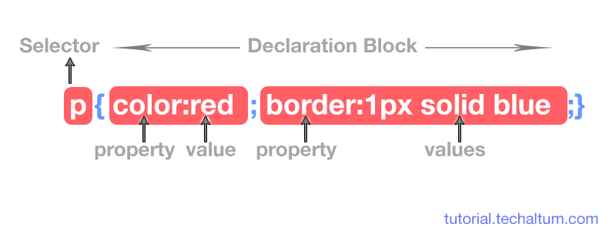
CSS Code

Slide 4
Type of css
CSS Type | Explanation
Internal CSS | CSS Code is written inside <style> tag in head. Recommended for single page only.
External CSS | CSS code is written in separate file with .css extension and <link> element is used to attach external css with html document. Used for multipage websites.
Inline CSS | CSS code is written inside html tag directly, in style attribute.

Slide 5
CSS Selectors
Selectors are used in internal or external css.
After selector name, a declaration block, i.e curly brackets {} are used.
Within {}, css code for targeted element is written with key:value pair.
Sometimes multiple values are there fro single key, so white space is used as separator.
After Property:value, semi-colon ; is used to add next property and value.

Slide 6
Type of CSS selectors
Id Selector
Class Selector
Grouping
Nesting
Attribute
Adjacent
Pseudo
universal-selector

Slide 7
CSS Selectors List
Selector | Example | Use
Type Selector | p{} | Used to call all p tags
ID Selector | #para{} | Used to call that unique element with id para.
Class Selector | .para{} | Used to call group of different elements with class para
Tag with Class Selector | p.para{} | Used to call only p elements with class para
Grouping Selector | h1, h3, h5{} | Used to group <h1>, <h3> <h5> elements

Slide 8
CSS Selectors List
Selector | Example | Use
Descendant Selector | div p{} | Used to call all p elements of div, i.e, children, grand children and so on.
Child Selector | div > p{} | Used to call only child p elements of div, not grand and great grand.
Adjacent Sibling | div + p{} | Used to call first next p element or sibling of div.
Attribute Selector | input[type="radio"] | Used to call an element on the basics of attribute and value.
Universal Selector | *{} | Used to call all elements in web document.

Slide 9
ID Selectors
ID Selector is used to call an HTML Element by its unique id name. Id is always unique in a single web page. We can not give same ID name to any other HTML Element in same webpage.
ID is basically an attribute used in opening or start tag of html element. Inside double quotation, the value of ID is given. ID value is single, means no white space separation
In css, id selector is called using HASH ( #), followed by id name.

Slide 10
Class Selectors
Class Selector in css is used to call all html elements with same class name.
Class represents a group of different or same html elements. We can give same class name to two or more different HTML Elements.
Class is basically an attribute used in Opening or Start Tag. Inside double quotation, the value of class is given.
In css, class is called using DOT ( .), followed by class name.

Slide 11
Class(.) vs id(#)
Selects a group of elements
Is written with a hash symbol followed by the ID name
Can be used to mark multiple elements within a page
Selects a single element
Is written with a period followed by the class name
Can only be used to mark a single element in a page

Slide 12
CSS Colors
CSS brings 16,777,216 colors to your disposal.
They can take the form of a name, an RGB (red/green/blue) value or a hex code.
Hexa Color Code: #FF0000
RGB Color Code: rgb(255,0,0)
color: yellow; background-color: blue;

Slide 13
CSS Text Properties
Text Align
Text Indent
Text Decoration
Text Transform
Word Break
overflow-wrap / Word Wrap
Word Spacing
Letter Spacing

Slide 14
Margins and Padding(How to space things out)
margin and padding are the two most commonly used properties for spacing-out elements.
A margin is the space outside something, whereas padding is the space inside something.

Slide 15
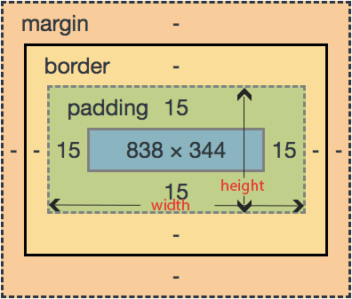
Box Model
Units for width and height are px, em, and %.

Slide 16
Borders
border-style: dashed;
border-width: 3px;
border-left-width: 10px;
border-right-width: 10px;
border-color: red;
Borders can be applied to most HTML elements within the body.

Slide 17
Overflow Property
overflow:visible;
CSS Overflow Property controls the behavior of overflowing content from an element.
The possible values are auto, visible, scroll and hidden.
Overflow can be used when width or height of content is more than parent element.

Slide 18
Background
Background Color
background-color:red;
Background Image
background-image:url(images/bg.png);
Background Repeat
background-repeat:no-repeat;
Background Position
background-position:left top;
Background Attachment
background-attachment:scroll;
Background

Slide 19
Position Property
CSS Position means where an element should be located. Positions are used to specify the location of an HTML element on a page layout.
By default, all elements in html are positioned statically ( except dialog tag ).
Static position is position on an element to page or document flow.
By using css positions, they can be moved from their position relatively or absolutely.

Slide 20
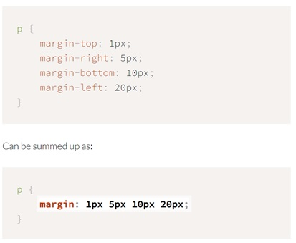
Shorthand Properties
Some CSS properties allow a string of values, replacing the need for a number of properties. These are represented by values separated by spaces.

Slide 21
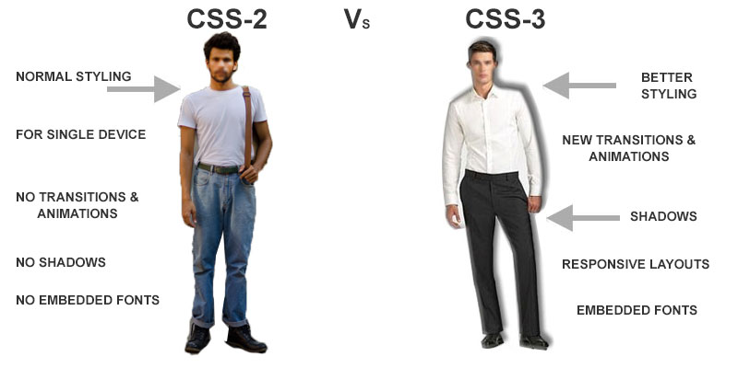
CSS3

Slide 22
CSS3 Features
CSS3 New Features | Uses
New Selectors | Better Selections of HTML Elements. CSS3 selectors
Shadows Effect | Box shadow and text shadow for shadow effects. Box shadow
Rounded Corners | Easily round the corners of images and block elements. Border Radius
Gradients | Linear, Radial and Repeating gradients for backgrounds. CSS3 Gradients
Opacity | Reduce opacity of Elements and Background colors using rbga colors. Opacity

Slide 23
CSS3 Features
CSS3 New Features | Uses
Transitions | Hover and Focus element with time and timing functions.CSS3 Transition
Transformations | Rotate, Scale, Skew and Translate any object. CSS3 Transform
Animations | Animate any object without using flash. CSS3 Animations
Multi Column layout | Create multiple columns layouts.
Flexbox | Flexbox is used to build one dimensional or 1d layout is CSS.
CSS Grids | CSS3 Grids are used to build two dimensional or 2d layout is CSS.
@font face | Embedded various fonts family. Font Face
@media | Condition based CSS to create Responsive Web Design.

Slide 24
THANK YOU

