Slide 1
HTML
HyperText Markup Language is a simple, elegant way to structure content.

Slide 2
Tags and Elements
Tags are used to add content in html, like text, headings, table, list links etc. Tags along with attributes are core components of HTML. The latest version of HTML, i.e HTML5 includes 145 tags.
An HTML Tag with attributes and content is called HTML Element. Element include start tag, end tag, attributes and content inside.
Basically all HTML Elements are build using html tags.

Slide 3
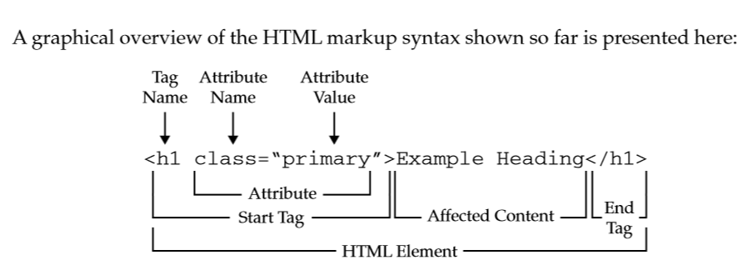
Tags and Elements

Slide 4
Type of HTML Tags
Paired Tags
Paired Tags are tags with both opening and closing. They can have child tags, plain text and attributes.
Unpaired Tags
Unpaired tags are tags with opening only, example <img>, <input> etc. They can have attributes.

Slide 5
HTML Tag <html>
HTML Tag is the parent tag of all HTML Elements. Its is also called root tag.
HTML Tag has two children, head tag and body tag. Since HTML3, It is compulsory to define doctype and then HTML tag.
lang attribute is used inside html tag to define language. An option dir="ltr" is also used to add direction which is by default left to right.

Slide 6
HTML Head tag is the first child of HTML. Head includes all the information related to webpage seo, css links, scripts and meta tags.
Head is not visible to user. It is mainly for search engines and browsers.
HTML Body Tag is used to define the body of our HTML Document, basically the content visible to user.
The Body Tag contain all visible contents of a web page like paragraph, headings, tables, lists, images, videos visible to user.
By default, body is 100% wide, having white background and took a margin of 8px.

Slide 7
Title Tag is the compulsory child of HEAD. Title is compulsory and should be unique on all webpages. Title enhance search engine visibility of a webpage on various search engines. Maximum limits of characters inside title tag is 70 for maximum search engines.
Always use the first targeted keyword in title for best seo results.
Meta charset was introduced in HTML5. Earlier meta tag with content and http-equiv was used to declare charset.
Meta charset is used to declare webpage character encoding. The recommended charset for maximum websites is UTF-8. The default charset for windows OS is windows-1252.

Slide 8
Meta
HTML4 Meta Charset
<meta http-equiv="Content-Type" content="text/html; charset=utf-8">
HTML5 Meta Charset
<meta charset="utf-8">

Slide 9
Tags List
HTML5 includes 145 tags in early versions. Some Html4/XHTML tags are removed in HTML5, and some new tags are added in HTML5.
Also some tags are renamed in HTML5. Here is a complete list of HTML5 Tags with name, use and version in which they were introduced.

Slide 10
HTML Attributes
HTML elements can have attributes in opening or start tag.
Attribute provides additional information about that element.
HTML attributes are added in opening tag and can have some value. Some popular Global Attributes are class, id, title, style etc.

Slide 11
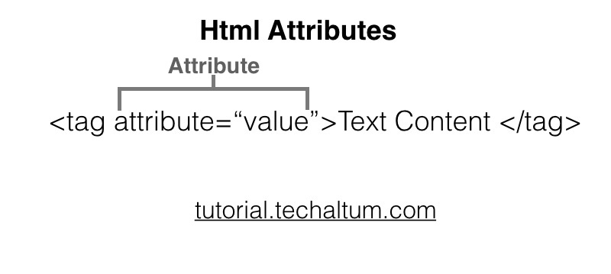
Attributes
Note: Earlier many presentational attributes were used, like align, valign, bgcolor etc, but now in HTML5, these attributes are removed. CSS is used instead of these attributes.

Slide 12
Attributes Type
Attribute Type | Meaning
Global Attribute | Attributes meant for all html elements. Exp : class, id
Boolean Attribute | Attribute with Attribute name only, no value. Exp :disabled, hidden, reversed etc.
Presentational Attributes | Attributes used to style HTML Element. For example : style, size, color, border, cellspacing, cellpadding etc.
Event Attributes | Event attributes are used to add javascript event on html element, like onclick, onmouseover, onmouseout, etc.

Slide 13
HTML Attributes
Attribute | Element | Description
class | Global Attribute | used to group elements for css
id | Global Attribute | Assign a unique id for the element
name | Global Attribute | Assign name of an element
style | Global Attribute | CSS attribute for tags (Specifies an inline style for an element)
title | Global Attribute | Specifies extra information about an element (displayed as a tooltip)
lang | Global Attribute | Language of text
dir | Global Attribute | direction of text, ltr or rtl only

Slide 14
HTML Attributes
Attribute | Element | Description
dir | Global Attribute | direction of text, ltr or rtl only
data- | Global Attribute | data attributes are used in html5 to define custom attribute
type | <input>, <audio>, <video>, <embed>, <iframe>, <source>, <script>, <track>, <ol> | Defines type of element.
src | <img>, <script>, <input>, <audio>, <video>, <embed>, <iframe>, <source>, <track> | source of media element
href | <a>, <link>, <base> | hypertext reference, path of hyperlink ( <a>) and link tag

Slide 15
HTML Attributes
Attribute | Element | Description
tabindex | <a>, <input>, <select>, <button>, <select>, <textarea> | to override default tab order and follow the specific one.
width | <img>, <embed>, <video>, <iframe> | Set width of element
height | <img>, <embed>, <video>, <iframe> | Set width of element
value | <input>, <option>, | Set default value of element visible at pageload
size | <input>, <select> | Width of element in px. For input type text, size means no of characters

Slide 16
Attributes removes in HTML5
bgcolor | Background Color of the document(Removed in HTML5) | <body bgcolor="aqua">
cellspacing | change space (margin) between table cells(Removed in HTML5) | <table cellspacing="10px">
cellpadding | inner space ( padding) between table cells(Removed in HTML5) | <table cellspacing="10px">
bottommargin | Margin from bottom(Removed in HTML5) | <body bottommargin="20">
topmargin | Margin from top(Removed in HTML5) | <body topmargin="10">

Slide 17
Attributes removes in HTML5
bgcolor | Background Color of the document(Removed in HTML5) | <body bgcolor="aqua">
background | Background Image of the document(Removed in HTML5) | <body background="img/bg.png">
border | To set border of table element.(Removed in HTML5) | <table border="1"> </table>
align | Align left, right, center(Removed in HTML5) | <p align="center">
valign | Align top, middle, bottom(Removed in HTML5) | <p valign="middle">

Slide 18
Text Tags
All text elements are written inside body. <p> is the common tag use to write paragraphs.
There are six headings in html, h1-h6.
Note:
Align attribute is removed in HTML5. To align text in Html5, use CSS text align.
Font and tt tag are deleted in HTML5.

Slide 19
Headings
Heading elements are used to write headings in a webpage, whereas p tag is only for plain text.
All Headings are bold and block level elements.
As per Search Engine Rules, it is compulsory to define atleast one h1 and h2 in a webpage.

Slide 20
HTML Block and Inline Elements
HTML Elements are classified as Block Level and Inline Level elements on the basics of their display.
Some elements display as blocks and some inline.
Block Vs Inline
<p> <div> <h1> < h2> <address> etc are block level elements,
<b>, <strong>, <i>, <span>, <u> and <s> are inline level elements.

Slide 21
Block level elements
HTML Block level elements are elements who behave like blocks, like <p>, <h1>, <div>, <ul>, <ol>, <pre> and <address>. These elements always starts from a new line and occupy full width of parent element. Block elements can contain both inline elements and block elements.

Slide 22
Inline level elements
HTML inline elements always start in the same line. Their width is equal to their content. Maximum inline elements are presentational, for exp, <b>, <i>, <s>, <u>. Some functional inline elements are <strong>, <em>, <del>, <time> etc.

Slide 23
Div tag
Html div tag is used to create divisions. Div is block level, thus starts from new line and occupy full width of parent. Div can group all block level elements.
Span tag
Html span tag is used to create division inside line. Span is inline level, thus starts in the same line and occupy width of content. Span is used to group inline level elements.

Slide 24
Lists
HTML Lists includes three type of lists to show single or multiple list item. These three lists are Unordered List, Ordered List and Description List, formerly known as Definition List.
There are three types of list in HTML, i.e, unordered lists , ordered lists & description list.
The ul tag is used to define unordered list and the ol tag is used to define ordered list. Inside the list, the li tag is used to define each list item.

Slide 25
Hyperlinks
HTML Hyperlinks are created using <a> tag. Formally known as anchor tag, hyperlink defines a link <a href=""> in html document.
A hyperlink links a webpage with other webpages and external pages.
A hyperlink can be Internal Link, External Link, Internal Link, Mail Link or telephone link .

Slide 26
Images
HTML Images are defined within <img> tag. Image tag is an unpaired element. src and alt attributes are compulsory to add path of image and alternative text.
HTML includes image tag since 4th version (HTML4) ie since 1997. Images not only enhance the look and feel of a website, they add information in the form of pictures. We can uses images as a logo, banner, icons, symbols, product etc.

Slide 27
Iframe
Iframe is a inline element used to embed other webpages or website within a page. Iframe can also be used to embedded Youtube video, embed Google map to a webpage.

Slide 28
Entities
HTML Entities are used to display reserved characters and special characters on a webpage. Html can not show all characters. Some characters are reserved by html.
To write special characters in HTML, we use HTML Entities. We can write an HTML entity by Entity No or Entity name.
10,000+ html entities.

Slide 29
Table
HTML Tables are used to display tabular data in html. HTMl Table is defined with the <table> tag and then table row <tr> and cells <td> or <th>. Table tag is the parent of table. Table can have rows, data, captions, colgroup, cols, etc.

Slide 30
Form
HTML Forms are used to send data across the web and are often used as contact form to convert information input by a user into Leads. HTML forms includes many inputs like text, password, file, radio, checkbox etc.

Slide 31
HTML 5

Slide 32
HTML5 Stack
The term HTML5 means not only HTML, it is a combination of HTML, CSS and Javascript with APIs.
For example, drawing and animation using canvas, offline storage, microdata, audio and video, drag and drop, geolocation, embedded fonts, web APIs etc.
HTML5 includes new semantic tags and some old tags( with redefinition ).
Html5 is the combination of three web technologies:
HTML → to build webpage structure,
CSS → to enhance look and feel( presentation layer), and
Javascript → to add functionality to HTML elements.

Slide 33
HTML5 Features
HTML5 Features | Use
New Semantic Tags | <header>, <nav>, <section>, <article>, <footer> etc. HTML5 New Tags
Audio and Video | <audio> & <video> Html5 Audio Video Tutorial
New Form Controls | New attributes, New input types, progress bar etc. HTML5 Form Tutorial
SVG | <svg> Tag for vector based drawings, shapes, pie and bar graphs, maps etc. SVG Tutorial
Canvas | <canvas> tag for 2-d drawings using javascript. Canvas Tutorial

Slide 34
HTML5 Features
HTML5 Features | Use
CSS3 | New Selectors & properties for better styling, transition, transformation, animations, embedded fonts, filters, multi-column layouts and responsive web design. Css3 Tutorial
Geolocation | To Detect user physical location. Html5 Geolocation
Web Storage | To store upto 5mb data on front end either as local or session storage. Local and Session Storage
Microdata | To tell search engines our page structure.
Drag n drop | New Events in javascript.

Slide 35
HTML5 New Tags List
Article
Section
Aside
Details
Summary
Time
BDI
Command
Figure
Figcaption
Picture
Footer
Header
Mark
Meter
Nav
Progress
HTML5 Canvas
HTML5 SVG
Wbr

Slide 36
HTML5 Audio and Video
Now we don't need any third party plugin, like flash to play audio or video in our website.
HTML5 Audio tag is used to play audio files, like mp3, ogg and AAC. All browsers supporting audio tag are having build in player.
HTML5 Video tag or <video> is used to add videos on a webpage. Video tag supports mp4, ogg, mov and H.264 files.

Slide 37
HTML5 Forms
HTML5 Form includes HTML5 New Form Elements & HTML5 New FORM Attributes for Form Validation and better usability on touch devices.
Using HTML5, we can create a form with built in validation (i.e. no javascript required).
Earlier, we were using JAVASCRIPT to control form validation. These form controls are meant for both Desktop, tablets and smart phones.

Slide 38
HTML5 Form Features
New Attributes | autofocus, required, placeholder, autocomplete, pattern, minlength, readonly, list.
New Input Types | number, email, tel, search, url, range, date, month, week, time, color, range
New Elements | meter, progress, datalist.

Slide 39
SVG
HTML5 SVG( Scalable Vector Graphics) is the new way to add graphics on your Webpage. SVG can create Vector based drawing and objects like lines, rectangle,circle, polygons, text so on.
Unlike bitmap images( jpg, png and gif), they can increase width and height without blur. They are even light weighted as compared to bitmap images.

Slide 40
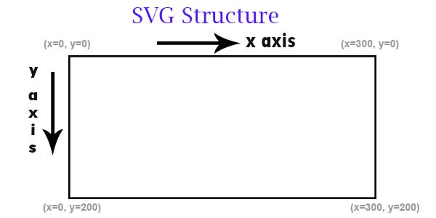
SVG

Slide 41
Canvas
HTML5 Canvas ( <canvas>) is a bitmap canvas used to build 2D shapes, drawings, Shapes like lines/ rectangle/circle, animations, and games using Javascript. canvas is just a inline-block element in our webpage where we can use JavaScript to draw whatever we want.
Unlike SVG, Canvas is bitmap, that means zooming a webpage can pixelate canvas shape.
A <canvas> element does not have any content inside, and no border. Default width of canvas is 300 and height is 150. However we can change width and height of canvas using width and height attributes or css.

Slide 42
Geolocation
HTML5 Geolocation or Geolocation API is used to get user Physical Location or geographical position using Device location Sensors. Geolocation will return coordinates like, latitude, longitude and accuracy. If device supports Barometer Sensor, then we can also get altitude and altitude accuracy. For moving devices, we can also get direction and speed.
Earlier IP based location was used, but now Geo Location is more popular as it is more accurate. As Geolocation is related to user privacy, first browser will grant your permission.

Slide 43
Geolocation
Geolocation Permission
Check Geolocation
Get Geolocation
Watch Geolocation
Clear Watch
Google Map Direction API

Slide 44
Cookies
Cookies are data stored on client side by javascript in small text files.
Data stored in cookies can be used when user visit again.
Cookies was developed by Netscape.
When user leave a website, browser never save anything.
Cookies can save upto 4kb text data on client side.

Slide 45
Cookies advantages
Login using cookies (without password).
Product added in shopping cart.
Last visited products on e-commerce sites.
Ads Channels show relevant ads.
Sites like Google use cookies for securities.

Slide 46
Cookies Limitations
Can store text data only.
Can store upto 4kb data only.
Create Cookies
Cookies Expiry

Slide 47
Web Storage - Local and Session
HTML5 Web storage includes local storage and session storage.
Both can store data on client side, same like cookies.
But Cookies can store upto 4kb data in string type, whereas HTML5 web storage can store 5mb, (Upto 10mb in some browsers) data in key-value pair.
Unlike cookies, they are easy to use, easy to parse have more storage capacities.

Slide 48
Type of web storage
Local Storage
Session Storage

Slide 49
Local Storage
HTML5 Local Storage can store 5-10 mb data,( can vary on different browsers) on client side same like cookies.
But cookies can store only upto 4kb data, and data is stored in string type only.
Local storage can store data in key-value pair.
Local storage data is easy to parse than cookies.
Add Local Storage
Check Local Storage
Remove Local Storage
Local Storage

Slide 50
Session Storage
Session Storage can store data on client side, but only for current session.
This means, once you close your web browser tab, all session storage data will be erased.
Even for new tab in browser, session storage data is not accessible.
Session storage data is also stored in key-valuepair.
Refreshing or reloading browser tab cannot remove session data.
Add Session Storage
Check Session Storage
Remove Session Storage
Session Storage

