Slide 1
Project Progress
CT Scan / Radon Project
Tim Shepard

Slide 2
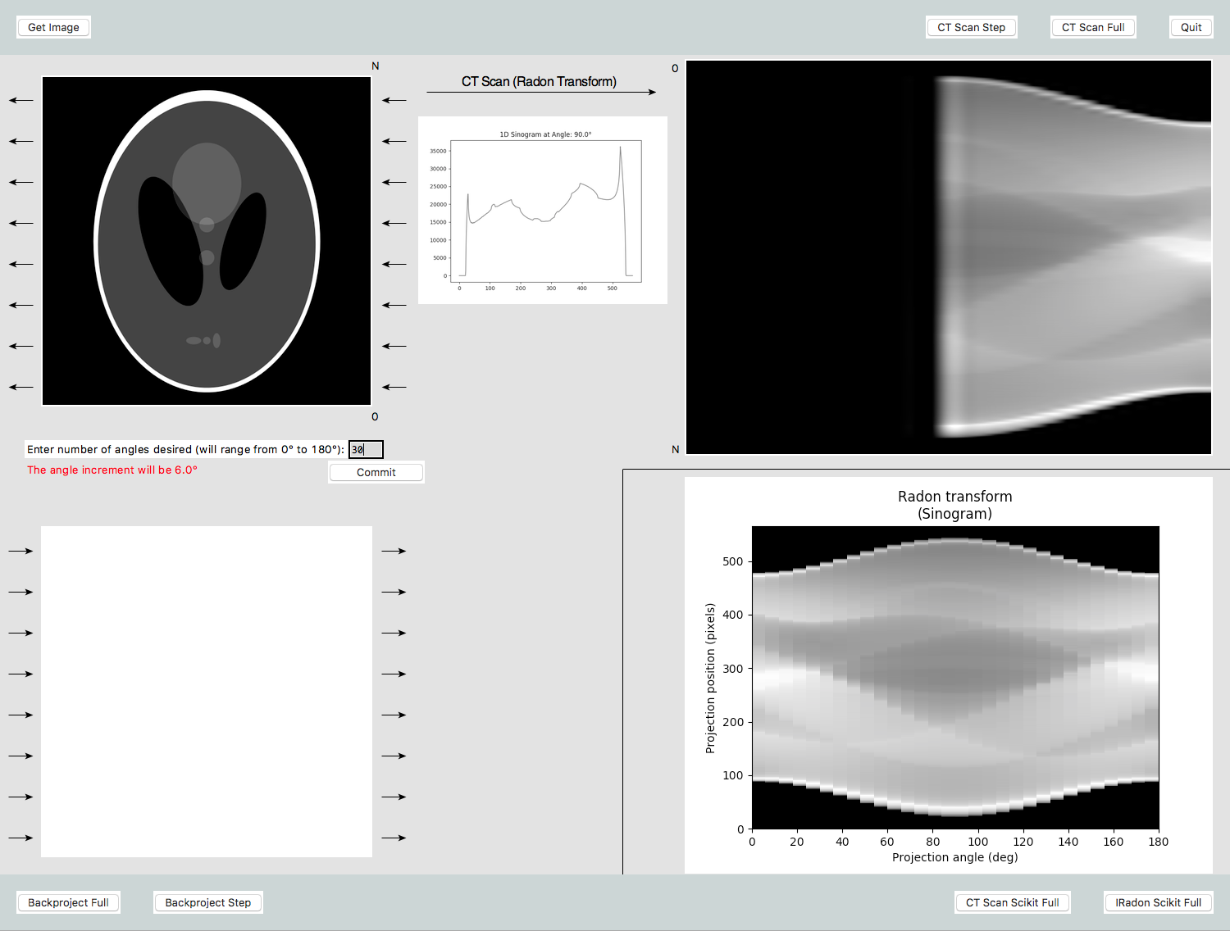
CT Scan / Radon Project
Objectives:
1. Simulate CT Scan
by stepping through the Radon Transform for each angle chosen. (Compare with Radon Transform from Python’s Scikit-Image)

Slide 3
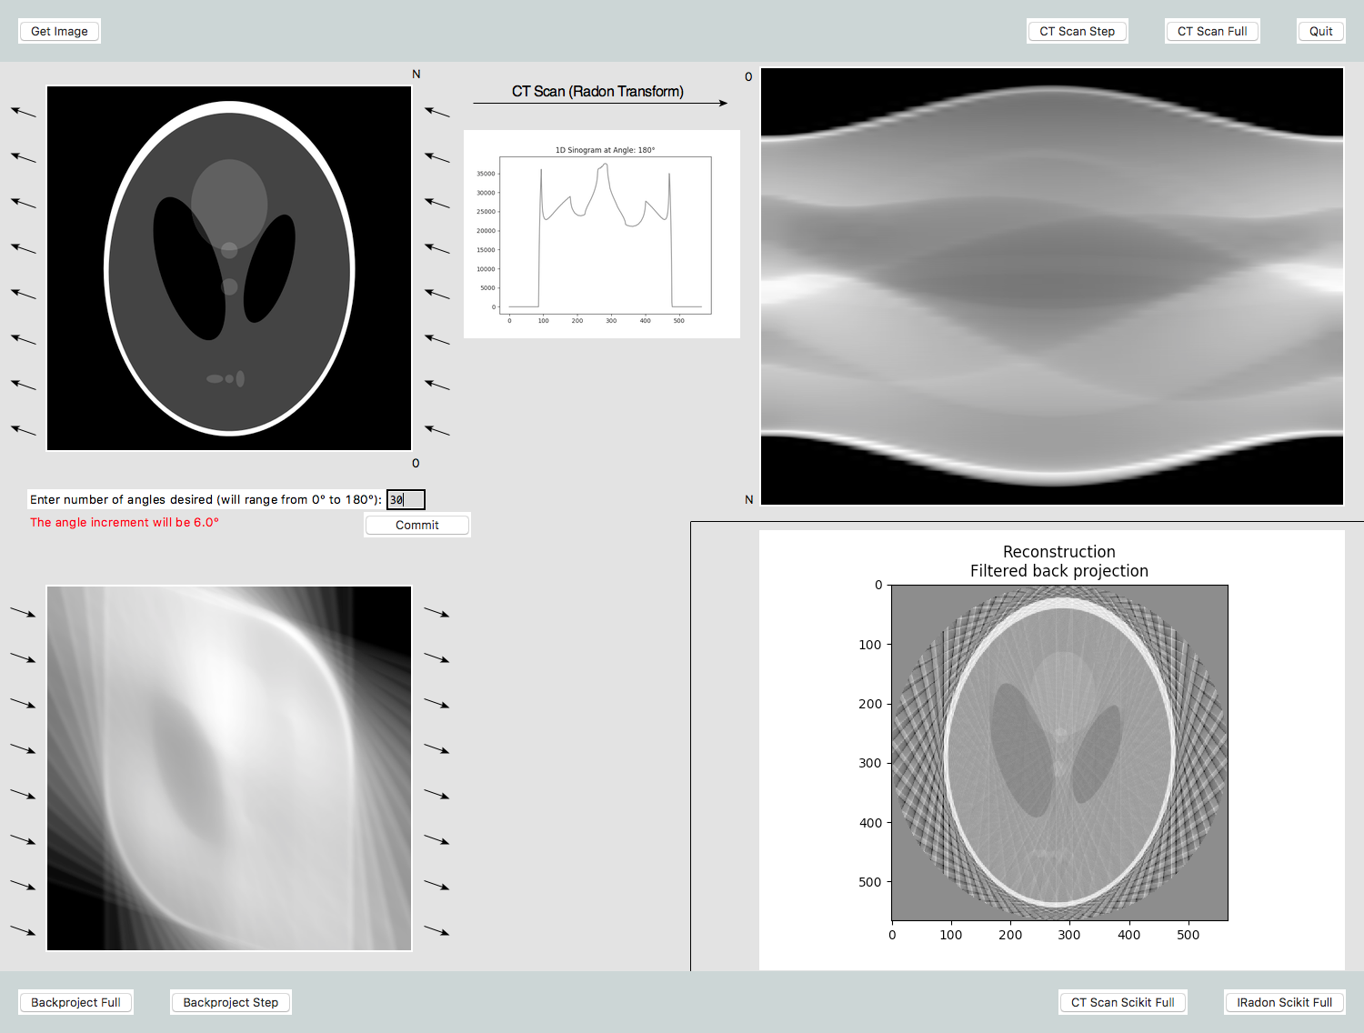
CT Scan / Radon Project
Objectives:
2. Simulate Slice Reconstruction by stepping through back-projections for each angle

Slide 4
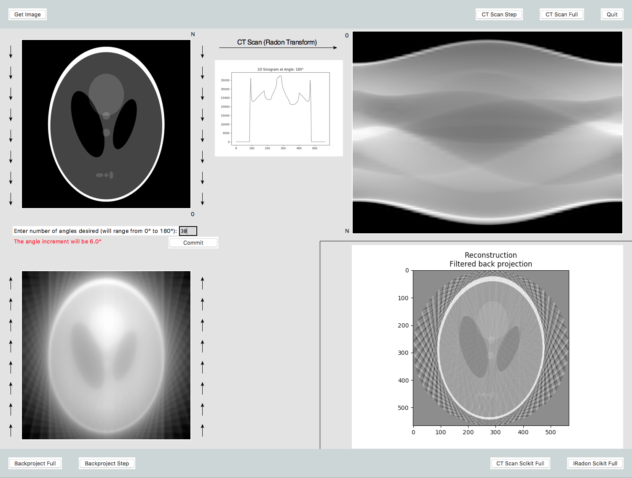
CT Scan / Radon Project
Objectives:
2. Simulate Slice Reconstruction by doing a back-projection for each angle. (Compare with Radon Transform from Python’s Scikit-Image)

Slide 5
CT Scan / Radon Project
Observations:
More, denser angles gives a better image
Must take CT Scans from 0° to 180° to get full image
Simple back-projection without filtering gives a blurred image. I think this is because the low frequencies from each CT Scan dominate.

Slide 6
CT Scan / Radon Project
Work Remaining
Do a high-pass filter before back-projecting each radon line
Improve GUI
Sources:
http://biomedicalsignalandimage.blogspot.com/2016/02/matlab-code-to-perform-tomographic.html
http://homepages.inf.ed.ac.uk/rbf/CVonline/LOCAL_COPIES/AV0405/HAYDEN/Slice_Reconstruction.html

Slide 7
Thank you

