Slide 1
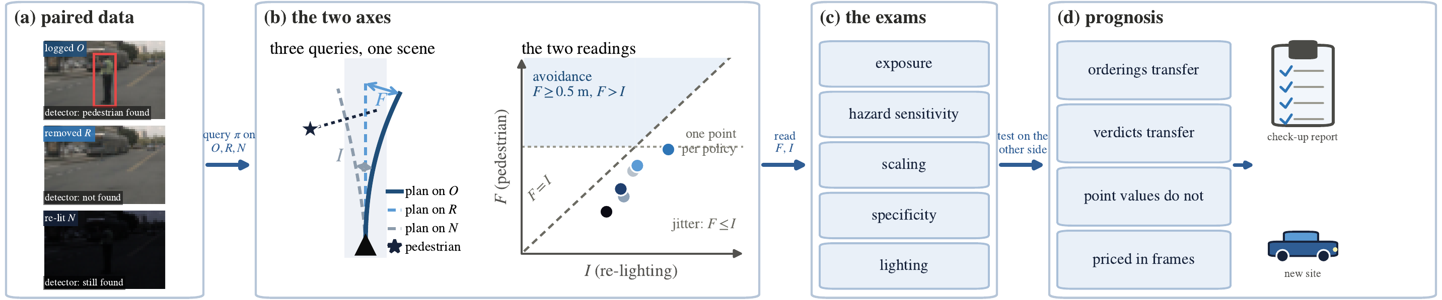
Fig. 1 The Check-Up framework (two-column strip, 7.16 x 1.49 in)

Slide 2
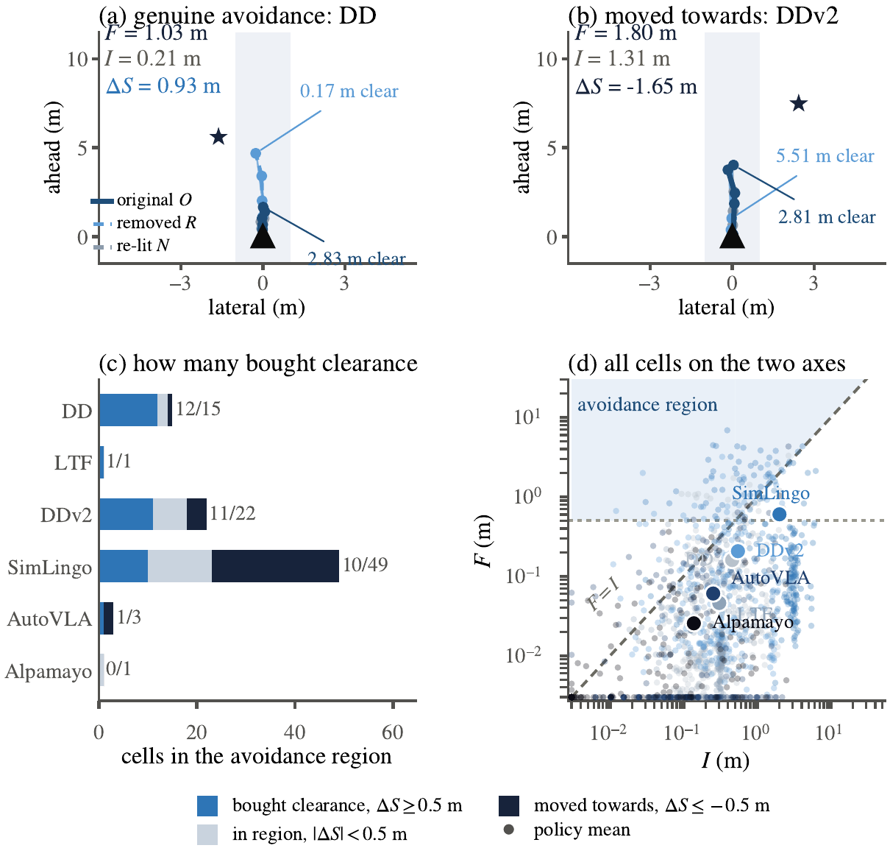
Fig. 2 The two axes (single column, 3.45 x 2.95 in)

Slide 3
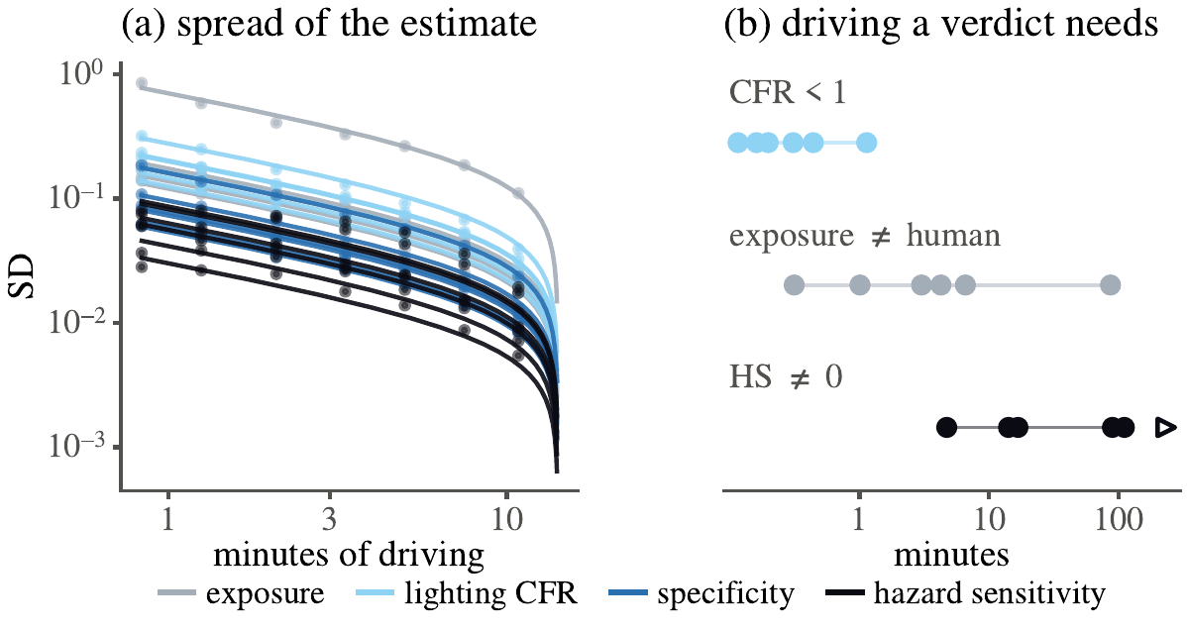
Fig. 3 What a verdict costs (single column, 3.45 x 1.4 in)

Slide 4
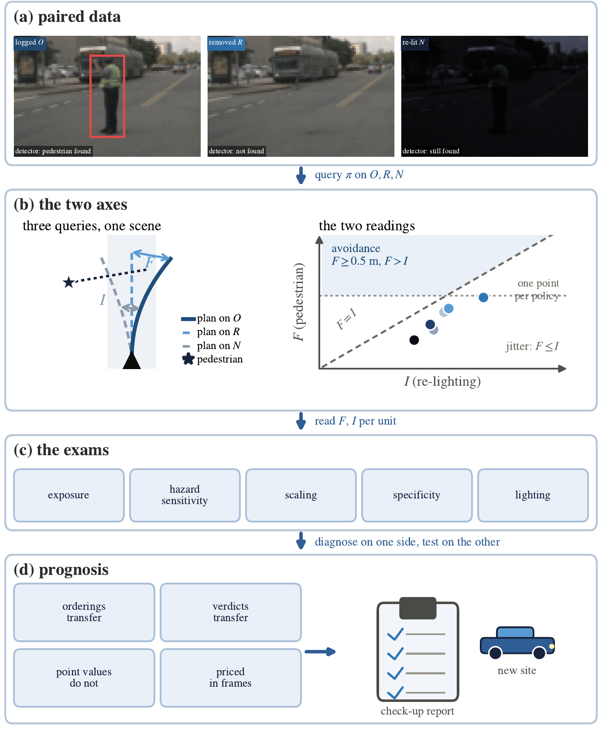
Fig. 1 alt single-column vertical version (not used)

