Slide 1

GaMP5
Compliance Key Elements for Regulated Software

Slide 2
GAMP5 guidelines content
Overview
GaMP5 and Merck millipore
Software specificities
GaMP5 and regulated industry
What is the current GaMP5 scope ?
What are the key requirements?
Software categories
GAMP5 processes review
Software development
Software Validation
Documentation needed
Change control

Slide 3

Why use GaMP5 ?
Since 1997, the release of U.S. 21 CFR Part 11 and Annex 11 European , computerized systems have been subjected to various levels of attention from regulated pharmaceutical industry, contributing to heterogeneous levels of requirements . GaMP® has evolved progressively to reach in version 5 published in 2008 , the reference position for the entire pharmaceutical industry.
It is Merck Millipore Policy to follow GaMP guidelines when developing softwares :
That will be used for supporting GMP or GLP regulated processes
Which are used to take quality decision in a regulated environment
To know if your product need to follow GaMP, fill form 12385FM

Slide 4
Is GaMP only a guideline ?
GAMP5 ® is a guideline provided by ISPE. (Intl Soc Phar Engineering)
GAMP has evolved progressively to reach reference position for pharmaceutical industry.
Furthermore, 2011 evolution of European GMP annex 11 has included in regulatory requirements key aspects of the GAMP
Therefore GAMP5 is a key requirement from our pharmaceutical customers and should be considered as an essential part of our software development and maintenance methodology.
Increased focus has been placed by regulator on GAMP5 since 2011, and regulatory notices related to GAMP5 topics will probably increase customers attention.
Failure to defend GAMP5 claims will result in a failure to sell to regulated companies

Slide 5
Software is different from hardware
While software shares many of the same engineering tasks as hardware, it has some very important differences.
Majority of software problems are traceable to errors made during the design and development process.
One of the most significant features of software is branching, i.e., the ability to execute alternative series of commands, based on differing inputs. This feature is a major contributing factor for another characteristic of software – its complexity. Even short programs can be very complex and difficult to fully understand.
Quality of a software product is dependent primarily on design and development with a minimum concern for software manufacture.
Software manufacturing consists of reproduction that can be easily verified. It is not difficult to manufacture thousands of program copies that function exactly the same as the original; the difficulty comes in getting the original program to meet all specifications.
Software is can be modified easily
This factor can cause both software and non-software professionals to believe that software problems can be corrected easily. Combined with a lack of understanding of software, it can lead managers to believe that tightly controlled engineering is not needed as much for software as it is for hardware. In fact, the opposite is true.

Slide 6
Software failures
Unlike hardware, software is not a physical entity and does not wear out. In fact, software may improve with age, as latent defects are discovered and removed.
However, as software is constantly updated and changed, such improvements are sometimes countered by new defects introduced into the software during the change.
Unlike some hardware failures, software failures occur without advanced warning. The software’s branching that allows it to follow differing paths during execution, may hide some latent defects until long after a software product has been introduced into the marketplace.
Because of its complexity, the development process for software should be even more tightly controlled than for hardware, in order to prevent problems that cannot be easily detected later in the development process.

Slide 7
FDA Change control focus
The FDA’s analysis of 3140 recalls conducted between 1992 and 1998 reveals that 79% of software failures were caused by software defects that were introduced when changes were made to the software after its initial production and distribution.
Software validation and change control revalidation proposed by FDA and ISPE are principal means of avoiding such defects and resultant recalls
Therefore, GaMP does not stop when software product is introduced to the market.
GaMP life cycle cover the complete operational life of the software up to retirement

Slide 8
What are GaMP main objectives ?
GAMP main objectives are to protect :
Patient safety
Pharmaceutical Product quality
Data integrity

Slide 9
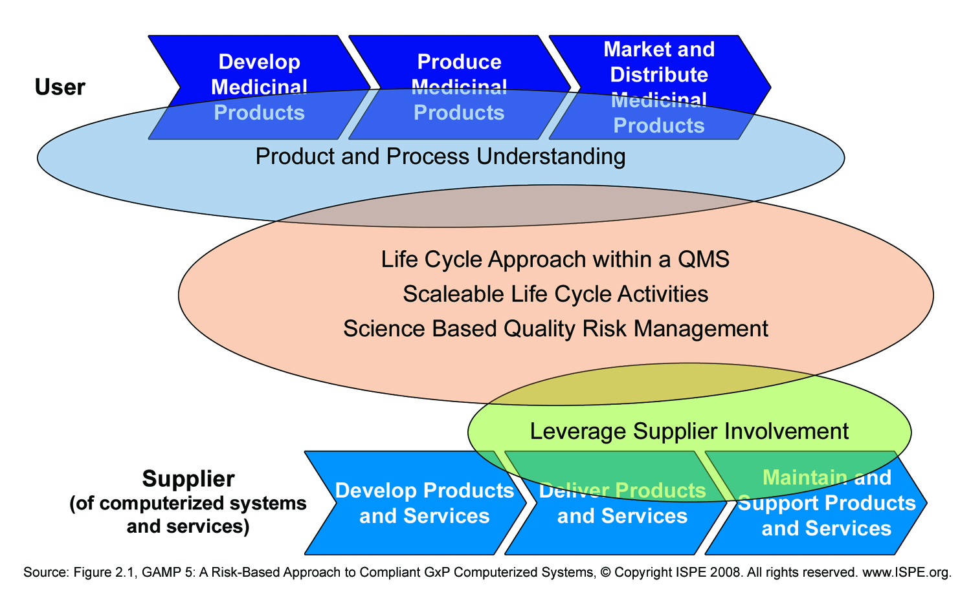
GaMP5 key requirements
GAMP5 include five key concepts :

Slide 10

Key Requirement 1 :
Product and process understanding
An understanding of the supported pharmaceutical/regulated process is fundamental for determining system requirements.
Product and process understanding is key for science based and risk based decisions to ensure the system is fit for intending use
The role of final user and marketing in defining user requirements is key for effective and efficient compliance and achievement of business benefit of GAMP methodology.
Voice of customer (VOC) and User requirement Specifications (URS)
are key deliverable to met this requirement.
Marketing is the owner of these deliverable
for GaMP softwares

Slide 11
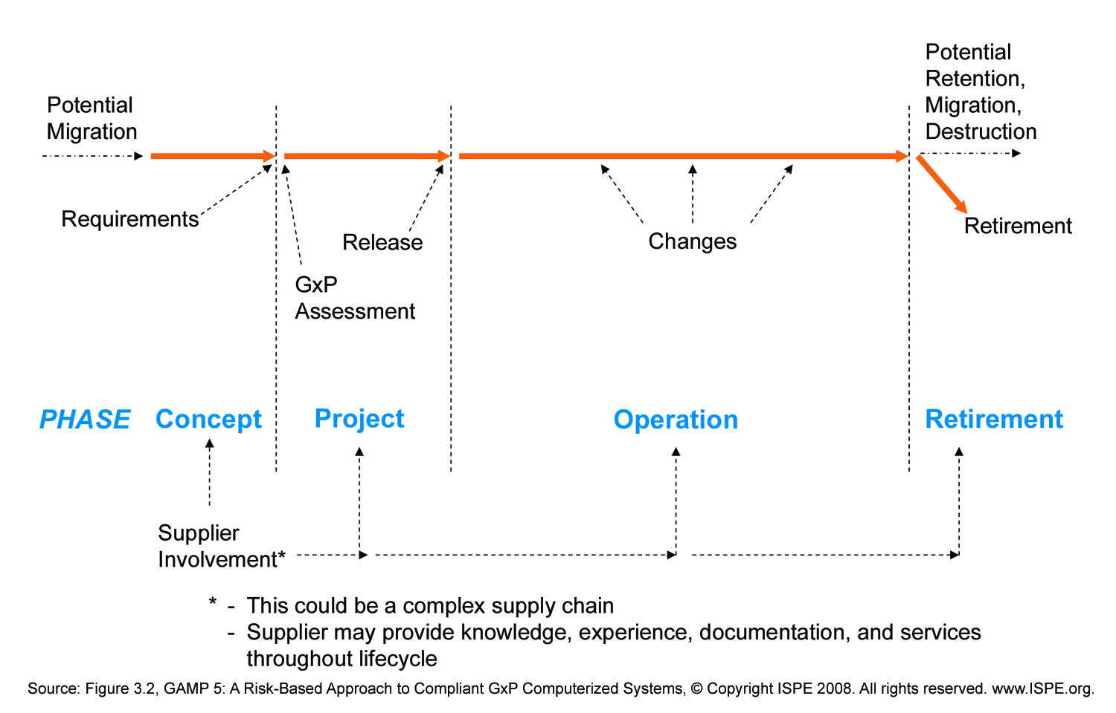
Key requirement 2 :
Life cycle approach within QMS
GAMP5 require that the whole life of computerized system (from concept to retirement) is controlled in a Quality Management System:
For Millipore it implies that operational changes and retirement are anticipated in software design and documentation, and that documentation follow quality approval cycle.

Slide 12
Key Requirement 3 :
Scalable life cycle activities
Life cycle approach should be scaled according to :
System impacts on patient safety, product quality, data integrity
System complexity or novelty (according GAMP categorization of software/hardware)
Supplier capability according to supplier assessment
Strategy should be clearly documented in dedicated Validation Plan,
and should follow established and approved policies and procedures
Design Control, validation (and revalidation) efforts have to be proportionate
to software categorization, risks and complexity

Slide 13
Key Requirement 4 :
Science based risk management
A systematic process for assessment, control, communication and review of risks has to be established
Application of quality risk management enables validation efforts to be focused on critical aspect of computerized system
Science based : qualitative (but fact based) or quantitative techniques have to be used to identify and manage risk
FMEA is a recommended tool
Functional risk assessment need to be systematic (each function analysed)
Need for further assessment (deeper in design/module specifications) has to be formally evaluated and documented

Slide 14
Key requirement 5 :
Leveraging supplier involvement
GAMP requests Regulated companies (our customers) to seek to maximize supplier (Millipore) involvement through :
Supplier assistance for requirements definition
Supplier Risk management
Supplier specification and testing documentation
Our customer are encouraged to assess our documentation for suitability, accuracy, completeness
Our GAMP related documentation has to be available for Regulator inspection (It is an European GMP annex 11 requirement)
00000663TC [A]

Slide 15
GaMP5 software categories
Category 1 : infrastructure software : operating systems
Category 3 : non configured software
e.g. commercially available product used with default configuration or non-configurable
Category 4 : configurable software
e.g. configuration of a commercially available product (trough configuration files)
Category 5 : custom software
software coded/developed for a specific application
Most of Merck Millipore newly developed product fall in category 5 or 4
Note : category 2 discontinued since 2008 (GAMP4 to GAMP5)

Slide 16
GaMP5 software categories and scalability
Category 1 : not subjected to direct specific functional verification
identity, version need to be verified during installation
Category 3 : One specification layer :
URS : User Requirement Specifications
Category 4 : 3 specifications layers :
URS / FS : Functional Specification
/ Configuration specification
Category 5 : 4 specifications layers
URS / FS /Software Design Specification /
Software Module Design Specifications
URS
Requirements Testing
Construction
URS
Requirements Testing
FS
Functional testing
Config Specs
Configuration testing
Construction
URS
Requirements Testing
FS
Functional testing
SDS
Integration testing
Specs
testing
SMDS
Module testing
Construction

Slide 17
Software validation key benefits
Software validation is a critical tool used to assure the quality of device software and software automated operations.
Software validation increase the usability and reliability of computerized systems resulting in decreased failure rates, fewer recalls and corrective actions, less risk to patients and users.
Software validation can also reduce long term costs by making it easier and less costly to reliably modify software and revalidate software changes (Software maintenance can represent a very large percentage of the total cost of software over its entire life cycle)
An established comprehensive software validation process helps to reduce the long-term cost of software by reducing the cost of validation for each subsequent release of the software.

Slide 18
Validation cycle

Slide 19
Test environments for process control system
00000663TC [A]
Software
Module
Verification in
development
environment
Software
Integration
Testing
on test bench
Functional
Testing
on process
equipment
Requirements
Testing
in final
environment
Process
Process
Equipment
Process
Equipment
Actuators
Actuators
Sensors
Sensors
Application
Application
Application
Software module
Software module
Software module
Software module
Software module
Software module
Software module
SMDS
SDS
FS
URS

Slide 20
GaMP Documentation needed
A full set of specification :
If your software is category 5 it imply to document URS, FS, SDS, SMDS
Traceability matrix provide connections through specification layers :
From URS to FS, from FS to SDS, from SDS to SMDS
A functional risk assessment
Usualy merged with product Design FMEA
Dedicated test protocols
Each specification item should be tested.
The software validation precede IQ/OQ/PQ of complete product
Documented test reports
Test results should be documented according Good Documentation Practices
A 21CFR11 assessment
If the software manipulate regulated electronic records/electronic signatures
A frozen software version / configuration

Slide 21
Change control Documentation needed
A review of specification :
Usually update SMDS documentation for minor changes, SDS or FS level for functionality upadte, URS for major changes impacting customer experience .
Redact and approve new revision of specification documents
Traceability matrix update
If new requirements are introduced
Functional risk assessment update
On new requirements, or if new modules may impact existing modules
Dedicated test protocols
If specifications have changed, test protocol need to be updated and approved
New software module need to be retested
Integration, and functional test need to be retested according to risk analysis
Documented test reports
A new validated software version / configuration need to be frozen

Slide 22
Conclusion
Using appropriate procedures for Software Development, Testing, Operational support and Management and documenting with deliverables aligned on GaMP guidelines is a success factor for delivering software to our regulated customers.
Detremine GaMP applicability, software category and potential 21CFR11 impacts with form 13285FM
Follow procedure 0040097MP for developing and maintening regulated softwares.

Slide 23
Thank you for more detailed training material, see 0000663TC

