Slide 1
Merck IOT/Automation Platform
QMS TRAINING v0.2
Molsheim, France
Bob Verhoeff

Slide 2
AGENDA
QMS TRAINING
Part 1 - QA Introduction
Quality Mission statement
Quality Principles
Good Documentation Practices
CSV, GAMP5 and V-Model
Part 2 - Highlights of Software Development Plan
Software Development Process
Quality Framework
Tools & Environments
Roles & Responsibilities
Part 3 - QMS Organization
QMS and SOP
Test strategy
Incident & Change management: Observations workflow
Part 4 – Maturing Quality Artifacts in Agile action
List of Quality Artifacts
The RACI, Review and Approval Matrix
Approval procedure
Acceptance Criteria for Sprint Quality Gate
Part 5 – Execution of QA: creation of test evidence and validation results

Slide 3
Overview
PART 1 – QA Introduction
Quality Mission statement
Quality Principles
Good Documentation Practices
CSV, GAMP®5 and V-Model
Notes:
The purpose in this QMS Introduction section (Part 1) is to :
1. Promote a Quality Mission Statement reflecting the quality culture of the
LS organization within Merck group with fully alignment with the Group Quality Policy (20043309);
2. Explaining the principles of Good documentation practices;
3. Describing the relation between computerized system validation, GAMP5 and the V-Model

Slide 4
Merck Group Quality Vision
PART 1 – QA Introduction
Merck Group Quality Vision is:
‘Quality is embedded in everything we do’
Notes:
The objective of the Corporate Quality Assurance Policy is derived from LS Global Quality Mission Statement.
Our Merck Group Quality Vision is : QUALITY IS EMBEDDED in EVERYTHING WE DO
A major focus of the Quality leadership is to create and establish unity of purpose and direction of the organization at all levels of the Merck organization.
This means that the Merck corporate quality mission statement and the accompanied objective, and key performance
indicators are aligned with each other and focused on enhancing customer satisfaction.
Additionally, the Quality leadership principles within LS are based on the six common values of the Merck Group. These are:
Courage,
Achievement,
Responsibility,
Respect,
Integrity, and
Transparency.

Slide 5

LS Quality Mission statement
PART 1 – QA Introduction
‘00005042POL- LS QUALITY MISSION STATEMENT’
Notes:
The Quality Mission Statement is reflecting the quality culture of the sector and fully aligned with the Group Quality Policy 20043309.

Slide 6
Quality and Regulatory Culture Pyramid
PART 1 – QA Introduction
Notes:
The six corporate values form the basis of the LS commitment to quality, which is described in the Quality and Regulatory Culture Pyramid derived from the ‘LS Global Quality Manual’ on p.11. Its elements detail the attributes and manners with which this culture is achieved.
The Quality and Regulatory Culture ensures that management develops the systems and processes and provides the environment and resources to meet all customer, statutory and regulatory requirements.
The CEO of Life Science is accountable for the quality and regulatory compliance of the LS products and ensures that effective quality and regulatory systems are in place, which are continuously improved and equipped with adequate resources. The LS CEO delegates the responsibility for the LS quality and regulatory systems to LS Quality and Regulatory Management (LS-Q). Quality and continual improvement is considered as a strategic pillar of the organization.

Slide 7


Quality Principles
PART 1 – QA Introduction
Why quality ?
Merck LS products = Pharmaceutical Industry
Pharmaceutical Industry = Regulated High Quality Environment
Regulated Environment = laws, rules (*GxP)
GxP stands for Good (x = any) Practices where x = M for Manufacturing
Ratio behind Regulated law texts = avoid future accidents based on historical casualties with aim to protect consumers and workers
(* GxP) = GMP, GLP or GCP
Notes:
Merck Life Science Business products is representing the Pharmaceutical Industry,
And the pharmaceutical Industry is classified as a Regulated High Quality Environment.
Regulated Environments are executed and controlled by dedicated laws, rules and regulatory compliancy guidelines (*GxP).
GxP stands for Good Practices in specific business areas where x can be
= M for Automated Manufacturing (GAMP)
= L for Laboratory (GLP)
= C for Clinical (GCP)
Ratio behind Regulated law is to standardize process and product description and avoid future accidents based on historical casualties with goal to protect the consumers and industry workers.

Slide 8
Quality Principles
PART 1 – QA Introduction
How to be compliant with the Law (compliant to regulatory)?
Quality Assurance = Patient safety and product quality and data integrity
Quality Assurance =
execute Quality System (of administrative and procedural activities) for
a product/service (development) activity
to ensure the fulfillment of requirements
1 : Write what to do
2 : Do what is written
3 : Document what has been done
Three QA Principles
Notes:
As a responsible organization, how can one achieve compliancy by the law and to be compliant to its regulatory?
Quality Assurance means patient safety AND product quality AND data integrity
Quality Assurance means maintain, execute and continuously improve a Quality System with all its administrative and procedural activities to ensure the fulfillment of requirements of products and services.
By following three general QA priniciples this fulfillment can be achieved:
1st : Write what to do
2nd : Do what is written
3rd : Document what has been done

Slide 9
Quality Principles
PART 1 – QA Introduction
1st Principle: Write what to do …
First document(s) = Documented requirements
Documented requirements = are written in such way to be understood by all stakeholders
Understood by everybody = accompanied risks are defined -> anticipated -> mitigated or eliminated
Notes:
1st Principle is write down what you intend to do and/or create. The very first documents are the documented Requirements.
The documented requirements are written in such way to be understood by all stakeholders.
This understanding by the involved people means that the accompanied risks are defined, anticipated, and finally mitigated (or even eliminated).

Slide 10
Quality Principles
PART 1 – QA Introduction
2nd Principle: Do what has been written …
The Requirements tells you what to create, if and only if:
it has been written ‘SMART’ (Specific, Measurable, Accurate, Result oriented and Testable) according to Good Documentation Practices;
Testing allows you to verify what has been built according to the ‘Requirements and Specifications’;
Testing must cover all identified risk: each risk(s) of FMEA/FRA must be covered by one (or more ) test case(s). Traceability in JAMA will create the required evidence.
Notes:
The 2nd principle is: execute what has been written as intended. The Requirements tells you what to create, if and only if, it has been written in a ‘SMART’ manner. According to Good Documentation Practices, this means these have been created Specific, Measurable, Accurate, Result oriented and Testable.
Structured and controlled testing allows you to verify what has been built according to the requirements and accompanied detailed specifications. Testing must cover all identified risks, each risk(s) identified by dedicated risk technics must be covered by one (or more ) test case(s). These techniques are the Failure Mode and Effective Analysis (in short FMEA) and the Functional Risk Assessment (FRA).
Traceability of documented requirements, tests and risks will create the required evidence that one need in order to fulfill the compliancy regulations. The system where all evidence will created and maintained, is Jama tool suite. The use of Jama will be demonstrated in a other training course.

Slide 11
Quality Principles
PART 1 – QA Introduction
3rd Principle: Document what has been done
Rule is “IF IT IS NOT SIGNED AND DATED, IT’S NOT DOCUMENTED”
plus
“IF IT IS NOT DOCUMENTED, IT WASN’T DONE AT ALL”
GxP is emphasizing the third QA principle: “Document what has been done”
Notes:
The third principle is: Document what has been done. This means after you have done the work (created products and solutions), assessments are executed to check the traceability is present and documents have been officially reviewed, approved and signed.
The general rule is “IF IT IS NOT SIGNED AND DATED, IT’S NOT DOCUMENTED”. And “IF IT IS NOT DOCUMENTED, IT WASN’T DONE AT ALL”. GxP is emphasizing on the third QA principle (Document what has been done).

Slide 12
Quality Principles
PART 1 – QA Introduction
Conclusion of general quality principles:
Write what to do,
Do what is described and,
Document what has been done …
… is supported by good documentation practices (part of GxP).
QA is about creating evidence which is accessible, traceable and timely stored.
Notes:
Conclusion of general quality principles are Write what to do, Do what is described and, Document what has been done. This is supported by good documentation practices (part of GxP).

Slide 13
Good Documentation Practices
PART 1 – QA Introduction
Follow the flow !
Approve Requirement before Specifications
Approve Specifications before release code
Approve test cases before execute it
The test execution and reporting must be done at the same time
No spaces entries are left blank - if unused, they are "N/A"
Notes:
Good Documentation Practices starts by following the prescribed flow. Firstly, approve the Requirements before the Specifications. Then approve Specifications before the code is released. And then approve the accompanied test cases before executing them.
The test execution and reporting must be done at the same time in a validated system (Jama). During execution no spaces entries are left blank. It is absoluut mandatory to fill in what have been done hence observed. And unused, they are filled with not applicable ( "N/A“).

Slide 14
Good Documentation Practices
PART 1 – QA Introduction
Specific directions for e.g. Test case Execution. Empower the generation of evidence by …
capturing SCREENSHOTS
capturing System date and time
Highlight the data focused in the test
logical trace back steps supported by clear, visible screen capture
Notes:
To empower the generation of the required evidence, the below specific directions are given during test case Execution:
Capture all related screenshots;
Capture the system date and time stamp;
Highlight the data focused in the test situation;
Write down logically the previous steps to trace back just before the error occurs.

Slide 15

CSV, GAMP5, V-Model
PART 1 – QA Introduction
GAMP®5
*
CSV:
Computerized System Validation
d
V-Model
source: www.ispe.org
Notes:
GAMP5 is a Risk-based Approach to Compliant GxP Computerized Systems and is the set of rules to execute a computerized system validation. It has parallell processes with the common lifecycle of system development prescribed by the V-Model.

Slide 16
CSV, GAMP5, V-Model
PART 1 – QA Introduction
Proof of Evidence
that system fulfill requirements & specifications
VALIDATION PLAN
VALIDATION REPORT
The USER needs …
REQUIREMENTS (Features, User Stories)
ACCEPTANCE
TESTING
How the system acts …
Chronology
Traceability
FUNCTIONAL
SPECIFICATIONS
FUNCTIONAL
TESTING
DESIGN
TESTING
DESIGN
SPECIFICATIONS
SYSTEM
BUILD

Slide 17
Summary
PART 1 – QA Introduction
GxP rules were created to protect the users/consumers;
Merck products are and new products will be compliant with GxP’s;
Quality Assurance policy and mission statement helps project/programs to be compliant;
Good Documentation Practices provide evidence that High quality product are compliant;
GAMP®5 guides teams and programs to build a compliant Computerized System Products.

Slide 18
Overview
PART 2 – Highlights of the Software Development Plan
Software Development Process
Quality Framework
Tools & Environments
Roles & Responsibilities

Slide 19
Overview
PART 2 – Highlights of the Software Development Plan
The Software Development Plan (SDP) is:
a corporate wide Quality policy document supporting the Agile Quality and Validation approach of LS for the development of Merck IOT/Automation Platform
Notes:
The Software Development Plan serves as a blueprint for:
Description of the Software Development Process and Frameworks to be used;
Description of the Agile Ceremony activities on the involved levels of the SAFe framework;
Detailed list of the formal Quality Artifacts, the QMS organization and the Validation Strategy;
Detailed list of Roles & Responsibilities and the Review & Approval procedures;
A reference for monitoring the progress of product/solution developments.

Slide 20
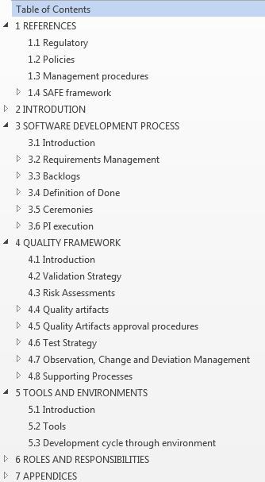
Table of content
PART 2 – Highlights of the Software Development Plan
Notes:
This is the table of content of the SDP. Next the corporate guidelines of the SPD, for each site, local procedures need to be updated, implemented and executed. This will be detailed in Part 4 about the QMS Organization.

Slide 21
Process, Quality and Tools, areas of Software Development Plan
PART 2 – Highlights of the Software Development Plan
c
FRAMEWORK:
SAFE 4.0
Retrospective
QUALITY:
GAMP®5
Scrum team
DoD
Validation Plan
Release
GxP
Poker planning
Requirements
SOP
Stand up
Validation Report
Review
IP Planning
Approval
Risk
NFRs
Workflow
Defect
Change
Sprint
Code
Test Plan
Testing
Test data
Roles & Responsibilities
User Stories
Audit trail
Backlog
Test Environment
Traceability
Relationship
Item
Build
TOOLS: JAMA JIRA …
Baseline
Extract
Notes:
To build understanding of the structure of the way of working as described in the software development plan, the main three areas are:
SAFe framework,
Quality
and Tools.
The SDP document is emphasizing on the three main areas including the fourth one, Roles and Responsibilities, which is overarching all the areas.

Slide 22
Overview
PART 2 – Highlights of the Software Development Plan
DEVELOPMENT FRAMEWORK
> Chapter 1 and 3 of SDP for SAFe (part of SAFe/Agile training course)
QUALITY FRAMEWORK
> Chapter 4 of SDP about QMS Organisation (this training course)
TOOLS AND ENVIRONMENTS
> Chapter 5 of SDP : Tools in the context of QA Review and Approvals are included in this training course (JAMA Jira tools in other course)
ROLES & RESPONSIBILITIES
> Chapter 6 of SDP : in this training course emphasis is on RACI, Review and Approval responsibilties
Notes:
Chapters 1 and 3 of SDP described the SAFe DEVELOPMENT FRAMEWORK (and is part of another training course).
Chapter 4 of the SDP is about QMS Organisation (and is part of this training course).
Chapter 5 of SDP explains high level the tools in the context of QA Review and Approvals. The tools of JAMA and Jira are part of another course.
Chapter 6 of SDP emphasize the RACI matrix the Review and Approval responsibilities.

Slide 23
Table of content - SAFe
PART 2 – Highlights of the Software Development Plan
DEVELOPMENT FRAMEWORK
SAFe 4.0
Ceremonies
Requirements (Epic, Capability, Feature, User Story, NFR)
Programs, Program Increment, Sprints
Backlogs
Definition Of Done
Notes:
DEVELOPMENT FRAMEWORK: description of SAFe 4.0 implementation, Programs, Program increment, Sprints, Requirements (Epic, Capability, Feature, User Story, NFR), Backlogs, DoD, Ceremonies

Slide 24
Table of content - QMS
PART 2 – Highlights of the Software Development Plan
QUALITY FRAMEWORK
Validation strategy & QMS Organisation
Risk assessments (Initial, FMEA, FRA)
Quality Artifacts (Formal deliverables)
Review and Approval procedures
Test strategy
Incident, change & déviation management
Standard Operating Procedures (SOPs) / supporting processes
Notes:
QUALITY ARTIFACTS: Validation strategy, Risk assessment, List of Quality Artifacts (delirables), approval procedure, Test strategy, incident, change (modification) & deviation management, all the SOPs supporting the process.
Validation strategy describes the way to achieve the validation/compliance of a system or a process; based on consideration of:
risk assessment;
system component and architecture assessment (more a component is standard, less are the needs of specific tests);
supplier assessment.
Risk assessment is a comprehensive evaluation of the risk and its associated impact by the “Failure Mode and Effect Analysis” (FMEA).
Approve: act with date & signature to document the acceptance (understand) of an action or a document.
Test strategy is built on the leverage the level of test based on the final risk assessment score.

Slide 25
Table of content - Tools
PART 2 – Highlights of the Software Development Plan
TOOLS AND ENVIRONMENTS
QA tools (ManGO, JAMA, JIRA)
Test Environments*
Development Environments*
Deployment Process*
* Other tools than JAMA/JIRA will be part of Validation Plan (update)
Notes:
TOOLS AND ENVIRONMENT: describes high level the tools (JAMA, JIRA, MANGO) and the process to handle code (creation, modification, release, repository)
JAMA : Tools to manage the GxP documentation of the Merck IOT/Automation Platform.
JIRA : Tools to manage the development activities of the Merck IOT/Automation Platform.
MANGO Merck GxP Document Management System/Tool
The process to handle code and the environment to develop and qualify it are explained in other architectural presentations

Slide 26
Table of content - Tools
PART 2 – Highlights of the Software Development Plan
ROLES & RESPONSIBILITIES
Portfolio and Value stream roles:
1. Business Sponsor (BS) *
2. Epic Owner (EO) *
3. Senior Quality Assurance manager (SQA)
4. Senior Product Owner (SPO) *
Scrum team supporting roles:
5. Scrum Master (SM)
6. Product Owner (PO)
7. Quality Assurance officer (QA)
8. Solution Architect (SA)
9. Lead Architect (LA)
10. Security officer (SO)*
Scrum team:
11. (Lead) Developer (D/LD)
12. (Lead) Tester (T/LT)
(Lead) Architect/Developer (A/AL)
Project Quality Manager (PQM)
*New roles to be introduced for SDP V2.0
Notes:
ROLES AND RESPONSABILITIES: lists all roles, defines for each of them the responsabilities, defines the training matrix (all the trainings sessions and SOPs that have to be read and understand and constitutes the individual training’s records)
2 specific roles for quality : PQM, QA.
What is the PQM role?
A quality expert in the team;
Ensures that all the roles are fully trained for the project;
Writes quality artifacts Validation Plan, traceability matrix, observations & deviation list, summary report;
Approves all the others project document from specifications to the test cases and observations;
Leads the triage meeting.
What does the QA do in the process :
- regulatory (GxP) support;
- approves the main validation documents (Initial Risk Assessment, Master Validation Plan, Validation Plan, and Reports, Requirements);
- ensure that the site quality procedures are followed;
- approve the deviation regarding the Software Development plan;
- final responsible for project documentation);
- approve the go life (release of the system to be commercialize to customers).

Slide 27
Overview
PART 3 – QMS Organization
QMS and SOP
Test strategy
Incident & Change management: Observations workflow & Triage committee

Slide 28

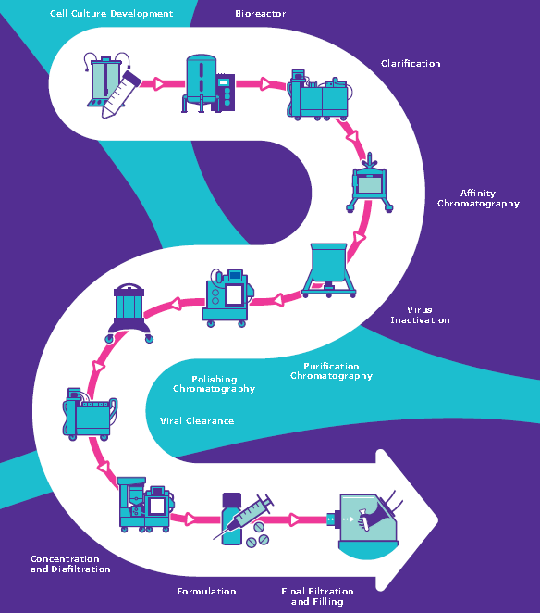
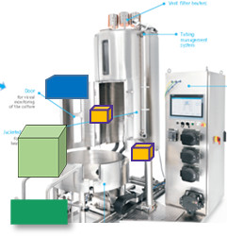

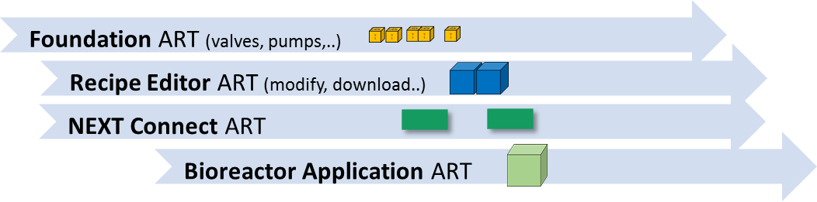
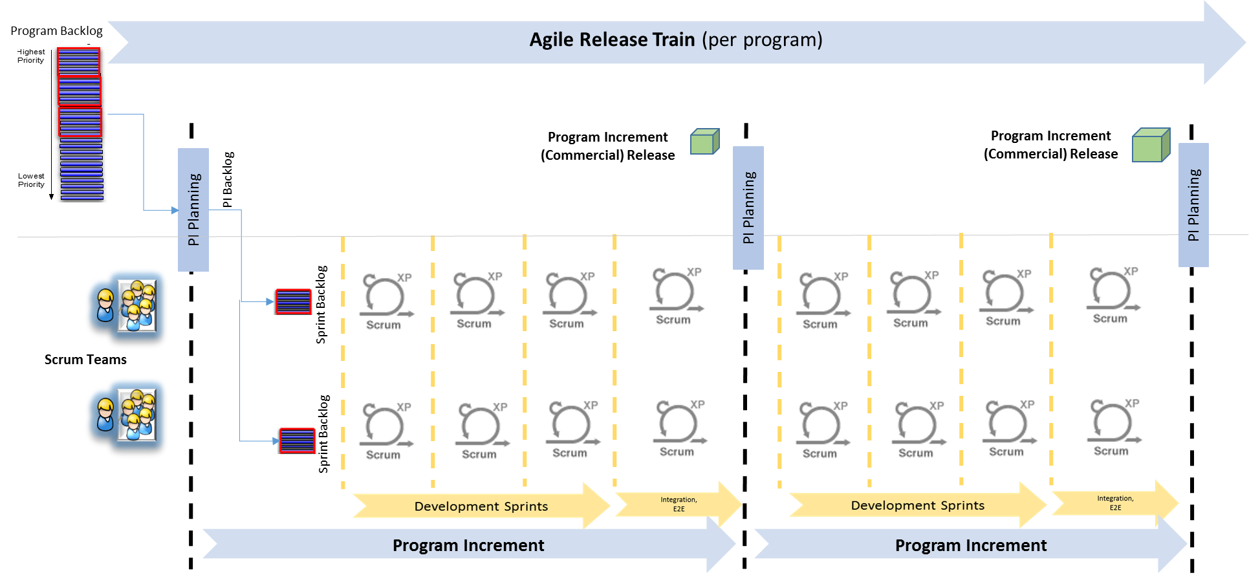
Risk Management & Validation
Enterprise
Value Streams
PORTFOLIO
SDP
Digitalizing E2E Biopharma
Strategic
Themes
Connected Lab
Smart Sensors
Digitalizing E2E Biopharma Process
Solution
Value Stream Digitalizing E2E Biopharma
VALUE STREAM
VMR
IRA
VMP
Supplier
1 Program per:
- Capability (Application)
- Module
- Foundation Stream
- NEXT Connect
VP
VR
Systems
VP
VR
PROGRAM
VP
VR
VP
VR
1-n Team(s)
per program
Program Increment / Sprint
FMEA/
FRA
TEAM
Notes:
This overview is a representation of the 4 layer of SAFe Framework. The Software Development Plan is created and maintained on corporate level so on Merck Life Science Business Unit. After that the Senior Quality Assurance manager is creating the Initial Risk Assessment and the Validation Master Plan for the project, hence the IoT/Automation Platform project. After that for each Program the QA manager is creating an (Program) Validation Plan. And will create also the Validation Report for each Program. Then when the teams are operating mode according to Agile the risk technique FMEA and or FRA are being used to asses risks for the User Stories.

Slide 29
Quality Management System Organisation
Validation of Computerized Systems
GLOBAL COMPUTERIZED SYSTEM MANAGEMENT
GAMP
Colors :
To use
To be updated or created
PORTFOLIO
SDP
ERES
Solution
QUALITY SYSTEM
SUPPLIER
MANAGEMENT
PRODUCT DEVELOPMENT PROCESS
SUPPORT
PROCESSES
VALUE STREAM
GESTION DOCUMENTATION
INCIDENT & CHANGE
RELEASE TO PRODUCTION
TRAINING
INTERNAL AUDIT CAPA
R&D SERVICE local SITE MERCK Group
Program
(*) system inventory, configuration management, access management, backup/recovery, archival/retrieval, business continuity plan, service level agreement, reevaluation management, retirement management.
LOCAL COMPUTERIZED SYSTEM MANAGEMENT (*)
QUALITY POLICY SOFTWARE
PROGRAM
SDP PROCESS
In Process Map Gap Analysis
Software team
JAMA JIRA TOOLS SOPs
REQUIREMENTS
CODING STANDARDS
TEST AND VERIFICATION
TEAM
SPECIFICATIONS
CODE REVIEW
TRACEABILITY
Notes:
This is the QA Process Map to outline the QA Documents applicable to the Project per SAFe Level. The yellow and blue colors are indicating the different state of the gap analysis as each document is assessed if applicable for Agile projects.
Portfolio level :
CQS 1510 Validation of Computerized Systems
SDP
00000663TC GAMP
00000620TC ERES
GLOBAL COMPUTERIZED SYSTEM MANAGEMENT to be defined goals/scope then to decide if there need for existence to update/create
Value Stream/Solution level:
00080083MP PRODUCT DEVELOPMENT PROCESS
001321MP RELEASE TO PRODUCTION
0005132A7MP QUALITY SYSTEM
00080009MP SUPPLIER MANAGEMENT
00080980MP GESTION DOCUMENTATION
0052009MP INCIDENT & CHANGE
000427MP TRAINING
00082055SO INTERNAL AUDIT CAPA
Program.R&D Service:
040097MP QUALITY POLICY SOFTWARE
LOCAL COMPUTERIZED SYSTEM MANAGEMENT (to be defined goals/scope then to decide if there need for existence to update/create*)
Team Level (to be defined goals/scope then to decide if there need for existence to update/create):
JAMA JIRA TOOLS SOPs
20117076 REQUIREMENTS
0040046MP CODING STANDARDS
20195826 TEST AND VERIFICATION
20115708 SPECIFICATIONS
20195734 CODE REVIEW
20120368 TRACEABILITY

Slide 30
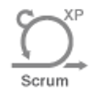
Test strategy
PART 3 – QMS Organization
Program Increment 1, ..2, ..3 (Foundation/Recipe Editor/Next Connect)
Iteration 1
Iteration 2
Iteration 3
Innovation & Planning
PROGRAM Backlog
Stage 1: Development Environment (DEV)
Unit/DEV Tests
Unit Tests
Unit Tests
Enhancements & Defects Tests
Design Tests
Design Tests
Design Tests
Design Tests
Design Tests
Design Tests
Design Tests
Design Tests
Design Tests
Func. Tests
Func. Tests
Func. Tests
Func. Tests
Func. Tests
Func. Tests
Func. Tests
Func. Tests
Func. Tests
Regress. Tests (team level)
PROGRAM INCREMENT BOUNDARY
Regress. Tests (team level)
Sprint Backlog
INFORMAL TESTING
Regression Tests
Stage 2:
TEAM Test Environment (VER)
Design Tests
Design Tests
Design Tests
Design Tests
Design Tests
Design Tests
Design Tests
Design Tests
Func. Tests
Func. Tests
Func. Tests
Func. Tests
Func. Tests
Func. Tests
Func. Tests
Func. Tests
FORMAL TESTING
Notes:
All solution parts are defined on the requirement levels (EPIC, CAPABILITY, FEATURE, USER STORY) and will be covered by various tests (types). If something is not correctly done not found during unit testing, the defect will be tested in requirement testing (Design Tests and Functional Test), after the developers have tested their corrections first in their own environment.
The unit testing could be considered as good practices relevant but in an informal iterative way. These informal test are considered as ‘Dry run’ testing’ done on Development (DEV) environment as preparation for the formal testing done in Verified test environment (in short ‘ VER’) and System testing environment (‘TST’). Also part of this informal testing are the Design and Functional Testing prepared and executed in the DEV-environment by the testers.

Slide 31
Teststrategy (2/2)
PART 3 – QMS Organization
Program Increment 1, ..2, ..3 (Foundation/Recipe Editor/Next Connect)
Iteration 1
Iteration 2
Iteration 3
Innovation & Planning
PROGRAM Backlog
Enhancements & Defects Tests
Prepare NFR & E2E Testing:
DRY RUN / INFORMAL TESTING
Prepare NFR & E2E Testing:
DRY RUN / INFORMAL TESTING
Prepare NFR & E2E Testing:
DRY RUN / INFORMAL TESTING
Stage 3:
SYSTEM Test Environment (TST)
NFR Tests
E2E / Integration Tests
(Automated) System Regression Tests
(Automated) System Regression Tests
(Automated) System Regression Tests
(Automated) System Regression Tests
PROGRAM INCREMENT BOUNDARY
Sprint Backlog
3WR1
3WR2
3WR3
3WR4
INFORMAL TESTING
FORMAL TESTING
Stage 4:
SOLUTION Test Environment (SOL)
E2E / Integration Tests
NFR Tests
QTR1
FORMAL TESTING
Notes:
Computerized systems can be composed of many different elements, each with varying degrees of complexity and proven reliability. To determine the level of testing necessary, and to ensure that a computerized system will function as expected, it is helpful to categorize its components based on their risk of system failure.
This risk of failure typically increases with the progression from standard hardware and software to custom designed interfaces and applications. This industrialized approach is common understood as ‘Risk based Testing’ approach and is used as basis for the Test Strategy in this Software Development Plan.
When defining type of tests (Unit Tests i.e. Development Test, Design Test, Functional Tests, Regression tests etc.) shown in the diagram, each test should be adding value based on their differentiated test goals. Each test has specific purpose against a requirement level and risk level assessed. In here, the defined tests are taken into Iterations from the Program Backlog, to be part of usual sprint tasks in each Iteration.
Based on the GAMP categories some parts of the solution/system will specified and tested differently meaning less of more level of depth in testing. The GAMP categories 1-5 are defined in Appendix M4 ‘Categories of Software’ of GAMP5. Test Cases and scripts are created to make evidence that the system parts are implemented according to Design and Functional specifications and the Requirements.

Slide 32
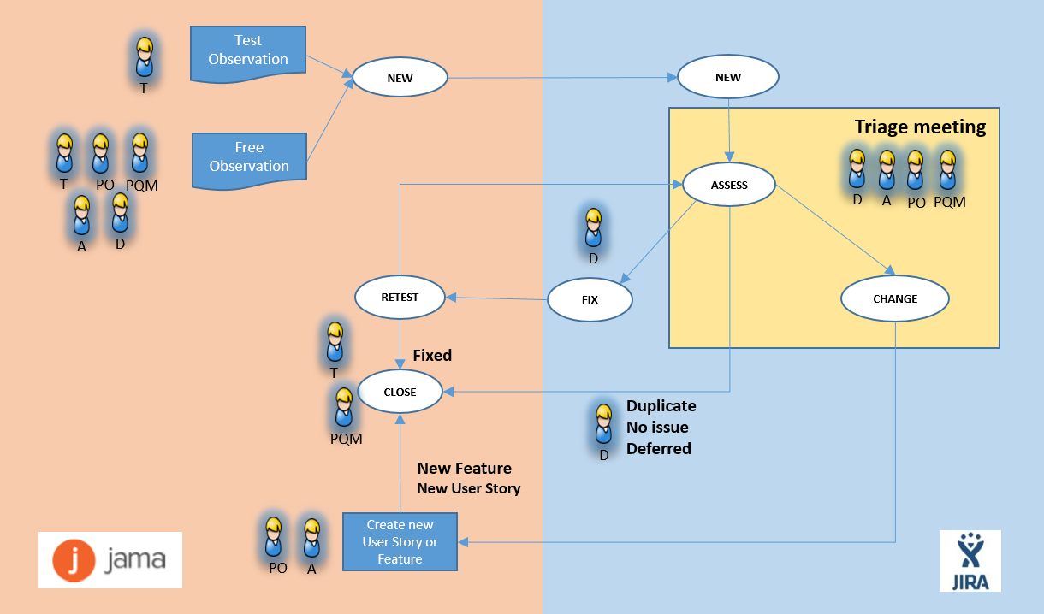
Incident & Change management : Observation workflow
PART 3 – QMS Organisation
Notes:
The figure represents the workflow for observation management for all issues, incidents, deviations, defects and changes which occur during the lifetime of the solution. They will be called observations.
Outside the project phase, when applicable for relevant sites, local procedures for incident and change management are valid. The sites are responsible to implementation.
During the project, the following steps have to be followed.
STEP 1:
For each case, an “observation” officially can be created in JAMA only selecting one of two options with the type “FREE OBSERVATION” or “TEST OBSERVATION”. The type “TEST OBSERVATION” is used during formal testing. The type “FREE OBSERVATION” is used outside formal testing.
STEP 2:
Once the Observation is created in JAMA, a JIRA issue is automatically created with the status “NEW”. A developer takes the task by changing the status to “ASSESS” after the Triage meeting haven taken place.
STEP3:
When a solution is found, the status become “FIX”. Once the new code is transferred into the new build version, the developer change the status to “RETEST”. The tester can retest the modified code. If the test is passed, the status changes to “CLOSE”. If the test is failed, the status changes to “ASSESS”.
STEP4 :
If the observation assessment conclude to the necessity of a change, the lead developer/architect change the status to “CHANGE”. This decision leads to the modification or the creation of a Feature or User Story. Once the change has been identified as an new user story on the backlog, only then the PQM can change the status to “CLOSE”.

Slide 33
Overview
PART 4 – Quality Artifacts in Agile action
List of Quality Artifacts
Review and Approval procedure
The RACI, Review and Approval Matrix

Slide 34
Quality Artifacts
on Program and Team level
Approved in Mango
Quality Artifacts created on Value stream Level:
Approved in JAMA
ID | Quality Artifacts
 | Initial Risk Assessment (IRA)
 | Validation Master Plan (VMP)
1
ID | Quality Artifacts
 | FS Test Cases (FST)
 | DS Test Cases (DST)
 | User Story Acceptance Test Cases (UST)
 | Feature Acceptance (FAT), E2E/Integration (INT) and Regression Test Cases (RGT)
 | Sprint Summary Report incl. Observation & Deviations (SSR)
 | Manual (MAN)
 | Traceability Matrix (TRM)
 | Increment Validation Report (IVR)
 | Validation Master Report (VMR)
 | Software Development Plan (SDP)
2
11
The list of Artifacts created during development:
12
ID | Quality Artifacts
 | Program Validation Plan (PVP)
 | Features (FTR)
 | User Stories (US)
 | FMEA and FRA
 | Architectural Design (ARD)
 | Functional Specifications (FS)
 | Design Specifications (DS)
 | Test Plan (TP)
13
3
14
4
5
15
6
16
7
17
8
18
9
19
10
20
Notes:
This is the official list of all identified Quality Artifact that will be created stored and maintained in either Mango or Jama system. ManGo is a qualified tool used for central repository for documentation as part of SQA organization. And the first three artifacts are indicated as Mango documents (marked in red). JAMA is a qualified tool used to generate, control and store all the GxP classified documentation including the marked documents marked in green.

Slide 35
Quality Artifact RACI Matrix 1/3
PART 4 – Quality Artifacts in Agile action
The RACI, Review and Approval matrix lists the quality of the artifacts and defines:
QA Identifier; e.g QA01_IRA
Quality Artifact Name;
The type of document; e.g Type Document or Items
The corresponding Approval Process Type; Type A - Indirect JAMA / B Direct JAMA / C. ManGo
The RACI Roles;
The list of reviewer roles;
The list of approver roles.
Notes:
Next slide will give an overview of all responsibilities per each role throughout the project for each Quality Artifact. In the table you will find colums with QA Id, the name of each artifact, type of document, type of approval applicable, the roles, the reviewers and the approvers.

Slide 36
Quality Artifact RACI Matrix 2/3
PART 4 – Quality Artifacts in Agile action
ID | Quality Artifacts | Artifact | Type of approval / Qualified Storage | Senior QA manger (SQA) | Senior Product Owner (SPO) | Product Owner (PO) | Solution Architect (SA) | Lead Architect (LA) | Developers (D) / Lead (LD) | Testers (T) / Lead (LT) | Scrum masters (SM) | Project Quality Manager (PQM) | Quality Assurance (QA) | Reviewers | Approvers
QA01_IRA | Initial Risk Assessment | Document | C / Mango | A | R | C | R | C | - | - | - | - | R | SQA SPO SA QA | SQA SPO SA
QA02_VMP | Validation Master Plan | Document | C / Mango | A | R | C | R | C | - | - | - | - | R | SQA SPO SA QA | SQA SPO SA
QA03_PVP | Program Validation Plan | Document | C / Mango | I | R | R | R | C | - | - | I | R | A | SPO PO SA PQM QA | PO SA SQA
QA04_FT | Features | Items | A / JAMA | - | A | R | R | C | I | I | I | R | R | SA SPO PO PQM QA | SPO SA QA
QA05_TUS | Technical User Stories | Items | A / JAMA | - | C | A/R | C | R/A | R | R | I | R | R | PO LA QA PQM | LA QA
QA05_BUS | Business User Stories | Items | A / JAMA | - | C | A | C | R | R | R | I | R | R | PO LA QA PQM | PO QA
QA06_RA | FMEA or FRA | Items | A / JAMA | - | C | A | C | R | R | R | I | R | R | PO LD LT QA PQM | PO QA
QA07_ARD | Architectural Design | Document | B / JAMA | I | I | I | R | A | R | I | - | C | - | LA SA LD QA | LA
QA08_FS | Functional Specifications | Items | A / JAMA | - | I | C | I | R | A | I | - | R | I | PO LA LD PQM | LD PQM LA
QA09_DS | Design Specifications | Items | A / JAMA | - | - | - | - | R | A | I | - | R | - | LD LA PQM | PQM LD
QA10_TP | Test Plan | Document | B / JAMA | - | - | C | C | R | C | A | I | R | - | LA LD LT PQM | LT PQM LA

Slide 37
Quality Artifact RACI Matrix 2/3
ID | Quality Artifacts | Artifact | Type of approval / Qualified Storage | Senior QA manger (SQA) | Senior Product Owner (SPO) | Product Owner (PO) | Solution Architect (SA) | Lead Architect (LA) | Developers (D) / Lead (LD) | Testers (T) / Lead (LT) | Scrum masters (SM) | Project Quality Manager (PQM) | Quality Assurance (QA) | Reviewers | Approvers
QA11_FST | FS Test Cases | Items | A / JAMA | - | - | C | C | R | C | R | - | A | I | (PO) LT LA PQM | LT PQM
QA12_DST | DS Test Cases | Items | A / JAMA | - | - | C | C | R | C | R | - | A | I | (PO) LT LA PQM | LT PQM
QA13_UAT | US Acceptance Test Cases | Items | A / JAMA | - | - | R | C | R | C | R | - | A | I | PO LT LA PQM | LT PQM PO
QA14_FAT QA14_INT QA14_RGT | Feature Acceptance, E2E/Integration and regression Test Cases | Items | A / JAMA | - | C | R | R | C | C | A | I | R | C | SA PO PQM LT | LT PQM PO
QA15_SSR | Sprint Summary Report (incl. Observation & Deviations) | Document | B / JAMA | - | - | C | C | R | C | A | I | R | - | PO LD LT PQM | LT PQM PO
QA16_MAN | Manual | Document | C / Mango | I | I | A | I | C | R | I | I | R | R | PO LA LD PQM QA | PO QA
QA17_TRM | Traceability Matrix | Document | B / JAMA | - | - | - | - | I | I | A | I | R | - | LT PQM | LT PQM
QA18_IVR | Increment Validation Report (incl. Traceability Matrix) | Document | C / Mango | I | R | R | R | R | C | C | I | R | A | SPO PO LA SA PQM QA | SPO SA QA
QA19_VMR | Validation Master Report | Document | C / Mango | A | R | C | R | C | I | I | I | I | R | SQA SPO SA QA | SQA SPO SA
QA20_SDP | Software Development Plan | Document | C / Mango | A | R | C | C | C | I | I | I | I | R | SQA SPO SA QA | SQA SPO SA
PART 4 – Quality Artifacts in Agile action

Slide 38

Approval procedure JAMA and ManGo
PART 4 – Quality Artifacts in Agile action
How to review and approve a Quality artifact document?
Drafted document to baseline
Quality Artifact
(US or Test Case)
Start a review V1
Quality Artifact with comments
Moderator
Approval type A / Indirect JAMA
Author
is revising version V1
Baselined document V2
For final review and approval, start a new review in JAMA
Quality Artifact approved in JAMA
Revised Quality Artifact V2
Approval type B / Direct JAMA
ManGo Ref. Guide 0004420MAN
or
Approval type C / ManGo
Quality Artifact ManGo approved
Quality Artifact transferred to Mango
Notes:
For each Quality Artifact, a process for formal review is launched first to the mandatory stakeholders before approval.
The reviewers make comments and return their feedback. In JAMA, the Jama function « Reviews» is used to review or approve documents. The author will improve the document based on received comments.
After that, in order to initiate the approval process, a new review process is launched but with the use of the e-signature.
Document approval process can be performed three ways:
Indirect Approval is used for documents which are not directly created in JAMA but might be retrieved as a set of items. They are needed to merge first as a document prior to the start of the review process. The following steps are needed:
Create a new JAMA item called “Additional document” joining the corresponding document as an attachment;
The approver has to read the document directly in the corresponding folder of JAMA;
On top of screen, click on Reviews, then click ‘ Start a review’ and select/fill the details;
After clicking on ‘Next’, select Reviewers and click on each icon after reviewer name (Make an approver);
Check the box ‘Require electronic signature from approvers’ and click Next;
The approver must then describe his/her role as a comment at the signature end step;
The electronic signature is mandatory for all the approvers involved in the process according to the RACI matrix.
For single item documents, the use the JAMA “Review Center” is provided as the LS standard approval process. The following steps are needed:
On top of screen, click on Reviews, then click ‘ Start a review’ and select/fill the details
After clicking on ‘Next’, select Reviewers and click on each icon after reviewer name (Make an approver);
Check the box ‘Require electronic signature from approvers’ and click Next;
The approver must then describe his/her role as a comment at the signature end step;
The electronic signature is mandatory for all the approvers involved in the process according to the RACI matrix.
For documents transferred from JAMA into ManGo, the approval procedure is described in the ManGo Reference Guide number ‘00004420MAN’.

Slide 39
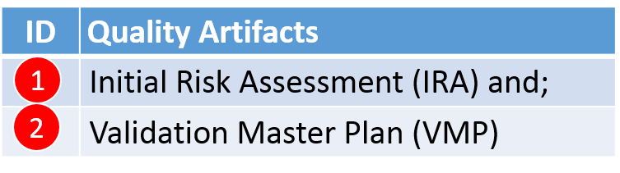
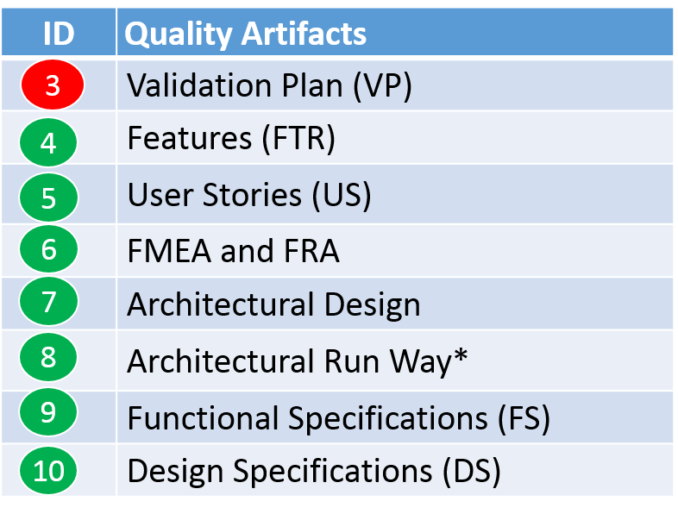

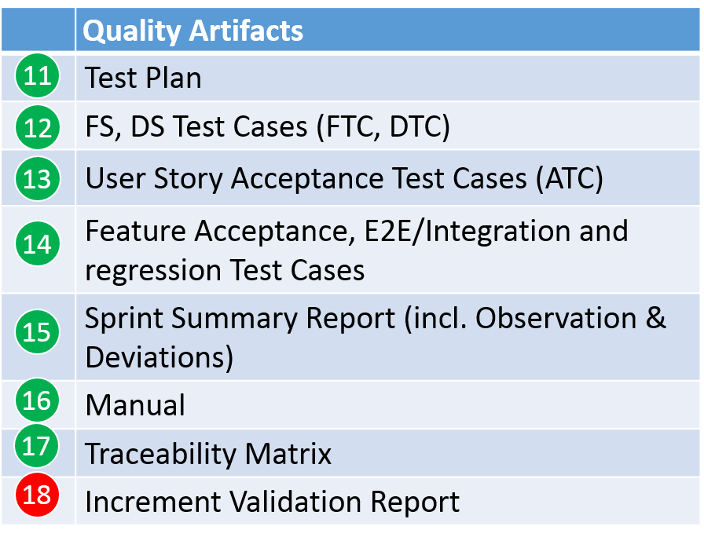
Quality Artifact handling
PART 4 – Quality Artifacts in Agile action
1
2
Quality Artifacts in Iteration & Program Increment
Agile Release Train for Release 1
3
18
Program Increment PI 1
Program Backlog
5
5
6
Program Increment
(Commercial) Release
PI Planning
4
Sprint Backlog
14
15
16
17
3 Development sprints
I&P Sprint
=
7
8
9
10
11
12
13
15
PI (Release) Planning
Development Sprints 1-n
Innovation & Planning
Notes:
Now, the question rises where are the Quality Artifacts are consulted and/or created? To rewind a bit, try to remember the Program Increment, the sprint time boxes (Development and I&P sprints).
The Product Backlog contains all the requirement items of the program in Jama. Once they have been reviewed and approved, the items are transferred to Jira and they can be taken by a team member to be developed.
This takes place after the Sprint Planning ceremony once the team has build full understanding of the descriptions and their acceptance criteria. The team have been estimating the stories and related tasks during the scrum poker sessions usually diect after the sprintplanning session or partially in the planning.
In each sprint, the team produce specifications, tests cases, code release, test plan, test results and the sprint summary report. This includes also the list of the related observations.
During the last sprint, which is called Innovation and Planning sprint, the feature acceptance test cases, the integration test cases and the NFR test cases are executed. Next to that, the assessed observations list are being solved, these maybe the lower priority observation from the development sprints.
At the end of the last program increment, if all tests have been executed, the QA creates the Program Increment Validation Report.

Slide 40
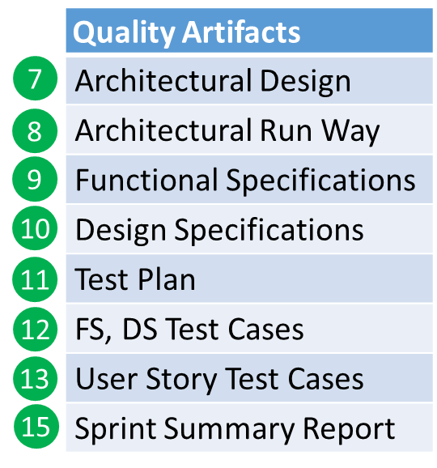


Quality Artifacts
What happens during a sprint ? …
1 Team
Pre-requisites “Development” week “Approval/Testing” week “Demo/Approval” week
Feature Approved in BL
User Story Approved
(incl. Acceptance Criteria)
Outcome Risk Assessment)
Sprint DoD
Draft FS / FTC
Draft DS / DTC
Draft ATC
Unit tests
Code Review
Approve Architecture
FTC, DTC, ATC
informal testing
Approve FS / FT
Approve DS / DT
Approve ATC
Code Release
DTC, FTC, ATC
Formal testing
Finish testing
Demo
Check Sprint DoD
Check Traceability
All observations & deviations accepted
Approve Summary report
Week 1
Week 2
Week 3
5
6
7
8
9
10
11
12
13
15
Before sprint
1 Development Sprint
FS : Functional Specifications
FTC/FTR : Functional Test Cases/ Functional Test Results
DS : Design Specifications
DTC/DTR : Design Test Cases/ Design Test Results
ATC/ATR: Acceptance Test Cases/ Acceptance Test Results (User Story)
Notes:
Quality Gates :
Design approval
Code Release
Sprint Summary report
Demo / DoD

Slide 41
Quality Artifacts
What happens during an innovation & planning sprint ? …
Team n
Pre-requisites “Approval/Testing” week “Testing” week “Demo/Approval” week
Program Increment DoD
Team 1 Sprint DoD OK
…
Team n Sprint DoD OK
Draft FIRTC
Approve FIRTC
FIRTC
Formal testing
Finish testing
Check Traceability
All observations & deviations accepted
Draft VR
FIRTC
Formal testing
Solution Demo
Check PI DoD
Approve Manuals (If commercial Release)
Approve Summary report (include traceability Matrix)
Approve VR
15
15
Week 1
Week 2
Week 3
3
14
15
16
17
18
Before ‘IP sprint’
While in Innovation & planning Sprint Execution
FIRTC: Feature E2E/Integration, regression and NFRs Test Cases
PI : Program Increment
IP : Innovatin & Planning
DoD : Definition of Done
NFRs: Non Functional Requirements
VR : Validation Report
Notes:
Quality Gates :
Design approval
Code Release
Sprint Summary report
Demo / DoD
PI Validation Report

Slide 42
Checklist for each Sprint Quality Gate
Quality Gate Description | Proof of Done | When | Responsible | Accountable | Consulted | Informed
Completed sprint tests plan execution | JAMA Test runs | Sprint demo | Team | PQM | - | PO
Closed JIRA tasks | All tasks and subtasks of User story are closed in JIRA | Sprint demo | Team | PQM | Architect | PO
NFRs are covered by tests | JAMA Test runs | Sprint demo | Tester | PQM | - | PO
Resolution of the observation(s) Planned in the backlog | All open observations all assessed with status CHANGE or FIX | Sprint demo | PQM | PO | Architect | Developer
Open observations prioritized by Triage meeting | All open observations are prioritized | Sprint demo | PO | PQM | Architect Tester | Developer
Approved closed User Stories | All user stories are in colums done | Sprint demo | PO | PQM | Architect | Developer
Closed and approved all test artifacts (Test plan, Test scripts, Test execution results, summary report) in JAMA. | Summary report approved | Sprint demo | Team | PQM | Architect | -
Executed source code review and committed source code / backup version | JIRA task closed | Sprint test execution | Developers | PQM | - | -
Approved Traceability Matrix | Summary report approved | Sprint demo | Team | PQM | Architect | -
All Risks are mitigated as specified in the test approach (in the user story), which is based on a product risk assessment. | Test cases JAMA approval | Sprint demo | Team | PQM | Architect | -
Approved FS and DS | Proof of JAMA Status is ‘ Approved’ | Before sprint test execution | Team | PQM | PO Architect | -
Functionality accepted by the stakeholders during a demo or acceptance testing | Sprint Demo | Sprint demo | PO | PQM | Team | -
All artifacts under version control | JAMA baseline | Sprint test execution | Team | PQM | PO | -
Notes:
Checklist for each Sprint Quality Gate

Slide 43
Overview
PART 5 – Execution of QA: from creation of test evidence to validation report
Recap : What is the goal of our work ?
Epic and Capability approval
QMS tasks by scrum team members
Feature & User Story approval
Risk assessment execution
Creation of Functional Specifications
Creation of Design Specifications
Test & Verification
Informal testing
Formal Test Case Artifacts
Design Approval
Sprint Formal test Execution

Slide 44
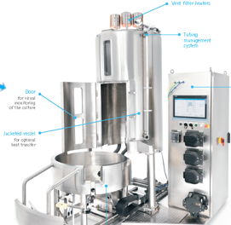

Small recap : What is the goal of our work ?
Customer
Solution
Capability = commercialize unit of the « Value Stream » level
Capability = a « product » that we can sell because it is interesting for a customer
Capability = a « product » that can become a « solution » at the customer’s site
VALUE STREAM
Product
NEXT Connect
Foundation (valves, pumps, equipment modules, login, audit trail,..)
Custom package (e.g. configuration, specific documentation for dedicated customer)
PROGRAMS
Recipe Editor (modify, download..)
Bioreactor Application
Notes:
Before any activity, we need to know and understand where is the beginning of the process and its end.
So, what is the final goal of our work ?
Our goal is to produce something shipable on the market. Something that can be considered as valueable by a customer.
Before the sprint activities, there is a program that has been defined. Before the program, there is a « value stream » that has been defined.
The Capability belongs to the « Value Stream » level. The Capability is the commercialize unit of this level. The Capability represent the finality of many programs which, combined, become a complete product. This product can be of interest for a customer and become a solution for him, espacialy through customization.

Slide 45
Features and User Stories execution starts when Epic/Capability has approval
As prerequisites of the sprint activities, the following Quality Artifact documents are created and must be approved :
QA01_IRA Initial Risk Assessment
QA02_VMP Validation Master Plan
QA03_VP Validation Plan
Business EPIC/CAPABILITY (example)
As a Single Use Franchise , I would like to launch a Mobius Bioreactor Family of system utilizing the state of the art software and control platform in a high quality environment that allows them to compete with the competition.
IRA
Acceptance criteria :
New platform launched on the 50, 200, 1000, 2000L Systems
The system should offer at least the same level of functionalities as CCP 6.7.
The system will propose options like Recipe and/or report editor, can be integrated to next connect platform;
The system can be customizable to be adapted and fulfil customers needs;
The system shall be benchmarked at Beta trials with customers to demonstrate that it is differentiated versus the competition.
Launch by +/- Mid 2018
VMP
VP
Notes:
At the beginningm prior of the start of a PI, the following artifacts are being created:
Epic and Capabilities;
Initial Risk Assessment;
The Validation Master plan for all the programs;
And the Validation Plan per program.

Slide 46
Feature & User Story approval as formal Quality Artifacts
FEATURE (example)
As User I need a recipe editor so that I can modifiy the recipe during the bioprocess
ACCEPTANCE CRITERIA
Given that a user has access to recipe editor and the connection is enabled with the bioprocess
When editor and bioprocess are accessible
Then the recipe is modified during the bioprocess
After Capability definitions are released, then:
One or more Features are created from a Capability and approved
One or more User Stories are created from the Feature and approved
Feature
4
USER STORY (example)
As User I can load an existing recipe.
ACCEPTANCE CRITERIA
Given that a user has access to recipe editor
When editor is accessible
Then the editor is available and display the stored recipes
User Story
5
Notes:
In the program, the program backlog is created. One or more Feature(s) are created from the capability and one or more User Stories are created from the Feature.

Slide 47
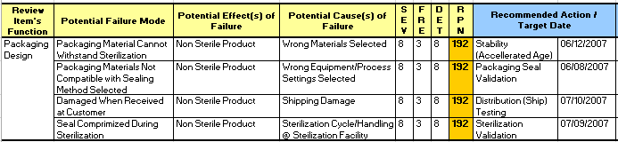
User Story is written, also a related risk assessment is executed following the approval
User Story
FMEA Risk Assessment
Expertise:
Product Owner
Expert (e.g. developer, tester)
Lead Architect
PQM
FAILURE MODE AND EFFECT ANALYSIS (FMEA) (per User Story at program level)
Failure Mode
Effect of Failure
Cause of Failure
Risk Priority Number (RPN) = Severity x Frequency x Detectability
Mitigation / Recommended Action
Risk : final RPN (*)
6
(*) RPN: Risk Priority Number
Notes:
For each User Story, one or more risk can be defined. For each risk, a Jama item will be created.
The method used at Molsheim is the Failure Mode and Effect Analysis (FMEA). Experts, Product Owner and Quality are agreed to define :
An integer value to define the Severity of the consequences of the failure mode;
An integer value to define the Frequency of apparition of the failure mode;
An integer value to define the Detectability of the failure mode (the higher if the Detectability is difficult).
The result is a Risk Priority Number (RPN). Mitigation action can be defined. Then, the stakeholders redefine new value for Severity, Frequency and Detectability of the mitigated failure mode (example, a sensor to detect a problem or a manual control _ via an action described in a SOP_ before the failure mode).
The final RPN can be used to leverage the test effort in the tests activities.
Explanation:
Risk High :
Comprehensive positive functional / acceptance testing (it does what it should do).
Risk-focused negative functional / acceptance testing (it does not do what it should not do where the risk assessment thought it vulnerable). This means all options and variations must be tested and assessed the correct working of the specified requirement.
Risk Medium:
Positive functional / acceptance testing of the defined user operation for this specific application (it does what it should do). Risk-focused negative functional / acceptance testing (it does not do what it should not do where the risk assessment thought it vulnerable).
Risk Low:
Positive functional / acceptance testing.

Slide 48

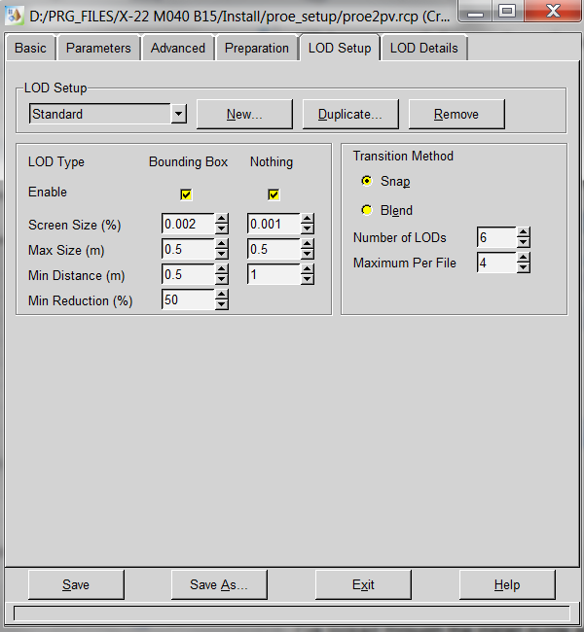
Translating User Stories tasks into Functional Specifications
Example :
formal design of a user interface : button, text box, colors … .
D
Draft Functional Specification
Notes:
As the same time that code and test cases are created, a Functional Specifications items is created as draft in JIRA …

Slide 49
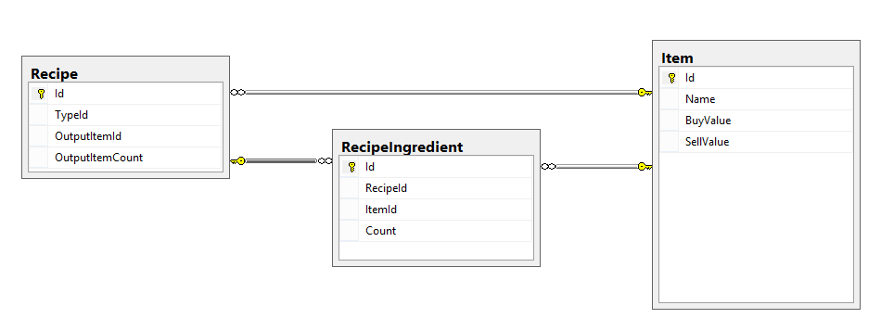
Implement the User Stories : the Design Specifications
Data Base type: MS SQL Server version X
Table: Recipe
Fields:
« UniqueId » : integer
« RecipeName » : text max 256 caracters
« CreationDate » : UTC
« ModificationId » : link to table « AuditTrail »
« CreatorNameId »: link to table « Users »
Example :
data base format
D
Draft Design
Specification
Notes:
As the same time that code and test cases are created, a Design Specifications items is created as draft in JIRA, related to the Functional Specification …

Slide 50
Informal testing during Development Sprints
At the same time:
Unit testing
Design Testing
Functional Testing
Informal acceptance Testing
D
Code & specifications & test cases Improvements
Test
Code
Design
Test
Code
T
Notes:
Until code & specifications are stable, improvements are made during the sprints and informal tests are taken place.

Slide 51
Implement the User Stories by proof of evidence of formal Test Case Artifacts
Test Goal
 | Description of the goal of the test case.
Test Script
Pre-Requisites |  | Define all is needed to be able to execute the whole test case : Qualified environment Test data (eg. Access credentials, some data in database …)
# | Step action | Expected result | Observed result | Result | Comment | Date / Initials
1 | Step description | The exact result to be expected … | To be filled in with Screen shots or other documented evidence | Pass or Failed | Any comment
2 | New step description … | The exact result to be expected in the step 2…
Test case result |  | Pass or Fail
Test case Comment
T
Draft Design
Test Cases
Draft Functional
Test Cases
Draft Acceptance
Test Cases
Notes:
As the same time that code and specifications are created, test cases items are created as draft in JIRA, related to the Functional Specification, Design Specifications and User Story. The Acceptance test cases are the test of the User Stories.

Slide 52
‘Design Approval’ Quality gate
When code and specifications are stable :
Code review
Specification
Approval
Code Release
Test cases approval
Functional Specification
Specifications
Test Cases
9
12
Design
Specification
Acceptance
Test Cases
10
13
Design Approval (Quality gate ) means Specifications Approval and Test cases Approval

Slide 53
QMS tasks by scrum team members
PQM:
creates Validation Plan;
approves specifications & test cases;
checks traceability;
creates test plan;
approves test results;
creates sprint summary report;
follows observations and organize the triage meetings;
creates PI validation report;
..
Tester:
Creates the “test” environment;
creates test cases;
informal test executions;
modifies test cases;
qualifies the “test” environment;
formal test executions;
opens “test observations”
Retest observation.. In new test campaign
..
Developer:
gets the “dev” environment, checkouts;
develops;
creates specifications;
unit tests;
modifies and retest unit tests;
Commits;
reviews DS test cases;
..

Slide 54
Sprint Formal test Execution
: Test cases, Test plan and test campaign
Risk : final RPN (*)
TEST CAMPAIGN 1
User Story
Acceptance test cases
TEST CAMPAIGN 2
Functional specifications
Functional test cases
Test Plan (*)
Sprint Summary report
TEST CAMPAIGN 3
11
…
Design
specifications
Design
test cases
TEST CAMPAIGN n
Demo
Sprint DoD
(*) The Test strategy is based on the Risk Priority Number from the risk assessment linked to the User Story.
Sprint Summary report
15
Notes:
Once all specifications and test cases have been approved (Design Approval), the formal tests can be executed.
The Jama test plan function is used to launch the test cases to be executed via the « test campaigns ». If all test pass at the first execution, there is only one test campaing. If some test cases have to be re-executed after a correction, an other test campaign is planned until all tests cases pass.
The test plan define the test strategy, the environment to use and its qualification, the list of test cases to execute.
Once test plan is fully executed, the test results, the traceability matrix and the list of observation and deviation are summarized in the sprint summary report.
A demo can be showed.
The DoD is checked with PO.
The summary report is approved.

Slide 55
Test cases execution
Good Documentation Pratices : Screen shot
T
Test Goal
 | Description of the goal of the test case.
Test Script
Pre-Requisites |  | Define all is needed to be able to execute the whole test case : Qualified environment Test data (eg. Access credentials, some data in database …)
# | Step action | Expected result | Observed result | Result | Comment | Date / Initials
1 | Step description | The exact result to be expected … | To be filled in with Screen shots or other documented evidence | Pass or Failed | Any comment
2 | New step description … | The exact result to be expected in the step 2…
Test case result |  | Pass or Fail
Test case Comment
Acceptance test cases
+
Functional test cases
+
Design
test cases
Next Design
test cases
TEST ENVIRONMENT
(NOT QUALIFIED)
TEST ENVIRONMENT
(QUALIFIED)
Notes:
Tester execute all the test cases in Jama.
A « test » environment is used. Design test cases are executed first to qualify the environment.
Once the environment is qualified, the other test cases can be executed.
As an evidence of the test result, screen shot must be created as possible.

Slide 56
Innovation and Planning Sprint will be only Formal testing
PI Validation report
Test cases, Test plan and Test campaign
Manuals (*)
TEST CAMPAIGN 1
Feature
Acceptance / NFRs test cases
Traceability Matrix
TEST CAMPAIGN 2
Capability
E2E integration tes cases
Test Plan (*)
Sprint Summary report
TEST CAMPAIGN 3
11
…
Regression test cases
TEST CAMPAIGN n
Solution Demo
PI DoD
Manuals (*)
Traceability Matrix
16
17
(*) For PI or Program release.
PI Validation report
Sprint Summary report
VR
15
Notes:
Once all specifications and test cases have been approved (Design Approval), the formal tests can be executed.
The Jama test plan function is used to launch the test cases to be executed via the « test campaigns ». If all test cases pass at the first execution, there is only one test campaing. If some test cases have to be re-executed after a correction, another test campaign is planned until all test cases pass.
The Sprint summary report and the PI validation report (as summary of all the sprint summary report) are created.
If the development of the program is going to be achieved, the manuals are created.
A solution demo can be showed.
The DoD is checked with PO.
The summary report, the traceability matrix and the Validation Report are approved.

Slide 57
Summary
PART 5 – Execution of QA: from creation of test evidence to validation report
Recap : What is the goal of our work ?
Epic and Capability approval
QMS tasks by scrum team members
Feature & User Story approval
Risk assessment execution
Creation of Functional Specifications
Creation of Design Specifications
Test & Verification
Informal testing
Formal Test Case Artifacts
Design Approval
Sprint Formal test Execution

Slide 58
Closure
PART 5 – Execution of QA: from creation of test evidence to validation report
QUESTIONS ?
DON’T FORGET TO FILL IN THE TRAINING SESSION REGISTRATION FORM …

