Slide 1
Project Management in JAMA
Procedure to manage projects and archive versions
Pauline Tristram / YggVal
Mars-2017

Slide 2
Reminder

Slide 3
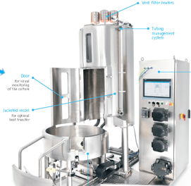

REMINDER
Product development strategy
Capability = commercialize unit of the « Value Stream » level
Capability = a « product » that we can sell because it is interesting for a customer
Capability = a « product » that can become a « solution » at the customer’s site
Product
NEXT Connect
Foundation (valves, pumps, equipment modules, login, audit trail,..)
Custom package (e.g. configuration, specific documentation for dedicated customer)
PROGRAMS
Recipe Editor (modify, download..)
Bioreactor Application

Slide 4
REMINDER
JAMA – Release Management
Product Backlog
Functional modification
Release Backlog Functional version 1.00.00
Release Backlog Functional version 1.01.00
Release 1.00.00.00
Release 1.01.00.00
Bug fixing
Customization
Release Backlog Functional version 1.00.01
Release Backlog Functional version 1.00.02
Release Backlog Functional version 1.01.00
Release 1.00.01.00
Release 1.00.02.00
Release 1.01.00.01

Slide 5
JAMA project management

Slide 6


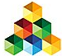
Projects structure
ART = Agile Release Train
PI = Program Increment
NFR= Non functional requirements
Integration = Pis Product integration
JAMA project management
Projects Models
Projects models configured to match the Software Development Plan strategy.
Digitilizing Biopharma Process – PI ART - Model
Program Increments in development - Current
Product Name – PI 1 ART - Current
Specific Agile Release Train project : Used to work on one specific Program Increment currently in development.
Product Name – Foundation ART - Current
Product Name – NFR ART - Current
Product Name – PI Integration ART - Current
Program Increments Archived versions
Product Name – PI 1 ART – v1.00.00.00 - Archive
Folder containing all finalized Program Increment projects. These are securized duplicates of Program Increment developped releases.
Product Name – Foundation ART – v1.00.00.00 - Archive
Product Name – NFR ART – v1.00.00.00 - Archive
Product Name – PI 1 ART – v1.01.00.00 - Archive

Slide 7
Projects management Workflow
Duplication without synchronization
JAMA project management
Duplication with synchronization + securization
Reuse with synchronization
Digitilizing Biopharma Process – PI ART - Model
Product Name – PI 1 ART - Current
Product Name – Foundation ART - Current
Product Name – PI 1 ART – v1.00.00.00 - Archive
Product Name – Foundation ART – v1.00.00.00 - Archive
Product Name – PI 1 ART – v1.01.00.00 - Archive
Product Name – NFR ART - Current
Product Name – NFR ART – v1.00.00.00 - Archive
Product Name – PI Integration ART - Current
Product Name – PI Integration ART - v1.00.00.00 - Archive

Slide 8
Project duplication/reuse in jama

Slide 9
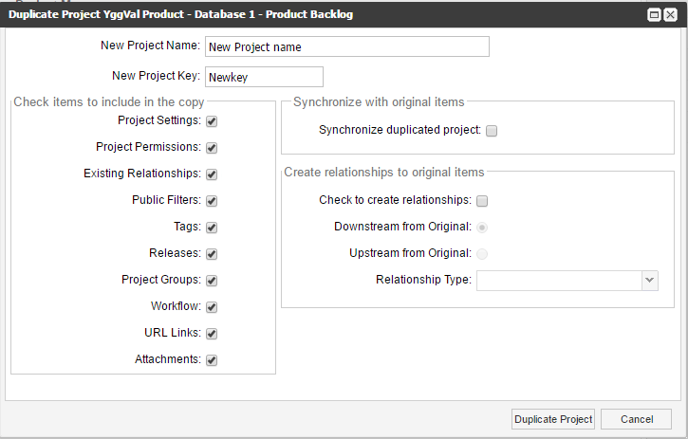
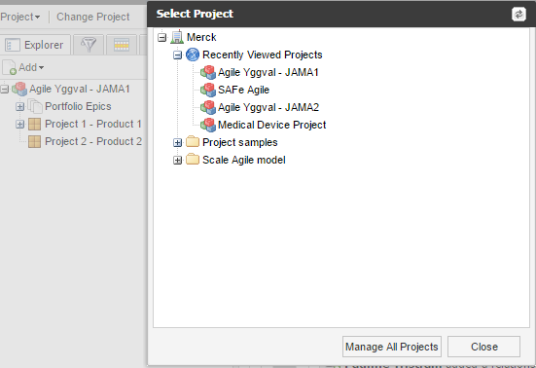
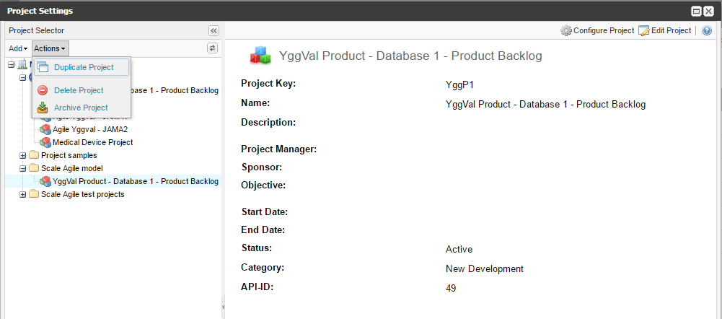
JAMA Project Duplication
To be selected if synchronization is needed
Project duplication/reuse in jama

Slide 10
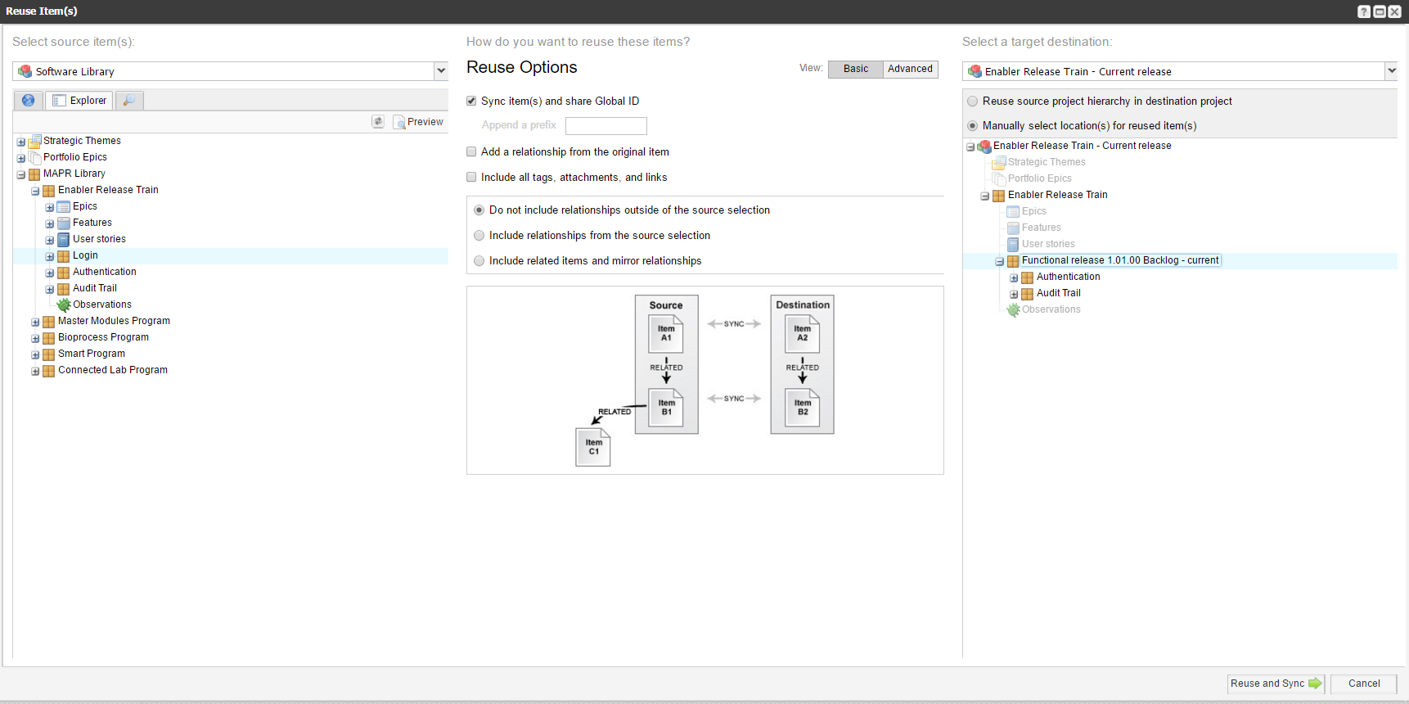
Item reuse
Project duplication/reuse in jama

Slide 11
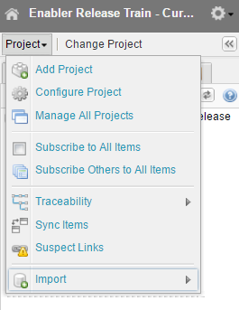
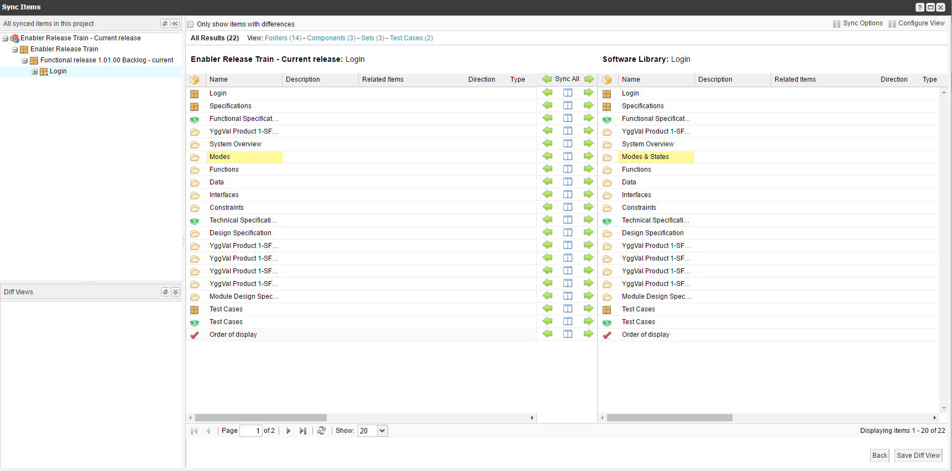
Synchronized item comparison
Project duplication/reuse in jama

