Slide 1
Code Coverage Tools
JAVA
Marri Narayana Reddy
07-09-2017

Slide 2
Code Coverage Tools
Static code analysis tool
SonarLint
Unit test code coverage tools
EclEmma
SonarQube with Jacoco code coverage plugin

Slide 3
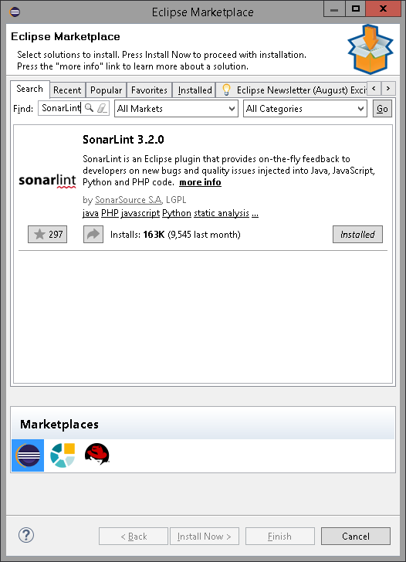
Static code analysis tool –setup
SonarLint – is a static code analysis tool and is eclipse plugin that provides on the fly feedback to developers on code quality.
SonarLint eclipse Plugin Setup
Navigate to Eclipse -> Help -> Eclipse Market Place -> Search for SonarLint plugin
Select and Install plugin

Slide 4
SonarLint - Usage
How to use
SonarLint can be run on whole project source or on single source file
Right click on project folder or right click on single Java file
Select SonarLint -> Analyze button
SonarLint report will be generated
Double click on error /warning in report will open source file and point to issue

Slide 5
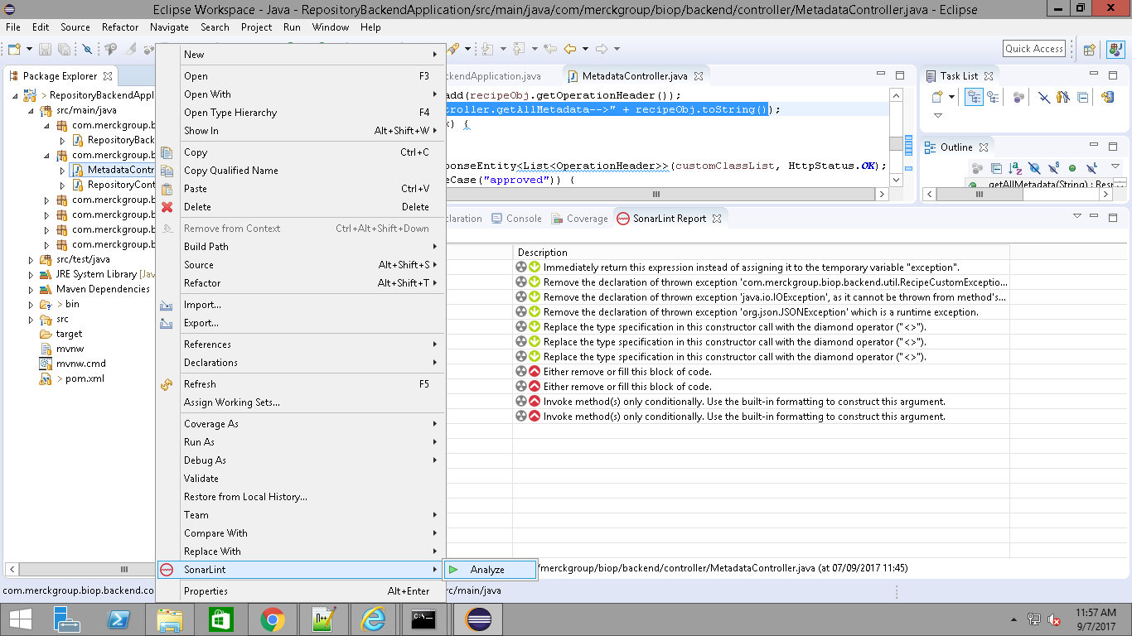
Continue …

Slide 6
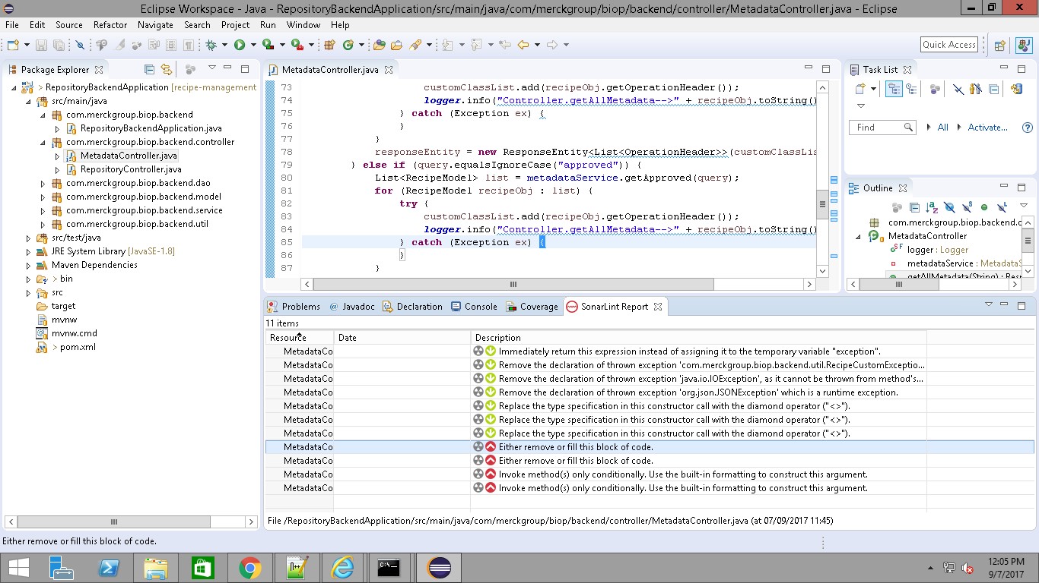
Continue…

Slide 7
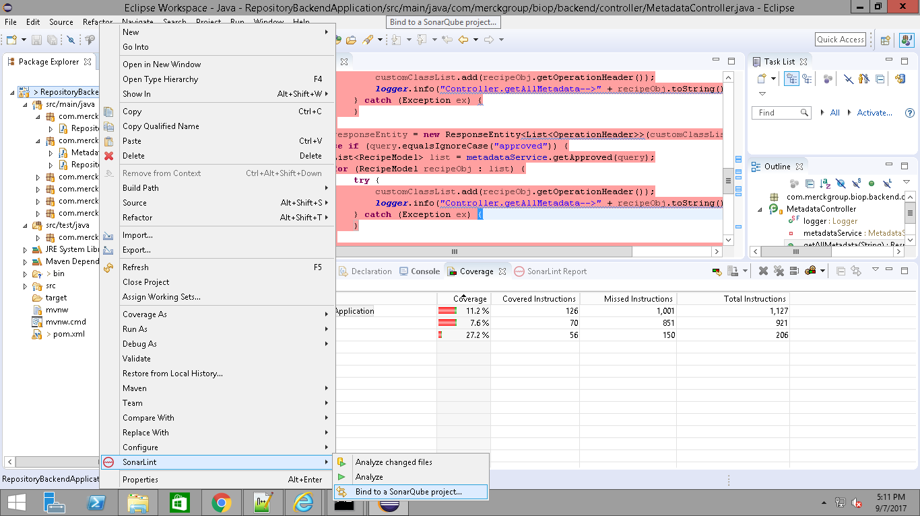
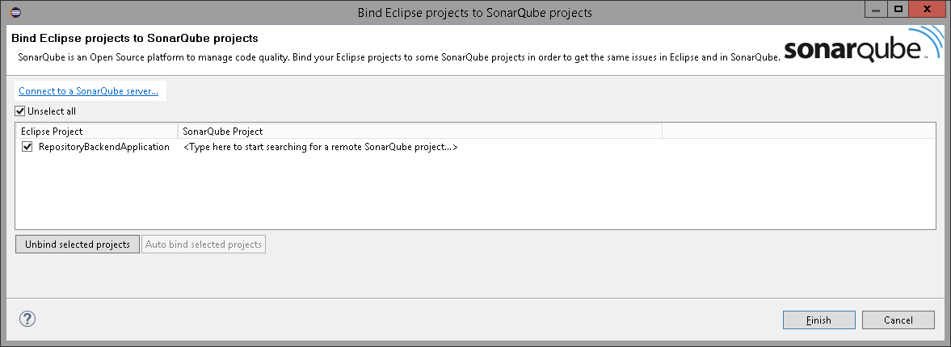
How to bind SonarLint to Sonarqube(optional step)
Eclipse ->Project directory -> Right click -> SonarLint -> Bind to sonar project ->Connect to Sonar Qube server (Note: Sonarqube server setup steps available in later slides)

Slide 8
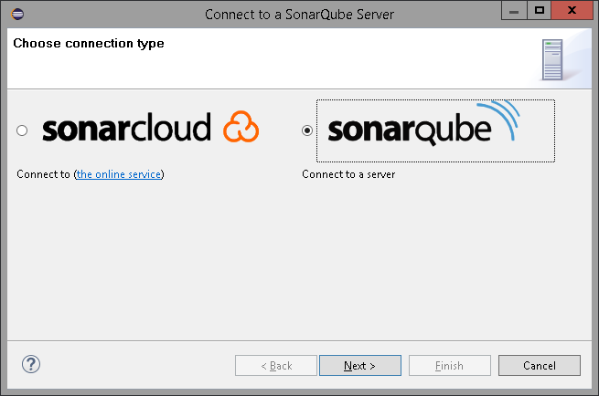
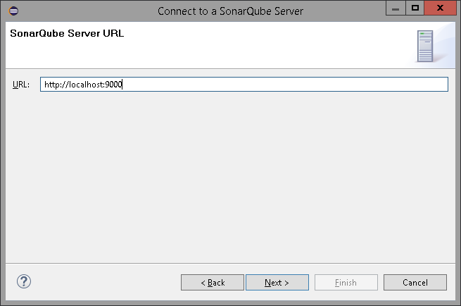
Continue …

Slide 9
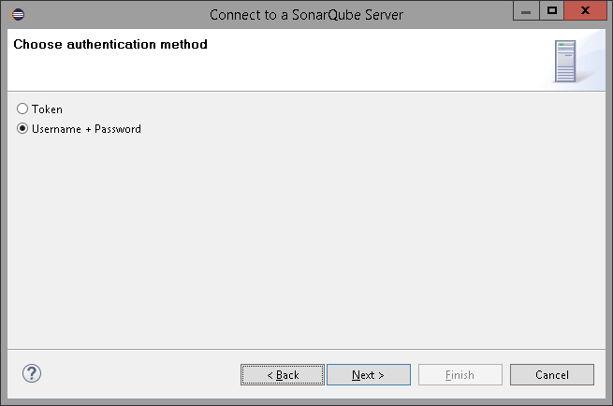
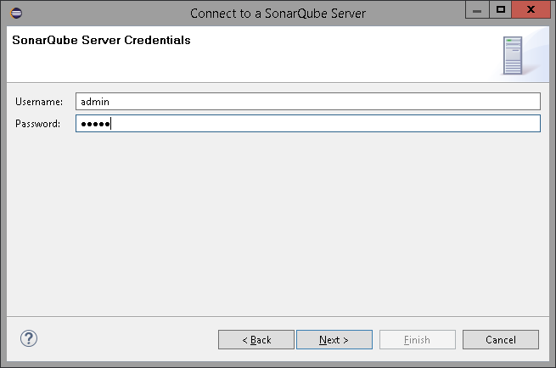
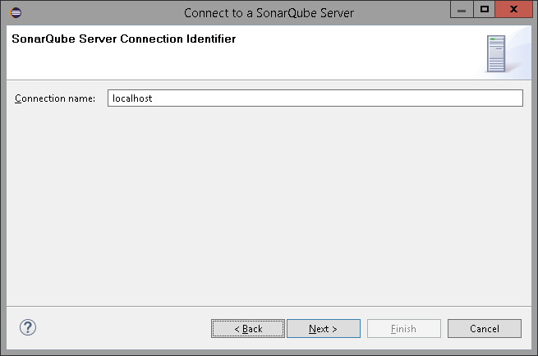
Continue …
Select User name + Password and enter User name as admin and Password as admin in the next screen and follow the instructions and finsih the setup

Slide 10
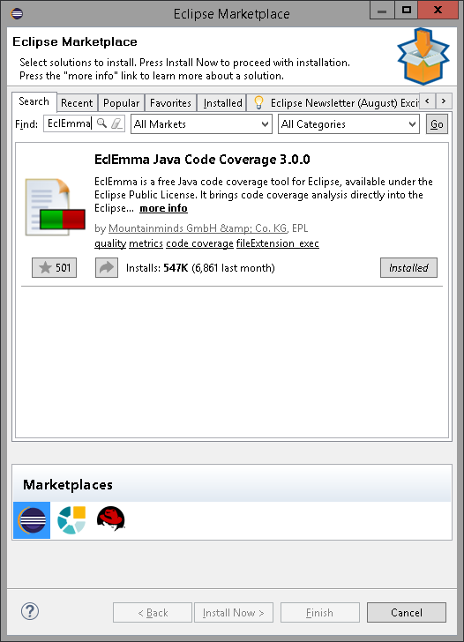
1.EclEMMA
Unit Test Coverage Tools
EclEmma – Is a java code coverage tool used to measure unit test coverage against source code. It is a open source eclipse plugin and available under ‘Eclipse Public license’.
EclEmma eclipse Plugin Setup
Navigate to Eclipse -> Help -> Eclipse Market Place -> Search for EclEmma plugin
Select and Install plugin

Slide 11
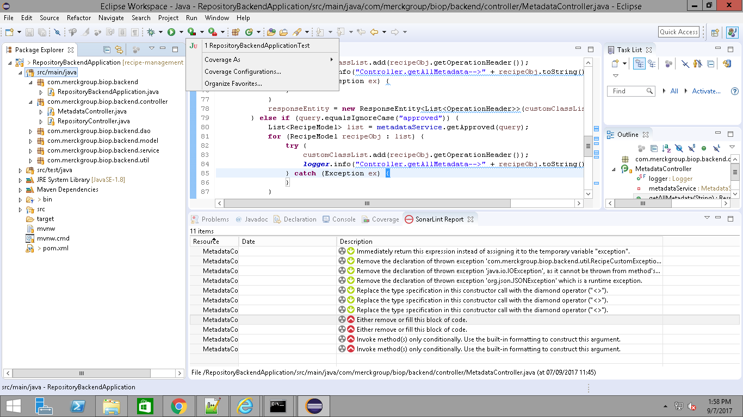
EclEmma – Configuration
Configuration : Navigate to Coverage launcher -> Coverage Configurations and include the source files for coverage measure

Slide 12
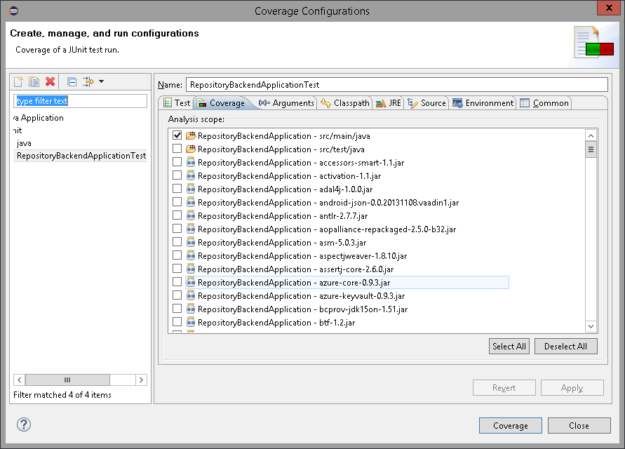
Continue …

Slide 13
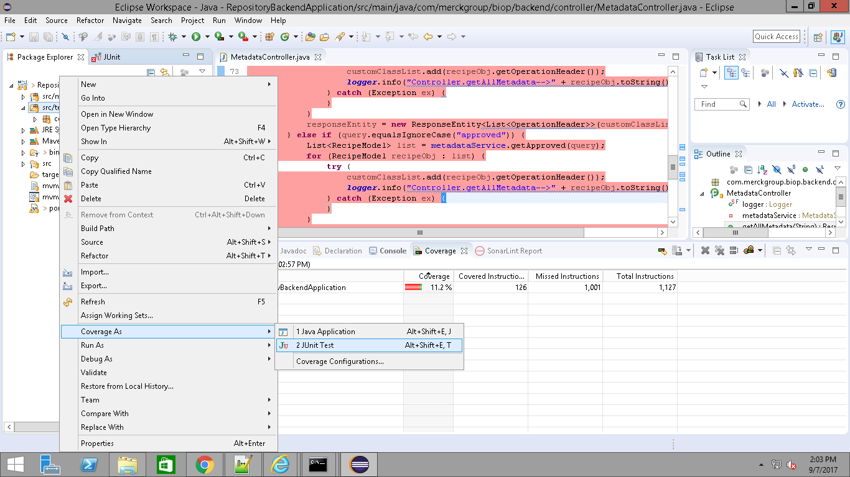
EclEmma –Usage
Eclipse -> Project explorer -> Select src\tests ->Right click -> Coverage as -> Select Junit test

Slide 14
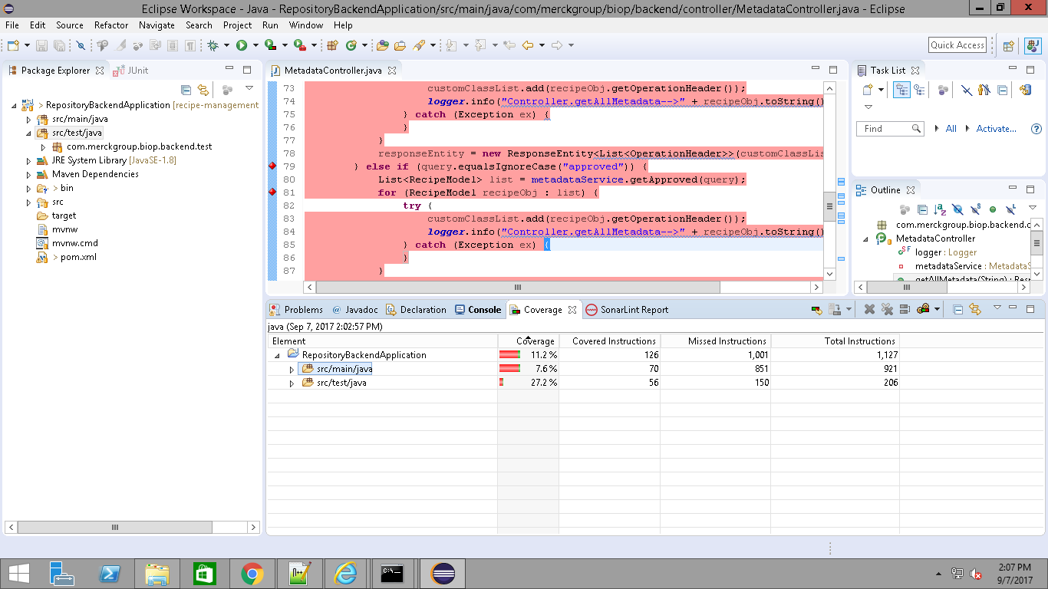
EclEmma – Report view
Coverage report will be displayed in the eclipse execution window after test execution is competed .

Slide 15
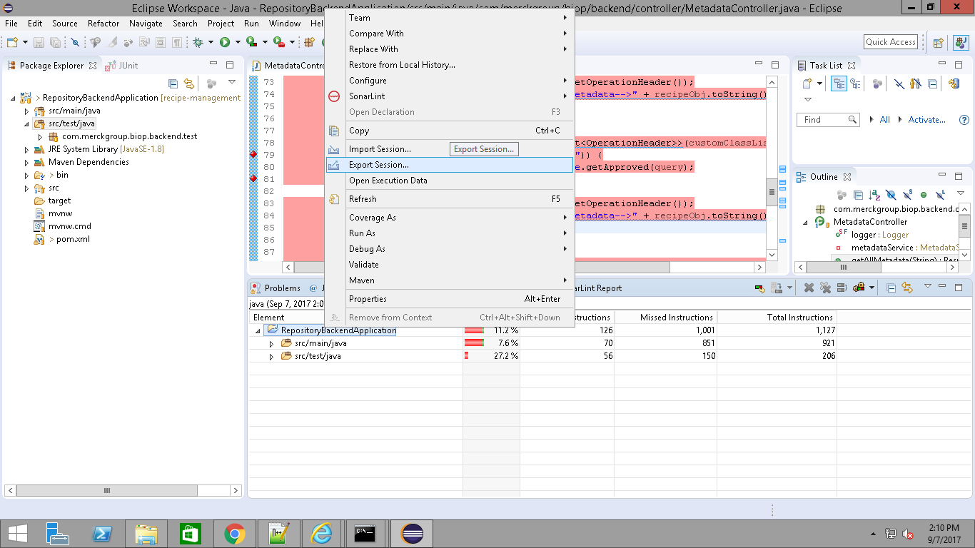
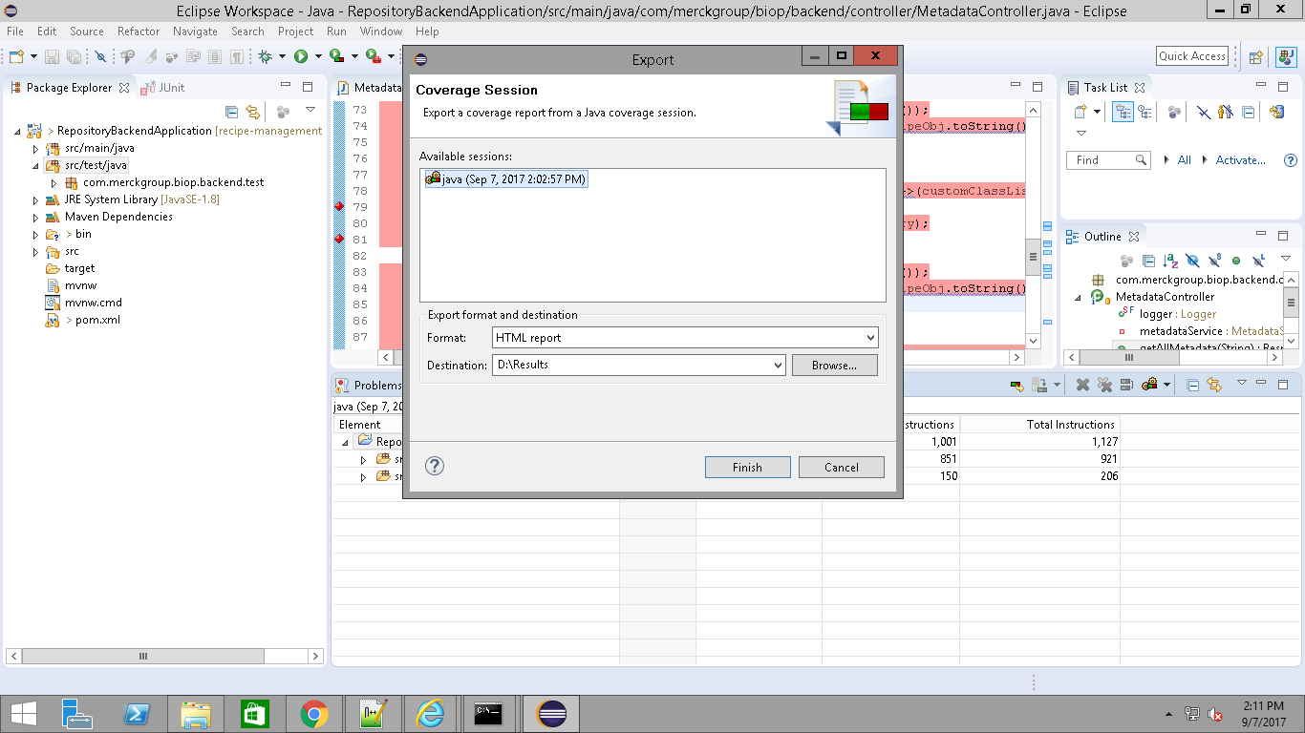
Export report ->View in browser

Slide 16
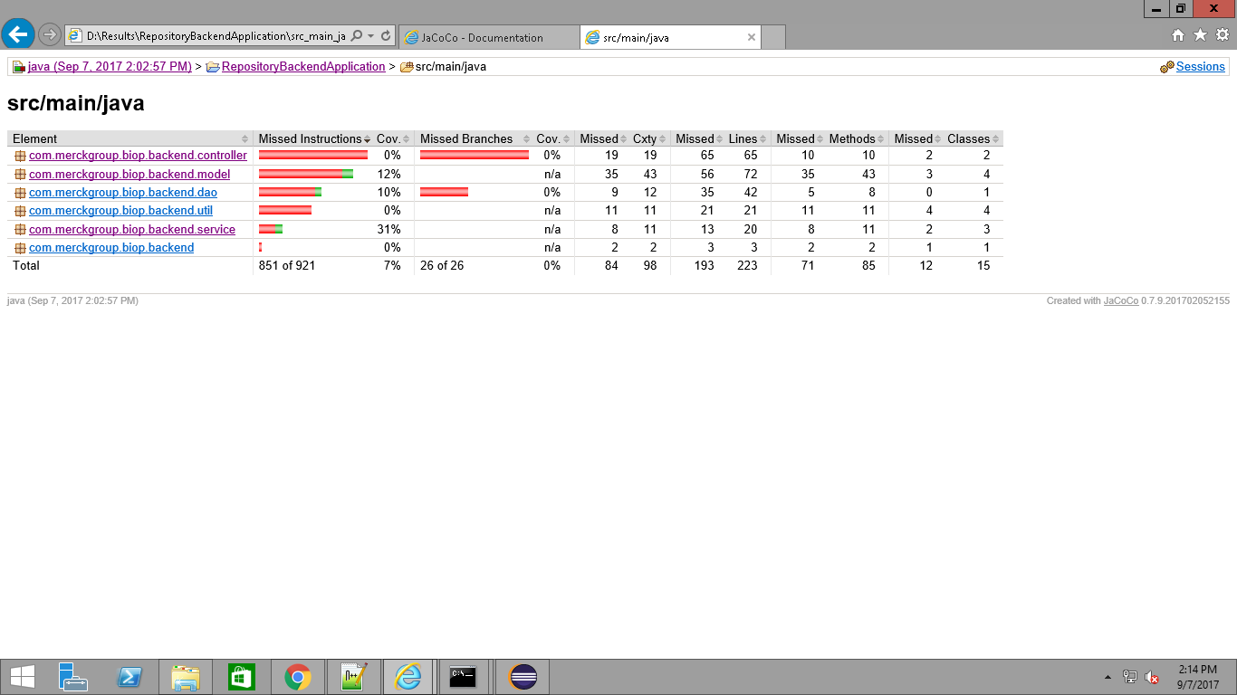
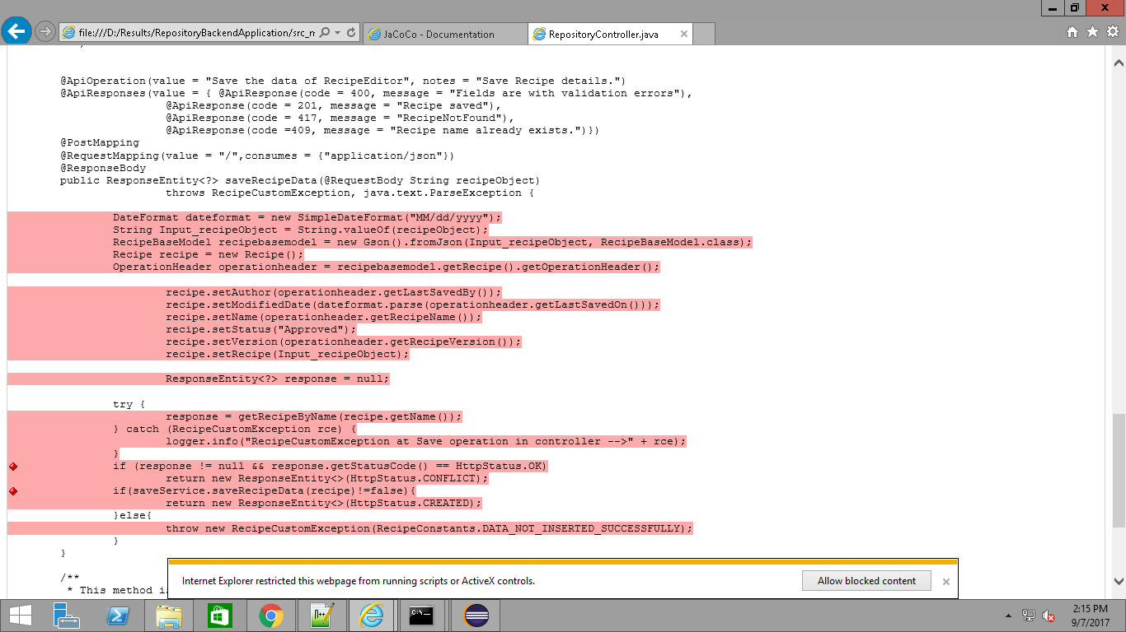
Continue …

Slide 17
2.SonarQube with Jacoco Plugin
SonarQube
Centralized server .
Dashboards to view code quality of the complete code base
Jacoco Plugin
Jacoco is open source java code coverage library . Jacoco coverage metrics will be published using Sonarqube

Slide 18
Sonarqube -Setup
Download SonarQube Server and install in local machine. Use below link to download latest version of SonarQube,
https://www.sonarqube.org/downloads/
Extract the zip and open command prompt and navigate to the path <Downloaded path>\sonarqube-6.5\sonarqube-6.5\bin\windows-x86-64 and run the “InstallNTService.bat” file
To Start the Sonarqube service run “StartNTService.bat” as administrator
Now configure the SonarQube in Maven.
Download the Maven using the below link,
https://maven.apache.org/download.cgi
Extract the zip and go to the below path and modify the setting.xml,
C:\Maven\conf\settings.xml
In setting.xml modify the following tags,

Slide 19
Continue…
In pluginGroups tag, we need to add the blow,
<pluginGroup>org.sonarsource.scanner.maven</pluginGroup>
In profiles tag, need to add the below,
<profile>
<id>sonar</id>
<activation>
<activeByDefault>true</activeByDefault>
</activation>
<properties>
<!-- Optional URL to server. Default value is http://localhost:9000 -->
<sonar.host.url>http://localhost:9000</sonar.host.url>
<sonar.core.codeCoveragePlugin>jacoco</sonar.core.codeCoveragePlugin>
<sonar.dynamicAnalysis>reuseReports</sonar.dynamicAnalysis>
</properties>
</profile>

Slide 20
Continue…
Below Environment variables should be added
Right Click My Computer → properties → Advanced system settings → Environment Variable
In User Variables click new and add the below,
Variable Name : JAVA_HOME
Variable Value : C:\Program \Files\Java\jdk1.8.0_121
In System Variables select path and click edit then add the below,
C:\Users\X188691\Downloads\sonarqube-6.5\sonarqube- 6.5\bin;
C:\Program Files\Java\jdk1.8.0_121\bin;

Slide 21
Usage
SonarQube + Jacoco
Open command prompt and navigate to project directory path
Ex: D:\Yoda\recipe-management\recipe-editor\Recipe_Editor_Backend\RepositoryBackendApplication>
Run the below commands
mvn clean
To start code coverage execution
mvn clean org.jacoco:jacoco-maven-plugin:prepare-agent install -Pcoverage-per-test
To process code analysis report using sonarqube
mvn sonar:sonar
After successful execution of above commands report will be viewable in the browser

Slide 22
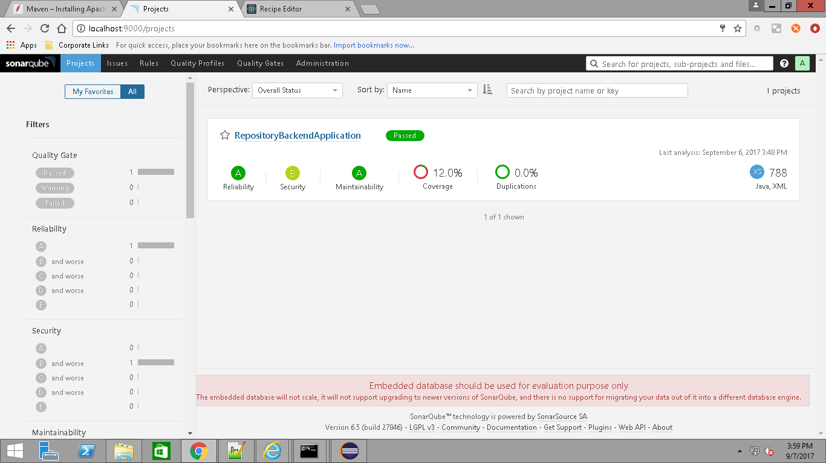
SonarQube - Report
Load URL http://localhost:9000 in browser

Slide 23
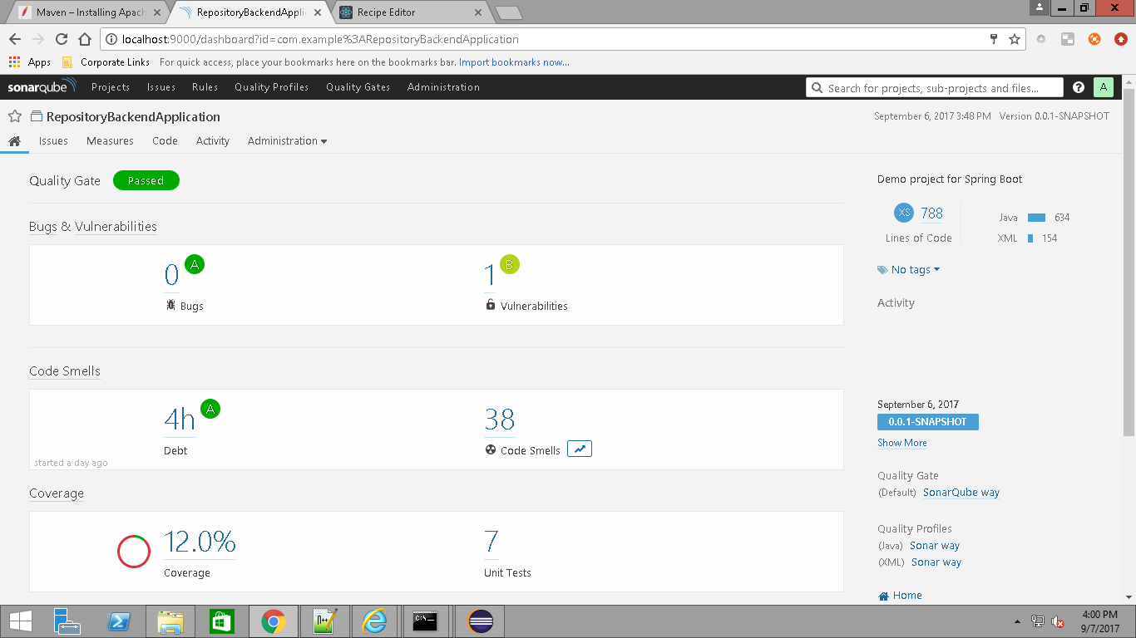
Continue…

Slide 24
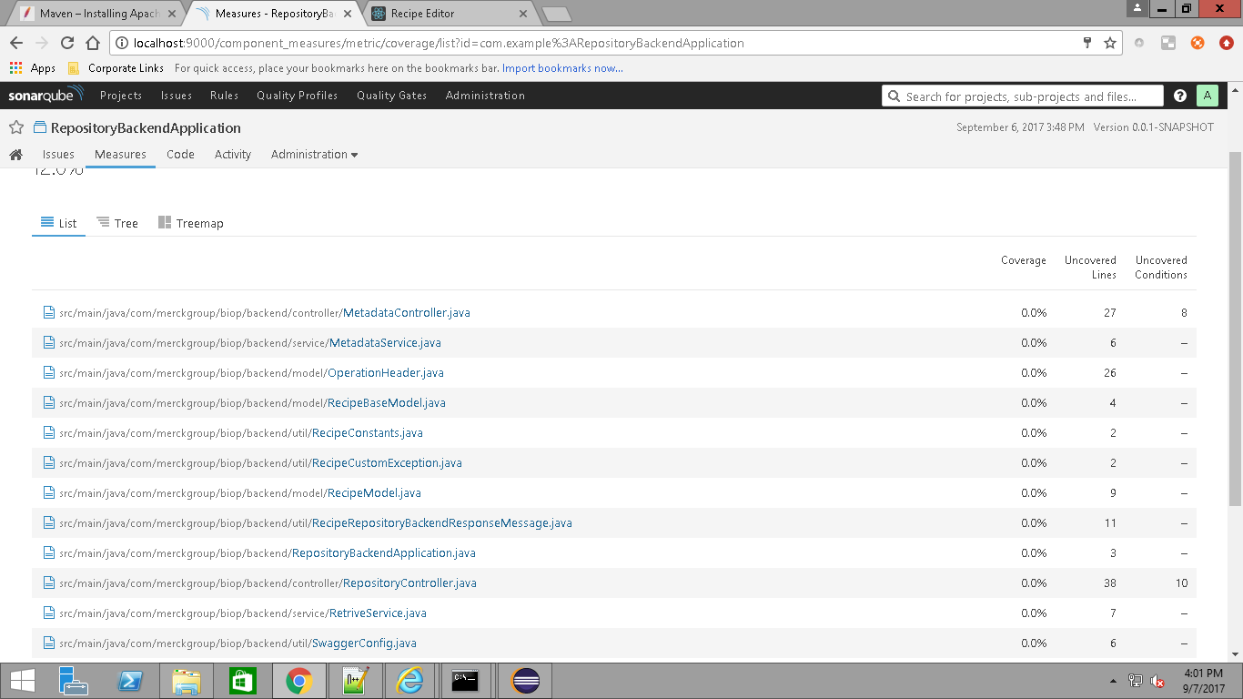
Continue …

Slide 25
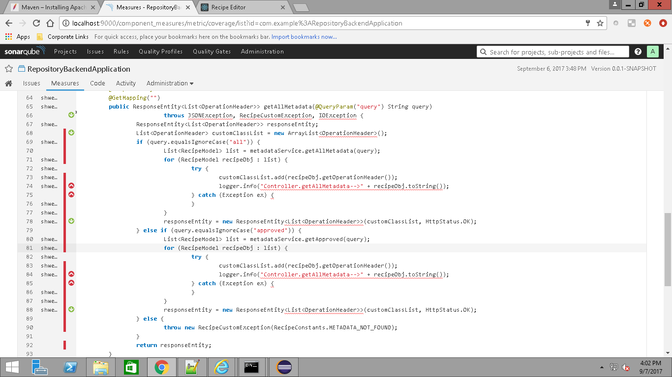
Continue…

Slide 26
References
http://www.sonarlint.org/eclipse/
http://www.eclemma.org/
https://www.sonarqube.org/

