Slide 1

Department of MCA
A Industrial Project on
CIVICCONNECT: A MERN-BASED PUBLIC GRIEVANCE MANAGEMENT SYSTEM
Presenter:
Dayanandayya H
(01FE22BCA036)
Under the guidance of:
Prof .Shilpa Hiremath

Slide 2
CIVICCONNECT: A MERN-BASED PUBLIC GRIEVANCE MANAGEMENT SYSTEM
STRUCTURE OF PRESENTATION
Introduction
Objectives
Scope of the project
System Requirements
Methodology
Modules
Technologies
Expected outcomes
Future Enhancements
Conclusion

Slide 3
CIVICCONNECT: A MERN-BASED PUBLIC GRIEVANCE MANAGEMENT SYSTEM
INTRODUCTION
In many communities, citizens struggle to report civic issues due to bureaucratic delays and inefficient complaint-handling systems. Traditional methods often lack transparency, making it difficult to track the progress of grievances. As a result, unresolved issues such as poor water supply, security concerns, and municipal inefficiencies continue to affect daily life. To address these challenges, CivicConnect provides a digital grievance management system for efficient issue resolution.
.

Slide 4
CIVICCONNECT: A MERN-BASED PUBLIC GRIEVANCE MANAGEMENT SYSTEM
OBJECTIVES
Easy Complaint Filing: Citizens can report issues with proof and get a tracking ID.
Live Updates: Track complaints, get notifications, and see resolutions.
Fast Resolution: Authorities can sort, assign, and fix issues quickly.
Smart Insights: Analytics help identify problem areas and improve resource use.
Public Feedback: Citizens can rate responses, ensuring transparency and trust.
Multi-Platform Access: Accessible via mobile app and website for convenience.
Emergency Reporting: Quick alerts for urgent issues like water leaks or power failures.

Slide 5
CIVICCONNECT: A MERN-BASED PUBLIC GRIEVANCE MANAGEMENT SYSTEM
SCOPE OF THE PROJECT
Easy Complaint Submission: Citizens can report issues with proof.
Real-Time Tracking: Users receive updates and track complaint progress.
Secure Role-Based Access: Different access levels for citizens, officials, and admins.
Complaint Management: Authorities can categorize, assign, and resolve issues efficiently.
Automated Notifications: Email/SMS alerts for complaint status updates.
Geolocation Mapping: Helps identify problem areas for better resource allocation.
Data Analytics Dashboard: Provides insights for better decision-making.
Public Feedback System: Citizens can rate responses and provide suggestions.
Future Enhancements: AI sorting, chatbot support, mobile app, and blockchain security..

Slide 6
CIVICCONNECT: A MERN-BASED PUBLIC GRIEVANCE MANAGEMENT SYSTEM
SYSTEM REQUIREMENTS
a) Software Requirements:
Operating System: Windows/Linux/macOS
Backend: Node.js ,Express.js
Fronted: React.js , Other necessary UI Libraries
Database: MongoDB
Email/SMS API for notifications.
b) Hardware Requirements:
Minimum 4 GB RAM 50GB SSD
Processor: Intel i5 or higher

Slide 7
CIVICCONNECT: A MERN-BASED PUBLIC GRIEVANCE MANAGEMENT SYSTEM
METHODOLOGY

Slide 8
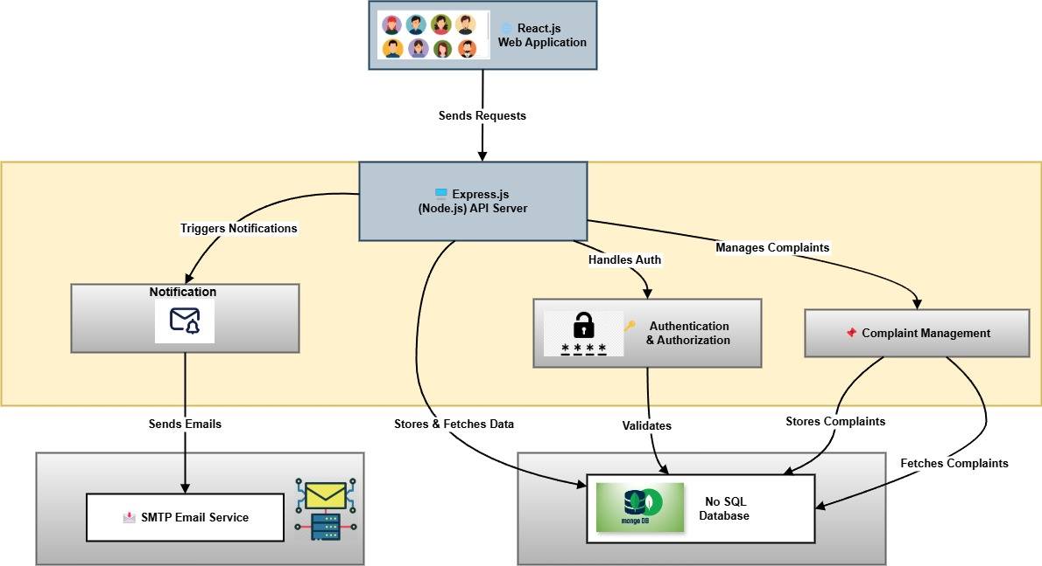
CIVICCONNECT: A MERN-BASED PUBLIC GRIEVANCE MANAGEMENT SYSTEM
SYSTEM ARCHITECURE :

Slide 9
CIVICCONNECT: A MERN-BASED PUBLIC GRIEVANCE MANAGEMENT SYSTEM
SYSTEM ARCHITECURE :
The CivicConnect system is a secure, scalable platform for managing citizen complaints. The React.js frontend enables complaint submission and tracking, while the Node.js/Express.js backend handles authentication, complaint processing, and notifications. MongoDB stores user data, complaints, and department details. JWT-based authentication ensures role-based access for citizens, officials, and administrators. Complaints, including images, are efficiently managed, with officials assigned by department. Node mailer provide email and real-time notifications. The admin panel oversees users, assigns officials, and manages resolutions. Security features include input validation and API rate limiting. it ensures reliability and scalability.

Slide 10
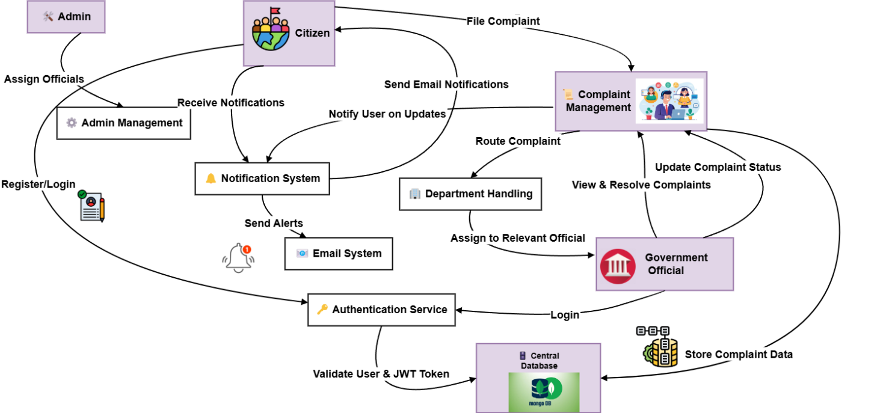
CIVICCONNECT: A MERN-BASED PUBLIC GRIEVANCE MANAGEMENT SYSTEM
DATA FLOW DIAGRAM :

Slide 11
CIVICCONNECT: A MERN-BASED PUBLIC GRIEVANCE MANAGEMENT SYSTEM
DATA FLOW DIAGRAM:
The CivicConnect Data Flow Diagram (DFD) illustrates how data moves within the system, ensuring efficient complaint management. Citizens register or log in, and their credentials are verified before they can submit complaints. The system stores complaints in MongoDB and assigns them to the relevant department. Officials manage complaints through the Complaint Management module, updating their status. Citizens receive real-time updates and email notifications. Administrators oversee users, assign officials, and monitor complaint resolution, ensuring transparency, security, and efficient governance.

Slide 12
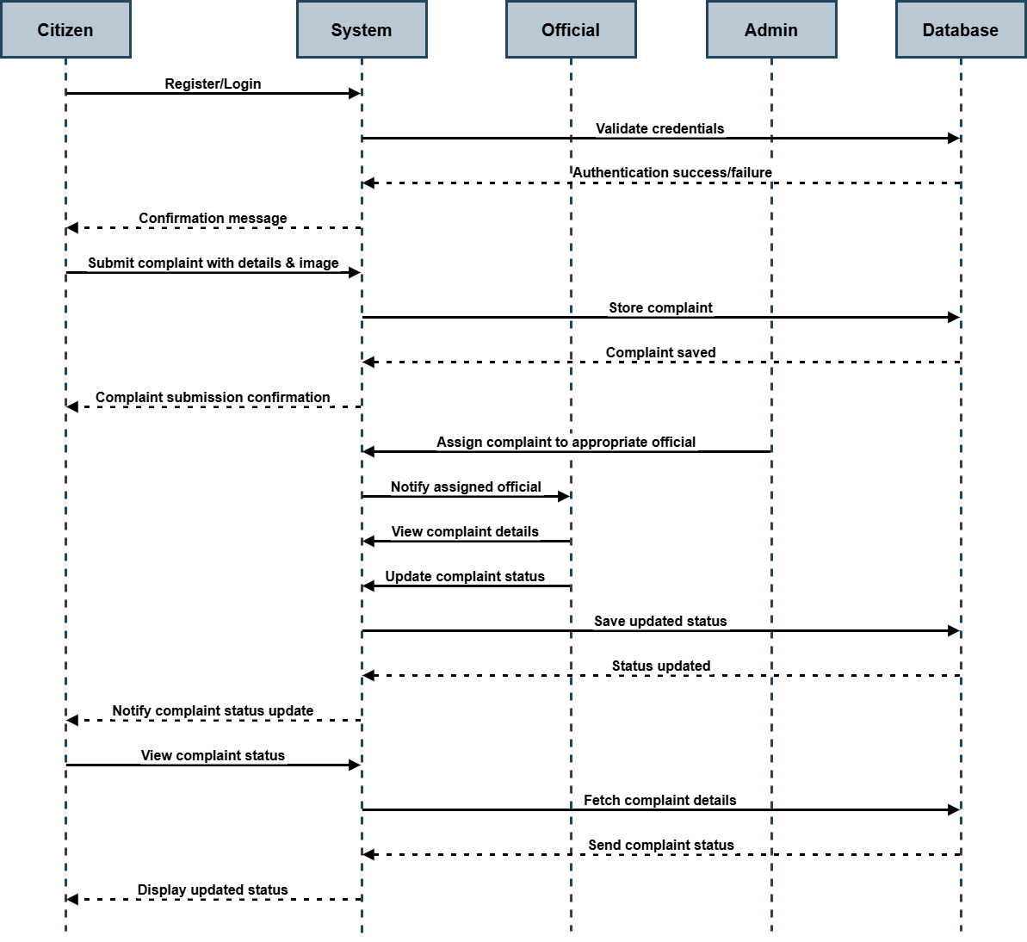
CIVICCONNECT: A MERN-BASED PUBLIC GRIEVANCE MANAGEMENT SYSTEM
SEQUENCE DIAGRAM :

Slide 13
CIVICCONNECT: A MERN-BASED PUBLIC GRIEVANCE MANAGEMENT SYSTEM
SEQUENCE DIAGRAM :
The Sequence Diagram of CivicConnect illustrates the interaction between citizens, the system, officials, administrators, and the database for complaint management. A citizen registers or logs in, and the system validates credentials. After successful authentication, the citizen submits a complaint, which is stored in the database. The administrator assigns the complaint to an official, who views and updates the complaint status. The system notifies the citizen about status changes. This structured flow ensures efficient complaint handling, real-time updates, and role-based access for all users.

Slide 14
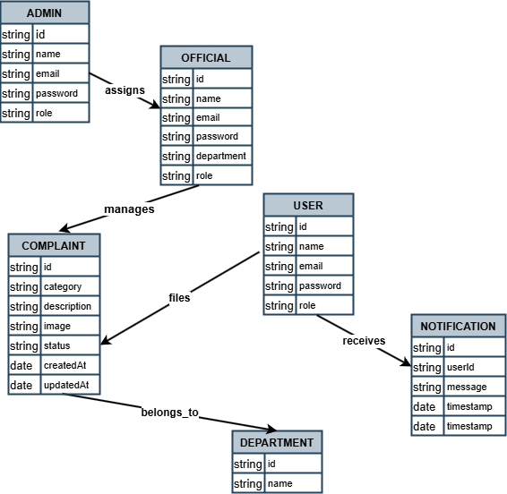
CIVICCONNECT: A MERN-BASED PUBLIC GRIEVANCE MANAGEMENT SYSTEM
ENTITY-RELATIONSHIP DIAGRAM (ERD) :

Slide 15
CIVICCONNECT: A MERN-BASED PUBLIC GRIEVANCE MANAGEMENT SYSTEM
ENTITY-RELATIONSHIP DIAGRAM (ERD)
The Entity-Relationship Diagram (ERD) for CivicConnect represents the database structure and relationships between key entities. The User entity stores citizen details, while Officials and Admins have extended roles. Users can file complaints, which belong to specific departments for resolution. Officials manage complaints, and Admins assign officials. A notification system ensures users receive updates. Relationships include one-to-many mappings for users filing complaints and receiving notifications. The ERD ensures efficient data organization, role-based access, and streamlined complaint resolution, improving civic engagement and governance.

Slide 16
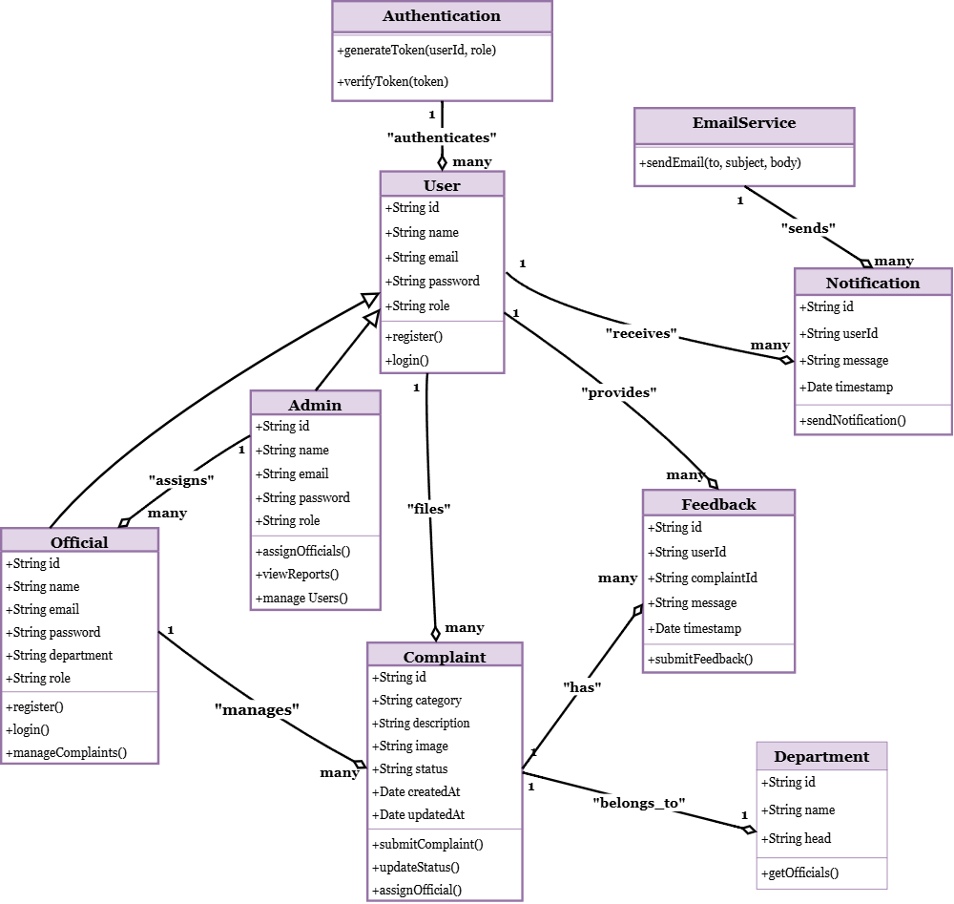
CIVICCONNECT: A MERN-BASED PUBLIC GRIEVANCE MANAGEMENT SYSTEM
CLASS DIAGRAM :

Slide 17
CIVICCONNECT: A MERN-BASED PUBLIC GRIEVANCE MANAGEMENT SYSTEM
CLASS DIAGRAM :
A Class Diagram in CivicConnect represents the system’s object-oriented structure, showing classes, attributes, methods, and relationships. The User class includes attributes like ID, name, email, password, and role, with methods for registration and login. Officials and Admins inherit from User, adding complaint management and assignment functionalities. The Complaint class stores details like category, description, status, and timestamps. Notifications handle updates, linked to users. Departments ensure proper complaint routing. Relationships like inheritance (User → Official/Admin) and associations (User → Complaint, Official → Complaint) define interactions, ensuring a scalable and modular system design.

Slide 18
CIVICCONNECT: A MERN-BASED PUBLIC GRIEVANCE MANAGEMENT SYSTEM
MODULES
User Authentication – Citizens and officials log in securely.
Dashboard – Users access complaint submission, tracking, and updates.
Complaint Filing – Users file complaints with category selection and media upload.
Assignment to Department – Complaints are routed to the relevant authority.
Status Tracking – Officials update complaint progress.
Notifications – Users get notified via email/SMS.
Resolution & Feedback – Users provide feedback after resolution.
Admin Dashboard – Admins track system performance and generate reports.
Interactive Map – Displays complaints for better issue visualization.
AI Chatbot (Future) – Guides users in submitting complaints.

Slide 19
CIVICCONNECT: A MERN-BASED PUBLIC GRIEVANCE MANAGEMENT SYSTEM
TECHNOLOGIES
Frontend: React JS and
Backend: Node JS , Express JS
Database: MongoDB
Other Tools: GitHub

Slide 20
CIVICCONNECT: A MERN-BASED PUBLIC GRIEVANCE MANAGEMENT SYSTEM
EXPECTED OUTCOMES
Faster and more efficient complaint resolution for improved public services.
Real-time tracking ensures transparency and accountability in issue handling.
Active citizen participation through reporting, feedback, and rating services.
Smart resource allocation using geolocation and data analytics.
Digital management reduces paperwork and streamlines government operations.
Data-driven insights improve decision-making and policy formulation.
Quick resolutions and feedback mechanisms enhance citizen trust.
Scalable and adaptable system to support future technological upgrades.

Slide 21
CIVICCONNECT: A MERN-BASED PUBLIC GRIEVANCE MANAGEMENT SYSTEM
FUTURE ENHANCEMENT
AI-Powered Chatbot: A virtual assistant to guide users in filing complaints accurately.
Smart Categorization: AI-based classification of complaints for faster processing.
Mobile App Integration: A dedicated mobile app for easy access and real-time updates.
Blockchain Security: Secure complaint data with blockchain to prevent manipulation.
Voice-Based Complaint Filing: Allow users to report issues using voice commands.
Advanced Analytics: Predictive insights and trends to improve resource planning.

Slide 22
CIVICCONNECT: A MERN-BASED PUBLIC GRIEVANCE MANAGEMENT SYSTEM
CONCLUSION
CivicConnect is a powerful digital platform designed to streamline public grievance management, ensuring efficient complaint resolution and transparency in governance. By leveraging the MERN stack, it provides real-time tracking, automated notifications, and data-driven decision-making tools for both citizens and authorities. The integration of geolocation mapping, role-based access control, and future AI-powered enhancements further enhances its effectiveness. With its user-friendly interface and responsive design, CivicConnect bridges the gap between citizens and government authorities, fostering accountability and improving public service delivery.

Slide 23
THANK
YOU!

