Slide 1
Vessel segmentation of the retina
SSIP 2012
Jianli Li, Kristína Lidayová, Karel Štěpka,
Krisztián Koós, Bodnár Péter

Slide 2
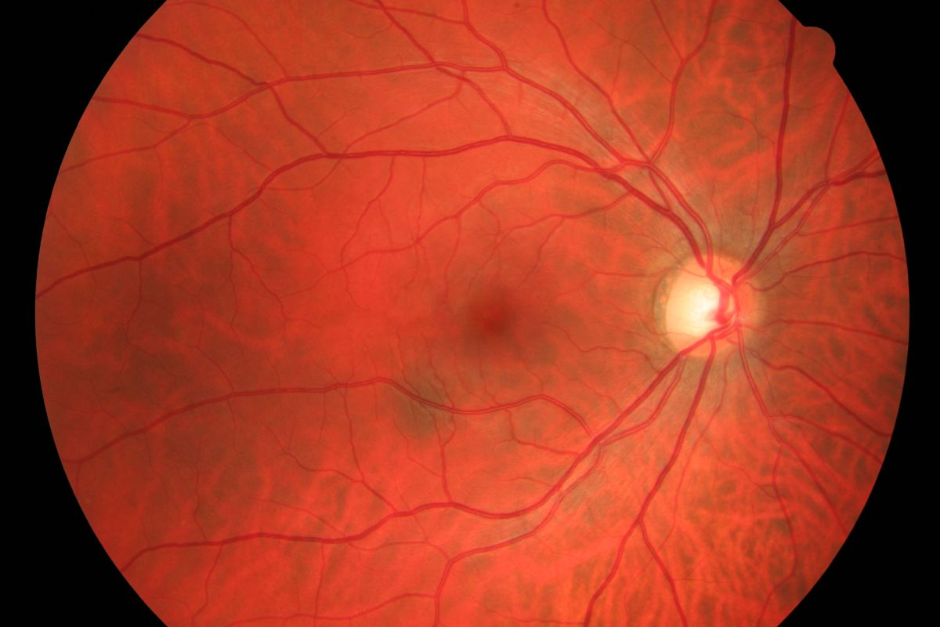
Motivation
SSIP 2012
Diagnostics
  Measurements
  Abnormalities
  Laser surgery
Registration
  Different modalities

Slide 3
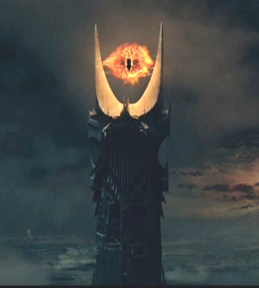
Difficulties of segmentation
No universal solution
Methods are dependent
  Modality
  Approach
  Automatic / Manual
Complex problem
  Combination of different approaches
  Specific detectors for all situations

Slide 4
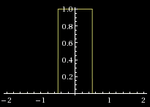
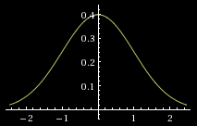
Vessel properties
Tubular structure
Linear segments
Similarity to each other
Significant cross-section (can be approximated by box or Gaussian functions)

Slide 5
Possible approaches
Pattern recognition
  multi-scale (resize image or mask)
  ridge-based (local peaks in max surface gradient)
  skeleton-based (centerlines)
  region growing (postprocessing, cavities, smoothing)
  differential geometry
  matching filters (+ centerline detection/thresholding)
  morphology-based (nonlinear filtering)
Model-based
  explicit models
  a priori knowledge
  active contours (requires good initial state)
  geometric deformable models

Slide 6
Possible approaches
Parametric models
  circles, ellipses, cylinders
  a priori knowledge
Tracking
  analyzing pixels orthogonal to tracking direction
  centerlines or boundaries
  problems: bifurcations, width changes
AI
  low level image processing → higher level anatomical knowledge
  neural networks, classifiers

Slide 7
Comparison to the state of the art
Thresholding
  Thitiporn Chanwimaluang, PhD thesis
Hessian-based Frangi filter
  Dirk-Jan Kroon

Slide 8
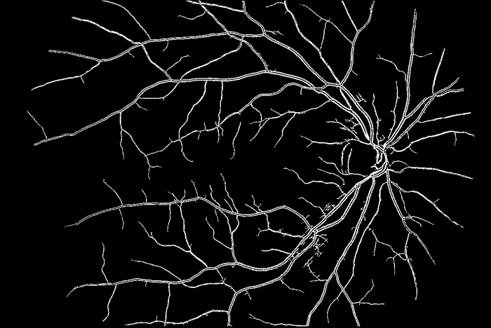
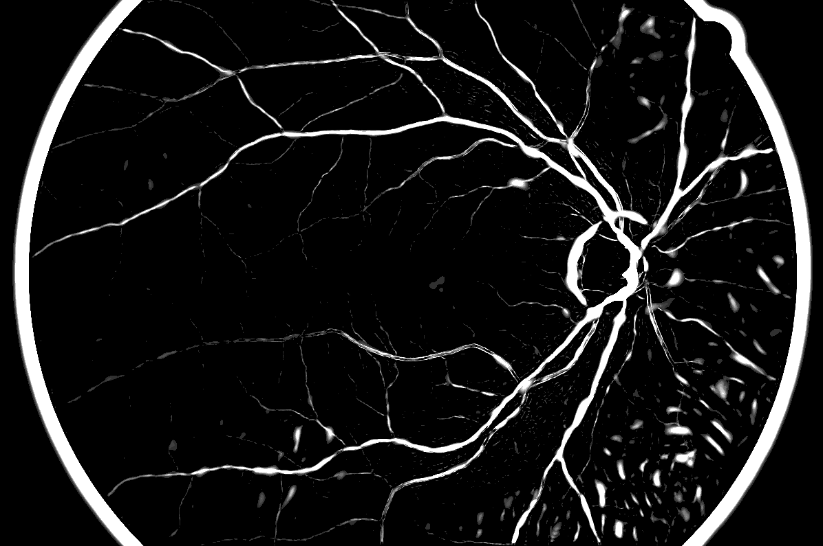
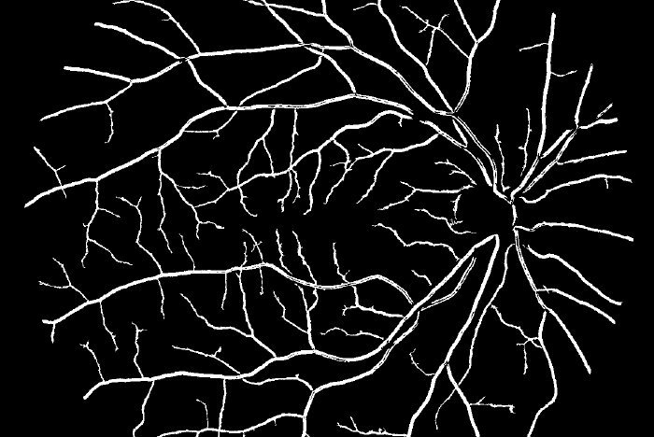
Visual comparison

Slide 9
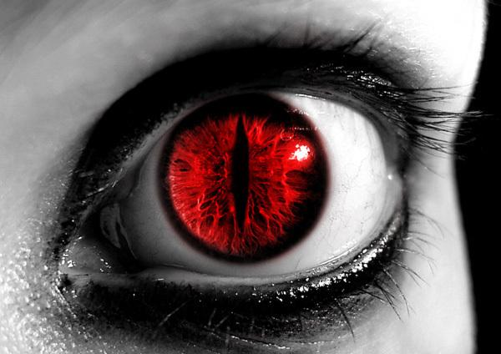
Thank you for your attention!

