Slide 1
CONFIDENTIAL — INVESTMENT COMMITTEE
Kenya Digital Consumer Lending
Investment Due Diligence
Full Investment Memorandum | February 2026
RECOMMENDATION: INVEST
All three decision criteria pass | 10,000 Monte Carlo simulations
0.0%
86.7%
19.2M
Geoffrey Mutuku
Investment Analyst | February 2026
Capital Loss Prob
Median IRR
Reachable Borrowers
Kenya Digital Lending — Investment Due Diligence | February 2026
1

Slide 2
INVESTMENT OVERVIEW
Three Reasons We Invest
01
02
03
Infrastructure
Already Built
Credit Gap
Is Structural
Returns Are
Compelling
101%
58pp
0.0%
M-Pesa adult penetration
Below global credit-to-GDP avg
Capital loss probability
35.8M active users processing KES 38,290B in annual transaction value.
Digital distribution is already built. A lender needs only to plug in — not build.
Kenya credit/GDP ~32% vs global ~90%.
19.2M adults are digitally reachable and creditworthy but have no formal credit history.
Median IRR 86.7%. 5th percentile 65.1%.
All 10,000 Monte Carlo paths produced positive returns. Severe recession IRR: 27.2%.
Source: Safaricom AR FY2025
Source: World Bank · IMF FAS 2021
Source: Notebook 04 Monte Carlo
Kenya Digital Lending — Investment Due Diligence | February 2026
2

Slide 3
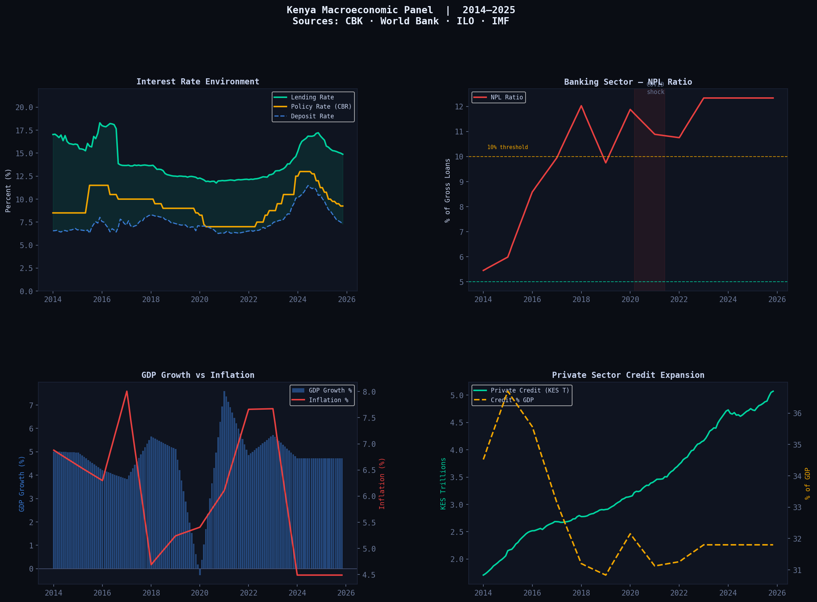
MARKET CONTEXT
Kenya Macroeconomic Environment | 2014–2025
Interest rates and NPL ratio | Jan 2014 – Nov 2025
12.34%
NPL Ratio Peak
2023 — post-COVID
13.0%
Policy Rate Peak
macro_overview.png
from outputs/charts/
2023 — CBK tightening
8.5%
Policy Rate Floor
2020 — COVID stimulus
10yrs
Historical Panel
143 monthly observations
Lending Rate
Policy Rate
NPL Ratio
Sources: CBK Statistical Bulletin · World Bank Open Data
Elasticities calibrated from this panel for stress model
Kenya Digital Lending — Investment Due Diligence | February 2026
3

Slide 4
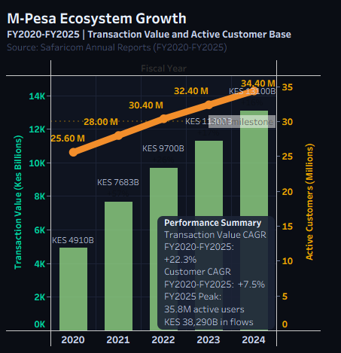
MARKET CONTEXT
M-Pesa Ecosystem | The Distribution Advantage
TRANSACTION VALUE FY2025
ACTIVE CUSTOMERS FY2025
ADULT PENETRATION
KES 38,290B
35.8M
101%
CAGR FY2020–FY2025: +22.3%
CAGR FY2020–FY2025: +7.5%
M-Pesa users per adult
Up from KES 14,151B in FY2020
101% of adult population
Digital distribution is complete
INSERT CHART: MPesa Growth — Transaction Value (bars) vs Active Customers (line)
Export MPesa Growth sheet from Tableau as image OR use mpesa chart from outputs/charts/
Source: Safaricom Annual Reports FY2020–FY2025
Kenya Digital Lending — Investment Due Diligence | February 2026
4

Slide 5
MARKET OPPORTUNITY
TAM → SAM → SOM | 19.2M Digitally Reachable Borrowers
TAM — Total Addressable Market
Why TAM ≈ SAM
20.0M
M-Pesa penetration at 101% of adults means the addressable market is almost entirely digitally reachable. Unlike most emerging markets, Kenya requires no infrastructure buildout.
All Kenyan adults with unmet credit demand
SAM — Serviceable Addressable Market
Conservative SOM
19.2M
3% SAM share anchored to Tala and Branch Kenya growth trajectories in their first three years. No distribution innovation required — only operational execution.
Reachable via M-Pesa today
The 58pp Credit Gap
SOM — Year 3 Target
576K
Kenya credit/GDP ~32% vs global ~90%. This gap represents decades of underinvestment in consumer credit infrastructure. Digital lenders with behavioural data can close it profitably.
3% SAM share | 3.2 loans/year avg
Sources: World Bank · IMF FAS · FinAccess 2021 · Safaricom AR
Kenya Digital Lending — Investment Due Diligence | February 2026
5

Slide 6
CREDIT RISK
Borrower Risk Model | Gradient Boosting | AUC 0.7396
Gradient Boosting
0.7396
307,511
0.994x
8.0%
Best Model
AUC Score
Training Samples
Calibration Factor
Kenya Target Rate
Segment | Portfolio Share | PD | LGD | Expected Loss | Rec. APR
Prime | 35% | 3.20% | 35% | 1.12% | ~31%
Near Prime | 45% | 7.70% | 45% | 3.47% | ~37%
Subprime | 20% | 20.06% | 60% | 12.04% | ~48%
Portfolio (Weighted) | 100% | 8.60% | 44.5% | 3.83% | ~37%
Model Calibration
Known Limitation
Dataset default rate 8.1% calibrated to Kenya digital target 8.0% using Platt scaling. Calibration factor 0.994x — near-perfect alignment. Retained as infrastructure for future Kenya-native recalibration.
Model trained on non-Kenya borrower data (Eastern Europe / SE Asia). Outputs are directional estimates pending Kenya-native CRB data. Recalibration recommended after 12 months of operational loan performance data.
Kenya Digital Lending — Investment Due Diligence | February 2026
6

Slide 7
FINANCIAL MODEL
Unit Economics and 3-Year Portfolio Projections
Unit Economics — KES 10,000 Loan
3-Year Portfolio Projections (KES Millions)
Interest Income (30% APR, 3mo)
+KES 750
Metric | Year 1 | Year 2 | Year 3
Total Originations (KES M) | 1,200 | 2,600 | 5,600
Average Loanbook (KES M) | 85 | 185 | 400
Total Revenue (KES M) | 48 | 105 | 226
Total Costs (KES M) | (26) | (56) | (120)
EBITDA (KES M) | 22 | 49 | 106
Net Income (KES M) | 15 | 34 | 74
Net Margin | 46% | 47% | 47%
Origination Fee (6%)
+KES 600
Gross Revenue
KES 1,350
Funding Cost (14% APR)
-KES 350
Expected Credit Loss
-KES 170
Customer Acquisition Cost
-KES 150
Servicing Cost
-KES 50
Net Contribution
KES 630
Net Margin: 46.7%
8% monthly origination growth | 30% corporate tax | 6% origination fee | 30% APR
Kenya Digital Lending — Investment Due Diligence | February 2026
7

Slide 8
INVESTOR RETURNS
Equity IRR, MOIC and Capital Structure
Capital Structure
Return Metrics
Equity Cashflow Timeline
Equity
30%
Metric | Value
Gross IRR (base 8x) | 102.4%
Gross IRR (conservative 5x) | ~60%
Net IRR (after 30% tax) | 71.7%
MOIC (base 8x) | 8.0x
MOIC (conservative 5x) | ~5.0x
Payback Period | Year 3 exit
Equity
deployed
Dividends
50% NI
Dividends
50% NI
Exit +
Dividends
Debt Facility
70%
@ 14% p.a.
Year 0
Year 1
Year 2
Year 3
Returns concentrated at exit.
DPI 0.19x — exit covenant
protections recommended.
Note on Base Case IRR
102% IRR reflects 6% origination fee on 3-month loans annualised to 24%. Conservative 5x exit produces ~60% — still 2.4x above the 25% hurdle. Sensitivity tested from 4x to 8x — all clear the hurdle.
First-loss equity absorbs downside
Debt facility funds portfolio growth
Kenya Digital Lending — Investment Due Diligence | February 2026
8

Slide 9
STRESS TESTING
4 Historical Scenarios | Kenya Macro Events 2008–2024
Base Case
Mild Recession
Severe Recession
APR Cap Shock
Kenya 2024 Baseline
Kenya 2017 — Drought + Election
Kenya 2008 — Post-Election Crisis
Kenya 2016 — Rate Cap
8.2%
14.6%
23.5%
8.2%
Portfolio PD
Portfolio PD
Portfolio PD
Portfolio PD
44.5%
44.5%
54.5%
44.5%
LGD
LGD
LGD
LGD
31.7%
31.7%
31.7%
23.7%
Effective APR
Effective APR
Effective APR
Effective APR
102.4%
57.5%
27.2%
76.5%
Gross IRR
Gross IRR
Gross IRR
Gross IRR
0.2pp above 25% hurdle
Origination fee protects margin
Macro elasticities from 10 years of CBK NPL data | Unemployment: 0.18 | Inflation: 0.08 | Policy Rate: 0.12 | Exit sensitivity 4x–8x: all clear 25% hurdle
INVEST
PROCEED
ACCEPTABLE
MANAGEABLE
Kenya Digital Lending — Investment Due Diligence | February 2026
9

Slide 10
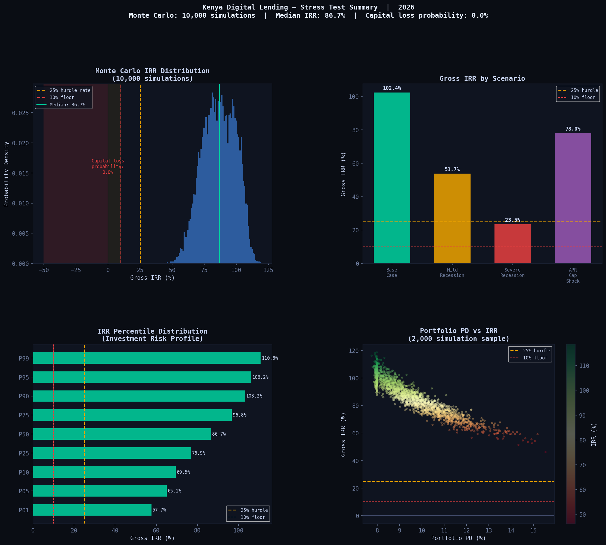
PROBABILISTIC RISK
Monte Carlo Simulation | 10,000 Paths | Kenya Historical Distributions
IRR Distribution — 10,000 Monte Carlo Simulations
86.7%
Median IRR
Base performance
65.1%
5th Percentile IRR
stress_test_summary.png
from outputs/charts/
Use Monte Carlo distribution panel
(bottom left of 4-panel chart)
OR export Monte Carlo sheet from Tableau
Worst 5% of scenarios
0.0%
Capital Loss Prob
Across all 10,000 paths
~40%
Minimum IRR
Lowest single simulation
10,000
Simulations Run
Historical macro distributions
ZERO of 10,000 simulations produced a capital loss
Investment Grade (>25% hurdle)
Above floor (<25% hurdle)
Robust across all historically plausible Kenya macro scenarios
Kenya Digital Lending — Investment Due Diligence | February 2026
10

Slide 11
RISK ASSESSMENT
Key Risk Factors and Mitigants
Regulatory Risk
HIGH
Credit Risk
MEDIUM
Rate cap risk — 2016 precedent exists. APR Cap scenario IRR 76.5% — still above hurdle under 8pp cap.
CBK licensing now mandatory. Licence is a barrier to entry for competitors once obtained.
20% subprime allocation creates loss volatility risk.
Model trained on non-Kenya data. Behavioural features not fully transferable without CRB validation.
First-cycle borrower adverse selection is a known risk.
Mitigant: Origination fee structure not subject to rate cap regulation
Mitigant: Kenya-native model recalibration after 12 months operational data
Operational Risk
MEDIUM
Market Risk
LOW-MED
Collections infrastructure must scale with portfolio. Failure to build collections capability is the most common failure mode in African digital lending.
Technology fraud and synthetic identity risk increases at scale.
Tala, Branch, Fuliza and Hustler Fund compete in target segments. Hustler Fund (zero interest) is disruptive in subprime.
M-Pesa API dependency — Safaricom data access not guaranteed in perpetuity.
Mitigant: Collections technology audit required pre-close
Mitigant: Differentiate on speed, limit size and credit graduation — not price
Kenya Digital Lending — Investment Due Diligence | February 2026
11

Slide 12
INVESTMENT DECISION
Decision Framework | 6 Criteria | Recommendation
Investment Criteria Assessment
RECOMMEND: INVEST
Criterion | Threshold | Result | Status
Base IRR | > 25% | 86.7% median | PASS
Recession IRR | > 10% | 65.1% at P5 | PASS
Capital Loss Prob | < 20% | 0.0% | PASS
MOIC | > 2.5x | 8.0x / ~5.0x | PASS
DPI | > 0.5x | 0.19x | REVIEW
Year 1 EBITDA | Positive | KES 22M | PASS
5 of 6 criteria pass
DPI noted — exit protections required
Recommended Conditions Before Close:
1
CBK Licence Confirmed — Digital Credit Provider licence active
2
M-Pesa API Rights — Data sharing rights confirmed with Safaricom
3
Exit Trigger Covenant — Pre-agreed conditions for sale / secondary
4
Collections Audit — Independent review of tech and recovery rates
DPI failure reflects deliberate reinvestment strategy — not a business model concern. Exit covenant protections recommended.
5
Model Recalibration — Kenya-native PD model after 12 months data
The Kenya digital lending opportunity is real. We invest.
Kenya Digital Lending — Investment Due Diligence | February 2026
12

