Slide 1


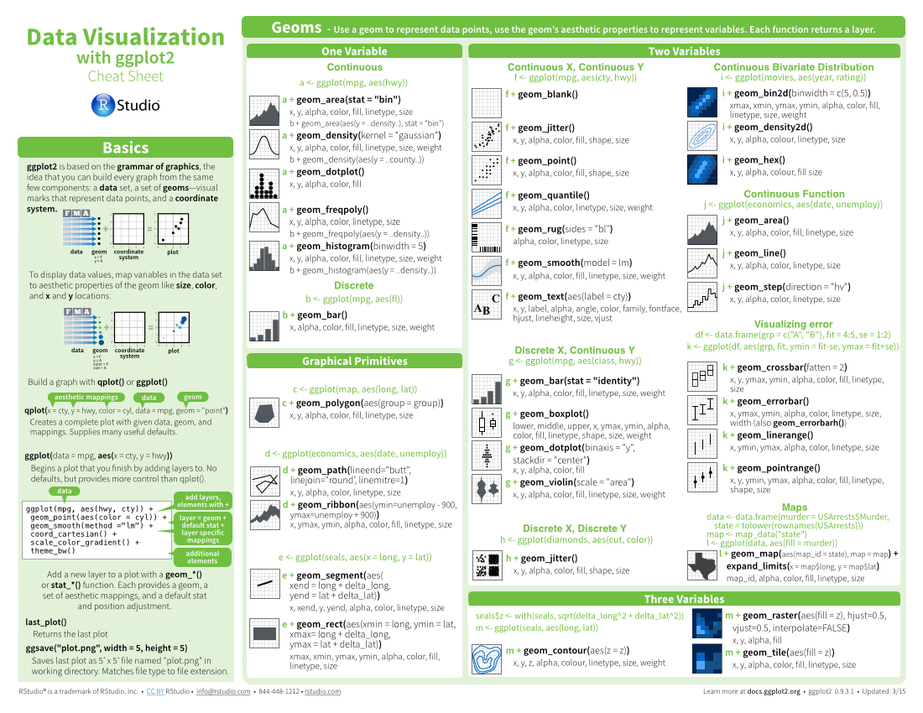

pxweb: CHEAT SHEET
Basics
Layout Suggestions
Manipulate Variables
Thank you for making a new cheatsheet for R! These cheatsheets have an important job:
Use headers, colors, and/or backgrounds to separate or group together sections.
Create a visual hierarchy. Help users navigate the page with titles, subtitles, and subsubtitles
Quickly identify content with a package hexsticker (if available)
Fit sections to content. Try several different layouts.
Use numbers or arrows to link sections if the order/flow is confusing.
Section 1
Section 2
Section 3
Title
Remember that the best cheatsheets are visual—not written—documents. Whenever possible use visual elements to make it easier for readers to find the information they need.
SUBTITLE
SUBSUBTITLE
Use a layout that flows and makes it easy to zero in on specific topics.
Logistics
Useful Elements
FONTS
CODE
This template uses several fonts: Helvetica Neue, Menlo, Source Sans pro, which you can acquire for free here, www.fontsquirrel.com/fonts/source-sans-pro, and Font Awesome, which you can acquire here, fortawesome.github.io/Font-Awesome/get-started/
Where possible, use code that works when run.
Word balloons
ggplot(mpg, aes(hwy, cty)) +
geom_point(aes(color = cyl)) +
geom_smooth(method ="lm")
can help explain
code
Use visualizations to explain concepts quickly and concisely.
To use a font awesome icon, copy and paste one from here fortawesome.github.io/Font-Awesome/cheatsheet/. Then set the text font to font awesome.
summary function
ICONS
☞    
These are just font awesome characters
Use visual elements to make the sheet scannable.
i + geom_area() x, y, alpha, color, fill, linetype, size
i + geom_line() x, y, alpha, color, group, linetype, size
KEYNOTE
TABLES
I make my cheatsheets in Apple Keynote, and not latex or R Markdown, because presentation software makes it much easier to tweak the visual appearance of a document
sub-option | description
citation_package | The LaTeX package to process citations, natbib, biblatex or none
code_folding | Let readers to toggle the display of R code, "none", "hide", or "show"
colortheme | Beamer color theme to use
Use visual emphasis (like color, size, and font weight) to make important information easy to find.
KEYNOTE TIPS
dplyr::lag() - Offset elements by 1
dplyr::lead() - Offset elements by -1
Select multiple elements by holding down shift and then selecting each. Click on a selected element before letting go of shift to unselect it.
To group elements together. Select them all , then click Arrange > Group
To evenly space multiple objects, select them all then Right Click > Align objects or Right Click > Distribute objects
Click on a table, then visit Format >Table > Row and Column Size to make even width rows/columns.
COPYRIGHT
Each cheatsheet should be licensed under the creative commons license.
To license the sheet as creative commons, put CC'd by <your name> in the small print at the bottom of each page and link it to http://creativecommons.org/licenses/by/4.0/
YOUR LOGO
(optional)
RStudio® is a trademark of RStudio, Inc. • CC BY SA Your Name • your@email.com • 844-448-1212 • your.website.com • Learn more at webpage or vignette • package version 0.5.0 • Updated: 2017-01

