Slide 1

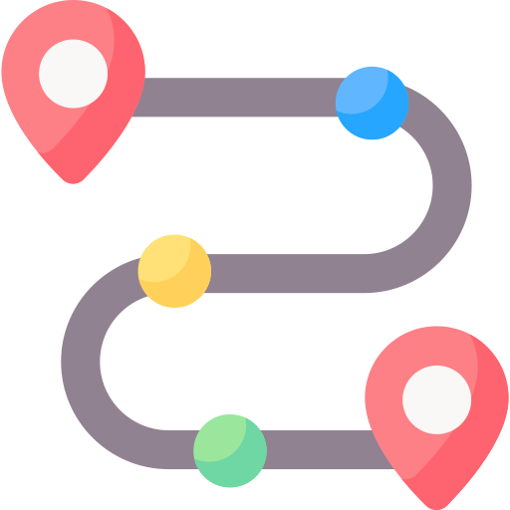


vehicles
Routing
Main server
Traffic signal
server

