Slide 1
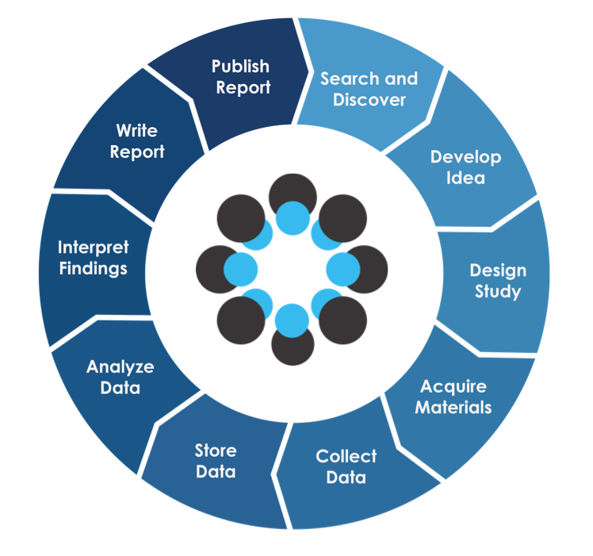
Reproducible Research with R
Session 1
Pre
Registration
Nosek, B. A., Alter, G., Banks, G. C., Borsboom, D., Bowman, S. D., Breckler, S. J., … Yarkoni, T. (2015). Promoting an open research culture. Science, 348

Slide 2
Parts of preregistrations
Time stamped, read-only version of your research plan
Research rationale
Hypotheses
Design
Analytic strategy (+)
http://www.apa.org/science/about/psa/2015/08/pre-registration.aspx

Slide 3
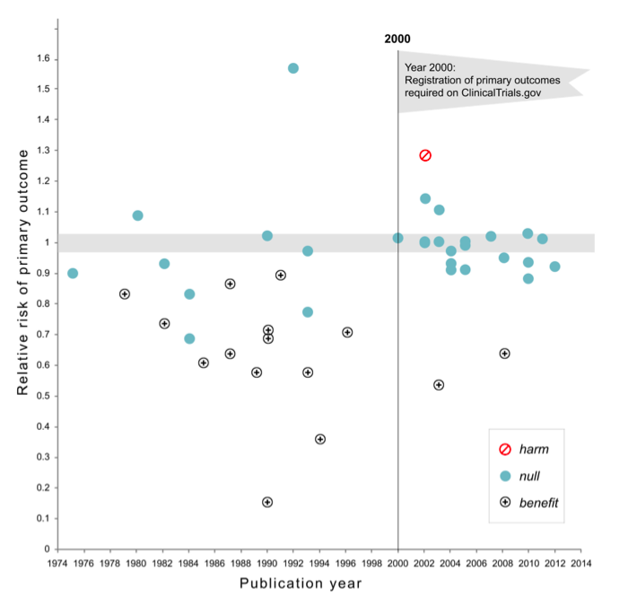
Kaplan RM, Irvin VL (2015) Likelihood of Null Effects of Large NHLBI Clinical Trials Has Increased over Time. PLoS ONE 10(8): e0132382. https://doi.org/10.1371/journal.pone.0132382

Slide 4
Task
Discuss with your neighbour benefits and concerns you personally see/have when thinking about repregistration
Write down a list for both
Time: 10 min

Slide 5
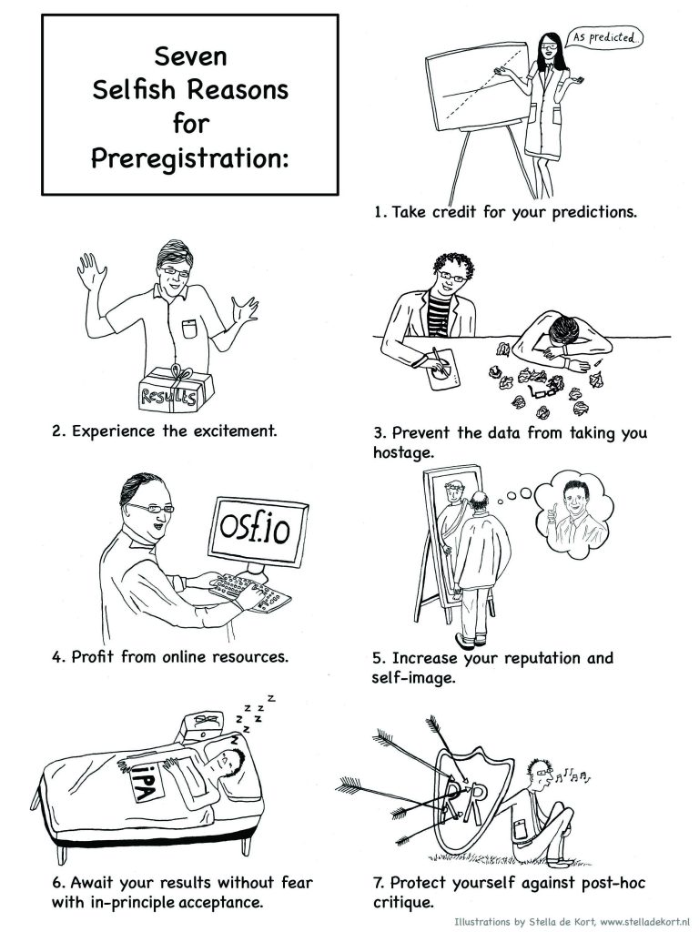
Benefits
Improved use of theory and stronger
research methods
A decline in false-positive publications
Reduced File drawer effect
Reduced P-hacking
Reduced HARKing

Slide 6
Concerns
Pre-registration could lead to undervaluing exploratory research
Rely more on researcher prestige to make decisions about accepting articles for pre-registration.

Slide 7
Confirmation
vs
Exploration

Slide 8
Task
Look at preregistration on OSF
What are particular difficulties?
Is the template appropriate for your studies?
What would you add to the template?
Time: 25 min; individually

Slide 9
Homework
Finish Preregistration
Simulate data for your replication

