Slide 1
MUSIC PLAYER
BY EPHREM SHIFERAW EWNETU
KAISA OTTERKLAU

Slide 2
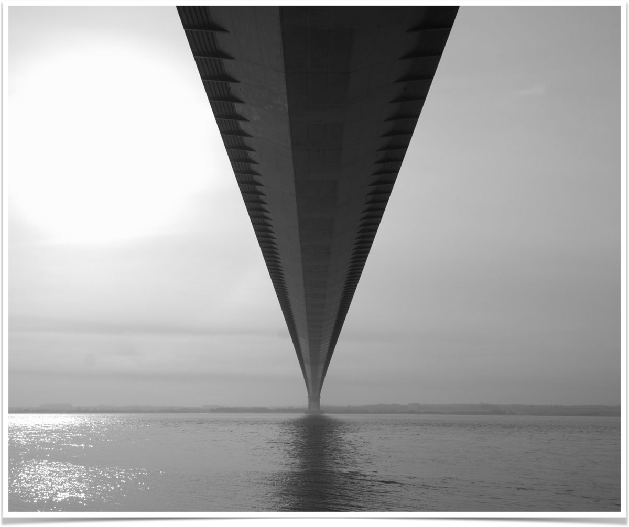

music player
The days of physical music is long gone with cd and radio players.
Digitalisation is increasing that brings more people online
The market has proved itself for profitability
curate the specific selection of media in a very customized manner.

Slide 3
Features
Make playlist
Delete playlist
Add songs to playlist
Delete songs from playlist
Play, Pause,Forward and Rewind
Alert message.

Slide 4
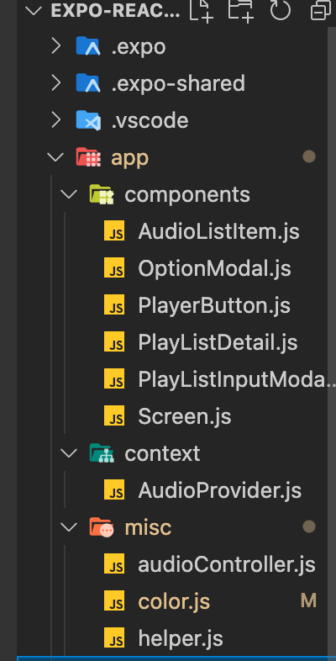
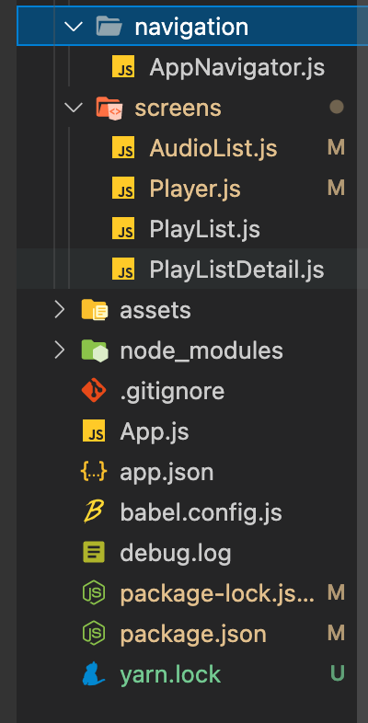
We have implemented:
Expo
Expo-av
React native slider
Linear gradient
Recycler list view
Expo media library
Async storage
React navigation bottom tabs
React navigation stack
Expo vector icons

Slide 5
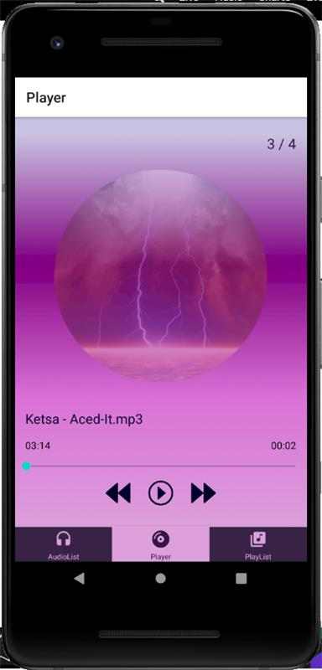
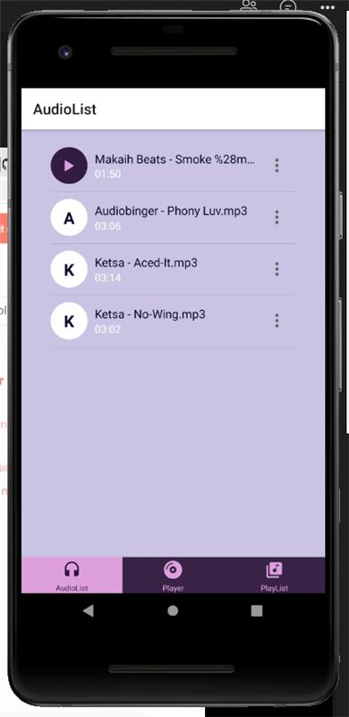
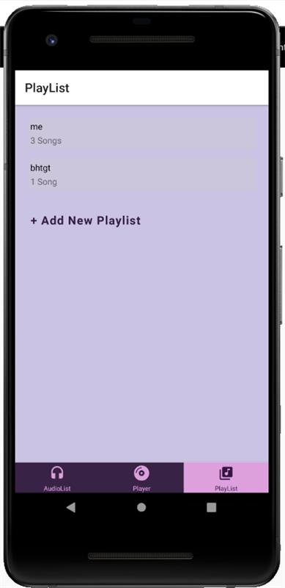

Slide 6
Thank you!
Kiitos!
By Ephrem Shiferaw Ewnetu
Kaisa Otterklau

