Slide 1

MUSIC PLAYER
BY EPHREM SHIFERAW EWNETU
KAISA OTTERKLAU

Slide 2

Music player
The days of physical music is long gone with CD and radio players.
Digitalization is increasing that brings more people online
Curate the specific selection of media in a very customized manner.
The market has proved itself for profitability

Slide 3
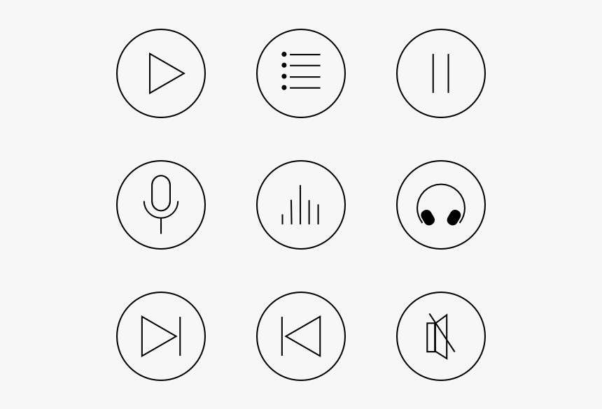
Features
Make playlist
Delete playlist
Add songs to playlist
Delete songs from playlist
Play, Pause, Forward and Rewind
Alert message.

Slide 4
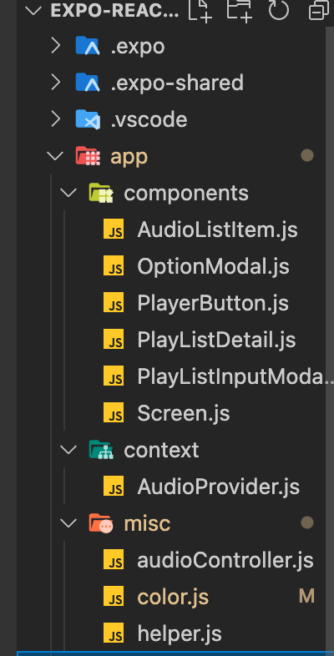
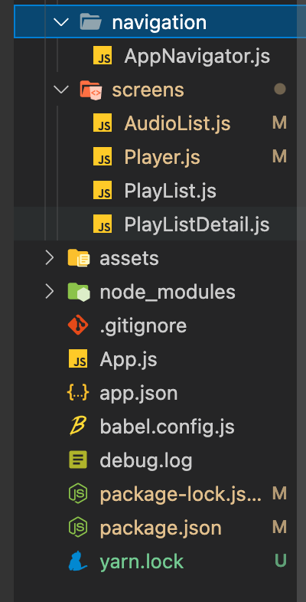
We have implemented:
Expo
Expo-av
React native slider
Linear gradient
Recycler list view
Expo media library
Async storage
React navigation bottom tabs
React navigation stack
Expo vector icons

Slide 5
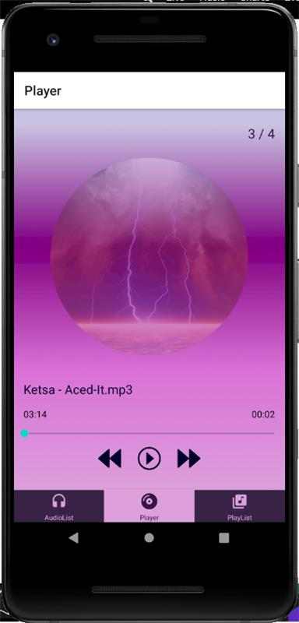
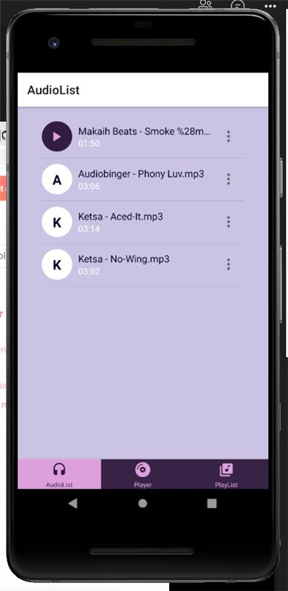
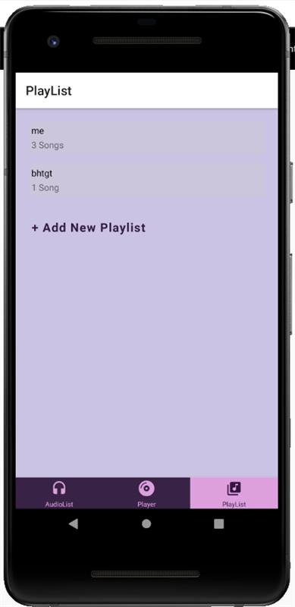

Slide 6
Thank you!
Kiitos!
By Ephrem Shiferaw Ewnetu
Kaisa Otterklau

