Slide 1

E-Commerce
Analysis
SIA PARTNERS

Slide 2
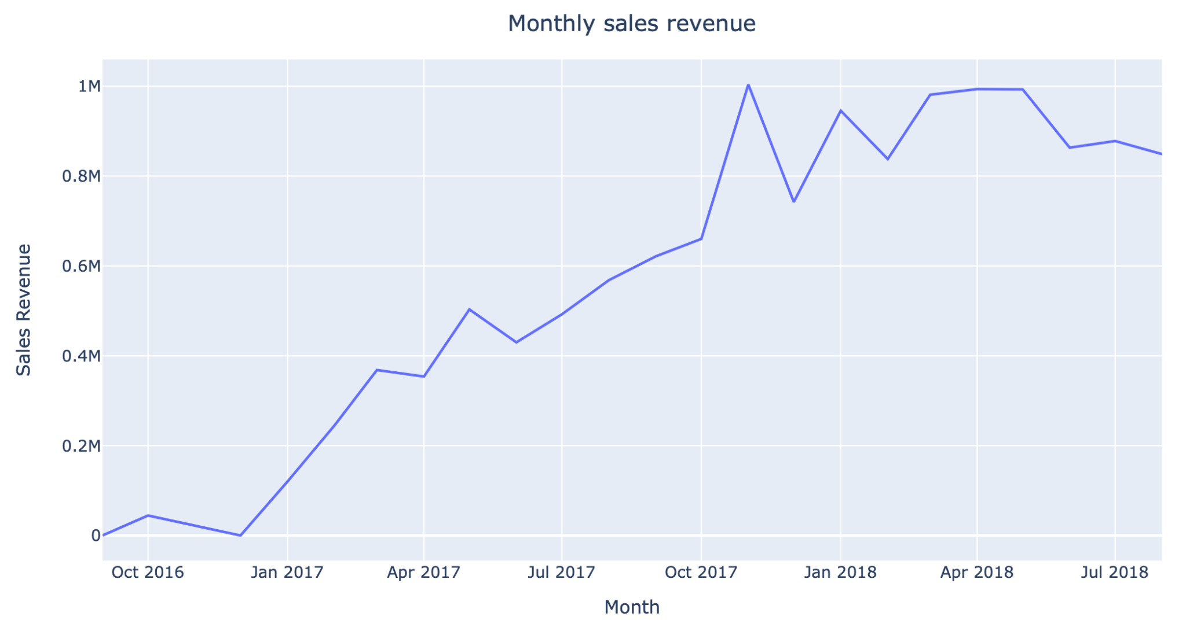
The revenue is not increasing anymore
-Although the monthly sales revenue has been increasing, there seems to be even a negative trend since May 2018
-This could possibly be due to the low sales figures or the high prices offered on the e-commerce platform

Slide 3
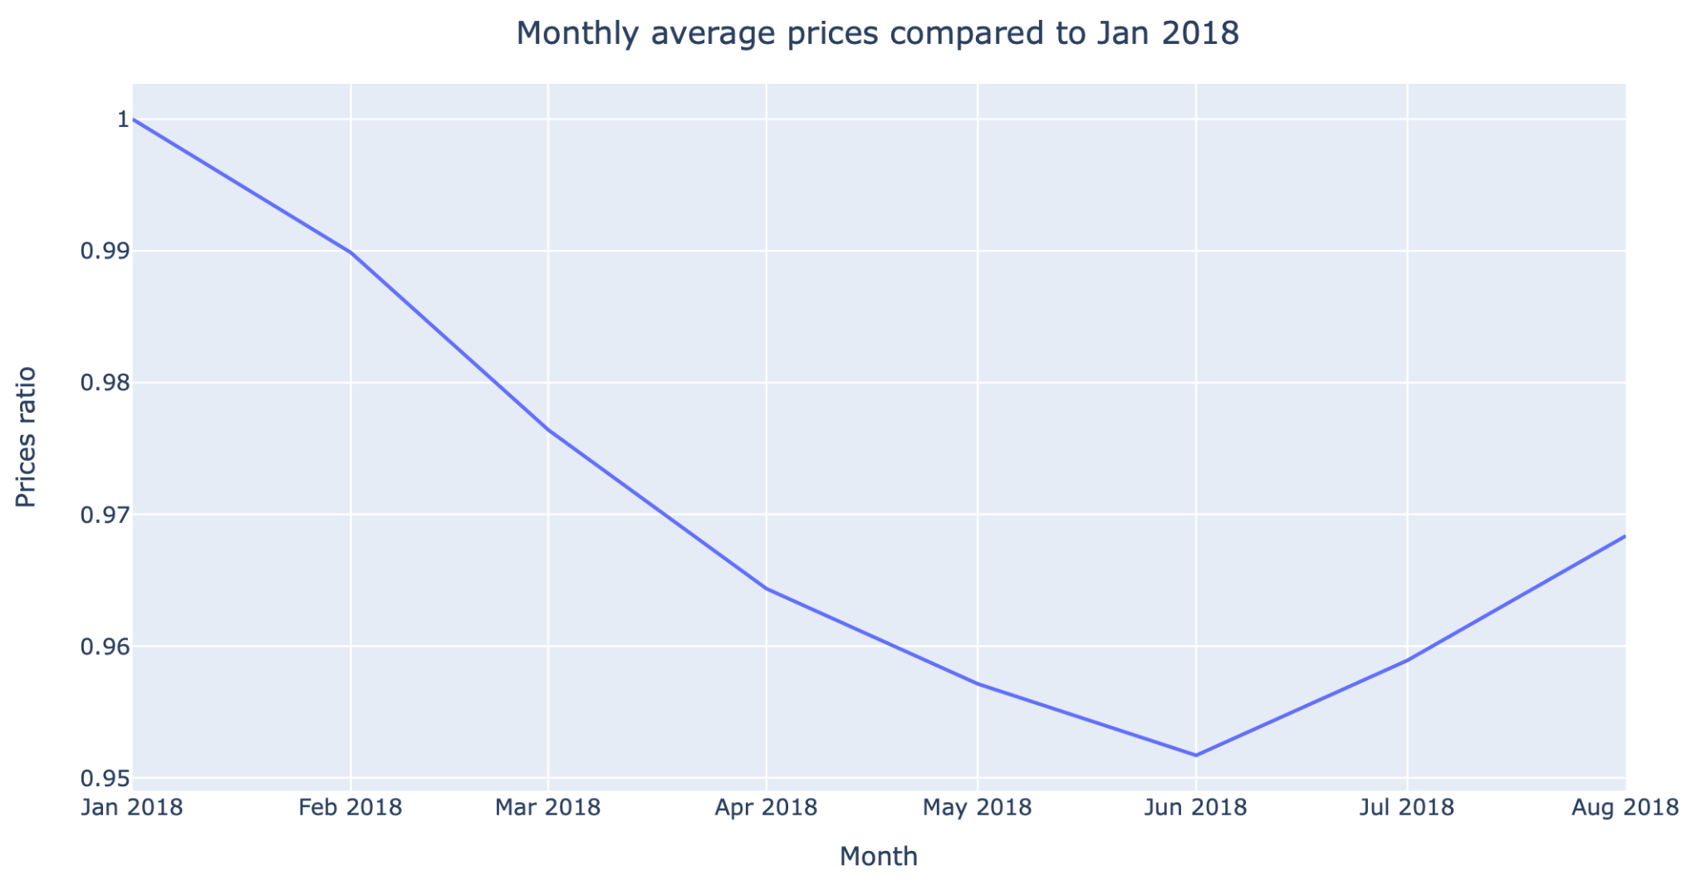
Brazil saw a high inflation in summer 2018
Prices of the products sold have risen slightly during summer
-Due to truckers strike in late May-early June
-Increase in estimated delivery durations from 3.5 weeks to 5.5 weeks

Slide 4
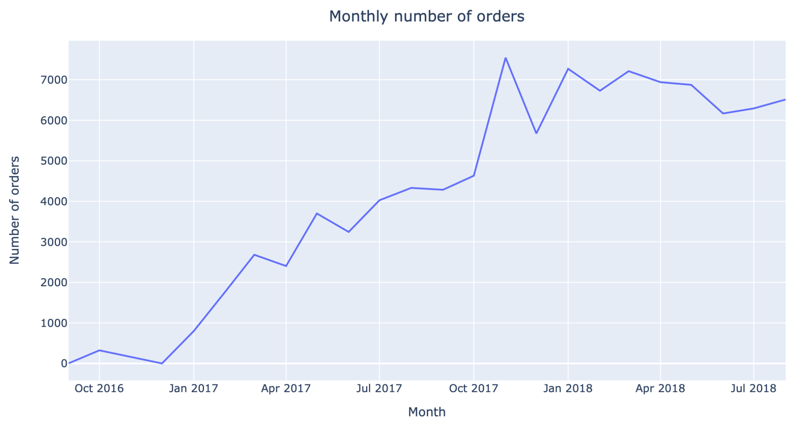
Sales are down too
Number of orders follows a similar pattern as the revenue
The focus should be on the sales

Slide 5


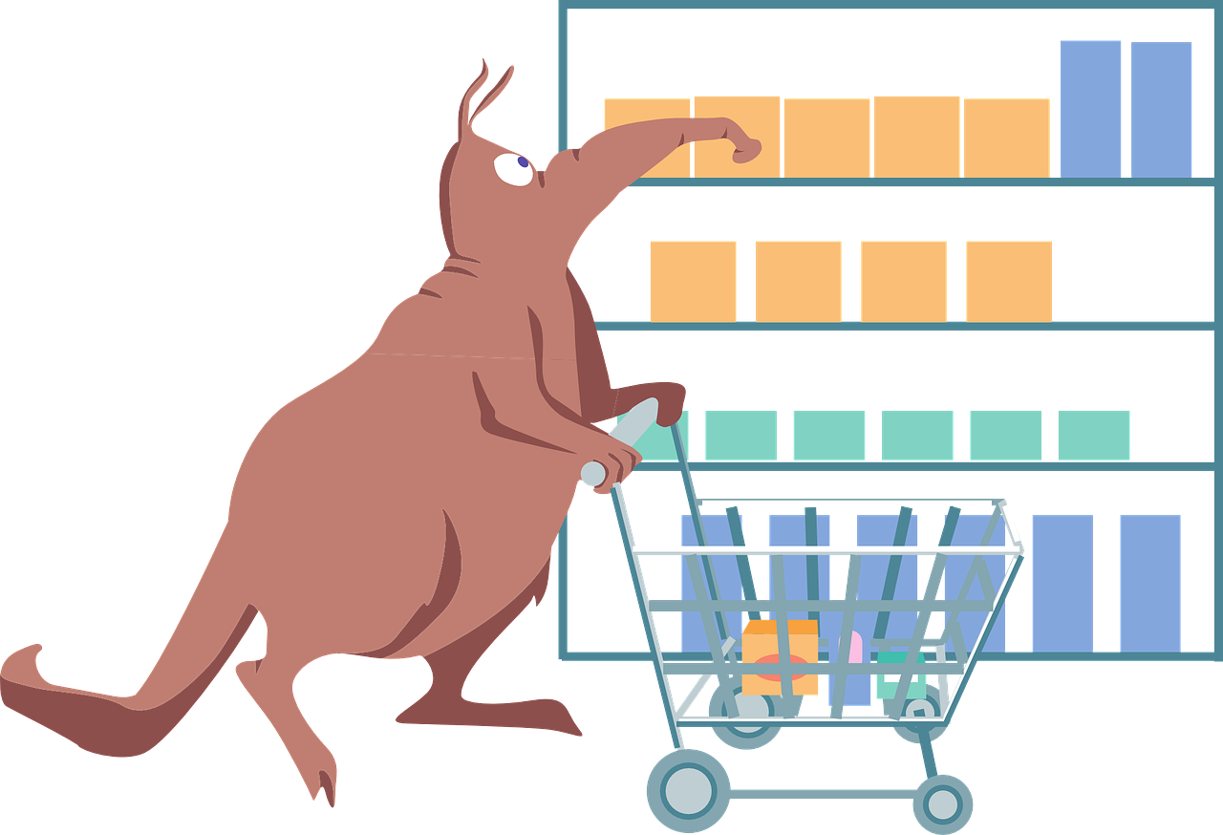


Potential reasons why sales are not increasing
1.
Low number of new
customers
2.
Customers order mostly
one item only
3.
Customers do not stay
4.
Some products are
seeing decline in sales

Slide 6

Customer
Analysis

Slide 7
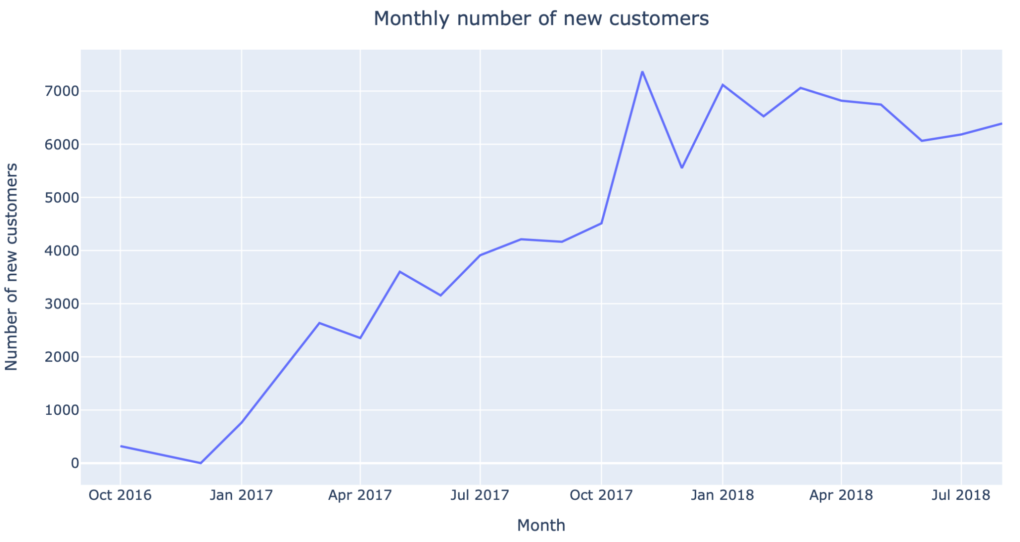
The number of new customers is not increasing

Slide 8
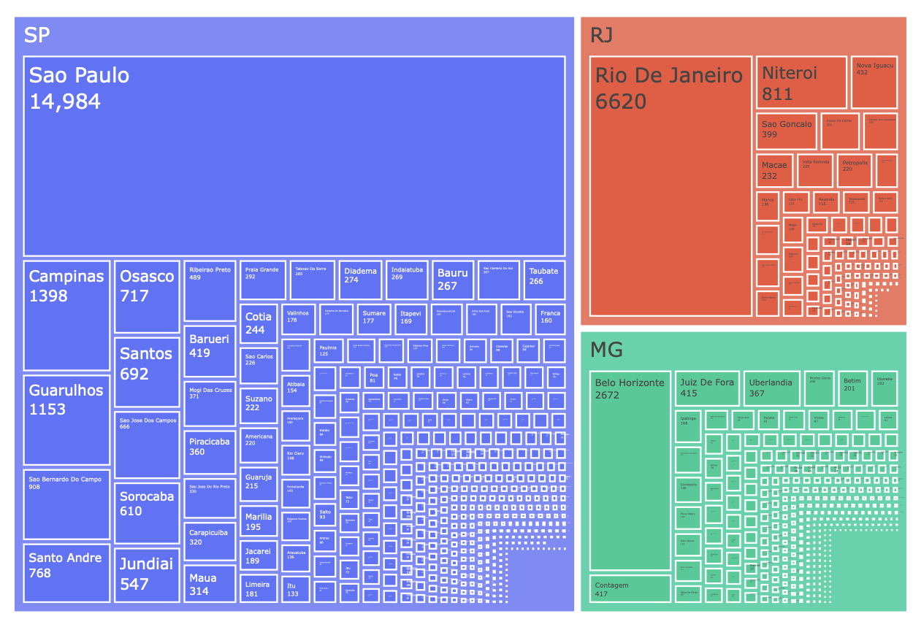
Solution
Attract customers from the big cities Sao Paulo, Rio De Janeiro
Combined population of Sao Paulo and Rio de Janeiro is 20 million people
SP and RJ states are small and densely populated, thus the deliveries are faster and easier compared to other states
Delivery fees are almost 2-3 times cheaper than for remotely located states, thus people in SP, RJ would be more likely to become customers

Slide 9
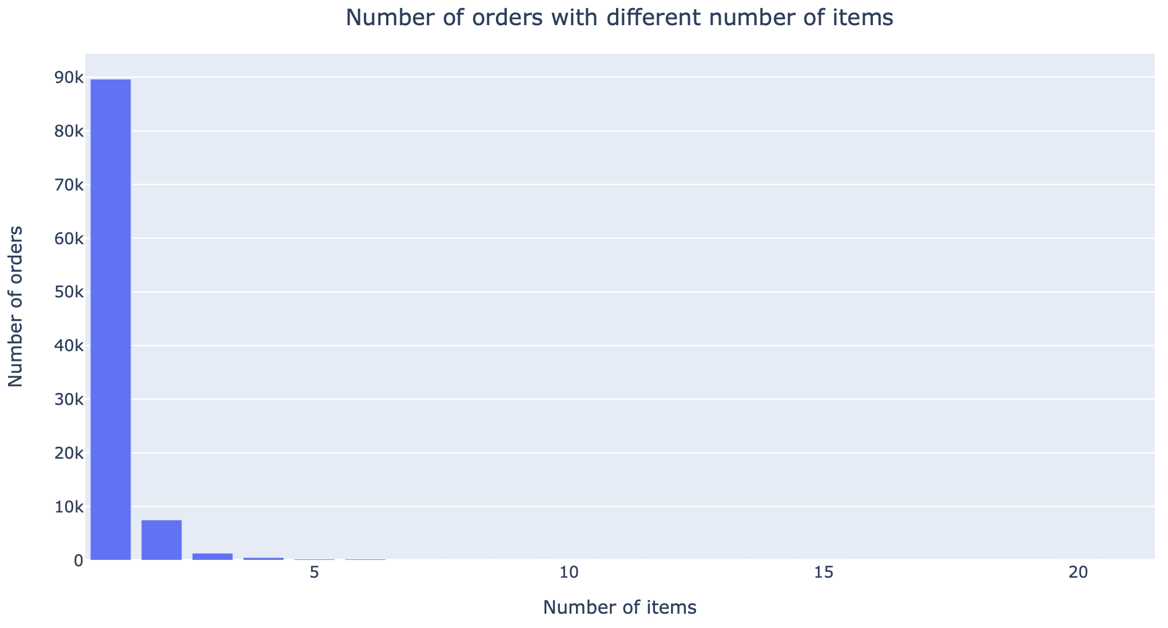
Most customers buy only one item per order
-Cross-selling is important in encouraging customers to add more items to their orders
-That could help in increasing the value of each order, thus increasing the total revenue

Slide 10

Solutions
Product-product recommendation:
-Identify which products are sold together by using the data for association learning
-Offer the most co-occuring products on check-out
-A/B testing on the “maybe buy?” offers to check the validity
Customer-product recommendation:
-Identify segments of similar customers
-On check-out, offer products frequently sold to similar customers
-A/B testing on the “maybe buy?” offers to check the validity

Slide 11
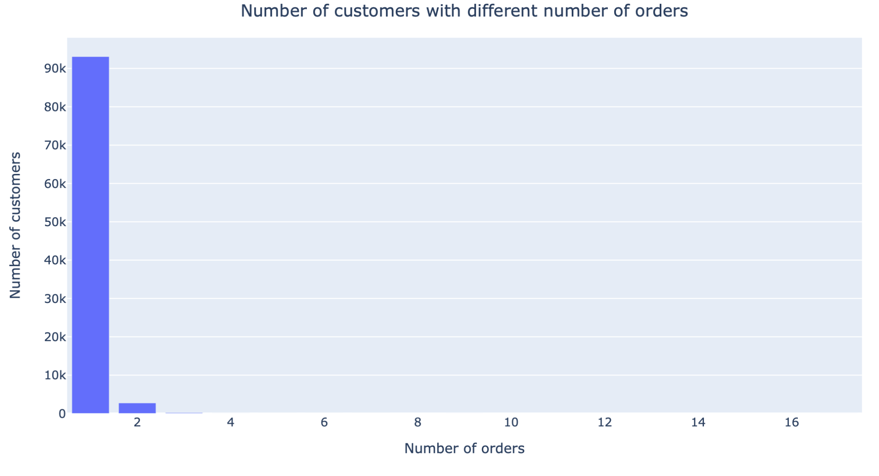
Most customers do not make more than one order
-Customer retention is important in building a loyal customer base, and acquiring new customers is usually more expensive
-That could help in increasing the sales revenue, reputation of the e-commerce which is quite competitive business

Slide 12
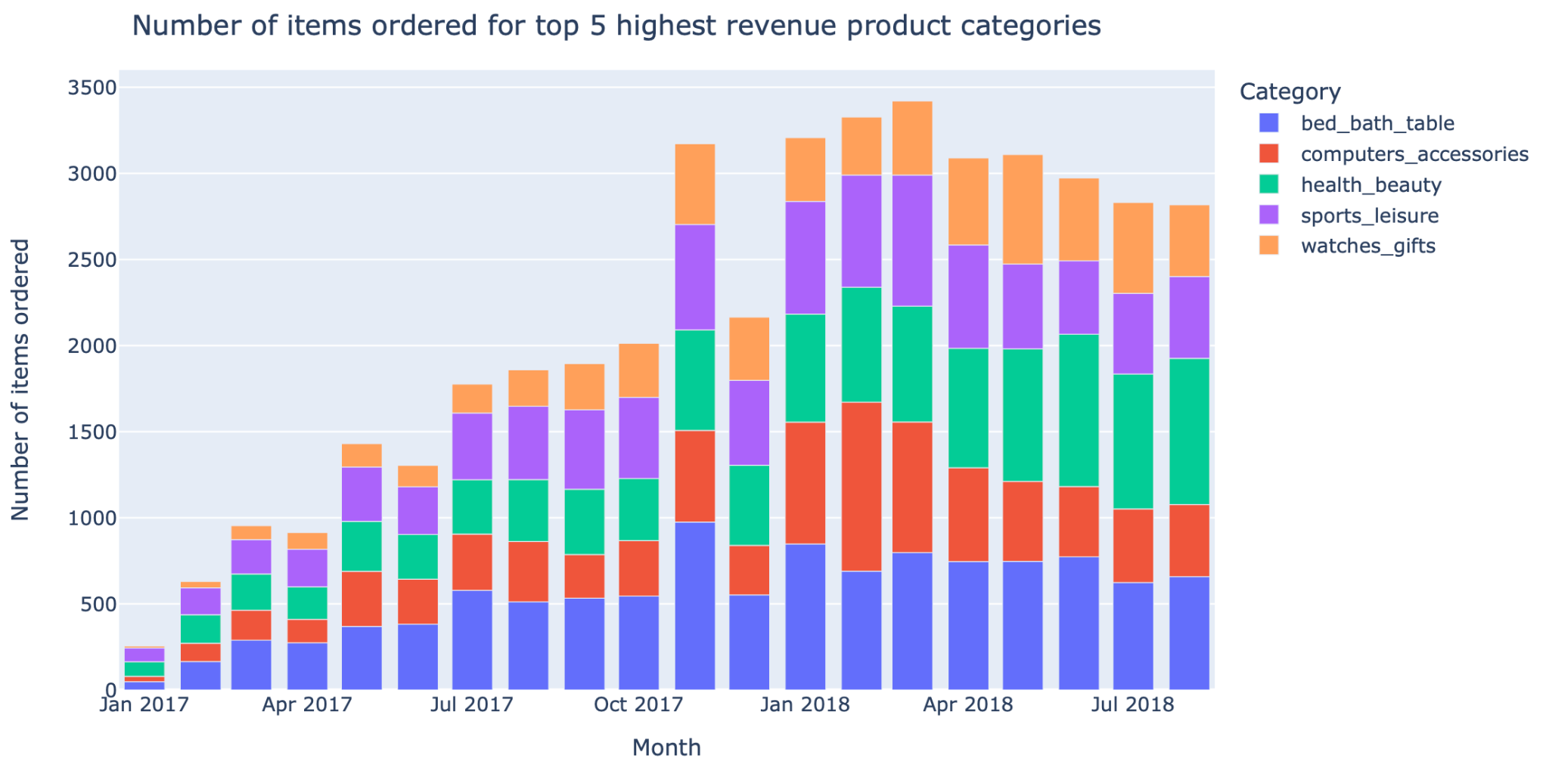
Only health and beauty products have increased in sales
-Diversification decreases the dependence on only one type of product
-It also helps in targeting a broader customer base and ‘one-stop’ e-commerces offer convenience for the customers

Slide 13
Solutions
Customer segmentation approach would be valuable:
-Identify segments of customers with similar purchase behavior regarding the product types they buy
-To get more orders, similar products frequently sold in the same segment could be offered
-To boost the sales of the ones which is declining, target the customers that belong to the segments with highly co-occurring product types

Slide 14

Customer
Segmentation

Slide 15
Variables selected
Product type based
Purchasing behaviour based
Number of Bed/Bath/Table products bought
Average spending per order
Number of Health/Beauty products bought
Average number of items per order
Number of Sports/Leisure products bought
Number of orders
Number of Furniture/Decor products bought
Total number of items
Number of Comp./Accesso. products bought
Total spending
Number of Houseware products bought
Number of Watches/Gifts products bought
Number of Telephony products bought
Number of Garden tool products bought
Number of Automobile products bought

Slide 16
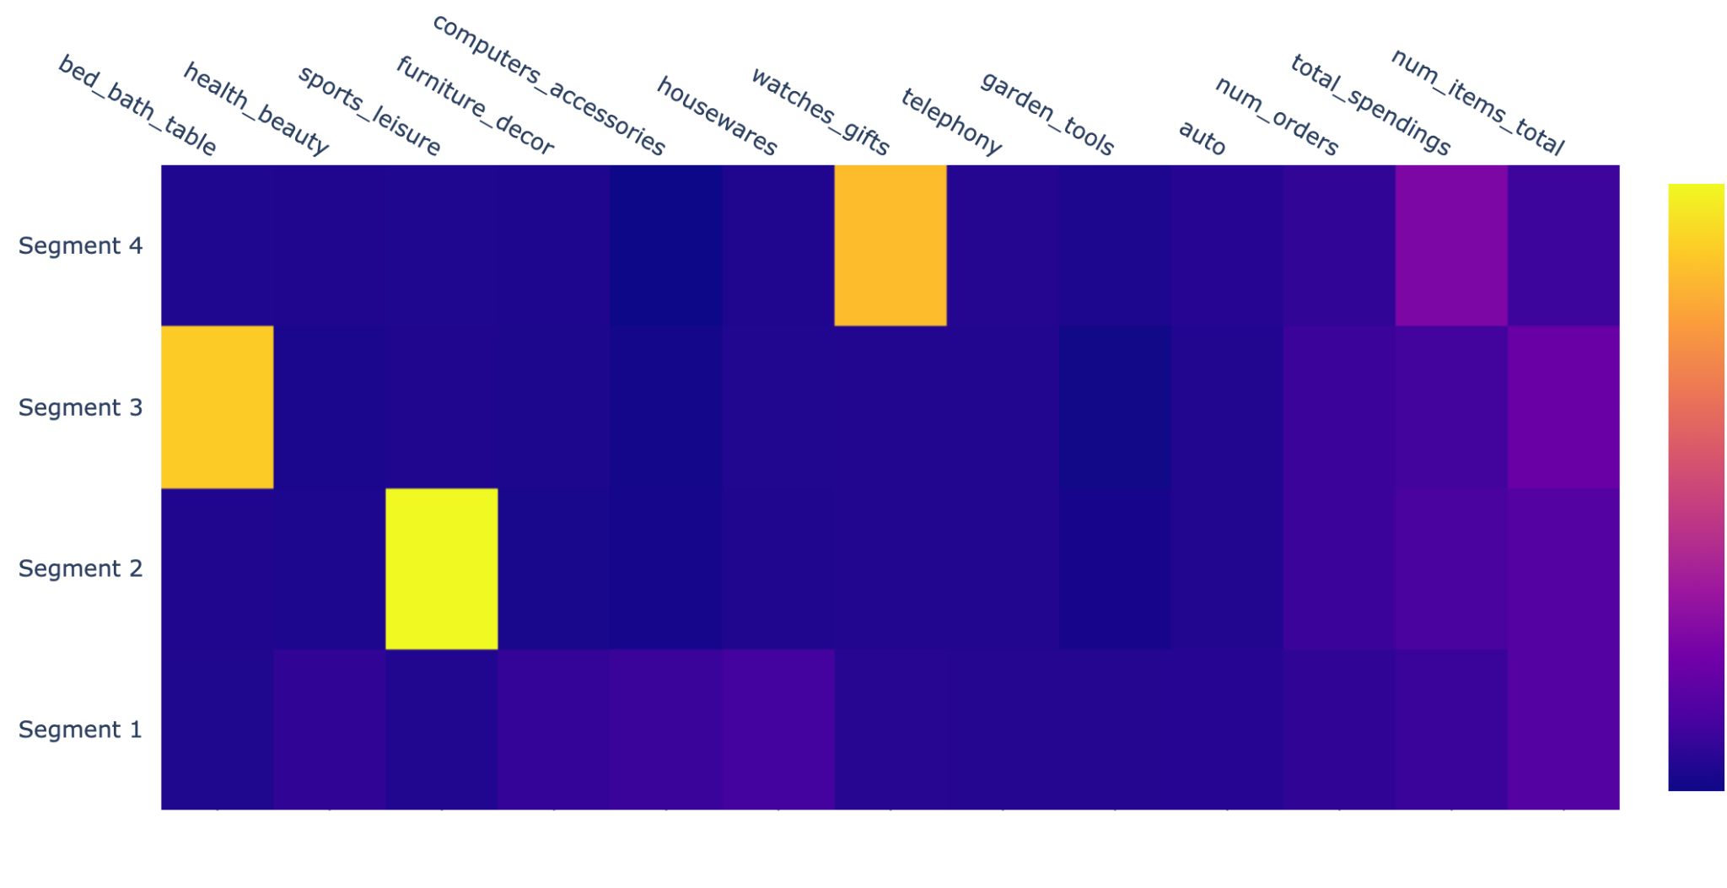
Customer segments

Slide 17
Customer segments
ONE-TIME BUYERS
PHYSICALLY ACTIVE BUYERS
-Customers who make only one order
-Not product specific
-Products they buy are quite cheap
-They buy mainly sports and leisure products
-Buy valuable products
BIG FURNITURE BUYERS
VALUABLE BUYERS
-Customer who buy beds, baths, tables products
-Buy cheaper products
-Customers who buy only once
-They buy watches and gifts
-Spend quite a bit of money on that

Slide 18
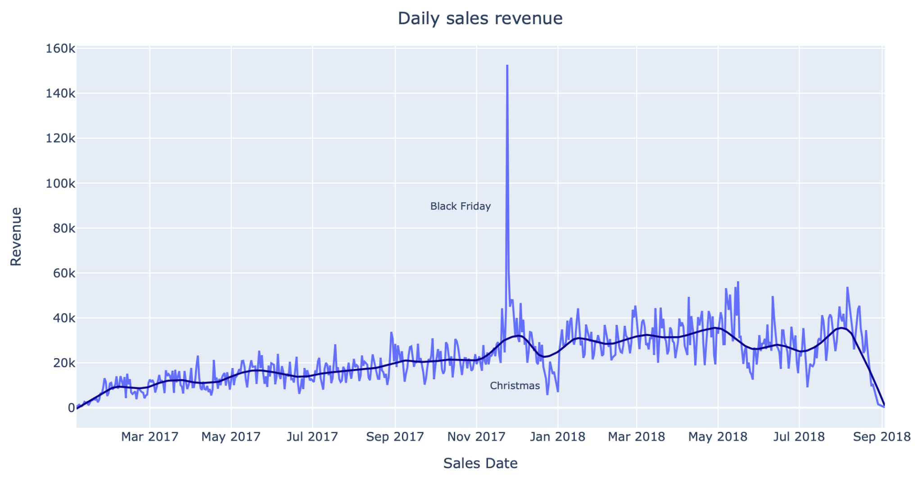
Other recommendations
Sales were extremely high on Black Friday
However, Christmas time saw a decline in sales which is counterintuitive
Sales days and holiday promotions need to be used effectively

Slide 19
Conclusion
-Attract customers from the potential markets of Sao Paulo and Rio De Janeiro
-Offer ‘maybe buy?’ option at check out by selecting the products to offer using association learning or customer segmentation
-Offer ‘maybe buy?’ after the order has been placed to increase the return rate
-As all the product types specific to the customer segments declined in sales recently, targeting those would be a priority
-Make use of the sales days and holidays to attract customers

