Slide 1
Payroll Management System for an Organization
Efficient Employee Salary and Compliance Management
Presented by: Muvvala Akash , YENUMULA THARUN

Slide 2
Introduction
Payroll Management System automates salary processing, tax deductions, and compliance.
Objective: Develop a system for seamless payroll management for organizations with 500+ employees.

Slide 3
Problem Statement
Manual payroll processing is error-prone and time-consuming.
Tax calculations and compliance reporting require accuracy.
Need for an automated system to streamline payroll operations.

Slide 4
Objectives
Automate salary processing and pay slip generation.
Ensure accurate tax and deduction calculations.
Integrate compliance reporting with legal requirements.

Slide 5
Specific Parameters
Organization with 500+ employees.
Tax compliance data integration.
Error-free payroll calculations with optimized efficiency.

Slide 6
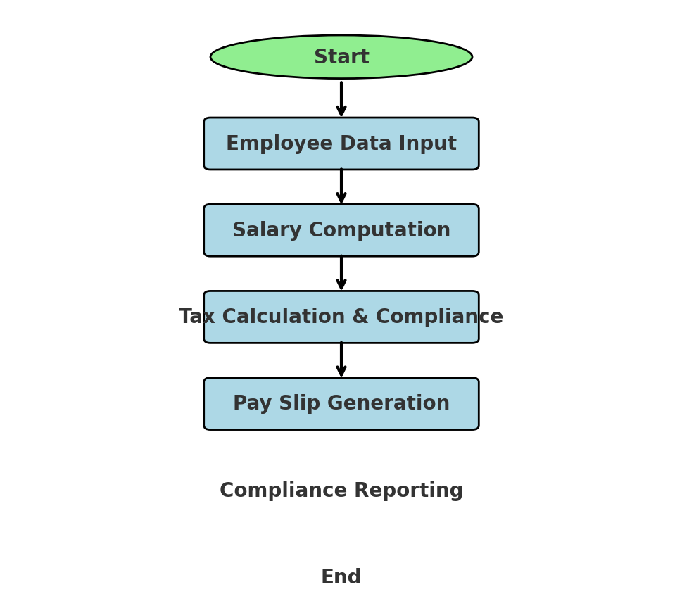
System Workflow – Flowchart
1. Employee Data Input
(Salary, Deductions, Taxes) 2. Salary Computation
(Basic Pay, Allowances, Deductions) 3. Tax Calculations & Compliance (Automatic tax deductions) 4. Pay Slip Generation
(PDF, Email Integration) 5. Compliance Reporting (Regulatory Reports, Audits)
Compliance reporting
End

Slide 7
SOFTWARE AND HARDWARE REQUIREMENTS
Software Tools:
Database: MySQL, PostgreSQL, Oracle
ERP: SAP, Odoo, Custom-built
Backend: Python, Java, Node.js
Frontend: React, Angular, Vue.js
Hardware Requirements:
workstations,
Secure Servers
and backup storage.

Slide 8
Techniques & Tools Used
Database Management System (DBMS) – Employee salary records.
Enterprise Resource Planning (ERP) – Payroll integration.
SQL – Data retrieval, calculations, and reporting.

Slide 9
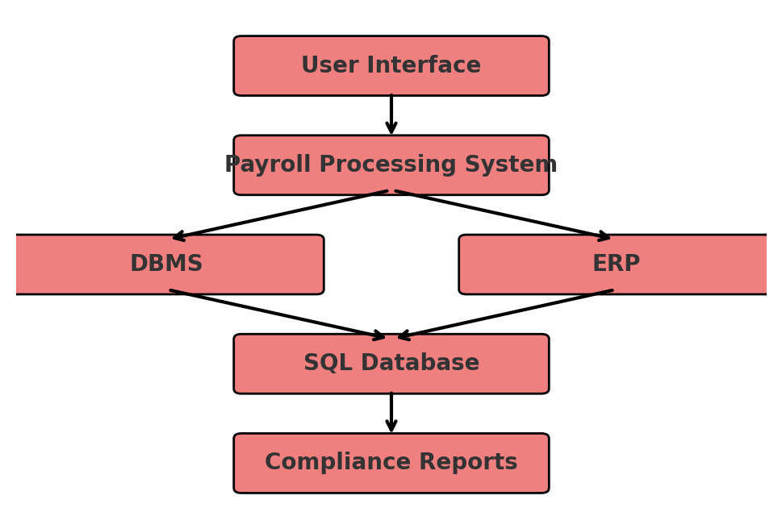
System Architecture - Block Diagram

Slide 10
Expected Outcomes
Efficient salary processing.
Reduced payroll errors.
Improved compliance with automated reporting.

Slide 11
Conclusion & Future Scope
The system ensures efficient payroll management, compliance, and accuracy.
Future Scope: AI-based analytics, blockchain-based security for salary transactions.

Slide 12
Thank You!
Questions & Discussions

