Slide 1
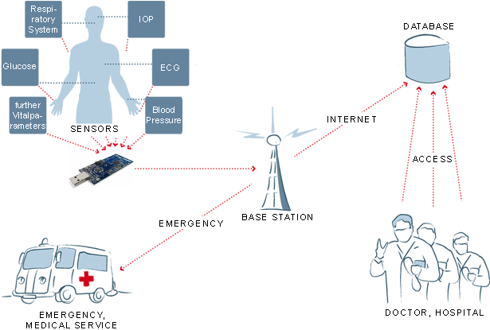
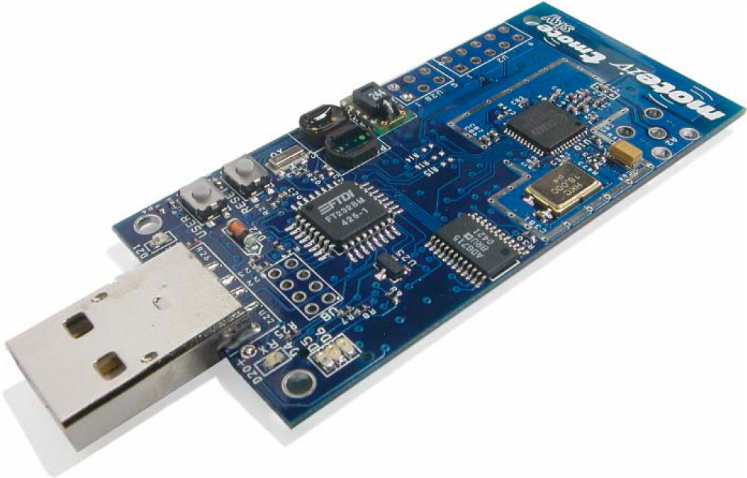
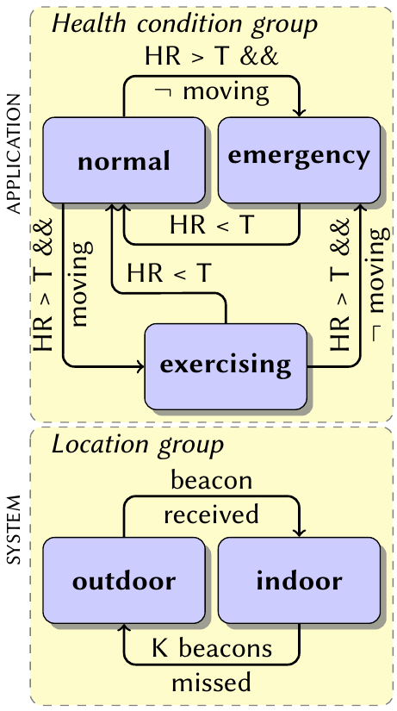
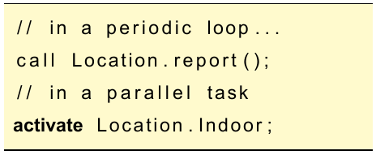
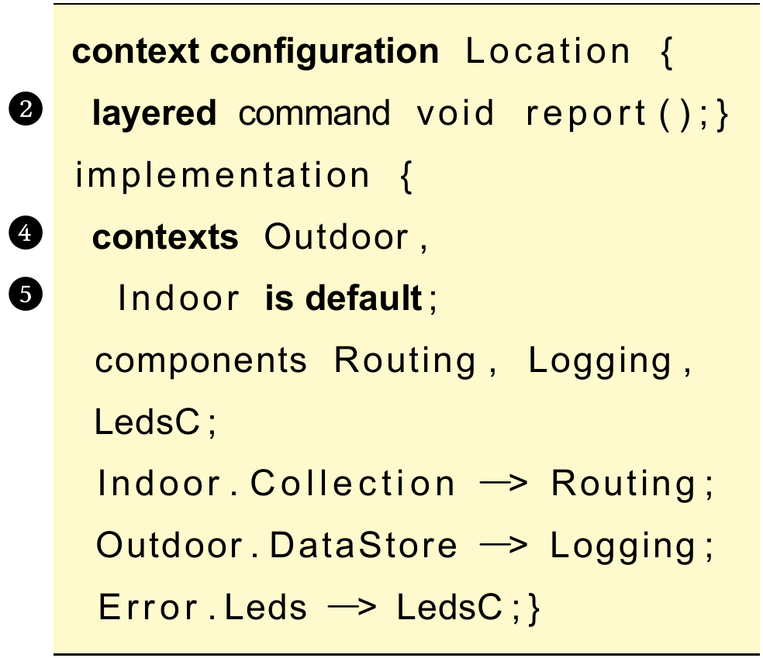
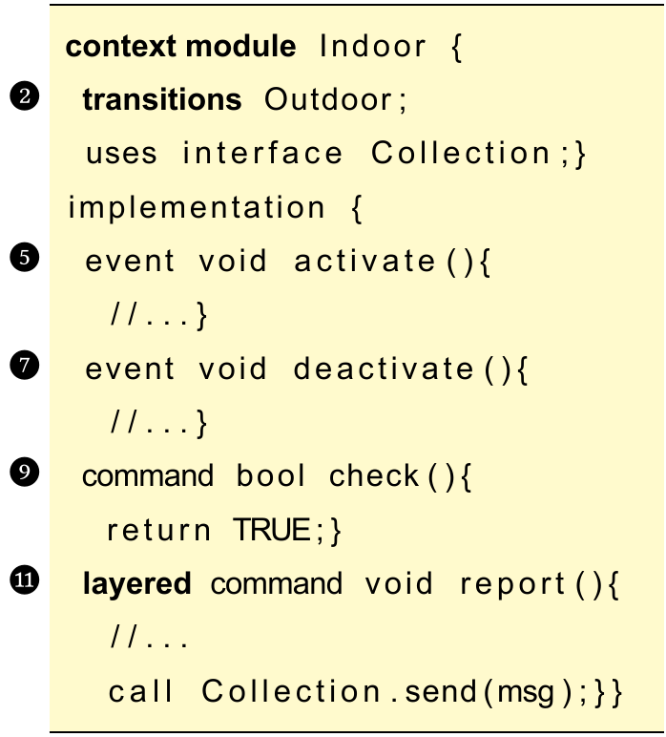


Towards Context-Oriented Programming for Wireless Sensor Networks
Mikhail Afanasov⋆, Luca Mottola⋆†, Carlo Ghezzi⋆
⋆Politecnico di Milano (Italy), †Swedish Institute of Computer Science (SICS)
Contact email: afanasov@elet.polimi.it
Wireless Sensor Networks for Healthcare Systems
Should save energy but provide a high quality of service
Should transmit data if the base station is in the reach
Should locally log data in infrastructure-less situations
Context-Oriented Programming for Wireless Sensor Networks
Wireless Sensor Networks are inherently environment dependent
Context is a representation of the environment
Context-Oriented programming is using context as a building block
Context-Oriented nesC (ConesC)
Usage example
Evaluation:
Two applications
The same functionality
TelosB platform
check context
indoor
call Indoor.report()
outdoor
call Outdoor.report()
Mapping
ConesC binary
only 2%
bigger
nesC
binary
7758 bytes vs 7640 bytes
Ongoing Work
Implementation of the translator
Evaluation on a real application
ConesC
Translator
nesC
UBICOMP13 – Zurich (Switzerland), September 8th-12th

