Slide 1

Введение в компьютерную науку
Salymbekov University
Miss Aliia Beishenalieva
aliya.beiwenalieva@gmail.com

Slide 2
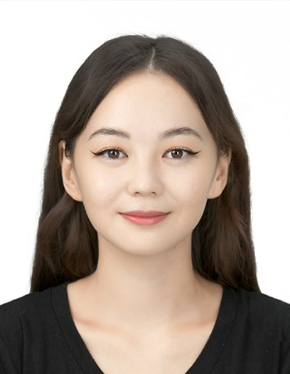
Lecturer
Aliia Beishenalieva
Education:
On-going: Ph.D. in Electrical and Computer Engineering (INHA University, South Korea)
2023.02: M.S. in Electrical and Computer Engineering (INHA University, South Korea)
2020.07: B.S. in Telematics (KGTU, Kyrgyzstan)
Experience:
From 2024: Lecturer (Salymbekov University)
2021.03-2024.08: Senior Researcher (Multimedia Networks LAB, Incheon), Teaching assistant
2020.09-2021.03: IT Specialist (startup company, Bishkek)
2020.03-2020.06: Internship in Data Engineering (Beeline, Bishkek)
Publications:

Slide 3
Course info
Course type: Offline, Online (zoom)
Duration: 3 раза в неделю по 80 мин
Period: с 03.09.24 по 16.01.25

Slide 4
Course info
The course program is based on the curricula of universities such as MIT, Stanford, Berkeley, KAIST, INHA
Text book:
TBD
References:
TBD

Slide 5
Grading Policy
Attendance: 10%
Midterm: 40%
Final exam: 40%
Extra points: 10%

Slide 6
Microsoft, Hardware, software, OS, (Artificial Intelligence), (Machine Learning), (Internet of Things), (Cryptography), (Cloud computing)
Schedule:
Week1 Introduction class, adaptation week
Week11
Week2 Hardware
Week12
Week3 OS: Windows, Linux, ios
Week13
Week4 Microsoft: Word, Excel, PowerPoint
Week14 Introduction to database, Big Data
Week5 PC Software: programming languages
Week15 Introduction to AI
Week6 Frontend vs Backend, Web Dev, Mobile App dev
Week16 Introduction to ML
Week7
Week17 Introduction to IoT, Smart city systems
Week8
Week18 Introduction to cryptography, cybersecurity
Week9
Week19 Introduction to cloud computing
Week10 Test
Week20 Test

